Slide 1
ETSI CNF Information Modeling Issues
May 11, 2020
Orchestration Scenarios (a.k.a. ETSI-Alignment) Task Force weekly meeting,
Weekly meeting: Mondays at 12PM UTC, 5AM PT, 8AM ET, 2PM CET, 5:30PM India, 8PM China. https://zoom.us/j/722438866
Dial In: +16699006833,,722438866# US (San Jose) +16465588656,,722438866# US (New York)
ETSI Alignment Support, https://wiki.onap.org/display/DW/ETSI+Alignment+Support

Slide 2
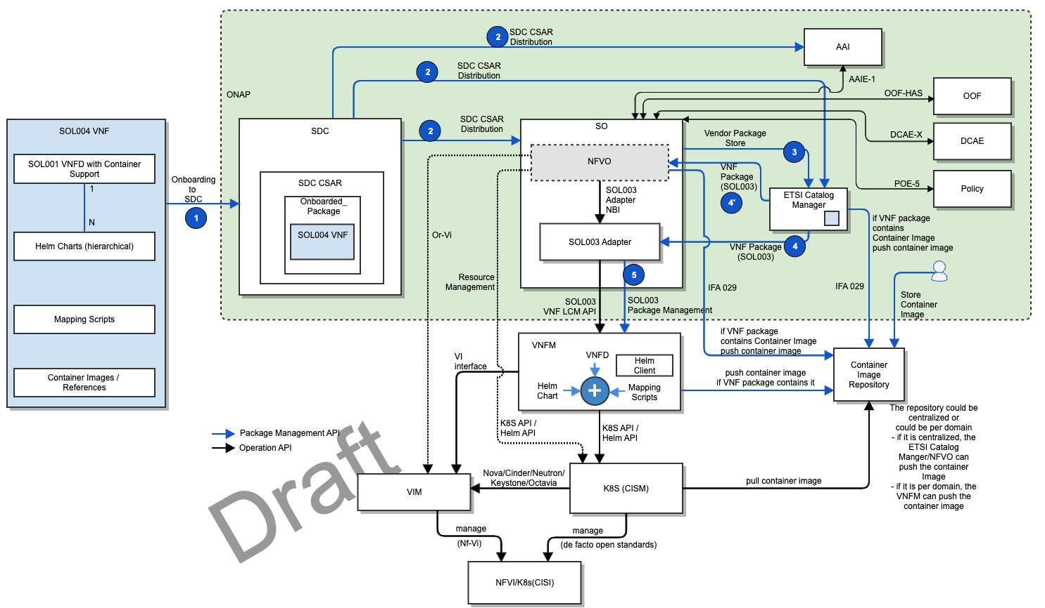
ETSI CNF Proposal

Slide 3
ETSI IFA040 Overview
https://nfvwiki.etsi.org/images/NFVIFA%2820%29000163_NFV_release_4_FEAT17_CNF_management_concepts.pdf

Slide 4
ETSI IFA040 Information Model Changes
https://docbox.etsi.org/ISG/NFV/Open/Drafts/IFA040__OS_Container_MANO_service_interfaces/NFV-IFA040v050.zip

Slide 5
ETSI IFA040 Object Relationships
https://nfvwiki.etsi.org/images/NFVIFA%2820%29000163_NFV_release_4_FEAT17_CNF_management_concepts.pdf

Slide 6
Enhanced IFA011 -> Impacts ONAP Resource IM

