Slide 1

ONAP CPS Data Models
Tony Finnerty, Niamh Core, Toine Siebelink
19 Jan, 2021

Slide 2
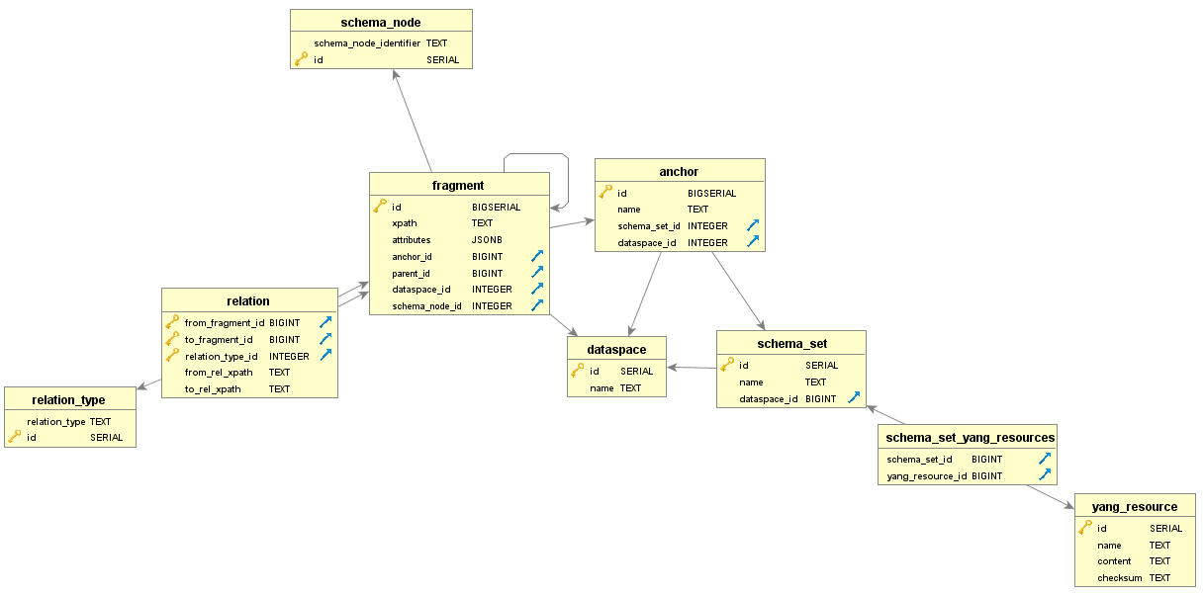
CPS Internal relational schema

Slide 3
Network Function CM Data
Dataspace is a logical separation of data
  Used in conjunction with the ‘owner’ concept. xNF proxy will not expose this.
Anchor is a logical separation of data within a dataspace
  Used to distinguish (xNF) instances with of the same model
  Relates directly to the xNF id in AAI
Schema set is a representation of the xNF model
  Preserves the original format to avoid collisions and poorly defined models
  Relates to the VNF Descriptor (VNFD) in ONAP
Fragment is a YANG container or YANG list
  Main data storage table. Attributes are stored in jsonb field
Relation preserves YANG cross references
Schema node provides fast access to relevant YANG meta data

Slide 4
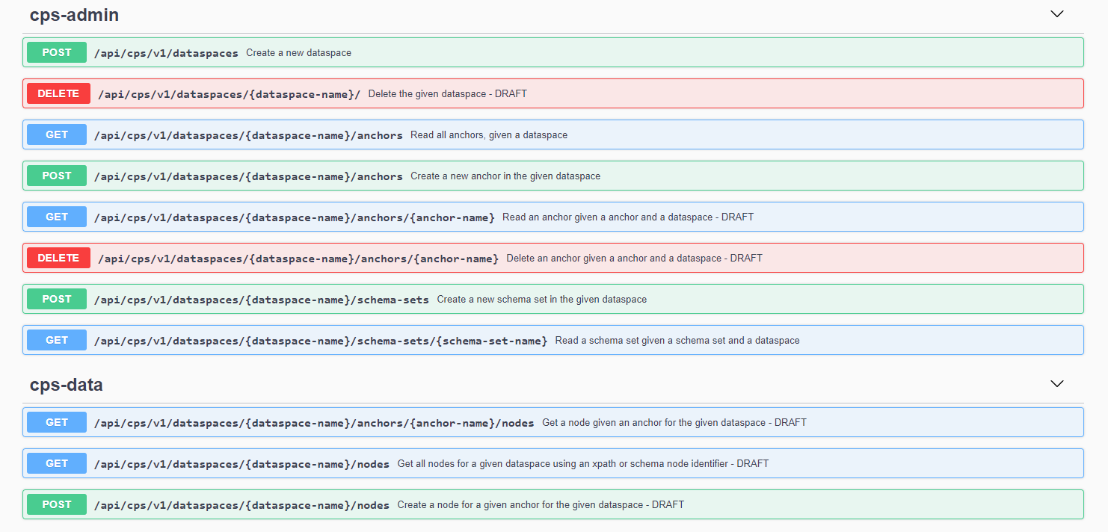
REST API

Slide 5
Links
API
  https://gerrit.onap.org/r/gitweb?p=cps.git;a=tree;f=cps-rest/docs/api/swagger;h=e815fb1926d69f724629885fcb2b5e32184c61e3;hb=aee547cfbeb8780ed21d2ee902110a888aee3b56
Schema
  https://gerrit.onap.org/r/gitweb?p=cps.git;a=tree;f=cps-ri/src/main/resources;h=895a5a62505f21fc126fcbd8fcc4381418607b89;hb=aee547cfbeb8780ed21d2ee902110a888aee3b56
Developer landing page
  https://wiki.onap.org/display/DW/Configuration+Persistence+Service+Developer%27s+Landing+Page

