Slide 1
3GPP Harmonization: stndDefined
ves-openapi-manager
Presentation & Demo
@nokia
@twitter

Slide 2
Agenda
3GPP Harmonization: Recap
3GPP Events: Validation
  3GPP openapi onboarding
ves-openapi-manager
  SDC Distribution enhancements
Demo

Slide 3
3GPP Harmonization: Recap
{ "event": {
"commonEventHeader": {
"domain": "stndDefined”,
"eventId": „stndDefined-gNB-Nokia000001",
"eventName": „stndDefined-gNB-Nokia-Notification",
"stndDefinedNamespace": "3gpp-FaultSupervision"
},
"stndDefinedFields": {
"schemaReference": https://forge.etsi.org/rep/3GPP/5G_APIs/blob/SA89-REL16/(…)/
S5-201487_fault3gppFields.json#definitions/notifyNewAlarm"",
„data":{
"uri": "xyz",
"notificationId": "xyz",
"notificationType": "notifyNewAlarm",
"eventTime": "xyz",
"systemDN": "xyz"
"probableCause": "xyz",
"perceivedSeverity": "Major",
"rootCauseIndicator": false,
"specificProblem": "xyz",
"backedUpStatus": true,
"backUpObject": "xyz",
"trendIndication": "No change",
"thresholdInfo": {},
"monitoredAttributes": [],
"proposedRepairActions": "xyz",
"additionalText": "xyz",
"additionalInformation": [],
"alarmId": "xyz",
"alarmType": "Environmental Alarm"
},
"stndDefinedFieldsVersion": ”1.0”
}
}
3GPP Harmonization has been started in Guilin release
Focus on 3GPP event collection in DCAE platform (VES collector)
A dedicated “stndDefined” domain defined in VES spec
  Support notifications defined in various standardization bodies
  openAPI format of notifications schema
2-stage validation of events
  1st – against VES schema
  2nd – against specific openAPI description (schemaReference)
VES commonEvent
Header
openAPI description
URL
(notification format)
Standards-defined notification
(e.g. 3GPP Fault)

Slide 4
3GPP Events: Validation (1/2)
VES uses DCAE-SDK libs to validate event data against an openAPI description indicated in the event
Certain 3GPP openAPIs are built-in VES collector image
A procedure to swap openAPI descriptions with a repository stored in a configMap exists
  A configMap generation script available
  A collector K8S spec integration script
With configMap, the openAPIs used for validation can be updated
Synchronous mode
(failure case – object not compliant with schema)
xNF
VES
DCAE SDK
msg
/eventListener/v7
configMap
openAPIs
needed
Validate event data against openAPI (schema)
HTTP/400 Bad request
Scripts
Scripts
Log event details

Slide 5
3GPP Events: Validation (2/2)
Challenge
  Assuming the scope of openAPIs present in the system is extendable (via configMap)…
  How does a system operator know, if the openAPIs present in the system are sufficient to validate the events generated by the xNFs?
  Do we have a solution to notify the operator, that he/she might need additional openAPIs?
Solutions
  Implement a schemaBroker, which can onboard, store and expose relevant openAPIs delivered in an onboarding package (Allows to add missing schemas within onboarding activity, solves #1 and #2)
  Implement a schemaManager, which will use the VES_Event_Registration, and compare the events registered there with the contents of DCAE openAPI configMap
  (Allows to notify, that necessary schemas are missing, solves #2 only)
We decided to continue the schemaManager approach, as it would give us immediate value, and allow migration to schemaBroker in the future

Slide 6
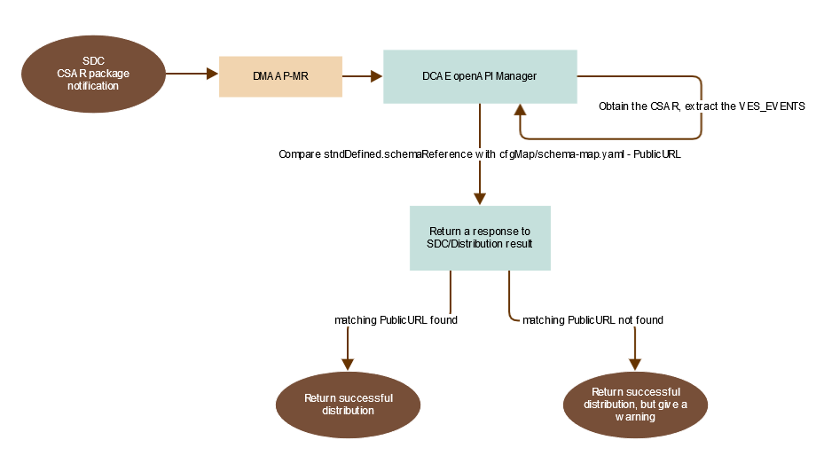
ves-openapi-manager
ves-openapi-manager algorithm
Schema Manager use-case scenario:
A user on-boards a new xNF package
That package contains stdnDefined events “declaration”
ves-openapi-manager consumes the VES_Events artifact
schemaReferences mentioned are compared against
contents of DCAE externalSchema configMap
A user gets warnings in SDC/Distribution, if the xNF uses schemas,
which are absent in DCAE externalRepo configMap
The warning in SDC doesn`t prevent the service distribution
A user is able to update the configMap with relevant openAPIs
There is a script, which is able to generate the configMap based
on 3GPP openAPI descriptions from ForgeETSI GitLAB
A user is able to successfully execute 2nd step of validation
with proper openAPIs

Slide 7
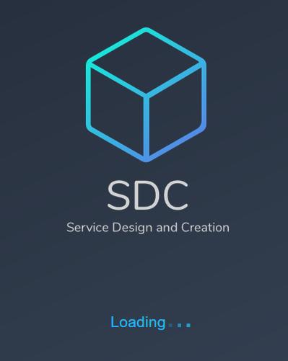
SDC Distribution enhancements (1/2)
SDC-Distribution-Client
  Has been updated to utilize recent 3rd parties, Java 11,…
  No API changes introduced, no usage scenario changes
SDC Front End - Distribution status screens have been expanded
  A new “Message” column added (Distribution notifications view)
  Presents details of component distribution responses (status, message)
  An expanded distribution status message area
  Covers all distribution statuses and associated messages for given ONAP component participating in the distribution.
SDC changes are generic and can be used for all ONAP components
  SDC-Distribution-Client can be used by any component
  SDC-FrontEnd changes are generic for all components.

Slide 8
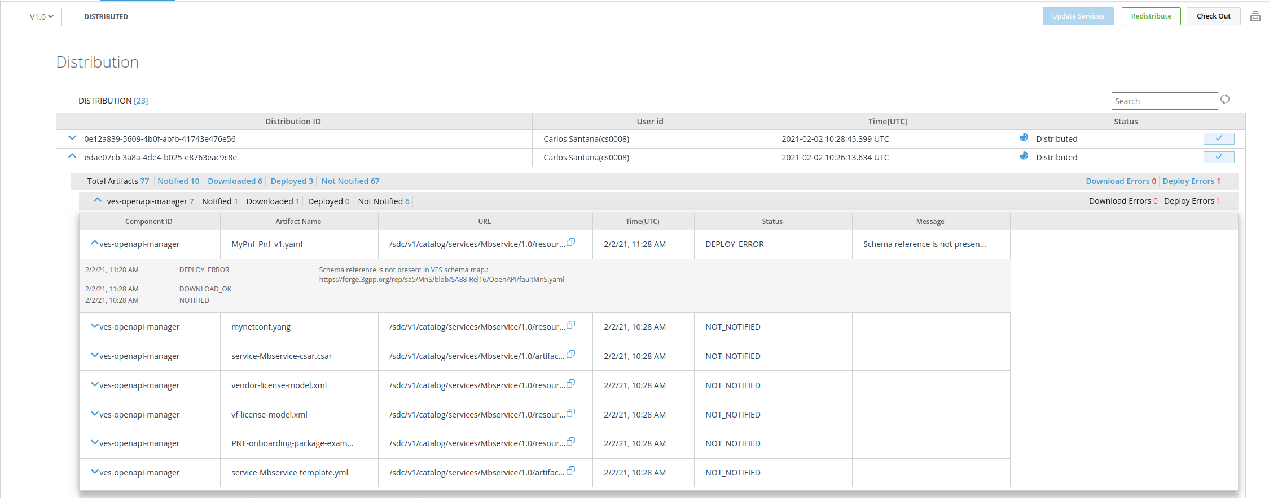
SDC Distribution enhancements (2/2)

Slide 9
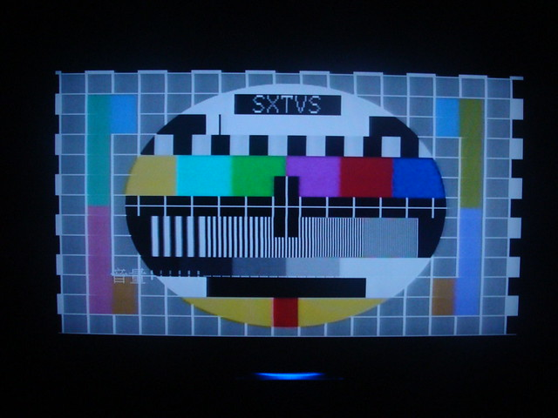
Demo

