Slide 1
Handling large CSARs in SDC
Michael Morris (Ericsson)
Apr 26th 2021

Slide 2
Problem Statement
Not possible to onboard csars larger than approx. 8MB
Limit is ok where external references are used for images, but the limit is impractical for csars where the images (often GBs in size) are included in the csar
2

Slide 3
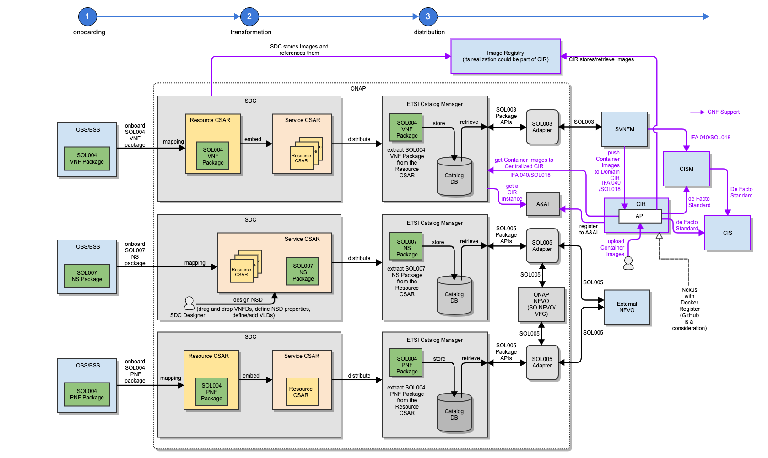
Proposed Solution (ETSI Alignment use case)
POSTPONED
3

Slide 4
Proposed Interim Solution
ARM added to onboarding backend through config
When csar sent to SDC onboarding backend and ARM is configured:
  Save to temp location on disk (to avoid OOM by parsing)
  Send the unaltered csar to the configured ARM
  Strip images from csar (controlled by config) before parsing into onboarding for normal processing
  When adding the ONBOARDED_PACKAGE in the csar, also add a file containing the reference to the csar in the ARM
  Csar is stored in SDC DB, minus the images, but with reference to ARM csar
ONBOARDING
ARM
SDC DB
Orchestrator
Upload csar
If ARM configured
Store unaltered in ARM
Strip images from csar
Add file to csar with ref to csar in ARM
Store csar in SDC DB
Fetch csar in SDC DB
Fetch unaltered csar from ARM
4

