Slide 1
A&AI Component Diagram
Amsterdam Release
Beijing Release
AAI-Model Loader
AAI-Sparky-FE
AAI-Sparky-BE
AAI-Babel
Input Abstraction
AAI-common
AAI-Data Router
Query Abstraction
AAI-logging
AAI-Gizmo
AAI-Resources
AAI-Traversal
AAI-Search Data Svc
CRUD End Points
AAI-router-core
AAI-rest-client
AAI-Champ
Database Abstraction
Elastic Search + Graph Data Store

Slide 2
A&AI Components
Component | Description
aai/sparky-fe aai/sparky-be | A&AI User Interface Backend and Front-end
aai/resources | AAI Resources Micro Service providing CRUD REST APIs for inventory resources. This micro-service provides the main path for updating and searching the graph.
aai/traversal | AAI Traversal Micro Service providing REST APIs for traversal/search of inventory resources such as custom queries, model-based queries and named-queries.
aai/data-router | AAI Micro-service used to route AAI queries and event data to correct storage engine. Serves as a query abstraction point for clients, as well as a gateway.
aai/search-data-service | Abstraction layer for search engine, supporting queries and updates. Currently supports elastic-search, but has also been design with Solr support in mind.
aai/model-loader | Obtains SDC artefacts and loads them into the A&AI Resources service for storage.
aai/gizmo | CRUD Rest API endpoint for resources and relationships, delivering atomic interactions with the graph for improved scalability.
aai/champ | Abstraction from underlying graph storage systems that A&AI would interface with.
aai/babel | AAI Micro-service to generate AAI model XML from SDC TOSCA CSAR artifacts
Other common library | Other common-libraries provide API for logging, rest calls, annotations, core camel components for data router.

Slide 3
AAI Contribution to Release -I
Features Added:
Re-factoring of old code.
    aai-service is re-factored into aai-traversal, aai-resources and aai-common.
Adding user-interface (UI) and search services
    aai-sparky-be /aai-sparky-fe – UI front end and UI back end.
    aai-data-router service to route the request from user interface to respective search or storage engine.
    aai-search data service (wrapper over elastic search) for user interface text search.
    Code Added: (Effective code < 100 KLOC including re-factored code)
  Java Code:
    Refactored :39 KLOC (aai-common – 22 KLOC, aai-traversal -10KLOC, aai-resources- 7K, auto-generated code – 30KLOC).
    New Code : 30 KLOC (aai-search-data-service – 7KLOC, aai-data-router – 3KLOC, sparky-be – 20KLOC).
  Front End Code: SASS + Java Script (12 KLOC)
  Others : YAML, XML, XSD, Maven – 350 KLOC, HTML – 568 KLOC (swagger, auto generated code)

Slide 4
AAI/SDC/VNFSDK – Community Notes for for past 2 weeks
Discuss M4 milestone – Review today
AAI-> VFC Schema changes
SDC -> VNFSDK Integration
AAI - Highlights
Completed all the required checklist to pass M4 milestone for VNFSDK.
Making even simple features to AAI, SDC code in the core flow is tedious job, as SDC and AAI teams are not allowing until and unless it is scrutinised by their experts.
AAI team not allowing to make even simple changes to the AAI schema model for VFC. They are asking to add attributes in the existing schema and access them by changing Edge rules. Unless the experts in ECOMP agree, they are not allowing community to change. Experts are not bound to milestones of community or its requirements hence their response is slow.
Same case with VNFSDK, SDC team not allowing to merge a single commit. After we have completed coding entire feature, they are getting it reviewed by UI experts and suggesting many changes.
Other Observations: SDC team is planning to support Heat, TOSCA and any other format in their designer.

Slide 5
Modeling New Inventory
Steps to add new inventory or adapt Open-O to ONAP:
Add/update AAI schema file according to the requirements.
Add Titan DB Edge Rules to the DBEdgeRules.java file.
Write a client adapter to provide PUT/GET/SET for the new inventory.
Follow synchronization rules to ensure latest data in AAI.

Slide 6
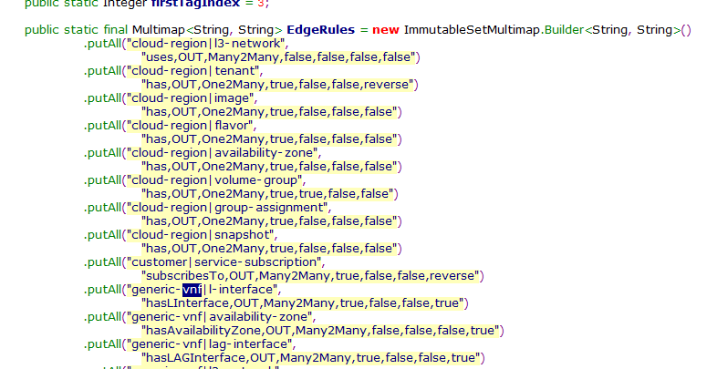
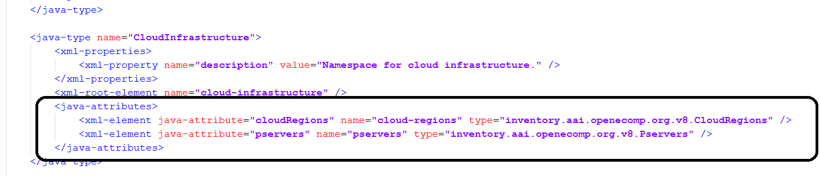
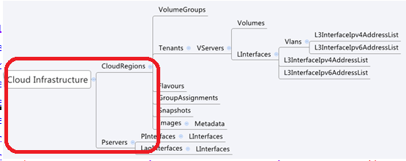
Separation of Domain specific attributes to DB related attributes
Domain specific attributes
DB related attributes
AAI schema file: aai_oxm_v8.xml
Edge Rules: DBEdgeRules.java
Edge property | Description
From and To | node types for the ends of the edges.
Edge Label | Name of the label within the graph
Direction | direction of the edge
Multiplicity | multiplicity rule between two nodes
ParentOf | indicates whether From is a parent of To
UsesResource | whether the From node uses resources of the To node.
hasDelTarget | specifies whether to try to delete the To node when the From node is deleted.

Slide 7
AAI provides Common Generic Interfaces for all the ONAP modules
(ONE FOR ALL –ALL FOR ONE)
SDNC
ServiceInstance requestServiceInterfaceData (String svc_instance_id) ;
……… ….
boolean postTenantData(String tenant_id, String cloudOwner, String cloudRegionId, Tenant request);
SDNC-AAI Adapter
AAI
AAI-Resources (Update, Patch, Delete)
AAI-Traversal
(Get, Search)
VFC
ServiceInstance requestServiceInterfaceData (String svc_instance_id) ;
……… ….
boolean postTenantData(String tenant_id, String cloudOwner, String cloudRegionId, Tenant request);
VFC-AAI Adapter
APP-C
void postGenericVnfData(Map<String, String> params, SvcLogicContext ctx) throws APPCException;
void getGenericVnfData(Map<String, String> params, SvcLogicContext ctx) throws APPCException;
APPC-AAI Adapter

Slide 8
Duplicate code and effort across adaptors.
SDNC
ServiceInstance requestServiceInterfaceData (String svc_instance_id) ;
……… ….
boolean postTenantData(String tenant_id, String cloudOwner, String cloudRegionId, Tenant request);
SDNC-AAI Adapter
AAI
AAI-Resources (Update, Patch, Delete)
AAI-Traversal
(Get, Search)
VFC
ServiceInstance requestServiceInterfaceData (String svc_instance_id) ;
……… ….
boolean postTenantData(String tenant_id, String cloudOwner, String cloudRegionId, Tenant request);
VFC-AAI Adapter
APP-C
void postGenericVnfData(Map<String, String> params, SvcLogicContext ctx) throws APPCException;
void getGenericVnfData(Map<String, String> params, SvcLogicContext ctx) throws APPCException;
APPC-AAI Adapter

Slide 9
Dis-advantages of AAI adapters across modules
Duplicate code and effort across the adapters.
In efficient code across adapters may cause bugs and issues with usage of AAI (Maintenance effort for AAI team).
Usage of AAI will become complex as clients of AAI may need to re-invent the wheel to write adapters.
Any change is AAI may need to be propagated across the modules.

Slide 10
Suggested design
SDNC
ServiceInstance requestServiceInterfaceData (String svc_instance_id) ;
……… ….
boolean postTenantData(String tenant_id, String cloudOwner, String cloudRegionId, Tenant request);
AAI
AAI-Resources (Update, Patch, Delete)
AAI-Traversal
(Get, Search)
AAI maintains the ext/aai-adapter as a reference or default adapter. (SDNC adaptor has already seed code for this.)
Any new client can chose to use the default adapter or write his own adapter. (after discussing with AAI team referring the default adapter code.)
Client code becomes simple as the usage of AAI becomes less complex.
AAI Adapter
AAI Adapter
APP-C
void postGenericVnfData(Map<String, String> params, SvcLogicContext ctx) throws APPCException;
void getGenericVnfData(Map<String, String> params, SvcLogicContext ctx) throws APPCException;

