Slide 1


Example Services Managed by OpenECOMP Demo
Service: Domain Name Service and Load Balancing
Spin up an authoritative vDNS on Rackspace, connected to a network facing the public Internet.
The number of vDNSs is dynamically adjusted based on load and policy.
Service: Firewall and Traffic Adjuster
Spin up a vFirewall and virtual traffic generators.
Based on the load of the vFirewall, traffic volume is adjusted as to not overload the vFirewall with low priority traffic.
Internet
Internet
OpenECOMP VMs
OpenECOMP VMs
Portal
APPC
Rackspace OpenStack API
Portal
APPC
Rackspace OpenStack API
SDC
SDNC
SDC
SDNC
AAI
DCAE
OpenECOMP Private Network
AAI
DCAE
OpenECOMP Private Network
MSO
Policy
MSO
Policy
vDNS
vLoadBalancer
vTrafficGen
Adjust
Traffic
Volume
vFirewall
vTrafficGen
vDNS
Default Gateway
v
Private VNF Network
Private VNF Network

Slide 2
ECOMP
Policy Engine
Closed loop
Events
APP-C
DCAE
DCAE Collector (VES)
Configuration change
(NETCONF/RESTCONF)
vFirewall
measurement record
(REST)
VF1
VF2
VES client
VF3
HoneyComb
Data flow
Data flow
vFirewall
Dest
PKTGEN
VM1
VM2
VPP
VM3
Rackspace cloud

Slide 3
ECOMP
Policy Engine
A&AI
Closed loop
Events
MSO
DCAE
DCAE Collector (VES)
vLoadBalancer
measurement record
(REST)
VF2
VM2
vDNS
VF1
HoneyComb
VES client
VF0
VF3
VM3
DNS queries
vLoadBalancer
vDNS
PKTGEN
VM0
VM1
VPP
Rackspace cloud
vDNS

Slide 4
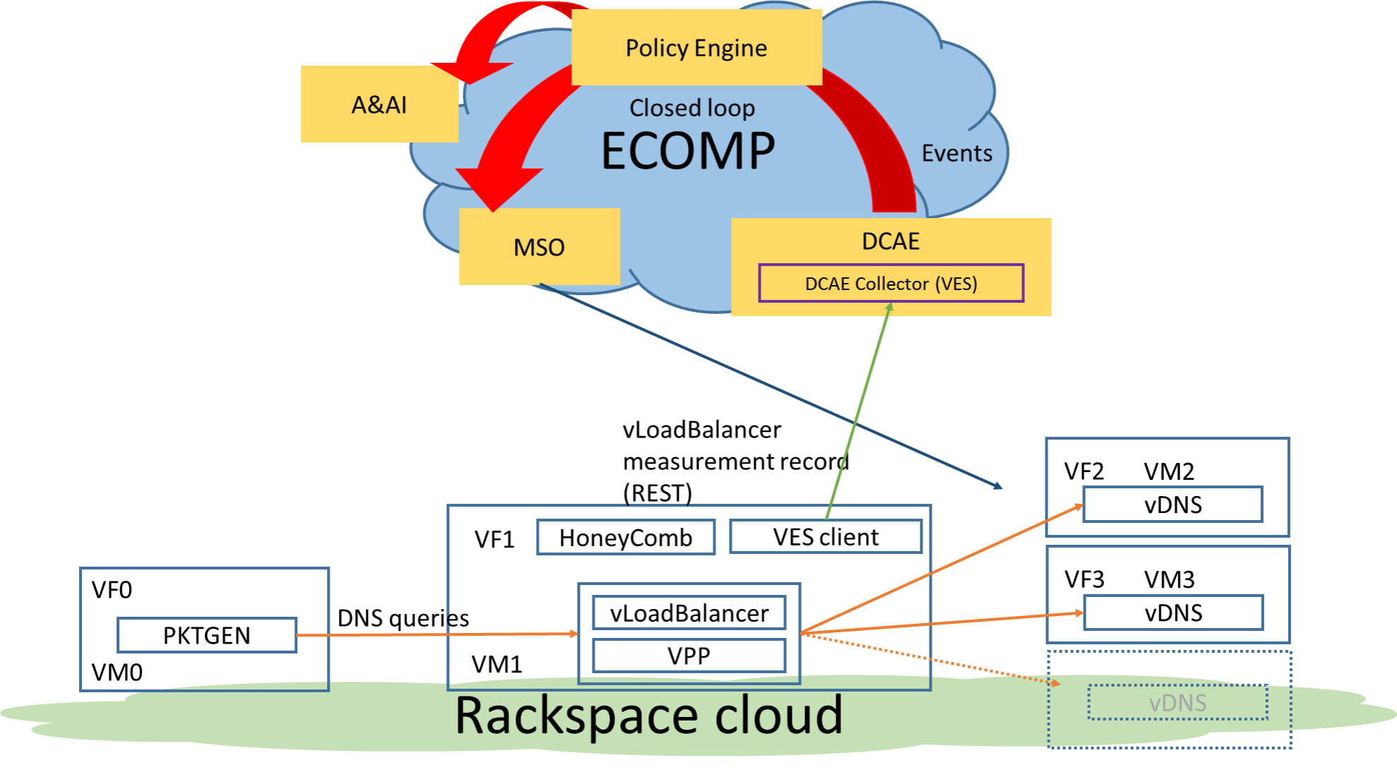
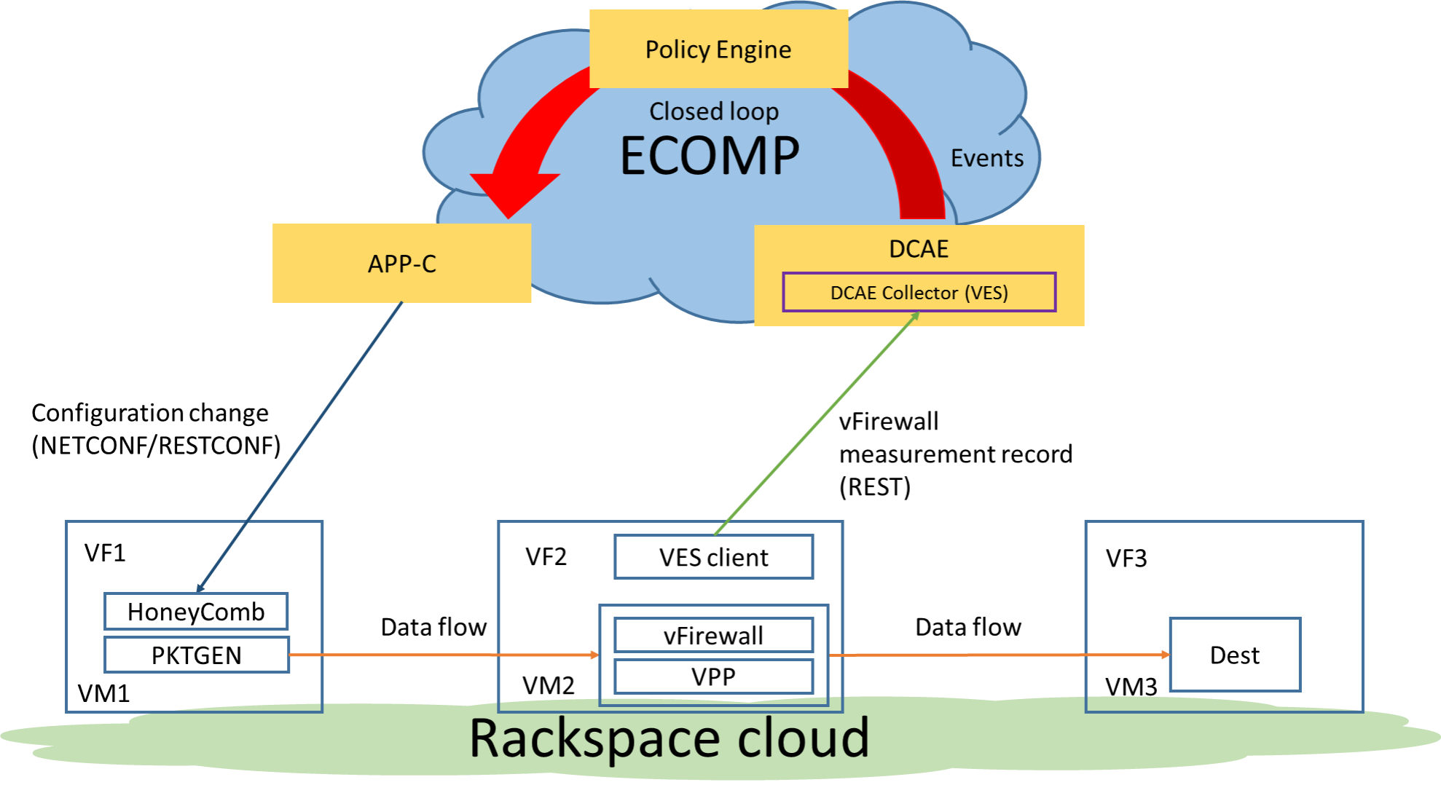
OpenECOMP Demo Services
Service: Domain Name Service and Load Balancing
Spin up an authoritative vDNS on Rackspace, connected to a network facing the public Internet.
The number of vDNSs is dynamically adjusted based on load and policy.
Service: Firewall and Traffic Adjuster
Spin up a vFirewall and virtual traffic generators.
Based on the load of the vFirewall, traffic volume is adjusted as to not overload the vFirewall with low priority traffic.

