Slide 1
ONAP Next Generation Security & Logging
Architecture, Design and Roadmap
June X,2021
Byung-Woo Jun (Ericsson)
Sylvain Desbureaux (Orange)
Krzysztof Opasiak (Samsung)

Slide 2
Migration from ONAP AAF to Service Mesh-based Security
Why not ONAP AAF (Application AuthZ Framework)
It is a solution for ONAP, which is maintained by ONAP only
  AAF CADI plugin supports Java only, where some ONAP components are written in other languages (Python, etc.)
  Clients in various languages could have language specific restrictions
AAF needs to keep up with the latest security technology evolution, but no active support in ONAP
AAF is not widely used by ONAP projects due to:
  Integration/enforcement of AuthN and AuthZ are done by each project
  Mutual-TLS enablement & Secrets/certificate management are done by each project
  For encryption, each project needs to understand AAF certificate management mechanism
  Compatibility with variety of external authentication systems is a challenge
  Third-party microservices requires modification to work with AAF
  SSO and Multi-factor authentication support is questionable
  AAF does not perform load balancing
What we want to achieve: simpler, uniform, open source- and standard-based Security (Service Mesh-pattern Security):
Eliminate or reduce microservice infrastructure level security tasks in services
  Security is handled at the platform level
  Enabling uniform security across applications
Minimize code changes and increase stability
Platform-agnostic abstraction reduces risks on integration, extensibility and customization
Use of Sidecar, so an application is not aware of sidecars, no deployment modification
  External Interfaces (encrypted) are performed by Ingress Gateway
  Internal Interfaces (encrypted) are performed by Service Mesh
User Management and RBAC is managed by open-source technologies
Benefits to ONAP, O-RAN and External Components
Once ONAP supports the uniform, open-source-based and standard-based security, it would be a foundation for secure integration between ONAP / O-RAN and external components
  Product impacts for security would be minimum
  Ensure ONAP services have only the business logic of that service
  Third-party microservices can participate in ONAP security by leveraging the platform-level security (sidecar)
Vendors can take advantage of open-source-based security, instead of having and maintaining their own security mechanism: cost effective
2

Slide 3
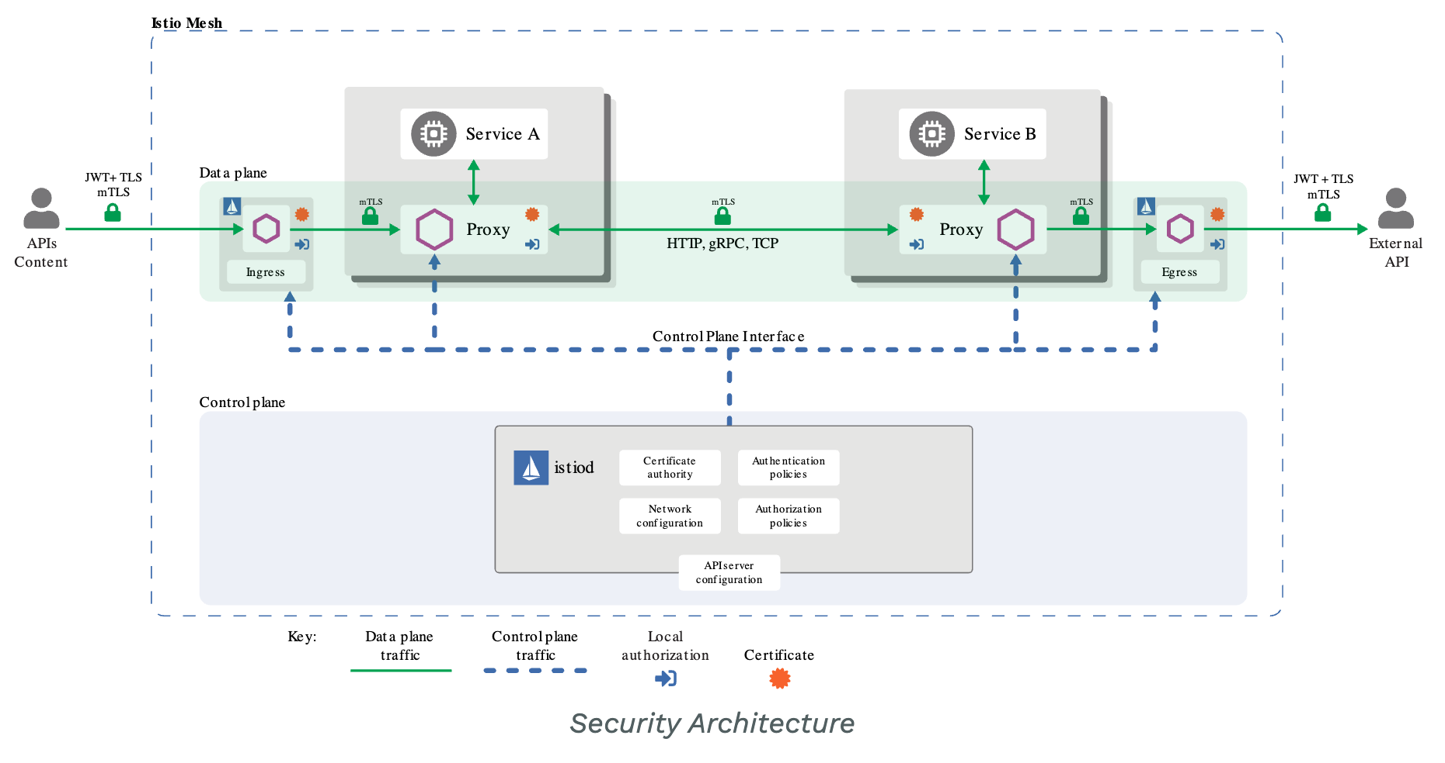
Open-Source Service Mesh Security with Istio
Microservices has security needs:
To defend against man-in-the-middle attacks, they need traffic encryption.
To provide flexible service access control, they need mTLS (mutual TLS) and fine-grained access policies.
To determine who did what at what time, they need auditing tools.
With Control and Data planes, mTLS, Ingress, Proxy and Egress, Istio provides Security features for :
Strong identity
Powerful policy
Transparent TLS encryption
Authentication, Authorization and Audit (AAA) tools to protect your services and data
<Source: https://istio.io/latest/docs/concepts/security/ >
Goals of Istio security are:
Security by default: no changes needed to application code and infrastructure
Defense in depth: integrate with existing security systems to provide multiple layers of defense
Zero-trust network: build security solutions on distrusted networks
Istio authentication:
Provides each service with a strong identity representing its role to enable interoperability across clusters and clouds.
Secures service-to-service communication.
Provides a key management system to automate key and certificate generation, distribution, and rotation.
3

Slide 4
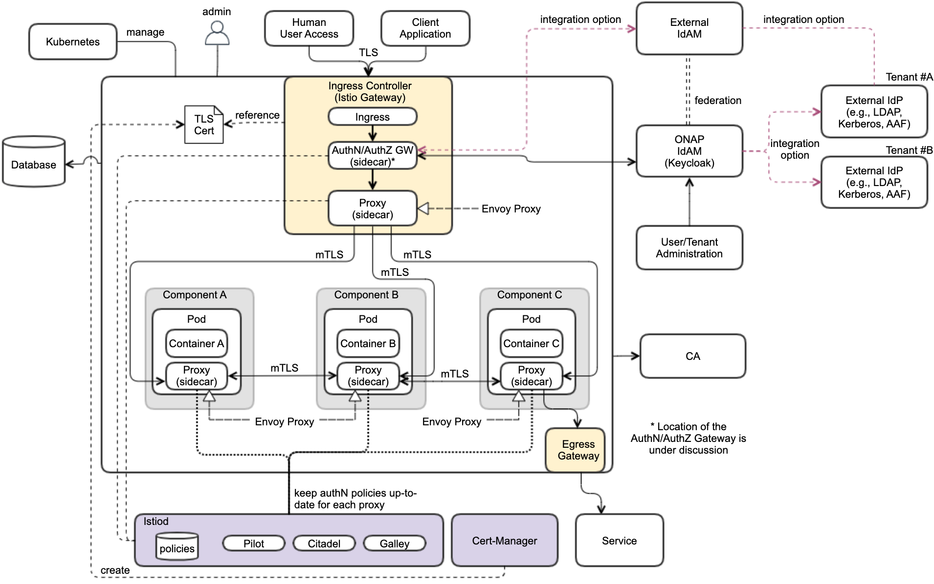
ONAP Access Control Security Architecture
- Leveraging Istio, Keycloak, Cert-Manager, Ingress, Egress
Security Functional Blocks
Ingress Controller (realized by istio-ingress)
AuthN/AuthZ Gateway (sidecar platform container)
ONAP IdAM (realized by Keycloak)
  User Administration
  Tenant Administration
Proxy (sidecar) – for data plane
External IdP (vendor-provided component)
External IdAM
Egress
Istiod – control plane
Cert-Manager
Certificate Authority (CA)
Use of control plane and pluggable sidecar (platform container) proxies to protect application service
  Intercept traffic and check AuthN/AuthZ with IdAM and IdP
  Support SSO for Human user access request
Compatibility with variety of external authN/authZ systems (e.g., external IdP, IdAM)
  Allowing external IdP(s) and IdAM(s)
  Enabling a foundation for authN federation
Multi-Tenancy support
RBAC support, based on user role, group & permission
RBAC
Roles
R-1
R-2
.
.
R-N
Permission Groups
PG-1
PG-2
PG-3
.
.
PG-N
Permissions
P-1
P-2
P-3
P-4
P-5
P-6
P-7
P-8
.
.
P-N
4

Slide 5
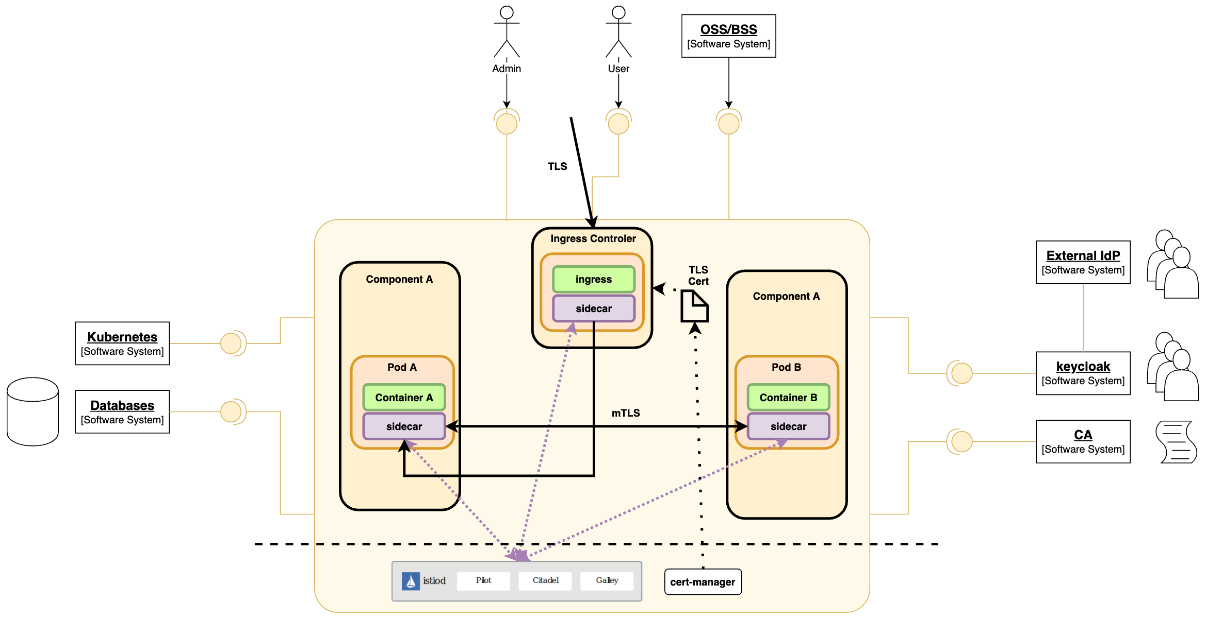
ONAP Component Security Requirements
# | Requirement
1 | No implicit dependencies between common components and ONAP
2 | No nodeports unless really required
3 | istio-ingress is used as ingress controller
4 | Define up to 4 entry points for deployment; E.g., UI, SBI, IdAM, NBI
5 | Every entry point is exposed as a separate ingress instance
6 | Every ingress gateway terminates the TLS and re-encrypts the payload before sending to the destination component using mTLS
7 | ISTIO network policy must be configured for only authorized services communications
8 | AuthN between services done using certs via mTLS
9 | OpenID Connect is used to authenticate user (AuthN/AuthZ GW)
10 | ONAP IdAM is realized by Keycloak, but it can be replaced with an external IdAM that is compatible with OIDC
11 | Cert-manager and Citadel are used to manage (CRUDQ) certificates
12 | Kubernetes is configured to use encryption at rest
13 | ISTIO automated sidecar injection is configured in underlying Kubernetes
14 | No root pods are used
15 | All DB is considered external
16 | User roles are documented
17 | Provide abilities to integrate with LDAP, Kerberos, AAF as IdP
18 | Provide abilities to retrieve the certificate from external CA
5

Slide 6
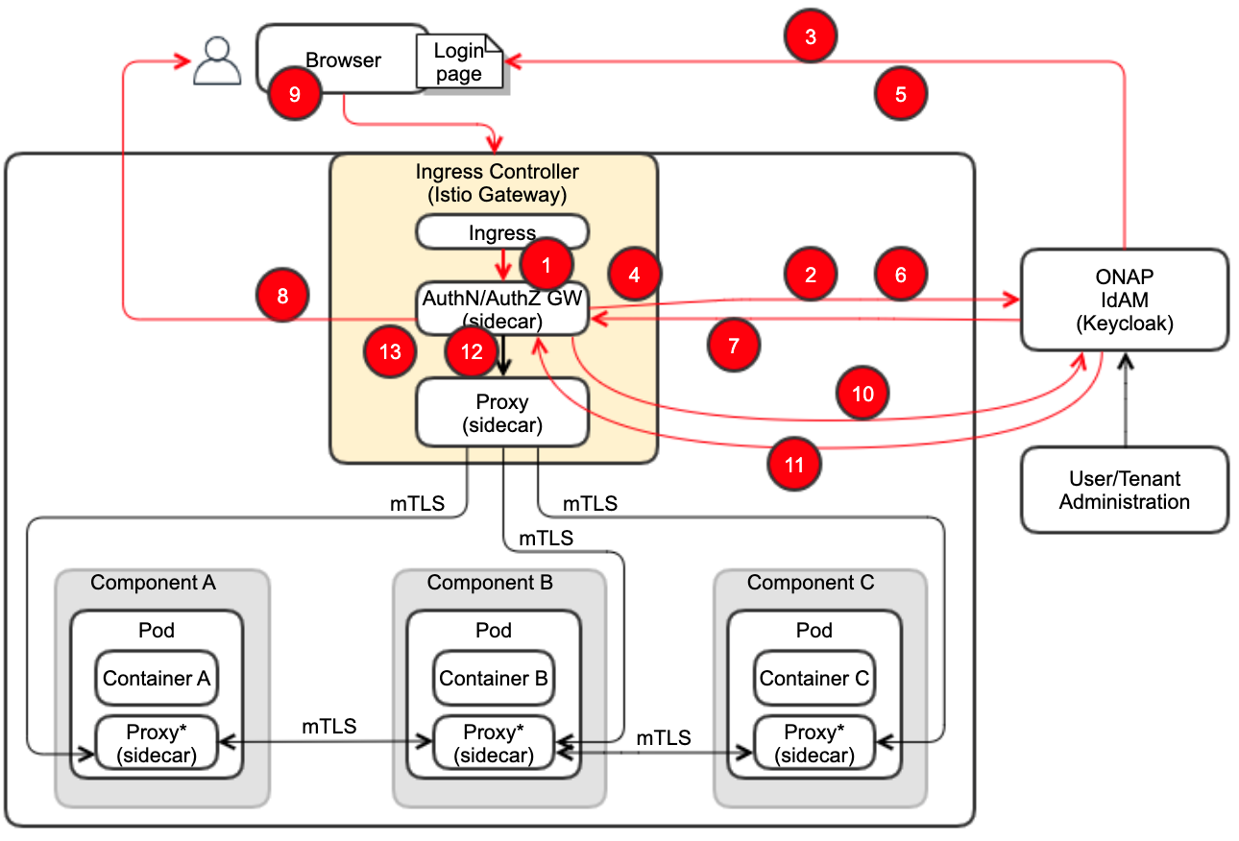
ONAP Human Request AuthN & AuthZ Use Case
# | Sequence
1 | GW intercepts the request that is coming from an external browser via the Ingress Controller, that terminates TLS
2 | If there is not a valid cookie in the request, the GW sends a request to Keycloak for an Authorization Code (one-time token). This request is sent by GW through the browser of the user
3 | The User is redirected to the Login page
4 | Once the user has inserted username/password (and the Tenant where supported), GW intercepts the request and ask Keycloak
5 | If the AuthN check is ok, then Keycloak provides an Authorization Code to the GW thru the user browser
6 | The Authorization code is used by the GW to communicate with Keycloak via a direct connection (no more through the user browser) to ask for an Access token to Keycloak
7 | Keycloak recognizes the Authorization Code and provides an Access token to the GW. This access token will contain the tenantID of the tenant that the user is associated with
8 | GW creates a cookie (session cookie only), that is associated to the Access token. This unique mapping is recorded in the GW memory
9 | The cookie (session cookie only) is provided to the user that will use it for subsequent request sent till the end of the session.
10 | GW uses the Access Token to ask for the authorization of the user’s request to Keycloak: this is done requesting another type of token (for authorization) to Keycloak.
11 | If the request is authorized, Keycloak sends an authorization token to the GW.
12 | Once GW receives the authorization token, then the user’s request can reach the recipient service. If the destination of the request is a Multi-Tenant-Aware service, then the Tenant info must be used by the service to allow the access only to the Tenant’s resources.
13 | The user, for subsequent requests, will use the session cookie. This will allow to skip the authentication phase. Once GW receives a request with a valid cookie, then starts only the flow to ask for the authorization for that request
All authN and AuthZ are carried out through the AuthN/AuthZ GW as IdAM client
6

Slide 7
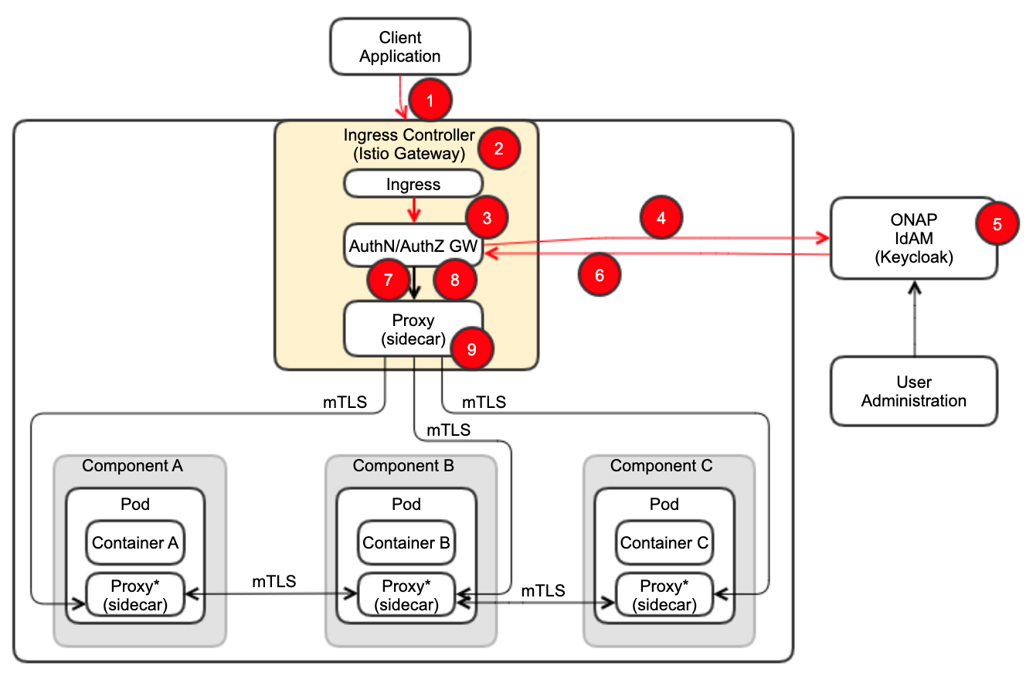
ONAP Application Client Request AuthN & AuthZ Use Case
# | Sequence
1 | The external machine submits, via HTTPS, a login request, including username/password/Tenant
2 | Ingress Controller terminates TLS
3 | GW intercepts the HTTP request
4 | GW starts a AuthN and AuthZ process towards Keycloak, forwarding username/password/tenantId, aiming to the correct Realm associated to the Tenant
5 | Keycloak performs the AuthN and AuthZ check
6 | If the check is successful, Keyclock provides an Access token to the GW
7 | GW and Keyclock perform RBAC
8 | If both AuthN and AuthZ are successfully validated, GW forwards the requests to a proper service
9 | Then, it follows Service-to-Service communication via mTLS
7

Slide 8
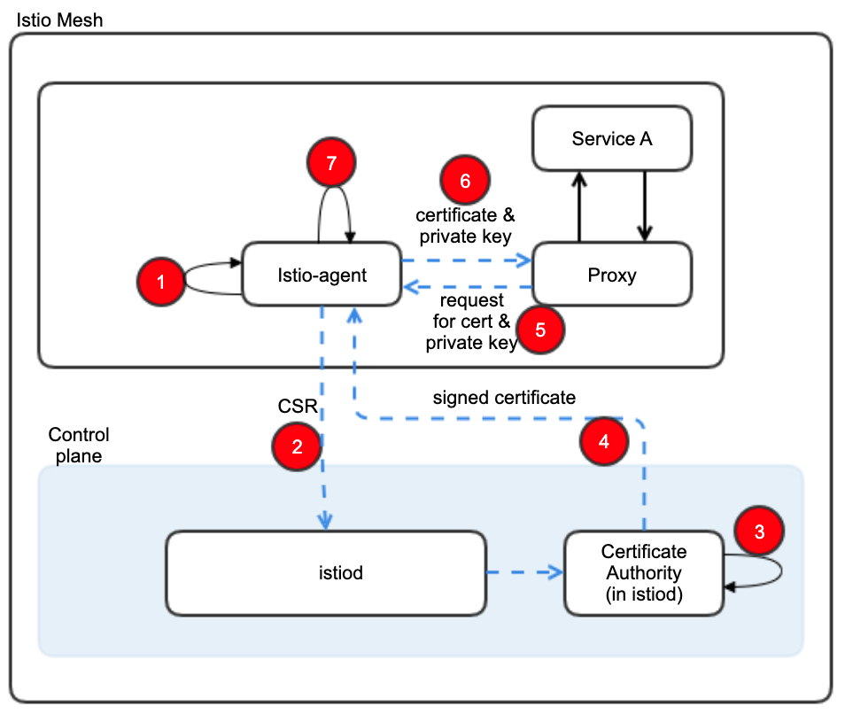
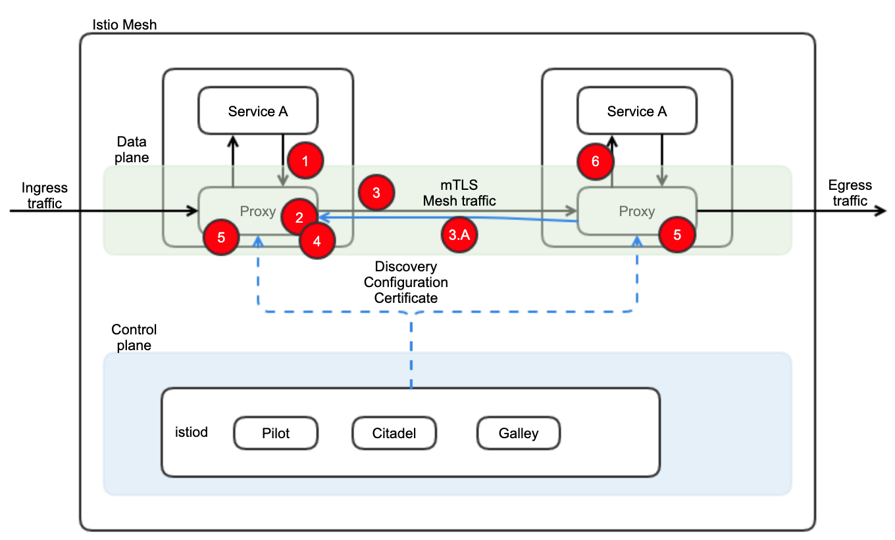
Service-2-Service mTLS Communication with Istio
A
The Service-to-Service authN is supported by leveraging mTLS certificates, instead of username/password
Two services will communicate using a direct connection (e.g., via REST AIPs) without passing thru Ingress Controller, GW or MSB
# | Sequence (mTLS Certification Management) - A
1 | When started, Istio agent creates private key & CSR
2 | Istio agent sends CSR with its credentials to istiod for signing
3 | CA in istioid validates credentials in the CSR, signs CSR to generate certificate
4 | CA in istioid sends the signed certificate to istio-agent
5 | When a workload is started, Envoy proxy requests certificate and key from istio-agent via SDS (secret discovery service) API
6 | Istio-agent sends certificates and private key to Envoy Proxy
7 | Istio-agent monitors the expiration of the workload certificate
B
# | Sequence (mTLS Authentication Flow) - B
1 | Client application in a container sends a plain-text HTTP request towards the server
2 | Client proxy container intercepts the outbound request
3 | Client proxy performs a TLS handshake with the server-side proxy
 | This handshake exchanges client and server certificates
 | Istio preloaded certificates the proxy containers (see diagram A)
4 | Client proxy checks for ‘secure naming’ on the server’s certificate, and verify the server identify
5 | Client and server establish a mTLS connection
6 | Server proxy forwards the request to the server application container
8

Slide 9
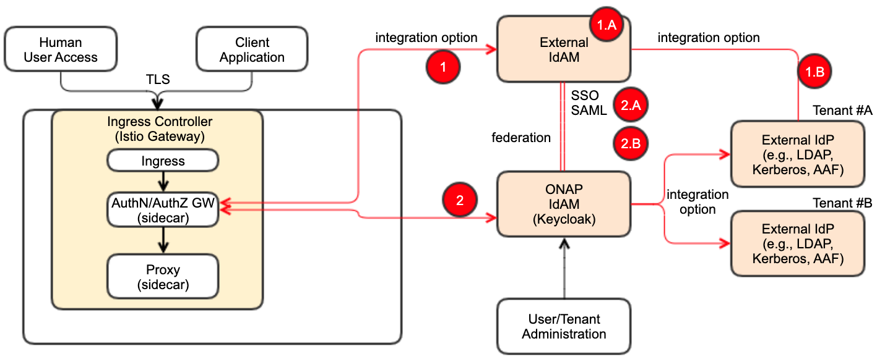
ONAP IdAM and External IdAM Interaction
# | Choice
1 | If the vendor chooses their own IdAM (external IdAM), the AuthN/AuthZ GW should be able to use the external IdAM, instead of ONAP IdAM – full integration choice
 | The external IdAM will handle AuthN/AuthZ for ONAP incoming traffic; session cookie handling, session handling
 | The external IdAM will typically use their own IdP (external IdP) to verify their own user identities
2 | If ONAP IdAM is used, based on business use cases ,the ONAP IdAM could interface with the external IdAM, based on IdAM-to-IdAM interface configuration
 | SSO
 | Authentication federation (SAML)
9

Slide 10
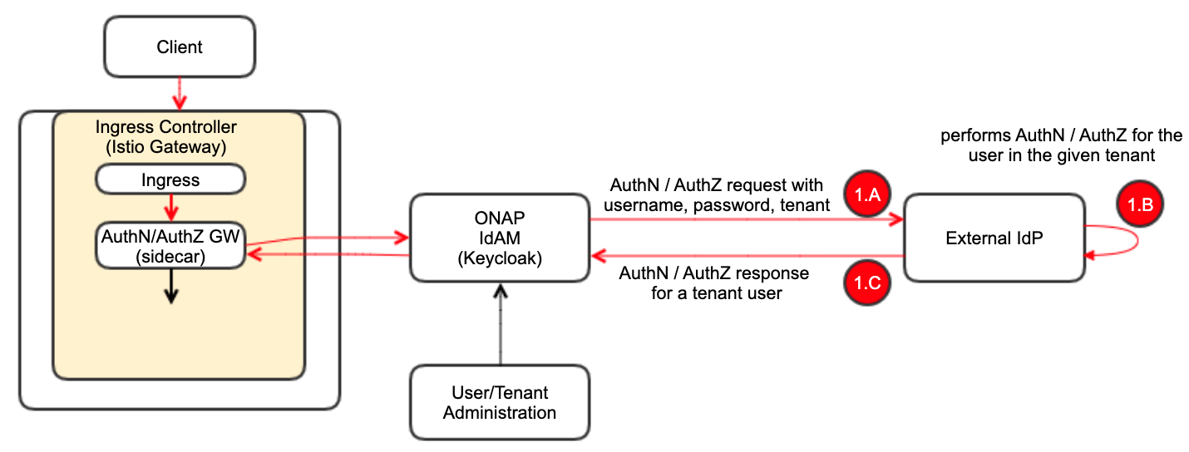
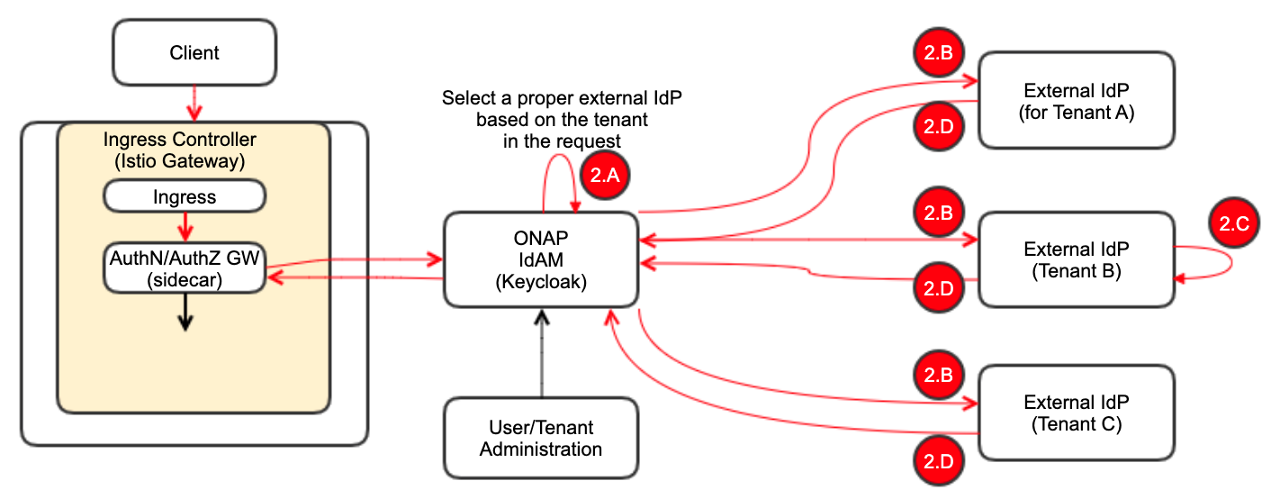
ONAP External IdP(s) and Multi-Tenancy Support
Each service provider will likely have existing centralized IdP that ONAP should integrate with. This architecture supports that integration.
ONAP IdAM proxies via plugin to a designated external IdP server(s)
ONAP IdAM must support fallback mode, where it can act as IdP for cases where external IdP is unavailable
Multi-Tenancy allows the same Username inside different tenants; There is no SSO between different tenants
A
# | Sequence (Single External IdP) - A
1 | If ONAP IdAM is connected to a single external IdP, the IdP contains the credentials of all the users from all the tenants
 | AuthN/AuthZ requests including username, password and tenant will be forwarded from ONAP IdAM to the external IdP
 | The external IdP performs the authN/authZ for the user in the tenant realm
 | The external IdP returns with AuthN/AuthZ response
B
# | Sequence (Multiple IdPs (each tenant has its own external IdP)) - B
2 | If each tenant has its own external IdP, the IdP contains the credentials for its tenant users
 | Based on the tenant info in the request, ONAP IdAM selects the correct external IdP
 | ONAP IdAM forwards the request to the selected external IdP
 | The selected external IdP performs AuthN/AuthZ
 | The selected external IdP returns with AuthN/AuthZ response
10

Slide 11
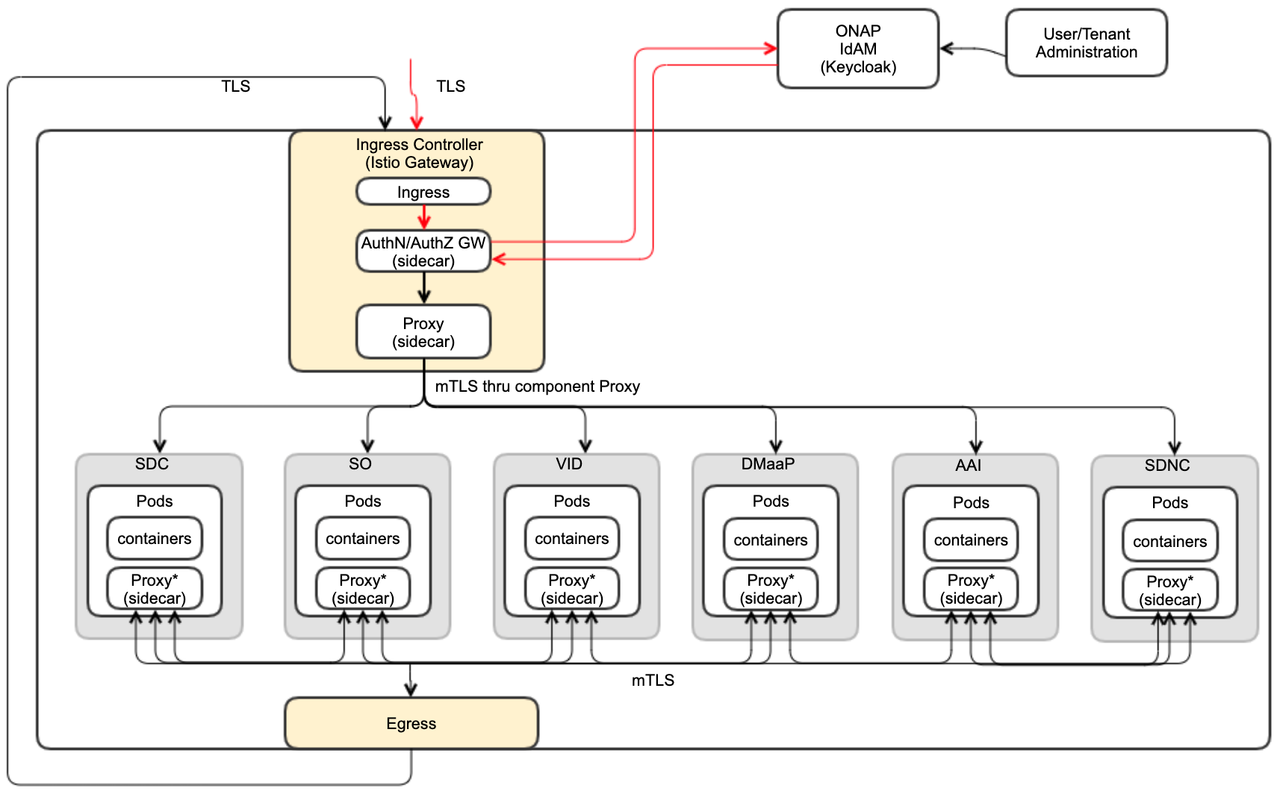
ONAP NG Security Status and Roadmap
Current ONAP Security PoC State and To-Do list:
ONAP OOM team created a Service Mesh-based security PoC and did initial testing
Due to the OOM team resource issue, this PoC is in the pending state.
With additional resources, the following work items could be done:
  Refine the PoC for more general purposes and more use cases
  Leverage industry open-source and standard security protocols for user management, cert manager and secrets
  Select ONAP components and make them work with the Service Mesh-based security mechanism
Istanbul Plan:
Getting additional resources from Ericsson and working with the OOM and SECCOM teams
Refine and Finish the Service Mesh-based Security in ONAP
  Select ~6 ONAP components (e.g., AAI, SDC, VID, SO, DMaaP, SDNC )
  Make the components work with the Service Mesh security mechanism.
11

Slide 12
ONAP Logging Architecture
12

Slide 13
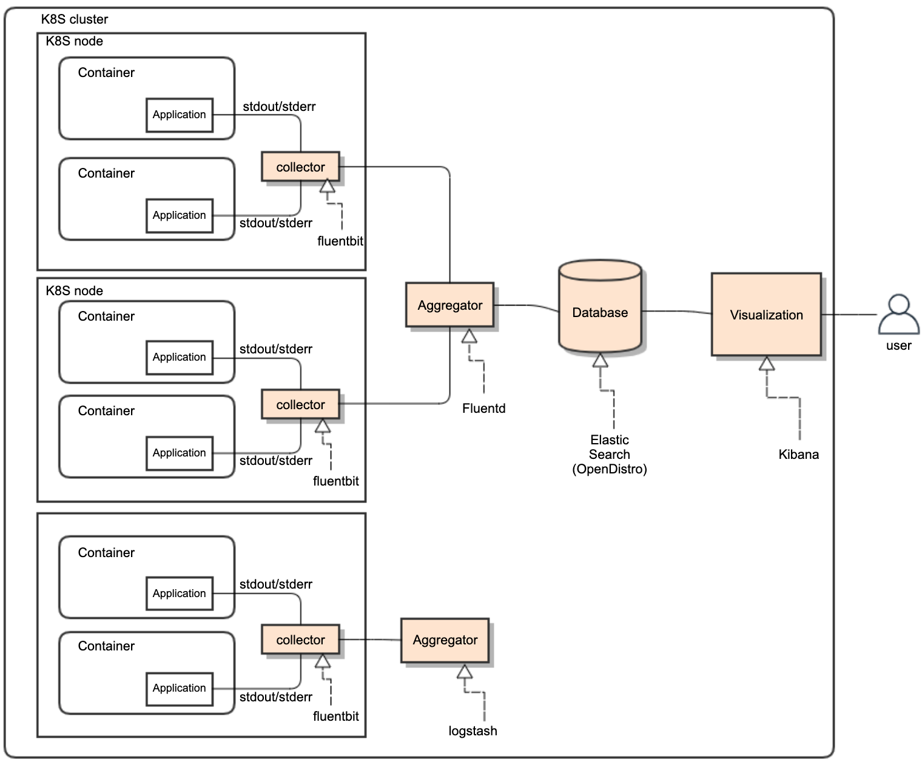
ONAP Logging Functional Architecture
ONAP supports open-source- and standard-based Logging architecture.
Once all ONAP components push their logs into STDOUT/STDERR, any standard log pipe can work.
  Allowing the logging component stack is realized by choices of vendors
  ONAP provides a reference implementation/choice
ONAP logs will be exported to a different and centralized location for security, persistent and aggregation reasons
  Log collector sends logs to the aggregator in a different container
  Aggregator sends logs to the centralized database in a different container
Logging Functional Blocks:
  Collector (one per K8S node)
  Aggregator (few per K8S cluster)
  Database (one per K8S cluster)
  Visualization (one per K8S cluster)
ONAP reference implementation choice:
  EFK: Elastic Search, Fluentd, Fluentbit, Kibana
  LFG: Loki, Grafana, Fluentd / Flentbit
ONAP logging conforms to SECCOM Container Logging requirements
  Event Types
  Log Data
  Log Management
13

Slide 14
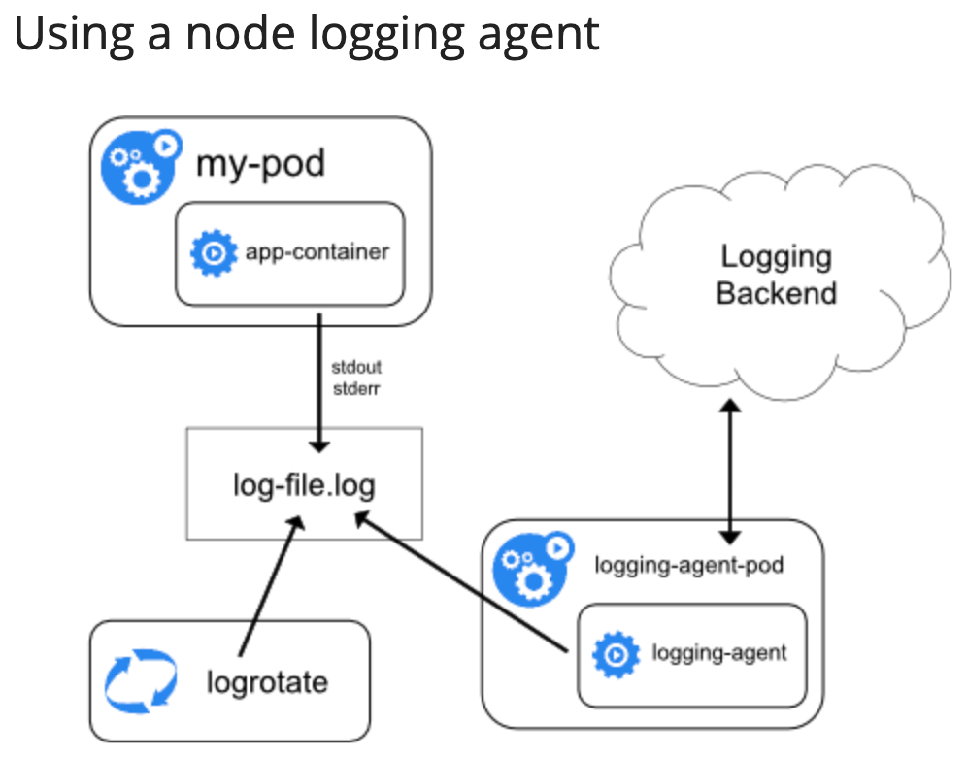
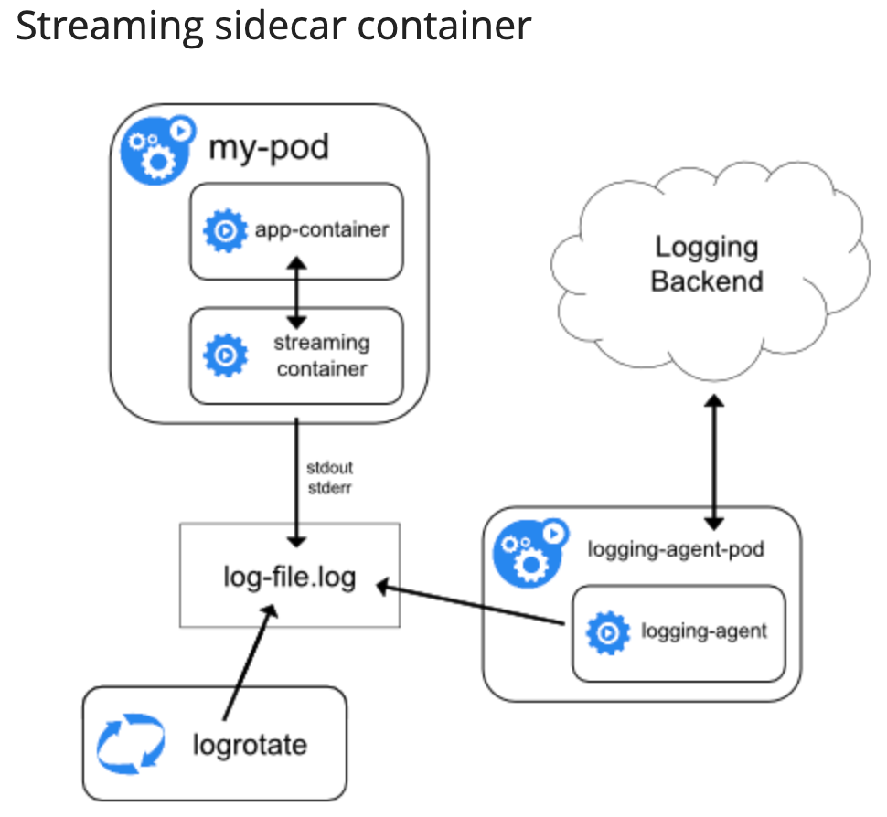
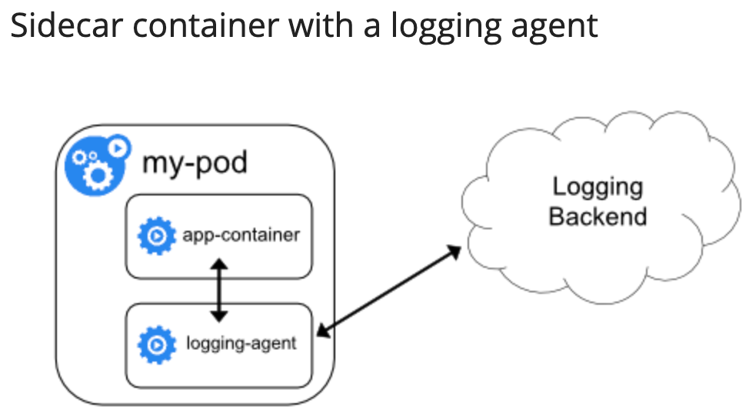
Cluster-Level Logging Requirements and Options
ONAP needs to support Cluster-Level Logging:
Allow users to access application logs event even if a container crashes, a pod get evicted or a node dies
Require a separate backend to store, analyze and query logs
Write to standard output and standard error streams
  E.g., A container engine handles and redirects any output generated to a containerized application's stdout and stderr streams
Support multi-tenancy logging
Cluster-level Logging Architecture (A)
Use a node-level logging agent (e.g., DaemonSet) that runs on every node
Include a dedicated sidecar container for logging in an application pod
Push logs directly to a backend from within an application
Note:
node-level logging creates only one agent per node and does not require any changes to the applications running on the node
Containers write stdout and stderr
A node-level agent collects these logs and forwards them for aggregation
Cluster-level Logging Architecture (B)
Allows users to separate log streams from applications, which can lack support for writing to stdout or stderr
Cluster-level logging Architecture (C)
If the node-level logging agent is not flexible, write an application-specific sidecar
A
B
C
14

Slide 15
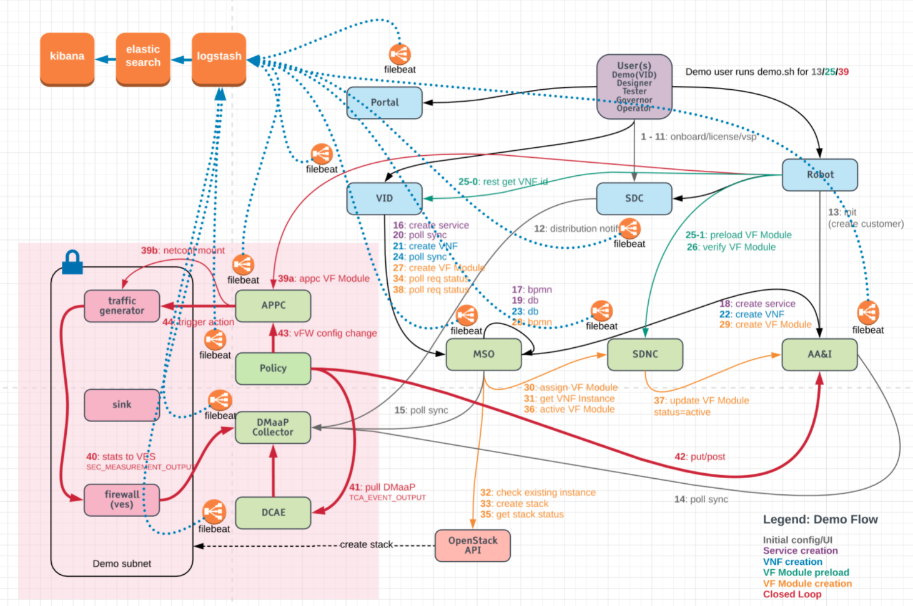
ELK -> EFK Stack in ONAP
We plan to move from ELK to EFK / LFG
ONAP provides reference implementation, but the implementation can be overwritten by vendors, by leveraging their own logging stack.
There are the 3 elk containers in the log pod in K8S off the OOM deployment
Currently all 3 ports are exposed, logstash, elasticsearch and kibana
Due to the licensing issue, we are thinking about:
  OpenDistro for Elastic Search
  Fluentd as aggregator
  Fluentbit as collector
  Kibana for visualization
We use K8S with Helm charts via the OOM project deployment
The ports are all mapped as node ports in the external 302xx namespace
Each participating ONAP component pushes STDOUT/STDERR
filebeat is used as a sidecar container for all the ONAP components, as a collector
filbeats pushes logs to the logstash node port
Logstash collects logs and pushes them to elastic search
Elastic search stores logs, indexes log contents and make them accessible
Kibana is used to visualize logs based on filtering criteria
15

Slide 16
References
ONAP Next Generation Security Architecture, https://wiki.onap.org/pages/viewpage.action?pageId=103417456
Istio Architecture, https://istio.io/latest/docs/ops/deployment/architecture/
Service Mesh Risk Analysis, https://wiki.onap.org/display/DW/Service+Mesh+Risk+Analysis
Service Mesh Impact on Project, https://wiki.onap.org/display/DW/Service+Mesh+Impact+on+Projects
ONAP Security Model, https://wiki.onap.org/display/DW/ONAP+Security+Model
Logging Architecture Proposal, https://wiki.onap.org/display/DW/Logging+Architecture+Proposal
Logging Enhancements Project proposal, https://wiki.onap.org/display/DW/Logging+Enhancements+Project+Proposal
SECCOM Container Logging Requirements, https://wiki.onap.org/display/DW/CNF+2021+Meeting+Minutes?focusedTaskId=239&preview=/93004634/100896899/2021-02-22_LoggingRequirementEvents_v8.pptx
16

