Slide 1
Smart Intent Guarantee based on IBN - R9 Intent Instance
AAI & Arch. Review
25th May, 2021
China Telecom, Huawei, CMCC
Dong Wang (wangd5@chinatelecom.cn), Henry Yu, Lin Meng

Slide 2
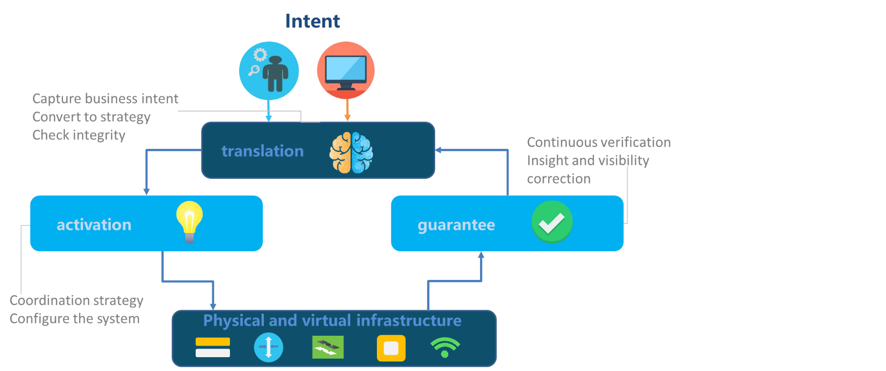
1.1 Introduction of Intent-based Network
Intent-based network (IBN) is a self-driving network that uses decoupling network control logic and closed-loop orchestration techniques to automate application intents.
An IBN is an intelligent network, which can automatically convert, verify, deploy, configure, and optimize itself to achieve target network state according to the intent of the operators, and can automatically solve abnormal events to ensure the network reliability.
A High-level Framework of Intent-Based Network
Ref: ITU-T “Scenarios and Requirements of Intent-Based Network for Network Evolution”

Slide 3
1.2 Outputs about IBN in Standardization Organizations
Organizations | Standards | Remarks
3GPP SA5 | TR 28.812 Telecommunication management; Study on scenarios for Intent driven management services for mobile networks TS 28.312 Management and orchestration; Intent driven management services for mobile networks | TS 28.312 has been approved to transfer from TR 28.812
ITU-T* | 476-WP3 Scenarios and Requirements of Intent-Based Network for Network Evolution
ETSI ENI* | ENI-0013 Intent Aware Network Autonomicity
IETF | Intent-Based Networking - Concepts and Overview Intent-Based Networking - Concepts and Definitions Intent Classification Transport Slice Intent Service Assurance for Intent-based Networking Architecture Interconnection Intents YANG models for VN/TE Performance Monitoring Telemetry and Scaling Intent Autonomics | 7 drafts have been published online
CCSA* | 2015B58 Network Intelligent Capability Enhancement for SDN/NFV: Study of Key Technologies of Intent Network
* Led by China Telecom

Slide 4
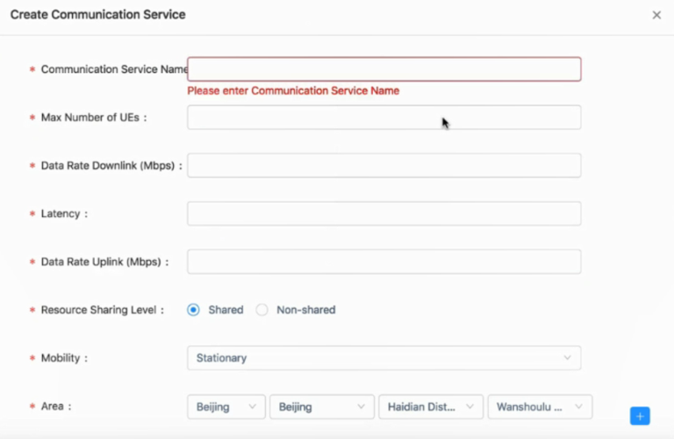
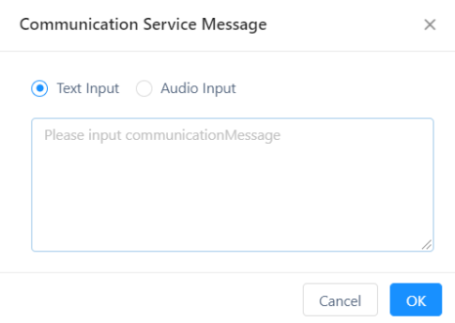
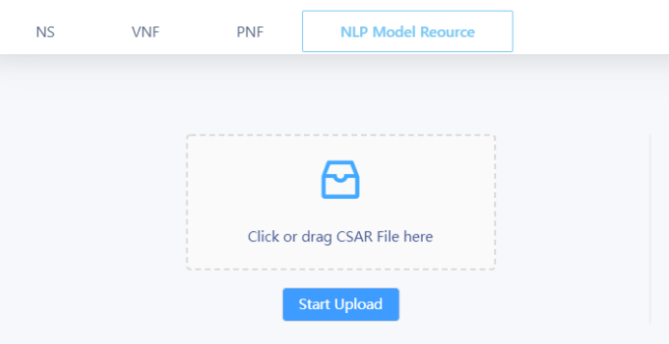
2. IBN proposal in ONAP Release H (R8)
UUI
Target of R8: translate from the human inputs to the slice parameters based on NLP in UUI, and then run the slices based on the current ONAP.
Parameter1: scenario (eMBB/mMTC/uRLLC)
Input
Parameter2: throughput
Nature Language Processing
Text
Parameter3: latency
Parameter4: reliability
Voice
…
…
Parameter x: …
Parameter x+1: …

Slide 5
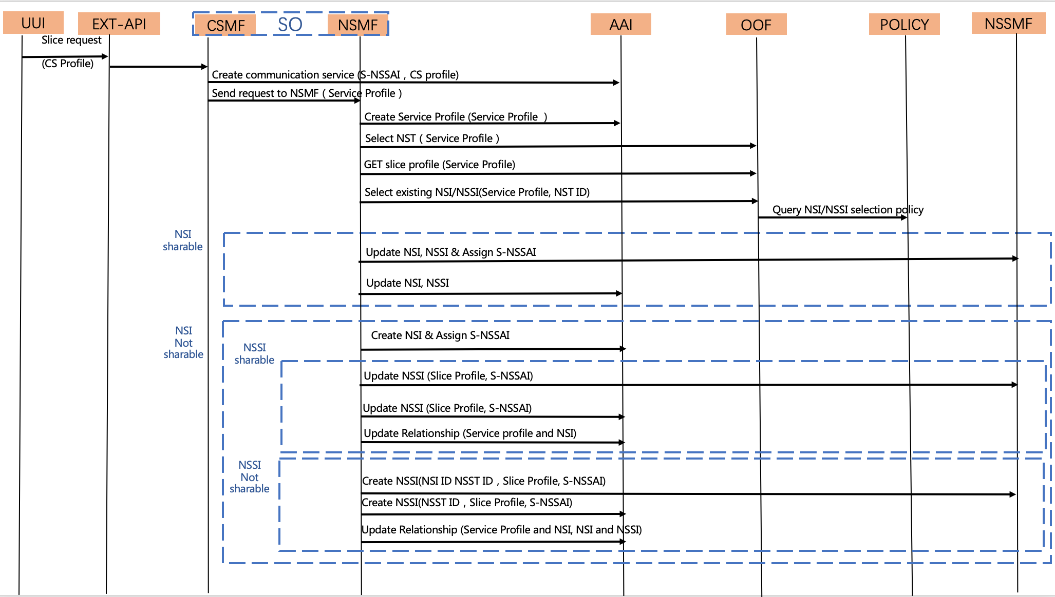
2. Input the parameters from UUI
High level Flow of E2E Slicing
Parameter1: scenario (eMBB/mMTC/uRLLC)
Parameter2: throughput
Parameter3: latency
Parameter4: reliability
…
Parameter x: …
Parameter x+1: …

Slide 6
3. Minimum IBN Model
Intent Input
& Translation
Nature Language Processing
Get Intent for Monitor by API or Use case
Usecase
①
②
Monitor API
Intent Closed-loop Management
Intent Monitor
& Analysis
AI/ML – performance forecast
Intent Decision
& Performing
Intent Verification (Digital Twin)
AI/ML - policy smart selection
performing API to usecase

Slide 7
3. Minimum IBN Model based on ONAP projects
Intent Input
& Translation
UUI
Nature Language Processing
Get Intent for Monitor by API or Use case
SO
①
Usecase
②
Monitor API
AAI
Intent Closed-loop Management
Intent Monitor
& Analysis
AI/ML – performance forecast
Intent Decision
& Performing
Intent Verification (Digital Twin)
AI/ML - policy smart selection
DCAE
?
performing API to usecase
Policy
Domain Controllers

Slide 8
3. REQ-861 Smart Intent Guarantee - Intent Instance
The new network applications, like E2E Slicing and CCVPN, provide different SLA services to customers. In this REQ, a scenario of intent guarantee is proposed to support the SLA requirements of users in run-time, as well as updating users’ intents. In R9, Intent instance will be developed to support the E2E Slicing and CCVPN.
Key Contacts - Dong Wang (China Telecom), Henry Yu (Huawei), Lin Meng (CMCC), Swaminathan Seetharaman (Wipro)
Executive Summary - Intent-based network (IBN) is a self-driving network that uses decoupling network control logic and closed-loop orchestration techniques to automate application intents. An IBN is an intelligent network, which can automatically convert, verify, deploy, configure, and optimize itself to achieve target network state according to the intent of the operators, and can automatically solve abnormal events to ensure the network reliability. In R9, a scenario of intent guarantee is proposed, and the development of Intent instance will be done to support the use cases of both E2E Slicing and CCVPN.
Business Impact - It is a challenging problem to guarantee the users’ intents in run-time. The REQ of intent-based network provides a scenario of users’ intent guarantee and interacting.
Business Markets - This REQ provides a novel solution to support the SLA service.
1. A users’ intent instance is proposed to monitor and analysis the network in run-time to satisfy the users’ SLA service.
2. The users’ intents are updated in run-time based on the network situation and the interaction with users.
Funding/Financial Impacts - This function will provide more SLA services to increase the income of operators based on the current networks with few investments.
Organization Mgmt, Sales Strategies -There is no additional organizational management or sales strategies for this requirement outside of a service providers "normal" ONAP deployment and its attendant organizational resources from a service provider.

Slide 9






3.1 E2E Slicing Closed Loop: Overview
Change Slicing Instance
Update Slicing Parameter
Optimization (OOF)
Co-ordination, Decisions
(Policy)
Leverage the SON ⬄ Control Loop (CL) framework in ONAP
Based on PM/FM data, analyze NSI/NSSI traffic patterns, KPI adherence, and resource occupancy in NSI/NSSI
Based on analysis, trigger OOF for NSI resource optimization/re-allocation to guarantee KPI adherence and optimal use of resources
Perform necessary resource adjustments via SO and Domain Controllers (modify NSI/NSSI/S-NSSAI mapping/etc.)
DCAE
Data Collection,
& Analysis
(DCAE)
Action
(SO)
Control loop
Domain
Controllers
5G network
FM, PM data
5G Network
Ref: E2E_Network_Slicing_ArchCom_Review_v1.0.pptx (R8 Honolulu)

Slide 10
3.1 IBN Support in E2E Slicing Closed-loop
Scope of R9
UUI
KPI Monitor
Change Slicing Instance
Update Slicing Parameter
Co-ordination, Decisions
(Policy)
Optimization (OOF)
SO
Usecase
Create an Intent Instance
(with Slicing ID)
Analysis Monitor API
DCAE
Data Collection,
& Analysis
(DCAE)
SDC
AAI
Action
(SO)
Control loop
Upload ML Model
5G Network
ML Model – training based on the history data and available policies
5G network
FM, PM data
Domain
Controllers
IBN

Slide 11
3.2 CCVPN data analytics and closed-loop for intent
ONAP IBN
Transport domain Control & orchestration
Transport domain analytics
CCVPN
SO
Policy
AAI
Closed loop
CPS
SDNC
DCAE
Network service config
AI analytics algorithms
Network performance data and events
Domain network controllers
Ref: ONAP_CCVPN_Istanbul_requirement_proposal.pptx

Slide 12
3.2 IBN support CCVPN
Intent input & translation in UUI 1
Scope of R9
CCVPN Network Monitoring and feedback to users
Transport domain Control & orchestration
Intent Instance in AAI with CCVPN service ID and users’ real-time intents
Transport domain analytics
CCVPN
SO
Policy
AAI
Closed loop
CPS
SDNC
DCAE
Network service config
AI analytics algorithms
Network performance data and events
Domain network controllers

Slide 13
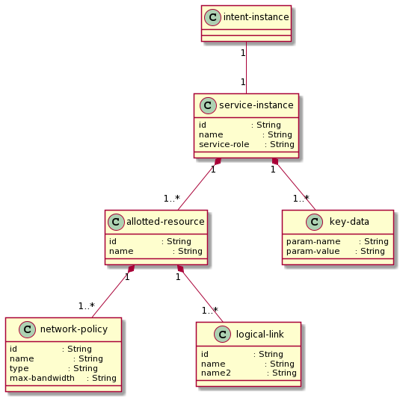
4. Ref. How performance monitoring data is used
ONAP IBN
1
IBN creates intent instance in AAI
4
IBN retrieves performance data from AAI
SO
SO creates CLL definition model instance in AAI
2
SDNC
3
After SDNC provisions CLL service on physical networks, it collects performance data from the domain controllers and writes them to AAI
Ref. SO SDNC AAI Istanbul release LLD v0.1.pptx

Slide 14
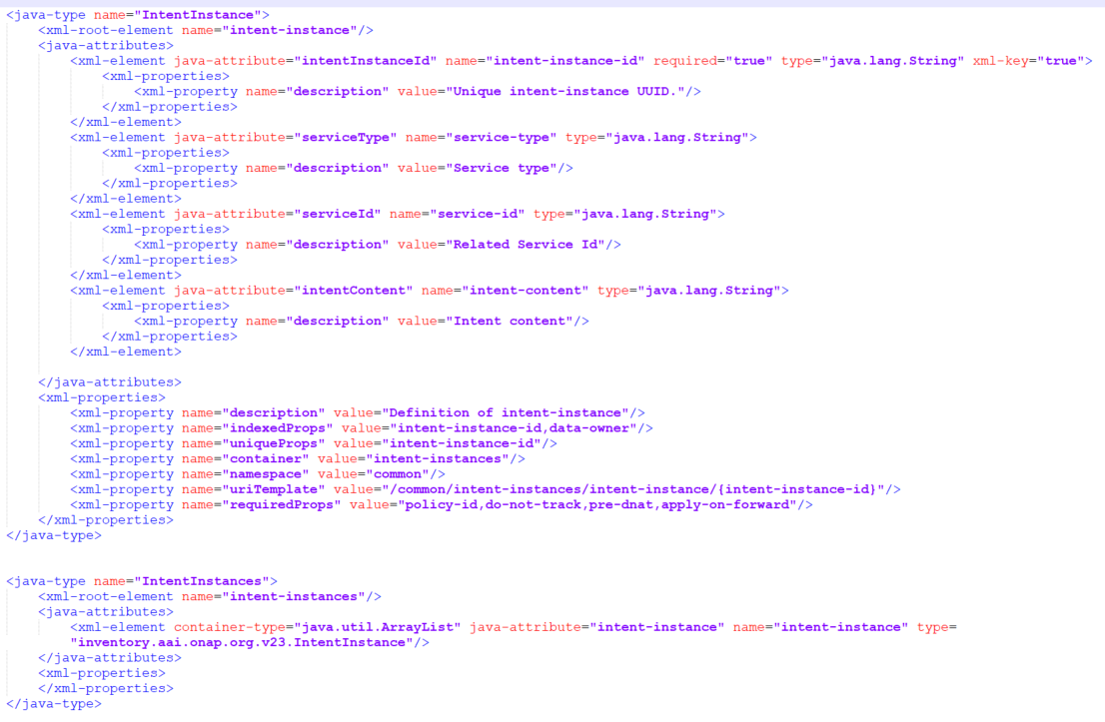
4. Intent Instance in AAI
Functions: Intent Instance is created to save the users’ real-time intent (network parameters) and connected service ID (CCVPN service ID / E2E Slicing CST ID) in AAI.
UUI/SO
DCAE
Intent-instance
intentInstanceID : String
serviceType: String
serviceID: String
intentContent: String
AAI
serviceType: ‘CCVPN’, ‘E2ESlicing’

Slide 15
4. Intent Instance in AAI
Functions: Intent Instance is created to save the users’ real-time intent (network parameters) and connected service ID (CCVPN service ID / E2E Slicing CST ID) in AAI.
The essentiality of Intent Instance to be added in AAI:
1. Intent Instance is created to save the users’ real-time intent, therefore, the most appropriate position to create it is Active and Available Inventory. The other records related to the intents are not real-time, which are saved in the independent database in UUI, and will be saved in CPS in further releases.
2. It is said that AAI is too big to add more nodes. However, the Intent Instance is essential to add to AAI. Maybe, it is better to move part of the non-real time nodes to CPS from AAI which are created before CPS is approved.
3. The target of Intent-based Network is developed to support multiple usecase services, so it is not a sub-node of any usecase in AAI. And the IBN will be expect to provide unawares service to users. Multiple usecases services could be changed by IBN instead of the users, so it should be an independent node in AAI.
UUI/SO
DCAE
Intent-instance
intentInstanceID : String
serviceType: String
serviceID: String
intentContent: String
AAI
serviceType: ‘CCVPN’, ‘E2ESlicing’

Slide 16
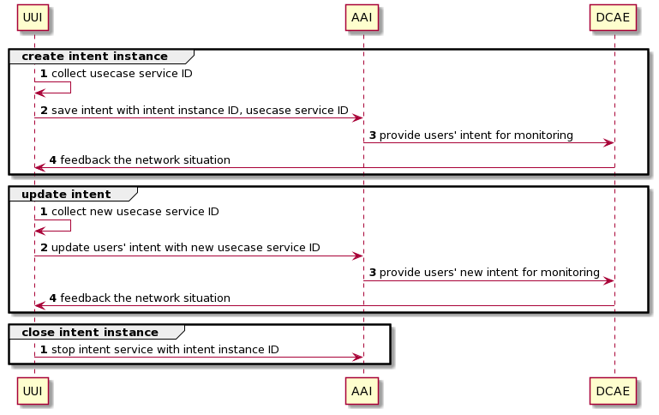
4.1 Intent Instance Management by IBN
*1. the usecase service ID, include the service instance ID of CCVPN and CST id of E2E Slicing, are collected in UUI after creating a new service.

Slide 17
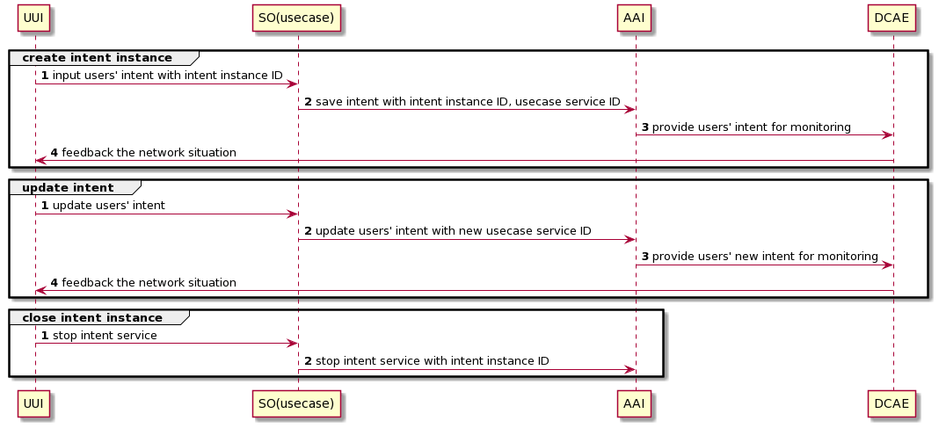
4.1 Intent Instance Management by IBN

Slide 18
5. Projects Impact
Project | Impact | Notes
UUI | 1. Enhance intent input and translation to support both E2E Slicing and CCVPN; 2. Add CCVPN monitoring page and functions
AAI | 1. Add Intent Instance and its management functions to add, update and delete users’ intents; 2. Provide the APIs for the use cases to collect the content of users’ intent in Intent Instance
DCAE | Research and modelling of E2E Slicing monitoring with both network data and users’ intent - no development works | research

Slide 19
6. Scope
Basic tasks:
1. Add Intent Instance and Intent Instance management function in AAI; provide APIs for the use cases (E2E Slicing & CCVPN) to collect the content of users’ intent in Intent Instance;
2. Expand the function of Intent translation in UUI to support the CCVPN requirements.
Extension:
1. Pre-research and modelling of intent closed-loop management in DCAE based on closed-loop of E2E slicing;
2. Research on algorithm of translation from audio to text.

Slide 20
Thanks!

