Slide 1
ETSI packaging and VNF descriptor with container support
Fred Oliveira - Verizon
2021-10-07

Slide 2
Istanbul Requirement: Onboard ETSI SOL004 v4.2.1 VNF/CNF packages
Executive Summary - Enable a vendor-provided ETSI SOL004 v4.2.1 compliant VNF package including an ETSI SOL001 VNF Descriptor to be onboarded into ONAP for composition into an ONAP Network Service
  Support for onboarding ETSI v4.2.1SOL004 CSAR Packages with Container support
  Support for onboarding ETSI v4.2.1 SOL001 VNF Descriptor with Container Support
  Support for mapping of ETSI v4.2.1 SOL001 VNF Descriptor with Container Support into SDC AID Data Model
Business Impact - Enables operators and service providers to use same ETSI compliant C/VNF packages with ONAP and existing NFVO. Industry compatibility.
Business Markets - All operators that are currently using ETSI packages to deploy VNFs
Funding/Financial Impacts - Reduction in operations expense from using industry standard VNF packaging. Reduction in capital expense from vendors using a single packaging methodology.
Organization Mgmt, Sales Strategies -There is no additional organizational management or sales strategies for this requirement outside of a service providers "normal" ONAP deployment and its attendant organizational resources from a service provider.

Slide 3
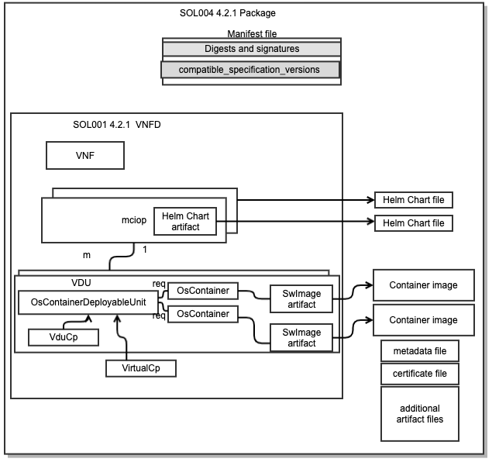
Minor changes in SOL004 Package to support containers
Support for Helm Chart file(s)
Container Images can be in the package or reference to external CIR
  ETSI Catalog Manager can upload package images to ONAP CIR

Slide 4
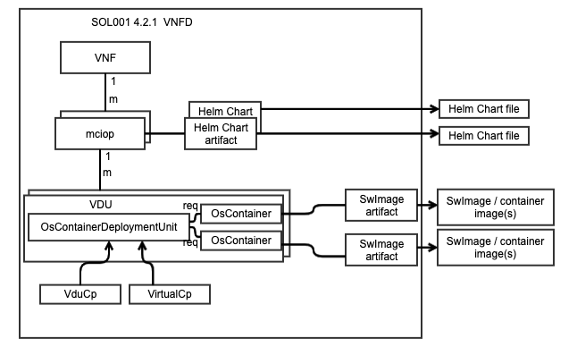
ETSI Aligned Container VNFD
Based on ETSI SOL001 v4.2.1 Enhancements
  Added Mciop Node
  Added Vdu.OsContainerDeploymentUnit Node
  Added Vdu.OsContainer Node
  Added VirtualCp Node

Slide 5
ETSI Status
ETSI 4.2.1 IM changes incorporated into ONAP IM
  https://wiki.onap.org/pages/viewpage.action?pageId=103423188
ONAP: Work is in progress in Orchestration Scenarios
  https://wiki.onap.org/display/DW/ETSI+NFV+SOL001+v4.2.1+based+proposal
O-RAN: Proposal to adopt ETSI v4.X SOL004/SOL001 model
  https://oranalliance.atlassian.net/wiki/download/attachments/2211414051/VZ-2021-09-28-WG10-Discussion%20on%20App%20Package%20And%20Descriptor.pptx?api=v2
Plans:
  Jakarta release:
    Update with v4.3.1 IM changes
    Complete v4.3.1 Data Model changes
    PoC of onboarding ETSI v4.3.1 package

Slide 6
Orchestration Scenarios
Meeting Information:
  Weekly meeting: Mondays at 1200 UTC, 5AM PDT, 8AM EDT, 1300 CEST, 5:30 PM India, 8PM China.
  https://zoom.us/j/722438866?pwd=d3VTTFJiK3Bkeml2RlRqVkdhSlhKQT09
  One tap mobile: +16699006833,,722438866# US (San Jose) +16465588656,,722438866# US (New York)

