Slide 1
ONAP Logs security Management
Fabian Rouzaut
February, 2021

Slide 2
Summary
Why security log management for ONAP?
Security Stakes
Perimeter
A collect chain
Next step
Proposal to enhancement

Slide 3

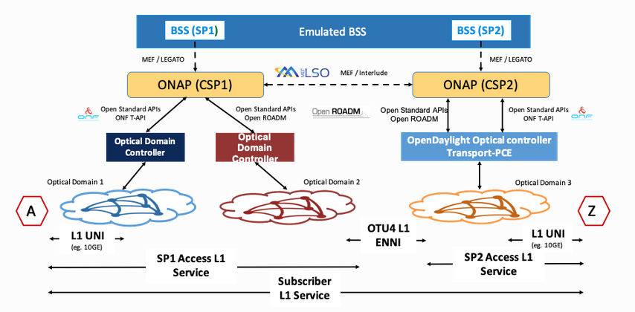

Why security log management for ONAP?
ONAP has a central position in the orchestration chain of the network.
For a country or an operator, loss the control of ONAP would have a huge impact.
To reduce threats, there are several levers: code quality, strong passwords, flow protected, etc...
ONAP MDONS Architecture example
Through ONAP, the hacker could have the control to the network
Security log management is a part of this levers

Slide 4
Security Stakes
Disponibility
Confidentiality
Feared events | Impacts
Total loss | Management of the service’s templates KO
 | Total stop of the production
 | Feedback mechanism KO
 | Interactions with the SI KO
Partial loss | Instability of the process (latency, overload)
 | Incomplete configuration
Integrity
Type of scenarios | Scenarios
Unlawful actions Information Compromise | External attacks to orchestrator like fuzzing, flooding (API, admin interface,…)
 | Internal attacks by a compromised component
 | Maintenance/Bug/Configuration of different orchestrator components (VM, K8S, containers, software,…)
Technical failures | Hardware failure
Traceability
Detection
Forensic
Notes:
what are the threats we need to address? Disponibility example DIC

Slide 5
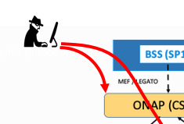
The perimeter of event
Onap System
  AAA,
  attempted SSH intrusion (could be covered by PAM)
  sudo failure
  Configuration File modification (could be covered by AIDE)
Onap Service though API
  AAA,
  authentication failure
  Interface unavailable
  Too many requests (e.g.10 per seconde)
Monitoring behavior
  Process, file access, etc.. (could be covered by AUDITD)
  Network activity (could be covered by FW, Ingress, etc..)
Notes:
Onap or infrastructure need to provide this events

Slide 6



Collect chain
External system must be use to save and display the log and event.
SIEM
Security event
System
Service
Monitoring
Syslog, trap, SNMP, etc..
SOC
Controller
HP-OV
Secure
protocol
Operational event
NOC
ONAP responsibility
Operator perimeter
Notes:
Onap is responsible for making available these events, wi th a secure protocole

Slide 7
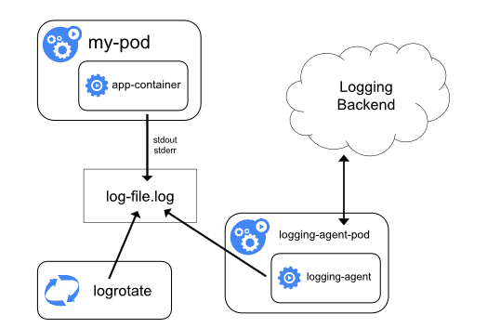

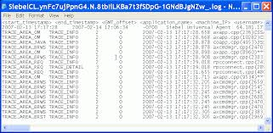


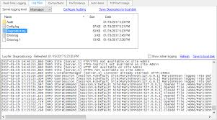
Next step
Deploy Logging Architecture
https://kubernetes.io/docs/concepts/cluster-administration/logging/
Analyze the events linked to threats
SYSTEM
Application
Example with Logging agent
Need to define: critical feature , exposed API etc..
Notes:
Several ways of making social security information available
Due to the size of ONAP, you must define critical feature, the exposed API

Slide 8


Proposal to enhancement
Propose to complete and help to deploy secure and detection tools
SELINUX
PAM
Auditd
AIDE
Etc…
SECCOM proposal:
two included this tools inside of basic
image JAVA11, Python3
TSC/PTL/SECCOM
Application events
integration into the code?
Best practice
Notes:
Could SECCOM take a decision to perform a Secure MVP? for operational release?
Requirements management is not enough, it is not binding. (look the code quality, requirements about java, flow matrix etc..)
what are the priorities?

Slide 9
Thanks

Slide 10
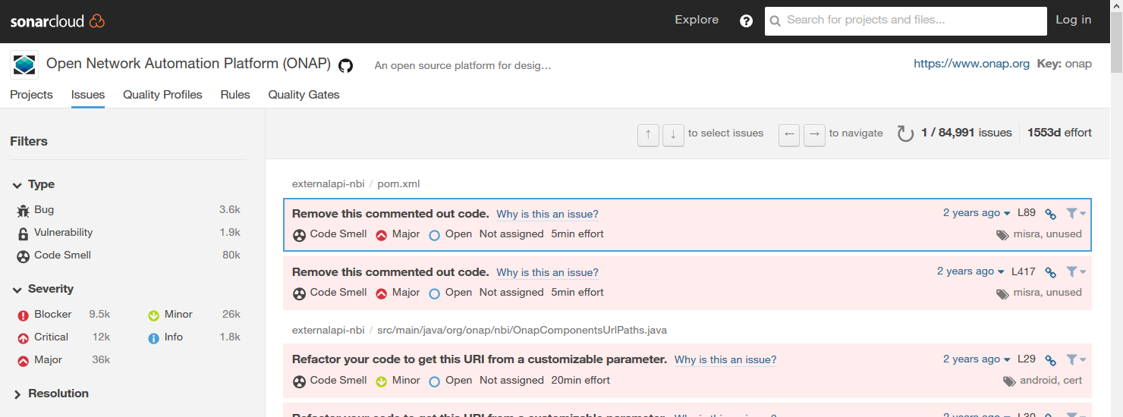
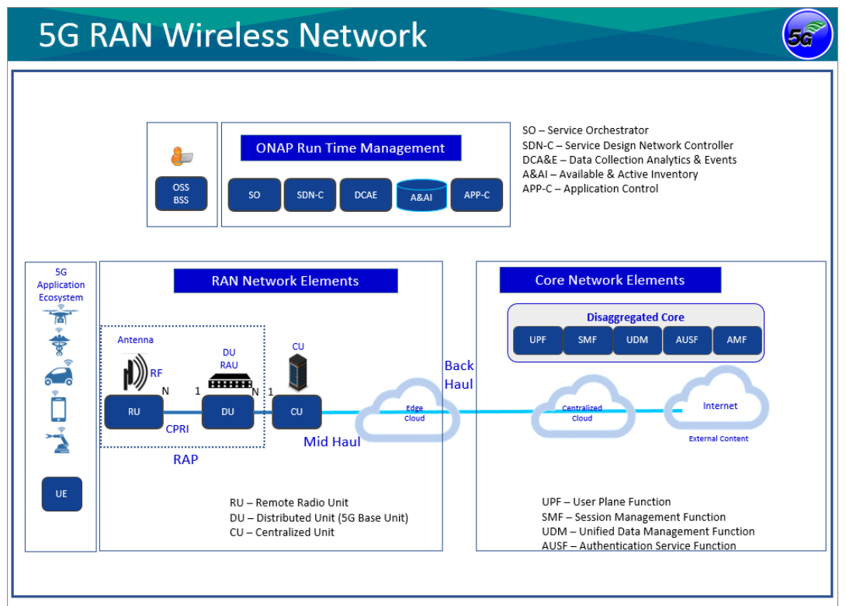
ONAP, Global reflexion of security view
ONAP Today
Innovation, PoC
IAM
CHA L L ENG E
Secret
management
Example
Network
flow
protected
Operator, Integrator, implication of the community?
Do we need to target an Operational release?
Hardening
Soc
Integration
Security
Update
ONAP Tomorrow
Ready for Operator integration?
Notes:
Requirements management is not enough, it is not binding. (look the code quality, requirements about java, flow matrix etc..)
To the operator have to pay an integrator?

