Slide 1
CCVPN Support for Intent

Slide 2
Timeline of CCVPN and its relation with Net Slicing and IBN use-case
Year 2018
Year 2019
Year 2020
Year 2021
ONAP Releases
Beijing
Casablanca
Dublin
El Alto
Frankfurt
Guilin
Honolulu
Istanbul
May 2018
June 2019
Sept 2019
June 2020
Nov2020
May2021
E2E Network Slicing Use-case
Phase I
Phase II
Phase III
Phase IV
Developed CSMF and NSMF
Developed AN, TN, CN NSSMF
Achieved E2E network slicing across AN, TN, and CN
Modify and reuse of existing NSI and NSSI
CCVPN Use-case
Phase I
Phase II
Phase III
Phase IV
Developed multi-domain L2 Service (EPL and EVPL service creation)
Developed Multi-domain L1 Service (OTN service creation)
Implemented both IETF/ACTN L1 and MEF/ONF L1 (i.e., MDONS use-case)
Transport Slicing solution, integrated with E2E NS in Guilin
FAN+OTN for cloud leased private line service
Intent support for CCVPN
Modify/reuse of existing TN NSSI (Honolulu)
IBN use-case
Phase I
Phase II

Slide 3
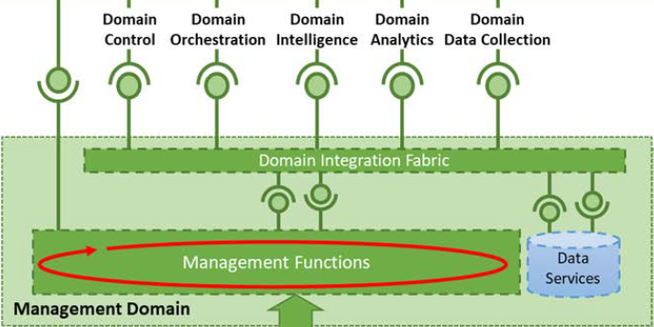
Background (1): CCVPN developed as ESTI ZSM Management Domain
Transport management services exposed by CCVPN to its consumers.
CCVPN can be implemented as a Transport Management Domain, which offers management services via standardized interfaces and also offers closed loop capability.
This modular design enables CCVPN services to be consumed by or work with other usecases. E.g., The IBN usecase can consume CCVPN management services to deliver a complete E2E intent solution.
Closed loop

Slide 4
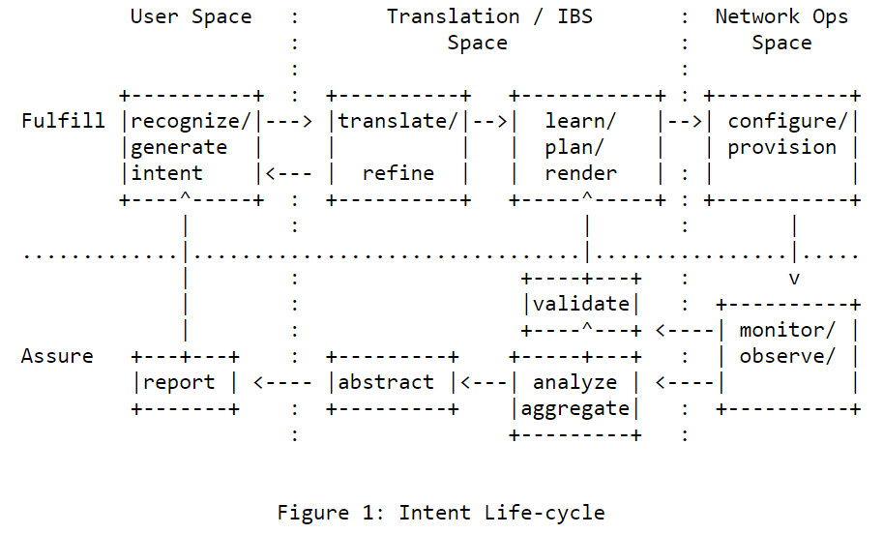
Background (2): Intent-based Networking Concepts
Based on draft-irtf-nmrg-ibn-concepts-definitions [1]:
Intent Fulfillment
  Intent ingestion and interaction with users
  Intent translation
  Orchestration: configure/provision
Intent Assurance
  Performance data monitoring
  Intent compliance assessment
    continuously monitor & compare actual vs. intended configs
  Intent compliance actions: learn/plan/render
  Abstraction and reporting
Intent Control Loops
  “Inner” loop: classic zero-touch closed loop within a management domain
  “Outer” loop: E2E service manage domain closed loop; intent exchange – involves end user
[1] https://tools.ietf.org/html/draft-irtf-nmrg-ibn-concepts-definitions-03

Slide 5
How IBN and CCVPN work together to offer an E2E intent solution
ONAP IBN
ZSM Management services exposed by CCVPN
ONAP CCVPN
SO
Policy
AAI
SDNC
Holmes
CPS
[1] https://tools.ietf.org/html/draft-irtf-nmrg-ibn-concepts-definitions-03
Domain network controllers
DCAE

Slide 6
Proposed CCVPN Architecture as Transport MD supporting Intent
ONAP IBN
Transport domain Control & orchestration
Transport domain analytics
IBN and CCVPN, when federated together, may offer the complete implementation of an Intent-Based System (IBS).
CCVPN (or Transport MD) offers the so-called “Service Intent”. Its NBI is a model-driven, intent-like interface. And it enables closed-loop to support service assurance.
CCVPN
SO
Policy
AAI
Intent service creation flow
Closed loop
CPS
SDNC
DCAE
Network service config
AI analytics algorithms
Network performance data and events
Domain network controllers

Slide 7
Cloud Leased Line Use-case
Cloud 1
Cloud POP
One VPN service that connects an enterprise network to multiple clouds
Multiple VPNs can co-exist (service isolation; performance monitoring)
Cloud PE
Enterprise/campus network
CE
OLT
CO
Cloud PE
Cloud POP
Cloud 2
Access network
Core network
Cloud PE
Cloud POP
Cloud 3

Slide 8
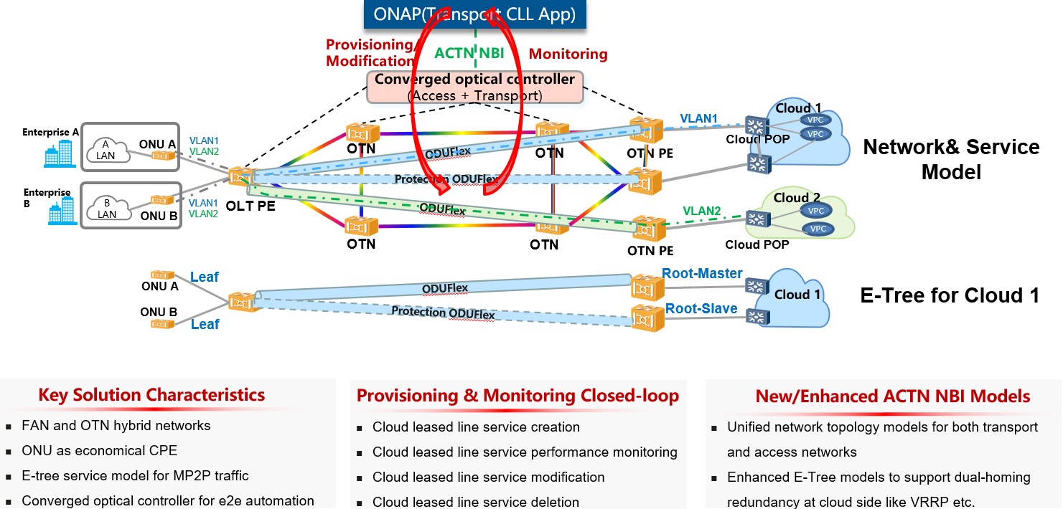
CCVPN Support for Cloud Leased Line (CLL)

Slide 9
Intent Fulfillment for Cloud leased line (CLL)
1
ONAP IBN
user
2
User expresses his/her intent (in natural language? )
IBN does Intent Translation and maps natural language into the parameters needed by the CLL definition model (i.e., Intent model of CLL)
IBN calls SO NBI passing intent model parameters
SO creates CLL definition model based on the input parameters
SO calls SDNC for CLL service provisioning
SDNC renders CLL definition model into implementation models and writes them into AAI
SDNC calls Domain Network Controllers, based on the implementation models, to configure the physical network
Intent-based API (technology agnostic)
3
SO
AAI
CLL definition model
ONAP Internal API
4
Intent Fulfillment call flow
5
CLL implementation models
SDNC
6
ACTN MPI
7
Domain network controllers
Physical network

Slide 10
CCVPN closed-loop design (based on ZSM 009)
Closed loop control flow contains the following stages:
M2A (monitoring): SDNC receives (or collects) telemetry and performance data from the domain network controllers, and forwards the data to DCAE
A2D (analysis): DCAE performs data analytics on the received data changes, and generates and sends the data insights to Policy
D2E (decision): Policy makes the decision on how to modify the existing services based on the data insights and calls SO to make service modification
E2M (execution): SO executes the service modification by instructing SDNC to apply new network configurations to domain controllers
D2E
decision
SO
Policy
AAI
A2D
analysis
E2M
execution
data
SDNC
DCAE
Service creation
Data collector
M2A
monitoring
Domain controllers

Slide 11
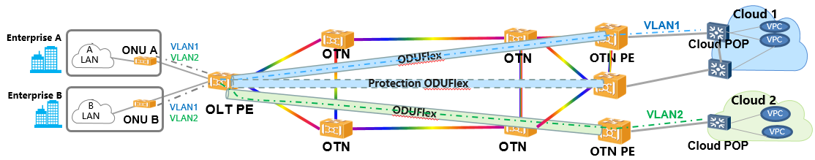
Putting together: Intent-based system for Cloud Leased Line usecase
IBN
Input/recognize
instantiate
“Outer” intent loop
report
verify
translate
control
intelligence
data collection
orchestration
analytics
“Inner” intent loop
CCVPN
Cloud leased line network configurations

Slide 12
Thanks!

Slide 13
Backup

Slide 14
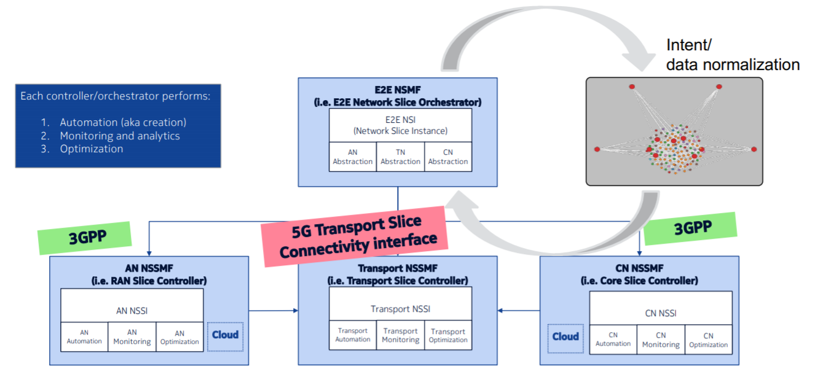
Applicability of Intent CCVPN: Network Slicing usecase
“E2E Network Slicing is too complex, transport part of it is a perfect candidate for intent based network”
ONAP IBN “outer” intent loop
CCVPN “inner” intent loop
https://www.itu.int/en/ITU-T/Workshops-and-Seminars/2019101416/Documents/Intent%20Based%20Networking%20the%20technology-ITU.pdf

