Slide 1
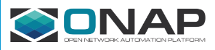
Illustrative Sequence Diagrams
for Residential Broadband vCPE Use Case

Slide 2
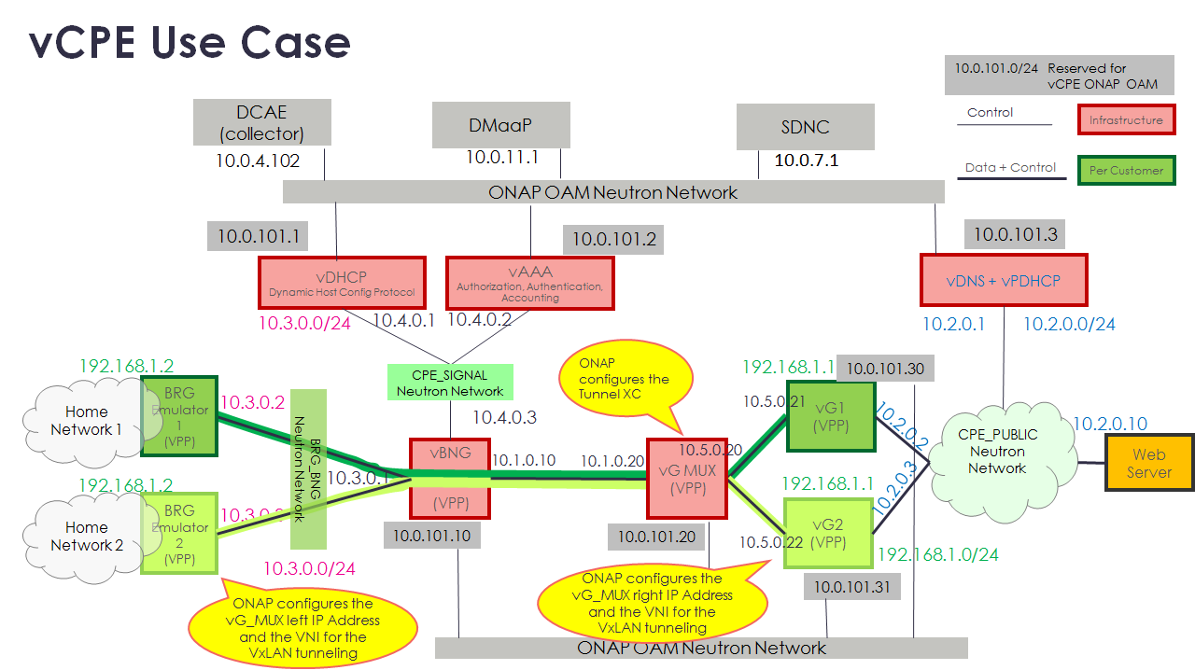
vCPE Use Case Used in These Examples

Slide 3
Residential Broadband vCPE Use Case Model: Infrastructure Flows
Note that in this table “_X” indicates applicability to both the “_HEAT” and “_TOSCA” approaches.
For simple Services which include only simple networks and VNFs (e.g., with no multi-data instances that map to different VF Modules), there is an SO “Generic Service” flow (“top level flow”) that calls the Generic VNF and/or the Generic Network resource-level flows. The SDNC functionality is also “generic” such that only modeling and configuration is needed to drive SDNC behavior for a specific VNF type. For example, this SDNC generic VNF flow can automatically assign the IP Addresses if pre-loaded. For “Generic VNF” the IP Addresses are pre-loaded. E.g., pre-load 25 vG instances with their assignments pre-populated. SDNC keeps track of which instances have/have not been assigned. It is expected that these SO and SDNC assets will be leveraged.
Service | Service Level Flow | Resource | Resource Level Flow | SDNC Northbound API | SDNC DG
vCpeCoreInfra_X | Generic Service | vCpeCoreInfraVnfs_X (VNF) | Generic VNF | GENERIC-RESOURCE | Generic DG
 | “ | CPE_PUBLIC (Network) | Generic Ntw | GENERIC-RESOURCE | Generic DG
 | “ | CPE_SIGNAL (Network) | Generic Ntw | GENERIC-RESOURCE | Generic DG
vGMuxInfra | Generic Service | vGMUX (VNF) | Generic VNF | GENERIC-RESOURCE | Generic DG
“ | “ | MUX_GW (Network) | Generic Ntw | GENERIC-RESOURCE | Generic DG
vBngInfra | Generic Service | vBNG (VNF) | Generic VNF | GENERIC-RESOURCE | Generic DG
 | “ | BRG_BNG (Network) | Generic Ntw | GENERIC-RESOURCE | Generic DG
BNG_MUX | Generic Service | BNG_MUX (Network) | Generic Ntw | GENERIC-RESOURCE | Generic DG
BRG_EMU | Generic Service | BRG_EMU (VNF) | Generic VNF | GENERIC-RESOURCE | Custom Process (Event Handling)
vCpeResCust | Custom [New] | TunnelXConn (AR) | Custom [New] | GENERIC-RESOURCE | Custom DG [New]
“ | “ | vG (VNF) | Custom [New] | GENERIC-RESOURCE | Generic DG
“ | “ | BRG (AR) | Custom [New] | GENERIC-RESOURCE | Custom DG [New]

Slide 4
Residential Broadband vCPE Use Case Model: vCpeResCust & vGMuxInfra Topology
TOSCA
HEAT
TunnelXConn AllottedResource:
Requirement:
TunnelXConnCapability
vCpeResCust Service:
topology_template:
node_templates:
TunnelXConn (AllotRes):
vG (VNF):
BRG (AllotRes):
vG VNF Resource:
vG (VFC)
vG VF Module:
BRG AllottedResource:
Requirement:
brg_pnf_capability
vGMuxInfra Service:
topology_template:
node_templates:
MUX_GW (Ntw):
vGMux (VNF)
Capabilities:
TunnelXConnCapability
BRG_EMU Service:
topology_template:
node_templates:
vBRG_EMU (VNF):
Capabilities:
brg_pnf_capability

Slide 5
Residential Broadband vCPE Use Case Model: vCpeResCust & vGMuxInfra Topology
TOSCA
HEAT
vGMuxInfra Service:
topology_template:
node_templates:
MUX_GW (Ntw):
vGMux (VNF)
Capabilities:
TunnelXConnCapability
MUX_GW Network Resource:
vGMUX VNF Resource:
vGMUX (VFC)
vGMUX VF Module:

Slide 6
Residential Broadband vCPE Use Case Model: BRG_EMU Topology (Use Case Only)
The BRG_EMU Service is an artificial construct to leverage ONAP to instantiate the BRG Emulator, which is implemented as a VNF in this Use Case. This Service would have no analogue in the “real world”.
TOSCA
HEAT
BRG_EMU Service:
topology_template:
node_templates:
vBRG_EMU (VNF):
Capabilities:
brg_pnf_capability
vBRG_EMU VNF Resource:
vBRG (VFC)
vBRG_EMU VF Module:
The vBRG_EMU VNF has no modeling relationship with the BRG Allotted Resource which is referenced in the vCpeResCust Service. The BRG Allotted Resource is designed to be useful in the “real world” in which a BRG is a true Allotted Resource, whereas the vBRG_EMU VNF is a construct that is useful only for standing up the BRG Emulator used in this Use Case.

Slide 7
Residential Broadband vCPE Use Case Model: vBngInfra and BNG_MUX Topology
TOSCA
HEAT
vBngInfra Service:
topology_template:
node_templates:
vBNG (VNF):
BRG_BNG (Network):
vBNG VNF Resource:
vBNG (VFC)
vBNG VF Module:
BRG_BNG Network Resource:
BNG_MUX Service:
topology_template:
node_templates:
BNG_MUX (Network):
BNG_MUX Network Resource:

Slide 8
Residential Broadband vCPE Use Case: vCpeCoreInfra Topology
CPE_PUBLIC_HEAT Network Resource
TOSCA
HEAT
vCpeCoreInfra_Heat Service:
topology_template:
node_templates:
CPE_PUBLIC:
CPE_SIGNAL:
vCpeCoreInfraVnfs_HEAT:
CPE_SIGNAL_HEAT Network Resource
vCpeCoreInfraVnfs_HEAT VNF Resource:
vCpeCoreInfraVnfs_H (VFC)
vCpeCoreInfraVnfs_H VF Module:
vDHCP (VM)
vAAA (VM)
vDNS+DHCP (VM)
CPE_PUBLIC_TOSCA Network Resource
TOSCA
HEAT
vCpeCoreInfra_Tosca Service:
topology_template:
node_templates:
CPE_PUBLIC:
CPE_SIGNAL:
vCpeCoreInfraVnfs_TOSCA:
CPE_SIGNAL_TOSCA Network Resource
vDHCP (VM)
vCpeCoreInfraVnfs_TOSCA VNF Resource:
vDHCP (VM)
vAAA (VM)
vDNS+DHCP (VM)
vAAA (VM)
vDNS+DHCP (VM)

Slide 9
Residential Broadband vCPE Use Case Model: Infrastructure Instantiation Sequencing
Manual sequencing via VID
Generic Service Flow [Existing]
vCpeCoreInfra_X Service:
topology_template:
node_templates:
CPE_PUBLIC:
CPE_SIGNAL :
vDNS+DHCP_X:
2
1
CPE_PUBLIC Ntw:
VID
Generic VNF
Flow [Existing]
3
CPE_SIGNAL Ntw:
Generic VNF
Flow [Existing]
4
vCpeCoreInfraVnfs_X VNF:
Generic VNF
Flow [Existing]
Generic Service Flow [Existing]
VID
5
BNG_MUX Service:
topology_template:
node_templates:
BNG_MUX:
6
BNG_MUX Ntw:
Generic Ntw
Flow [Existing]
As part of the “Assign” operation, SDNC assigns the “10.1” subnet to this network instance.

Slide 10
Residential Broadband vCPE Use Case Model: Infrastructure Instantiation Sequencing
In Release 1 this sequencing of the vGMuxInfra Resources will be accomplished via the Generic SO Service-Level which always instantiates Networks before VNFs.
Generic Service Flow [Existing]
7
vGMuxInfra Service:
topology_template:
node_templates:
MUX_GW (Network):
vGMux (VNF):
Robot
8
MUX_GW Ntw:
Generic Ntw
Flow [Existing]
9
vGMUX VNF:
Robot will remember…
Generic VNF
Flow [Existing]
As part of the “Assign” operation, SDNC assigns the “10.3” subnet to this network instance.
Generic Service Flow [Existing]
VID
10
vBngInfra Service:
topology_template:
node_templates:
BRG_BNG (Network):
vBNG (VNF):
11
BRG_BNG Ntw:
Generic Ntw
Flow [Existing]
12
vBNG VNF:
Generic VNF
Flow [Existing]
As part of the “Assign” operation, SDNC determines that the VNF must connect to two networks: BRG_BNG “10.3” and BNG_MUX “10.1”. It also assigns the IPs “10.3.0.1” and “10.1.0.10” at these networks. As part of the “Activate” operation, SDNC configures a static route between the 10.3 and the 10.1 subnets.

Slide 11
Residential Broadband vCPE Use Case Model: Instantiation Sequencing
Manual sequencing via VID
Service Level
(TOSCA)
VNF Level
(TOSCA)
Allotted Resource
(TOSCA)
BRG_EMU Service:
topology_template:
node_templates:
BRG_EMU (VNF):
Generic Service Flow [Existing]
VID
13
14
BRG_EMU VNF:
Generic VNF
Flow [Existing]
Robot is acting as a BSS emulator, and is kicked off automatically upon detecting that the BRG MAC Address has registered.
This sequencing of the vCpeResCust Resources will be accomplished via a custom vCpeResCust SO Service-Level workflow in Release 1. In Release 2+ we hope a generic Service-Level workflow can perform sequencing from dependencies modeled in SDC.
ROBOT
15
16
TunnelXConn AllottedResource:
Custom [New]
Custom [New]
vCpeResCust Service:
topology_template:
node_templates:
TunnelXConn (AllottedResource):
vG (VNF):
BRG (AllottedResource):
17
Depends On
vG VNF:
Generic VNF
Flow [Existing]
Depends On
18
BRG AllottedResource:
Custom [New]
vAAA VNF:
vDNS+DHCP VNF:

Slide 12
Residential Broadband vCPE Use Case Model: vCpeResCust & vGMuxInfra Inventory Instance Example
vG VF Module Instance
Instance “J”
vG VNF Instance
Instance “X”
vCpeResCust Service Instance
Instance “A”
TunnelXConn AllottedResource Instance
Instance “N”
BRG AllottedResource Instance
Instance “Y”
BRG_EMU Service Instance
Instance “A”
vGMuxInfra Service Instance
Instance “B”

Slide 13
Residential Broadband vCPE Use Case Model: BRG_EMU and vCpeCoreInfra Inventory Instance Example
vGMuxInfra Service Instance
Instance “B”
vGMUX VNF Instance
Instance “Z”
vGMUX VF Module Instance
Instance “K”
MUX_GW Network Instance
Instance “Z”
BRG_EMU Service Instance
Instance “A”
vBRG VNF Instance
Instance “U”
vBRG VF Module Instance
Instance “J”

Slide 14
Residential Broadband vCPE Use Case Model: BRG_EMU and vCpeCoreInfra Inventory Instance Example
vCpeCoreInfraVnfs_HEAT VNF Instance
Instance “X”
vCpeCoreInfraVnfs_HEAT VF Module Instance
Instance “L”
vCpeCoreInfra_HEAT Service Instance
Instance “C”
CPE_PUBLIC Network Instance
Instance “Y”
CPE_SIGNAL Network Instance
Instance “Z”
vCpeCoreInfraVnfs_TOSCA VNF Instance
Instance “X”
vCpeCoreInfra_TOSCA Service Instance
Instance “D”
CPE_PUBLIC Network Instance
Instance “Y”
No VF Modules on the TOSCA VNF.
CPE_SIGNAL Network Instance
Instance “Z”

Slide 15
Residential Broadband vCPE Use Case Model: vCpeResCust & vGMuxInfra Topology
vBNG VNF Instance
Instance “V”
vBNG VF Module Instance
Instance “K”
vBngInfra Service Instance
Instance “B”
BRG_BNG Layer 3 Network Instance
Instance “K”
BNG_MUX Service Instance
Instance “C”
BNG_MUX Layer 3 Network Instance
Instance “K”

Slide 16
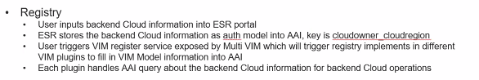
A&AI Detail Example
The Cloud Region object in A&AI is created via the ESR (A&AI) portal
Service Instance
“Upper Level”
Service Instance
“Lower Level”
Generic VNF
Generic
VF Module
Key:
Created by…
Tenant
vServer (VM)
- Hostname
L Interface
Auth Info
SO
Allotted Rsc Inst
IP Address List
Cloud Region
- Keystone Identity URL
ESR
Subnet
Multi-VIM
Multi-VIM plans to create the Tenant, Flavor, and Image objects in A&AI when a new VIM is instantiated.
Flavor
Image
L3 Network
MUX_GW Ntw
???
(and not critical for use case)
???
(but critical for use case)
“Cloud_Region” is a representation of a unique cloud instance which has geographical significance. Multi-VIM expects SO to pass the Cloud_Region Id in with the request along with the Keystone Identity URL.

Slide 17
Residential Broadband vCpeCoreInfra_X Data
The Generic Service flow doesn’t call “homing”. Rather it works off of separate (non-TOSCA) fielded attributes in the Svc Instantiation API for Cloud Configuration Data, which includes Cloud_Region and Cloud_Tenant.
As part of the Network-level “Assign” operation, SDNC assigns the network name and the “10.2” subnet to this network instance.
Service Level
Resource Level
2
VF Module Level (HEAT)
CPE_PUBLIC Network:
Input Attributes:
{NULL Set}
Assignable Attributes:
Subnet
1
Generic Service Flow [Existing]
vCpeCoreInfra_X Service:
topology_template:
node_templates:
CPE_PUBLIC (Network)
CPE_SIGNAL (Network)
vCpeCoreInfraVnfs_X (VNF)
Input Attributes:
{NULL Set}
vCpeCoreInfraVnfs _HEAT VF Module:
Input Attributes:
{NULL Set}
Assignable Attributes:
CPE_PUBLIC_IP
CPE_SIGNAL_IP_DHCP
CPE_SIGNAL_IP_AAA
OAM_IP_DHCP
OAM_IP_AAA
OAM_IP_DNSnDHCP
3
CPE_SIGNAL Network:
Input Attributes:
{NULL Set}
Assignable Attributes:
Subnet
4
As part of the Network-level “Assign” operation, SDNC assigns the network name and the “10.4” subnet to this network instance.
vCpeCoreInfraVnfs_X VNF:
Input Attributes:
{NULL Set}
Assignable Attributes:
Ext_Conn_Pt (CPE_PUBLIC)
Ext_Conn_Pt (CPE_SIGNAL)
Ext_Conn_Pt (ONAP_OAM)
Configuration Attributes:
{NULL Set}
As part of the VF Module-level “Assign” operation, SDNC assigns the IPs on each of the networks
As part of the VNF-level “Assign” operation, SDNC determines that this VNF must connect to three network types. There is no infrastructure-level configuration of the VNFs needed.

Slide 18
Residential Broadband vCPE Use Case Model: BRG_EMU Service Data Mappings
The Generic Service flow doesn’t call “homing”. Rather it works off of separate (non-TOSCA) fielded attributes in the Svc Instantiation API for Cloud Configuration Data, which includes Cloud_Region and Cloud_Tenant.
As part of the Network-level “Assign” operation, SDNC assigns the network name and the “10.1” subnet to this network instance.
Service Level
Resource Level
5
Generic Service Flow [Existing]
6
BNG_MUX Service:
topology_template:
node_templates:
BNG_MUX (Ntw):
Input Attributes:
{NULL Set}
BNG_MUX Network:
Input Attributes:
{NULL Set}
Assignable Attributes:
Subnet

Slide 19
Residential Broadband vCPE Use Case Model: vGMuxInfra Service Data Mappings
Service Level
As part of the Network-level “Assign” operation, SDNC assigns the “10.5” subnet to this network instance.
Resource Level
VF Module Level
8
As part of the VF Module-level “Assign” operation, SDNC assigns the IPs “10.1.0.20”, “10.5.0.20” and “10.0.101.20” on these three networks
The Generic Service flow doesn’t call “homing”. Rather it works off of separate (non-TOSCA) fielded attributes in the Svc Instantiation API for Cloud Configuration Data, which includes Cloud_Region and Cloud_Tenant.
MUX_GW Network:
Input Attributes:
{NULL Set}
Assignable Attributes:
Subnet
7
vGMUX VF Module:
Input Attributes:
{NULL Set}
Assignable Attributes:
vGMUX_WAN_IP (BNG_MUX)
vGMUX_LAN_IP (MUX_GW)
OA&M_IP (ONAP_OAM)
Generic Service Flow [Existing]
vGMuxInfra Service:
topology_template:
node_templates:
vGMux (vGMUX):
MUX_GW (Network):
Input Attributes:
{NULL Set}
9
vGMUX VNF:
Input Attributes:
{NULL Set}
Assignable Attributes:
Ext_Conn_Pt (BNG_MUX)
Ext_Conn_Pt (MUX_GW)
Ext_Conn_Pt (ONAP_OAM)
VNI Pool
Configuration Attributes:
{NULL Set}
As part of the VNF-level “Assign” operation, SDNC determines that the vGMUX must connect to three network types. SDNC assigns the network names for each. SDNC uses the TOSCA to determine that these connection points need to be assigned; SDNC returns a structure to SO, which SO maps to the HEAT. There is no infrastructure-level configuration of the vGMUX needed.

Slide 20
Residential Broadband vCPE Use Case Model: vBNG Service Data Mappings
Service Level
Resource Level
As part of the VF Module-level “Assign” operation, SDNC assigns the IPs “10.4.0.3”, “10.1.0.10”, “10.3.0.1”, and “10.0.101.10” to these networks, respectively.
As part of the Network-level “Assign” operation, SDNC assigns the “10.3” subnet to this network instance.
11
BRG_BNG Network:
Input Attributes:
{NULL Set}
Assignable Attributes:
Subnet
10
Generic Service Flow [Existing]
vBngInfra Service:
topology_template:
node_templates:
vBNG:
BRG_BNG
Input parameters:
{NULL Set}
vBNG VF Module:
Input Attributes:
{NULL Set}
Assignable Attributes:
CPE_SIGNAL_IP
BNG_WAN_IP
BRG_BNG_IP
OA&M_IP
The Generic Service flow doesn’t call “homing”. Rather it works off of separate (non-TOSCA) fielded attributes in the Svc Instantiation API for Cloud Configuration Data, which includes Cloud_Region and Cloud_Tenant.
12
vBNG VNF:
Input Attributes:
{NULL Set}
Assignable Attributes:
Ext_Conn_Pt (CPE_SIGNAL)
Ext_Conn_Pt (BNG_MUX)
Ext_Conn_Pt (BRG_BNG)
Ext_Conn_Pt (ONAP_OAM)
Configuration Attributes:
{NULL SET}
As part of the VNF-level “Assign” operation, SDNC determines that the vBNG must connect to four network types. SDNC assigns the network names for each. SDNC uses the TOSCA to determine that these connection points need to be assigned; SDNC returns a structure to SO, which SO maps to the HEAT. There is no infrastructure-level configuration of the vBNG needed.

Slide 21
Residential Broadband vCPE Use Case Model: BRG_EMU Service Data Mappings
The Generic Service flow doesn’t call “homing”. Rather it works off of separate (non-TOSCA) fielded attributes in the Svc Instantiation API for Cloud Configuration Data, which includes Cloud_Region and Cloud_Tenant.
The BRG_WAN_MAC_Address is communicated via the BRG HEAT.
Service Level
Resource Level
VF Module Level
13
Generic Service Flow [Existing]
BRG_EMU Service:
topology_template:
node_templates:
BRG_EMU (VNF):
Input Attributes:
BRG_WAN_MAC_Address
14
vBRG_EMU VF Module:
Input Attributes:
BRG_WAN_MAC_Address
Assignable Attributes:
{NULL SET}
vBRG_EMU VNF:
Input Attributes:
BRG_WAN_MAC_Address
Assignable Attributes:
Ext_Conn_Pt (BRG_BNG)
Configurable Attributes:
{NULL SET}
Mapped From
Mapped From
There is a feature in 1710 whereby the generic Service Level flow converts Service-Level Input Attributes into a MAP that is then sent as an input into every subtending building block (VNF level and VF Module level). We will rely on that feature. If for some reason that feature doesn’t make it into ONAP R1, we will depend on the “a la carte” method to instantiate the BRG_EMU Service, VNF, and VF Module. In an “a la carte” method, the MAC Address would only be on the VF Module level input.

Slide 22
Residential Broadband vCPE Use Case Model: vCpeResCust Input Data Mappings (R1)
Allotted Resource
As part of the VNF-level “Assign” operation, SDNC determines that the vG must connect to three network types. SDNC assigns the network names for each. SDNC also looks up the vGMUX_LAN_IP (10.5.0.20). SDNC will configure the vG_LAN_IP, VNI, and vGMUX_LAN_IP.
Service Level
16
TunnelXConn AllottedResource:
Input Attributes:
BRG_WAN_MAC_Address
Assignable Attributes:
VNI
vGMUX_LAN_IP
vGMUX_Bearer_IP
Configuration Attributes:
Xconn: {BRG_WAN_IP, VNI}
15
VNF Level
Custom [New]
17
vCpeResCust Service:
topology_template:
node_templates:
vG (VNF):
TunnelXConn (AllottedResource):
BRG (AllottedResource):
Input Attributes:
BRG_WAN_MAC_Address
vGMxuInfra_UUID
vGMux_Cloud_Region
Homing Attributes:
vGMuxInfra_UUID
vG VNF:
Input Attributes:
VNI
vGMUX_LAN_IP
Assignable Attributes:
Ext_Conn_Pt (CPE_PUBLIC)
Ext_Conn_Pt (MUX_GW)
Ext_Conn_Pt (ONAP_OAM)
Configuration Attributes:
vG_LAN_IP
VNI
vGMUX_LAN_IP
Mapped From
Mapped From
18
BRG AllottedResource:
Key:
BRG_WAN_MAC_Address
Input Attributes:
vGMUX_Bearer_IP
VNI
BRG_WAN_MAC_Address
Assignable Attributes:
{NULL Set}
Configuration Attributes:
vBRG_WAN_IP
VNI
vGMUX_Bearer_IP
Mapped From
Mapped From
Mapped From
The Input Data for the vCpeResCust Resources will be mapped by the custom vCpeResCust SO Service-Level workflow in Release 1. In Release 2+ we hope a generic Service-Level workflow can derive this data mapping from information contained in the SDC model.
VF Module Level
vG VF Module:
Input Attributes:
{NULL Set}
Assignable Attributes:
vG_LAN_IP (MUX_GW)
OA&M_IP (ONAP_OAM)
As part of the VF Module-level “Assign” operation, SDNC assigns the IPs “10.5.0.21” and “10.0.101.30” on these the MUX_GW and ONAP_OAM networks

Slide 23
Residential Broadband vCPE Use Case Model: vCpeResCust Input Data Mappings (R1)
Allotted Resource
As part of the VNF-level “Assign” operation, SDNC determines that the vG must connect to three network types. SDNC assigns the network names for each. SDNC also looks up the vGMUX_LAN_IP (10.5.0.20). SDNC will configure the vG_LAN_IP, VNI, and vGMUX_LAN_IP.
Service Level
16
TunnelXConn AllottedResource:
Input Attributes:
BRG_WAN_MAC_Address
Assignable Attributes:
VNI
vGMUX_LAN_IP
vGMUX_Bearer_IP
Configuration Attributes:
Xconn: {BRG_WAN_IP, VNI}
15
VNF Level
Custom [New]
17
vCpeResCust Service:
topology_template:
node_templates:
vG (VNF):
TunnelXConn (AllottedResource):
BRG (AllottedResource):
Input Attributes:
BRG_WAN_MAC_Address
Customer_Location
Homing Attributes:
Customer_Location
vG VNF:
Input Attributes:
VNI
vGMUX_LAN_IP
Assignable Attributes:
Ext_Conn_Pt (CPE_PUBLIC)
Ext_Conn_Pt (MUX_GW)
Ext_Conn_Pt (ONAP_OAM)
Configuration Attributes:
vG_LAN_IP
VNI
vGMUX_LAN_IP
Mapped From
Mapped From
18
BRG AllottedResource:
Key:
BRG_WAN_MAC_Address
Input Attributes:
vGMUX_Bearer_IP
VNI
BRG_WAN_MAC_Address
Assignable Attributes:
{NULL Set}
Configuration Attributes:
vBRG_WAN_IP
VNI
vGMUX_Bearer_IP
Mapped From
Mapped From
Mapped From
The Input Data for the vCpeResCust Resources will be mapped by the custom vCpeResCust SO Service-Level workflow in Release 1. In Release 2+ we hope a generic Service-Level workflow can derive this data mapping from information contained in the SDC model.
VF Module Level
vG VF Module:
Input Attributes:
{NULL Set}
Assignable Attributes:
vG_LAN_IP (MUX_GW)
OA&M_IP (ONAP_OAM)
As part of the VF Module-level “Assign” operation, SDNC assigns the IPs “10.5.0.21” and “10.0.101.30” on these the MUX_GW and ONAP_OAM networks

Slide 24
Residential Broadband vCPE Use Case Model: Homing Policies (Release 2)
vCpeResCust Service:
topology_template:
node_templates:
TunnelXConn (AllottedResource):
vG (VNF):
BRG (AllottedResource):
Homing_Policy: Latency {Customer_Location, TunnelXConn} < X ms
SDC should, in the future, be able to derive the “Homing Input” attributes for a given Service type by determining which homing policy variables have no defined source.
Homing_Policy: Affinity {TunnelXConn, vG} <Same Cloud Zone>

Slide 25
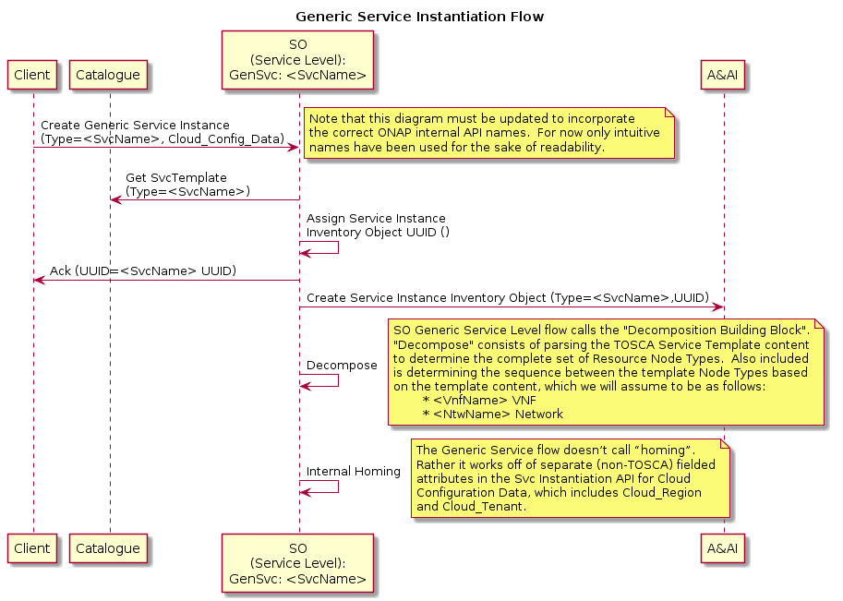
Generic
Service Level Processing

Slide 26
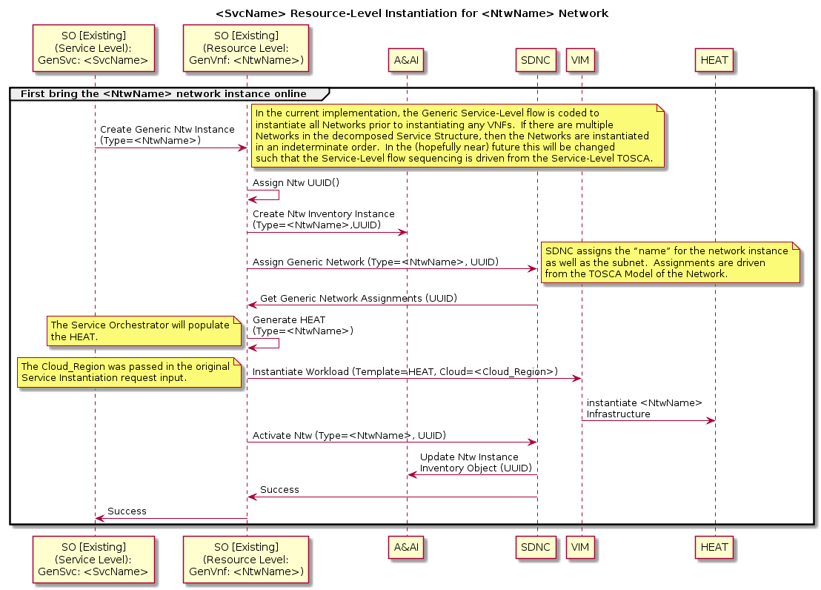
Generic
Resource Level Processing:
Networks

Slide 27
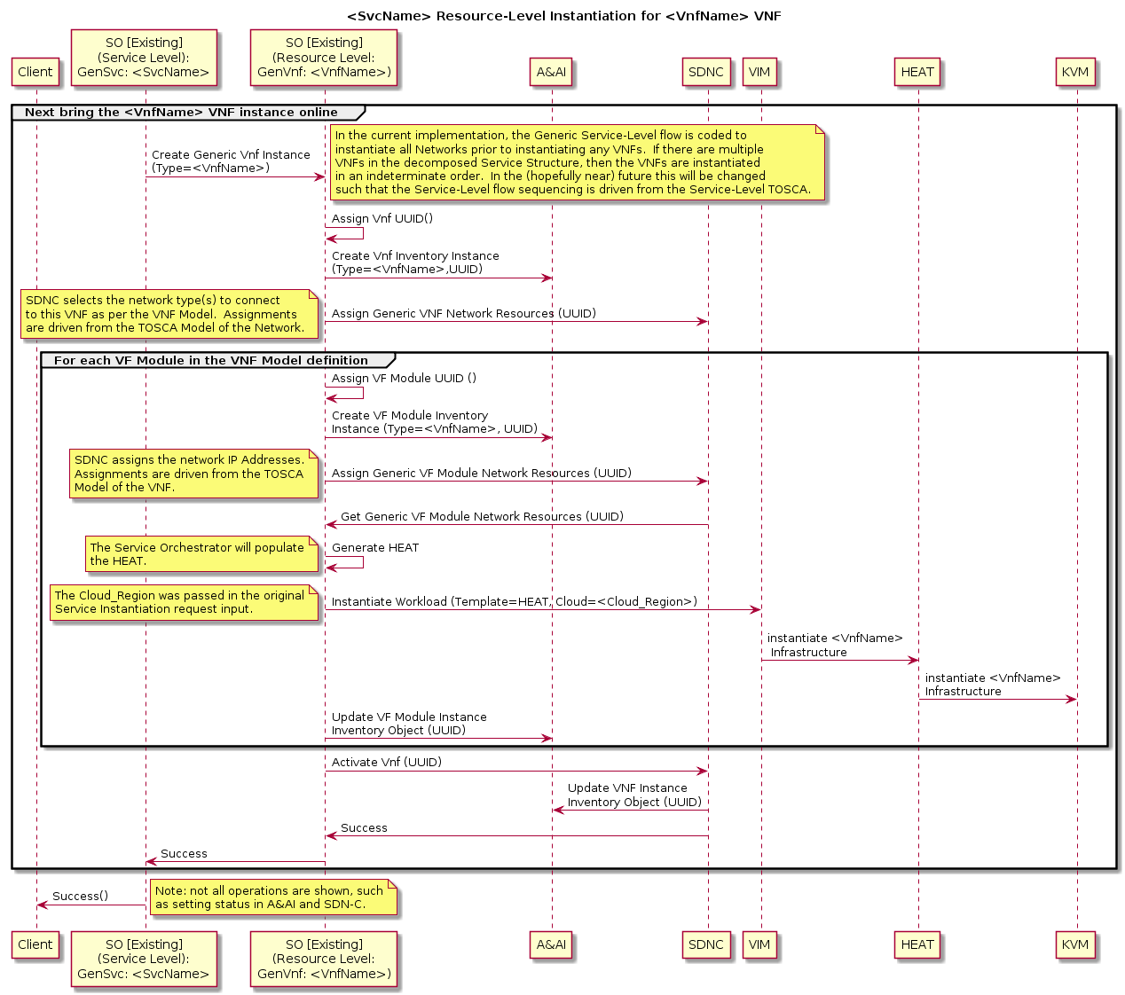
Generic
Resource Level Processing:
VNFs

Slide 28
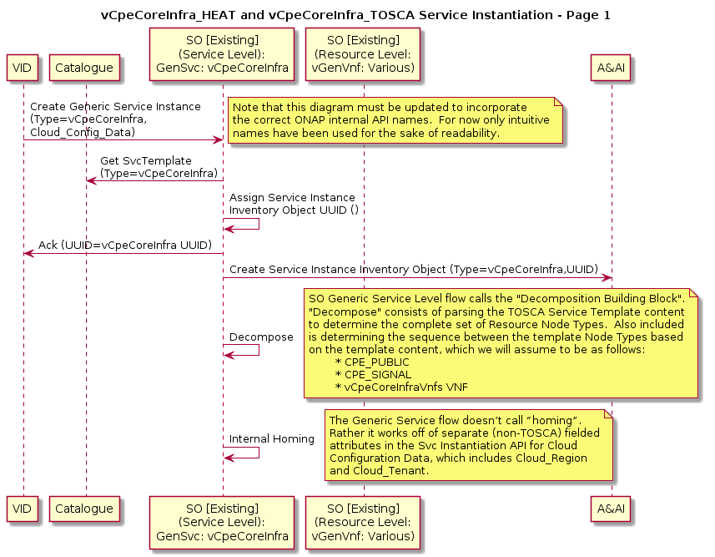
vCpeCoreInfra_HEAT
And
vCpeCoreInfra_TOSCA
Service Level Processing

Slide 29
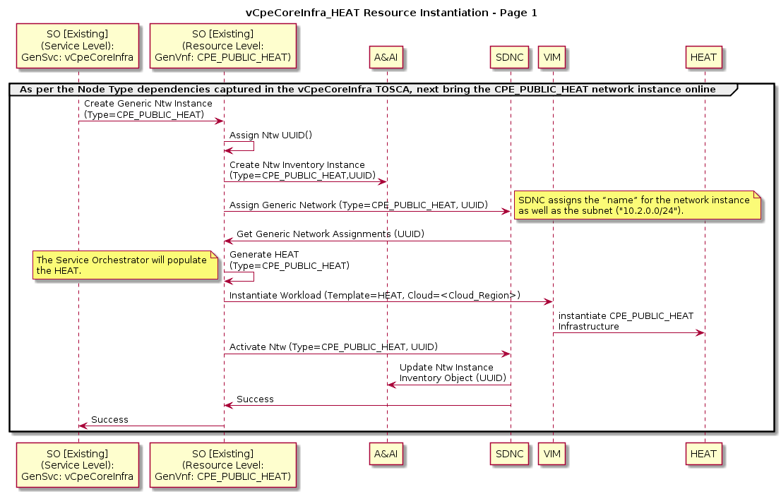
vCpeCoreInfra_HEAT Resource Level Processing
(CPE_PUBLIC_HEAT)

Slide 30
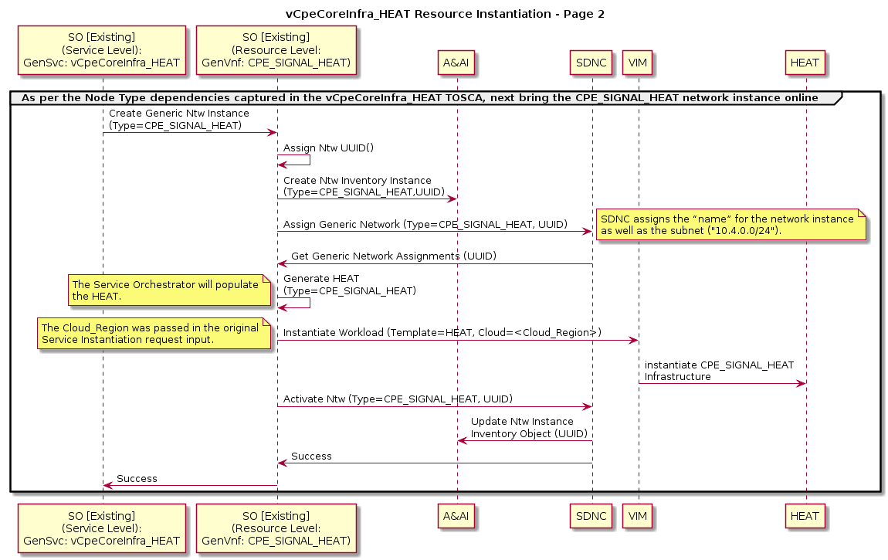
vCpeCoreInfra_HEAT Resource Level Processing
(CPE_SIGNAL_HEAT)

Slide 31
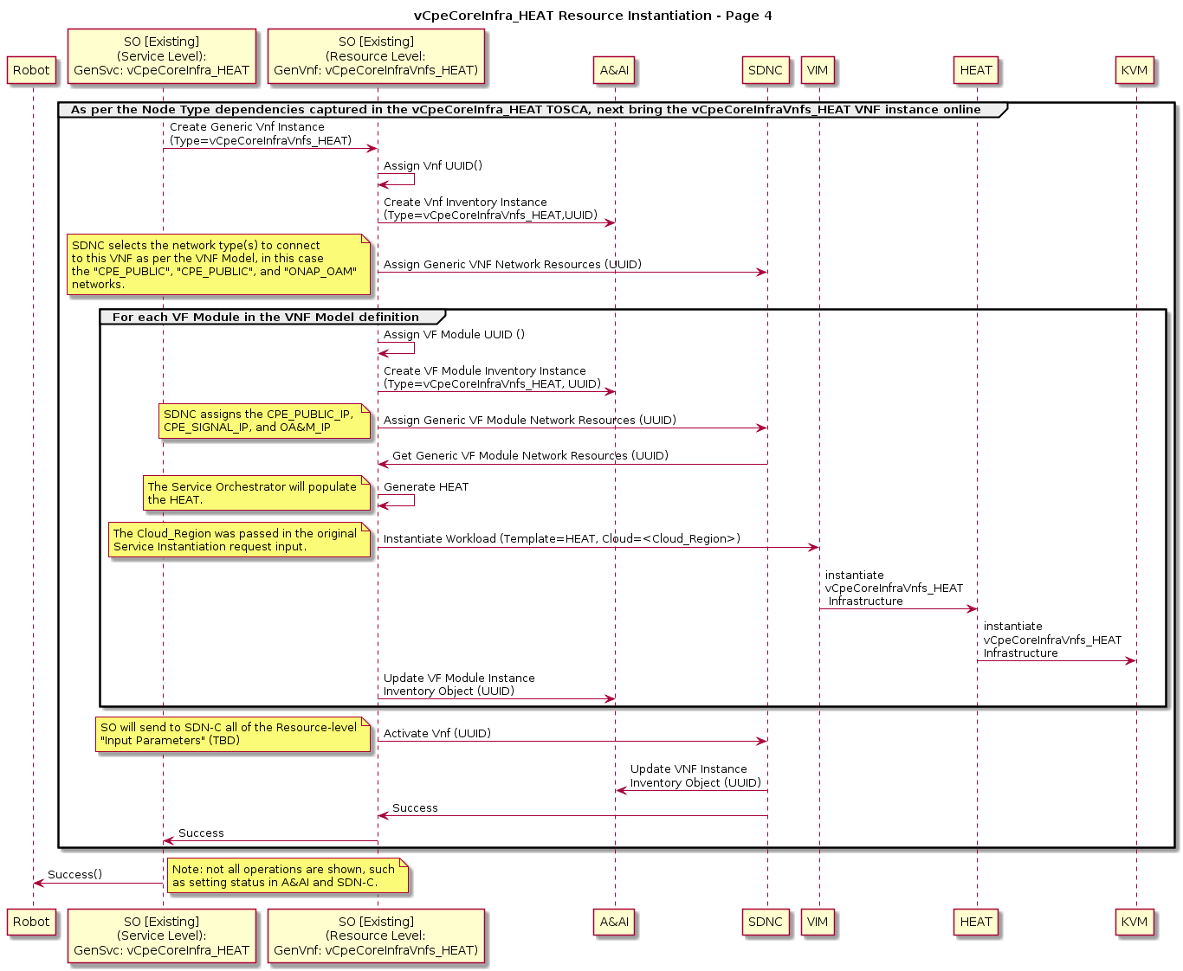
vCpeCoreInfra_HEAT Resource Level Processing
(vCpeCoreInfraVnfs_HEAT)

Slide 32
vCpeCoreInfra_TOSCA Resource Level Processing
(vCpeCoreInfraVnfs_TOSCA)
To incorporate ARIA option, need to show that the SO Adaptor determines from the SDC Model that the VNF is described using TOSCA versus HEAT. In the former case the Adaptor will generate a TOSCA document to forward to ARIA, rather than what is shown here.
Need to flesh out the interactions between HEAT and OS and ARIA and OS

Slide 33
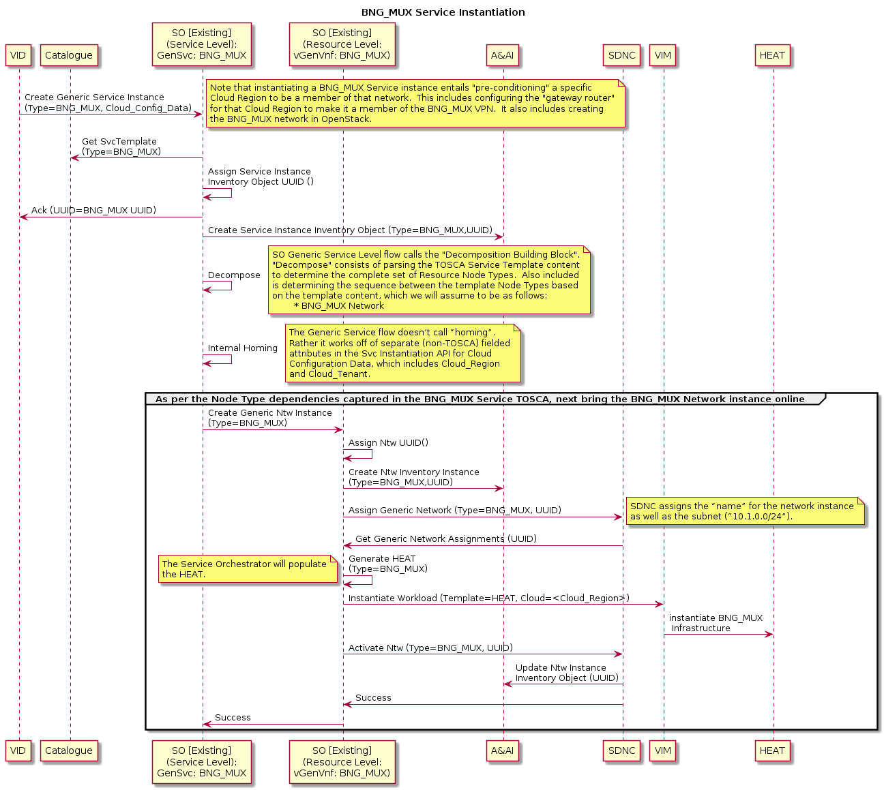
BNG_MUX Service and Resource Level Processing

Slide 34
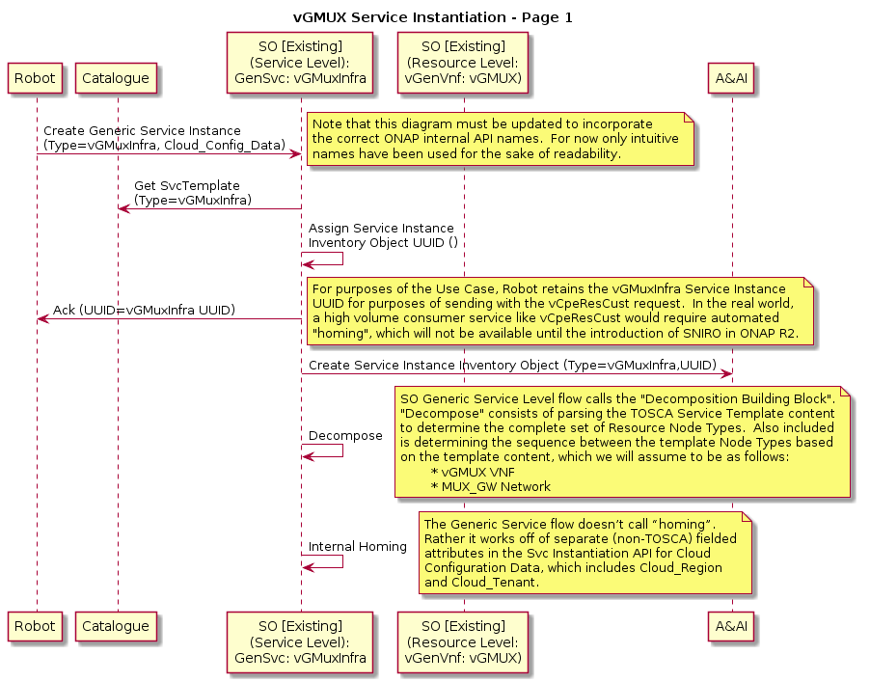
vGMuxInfra Service Level Processing

Slide 35
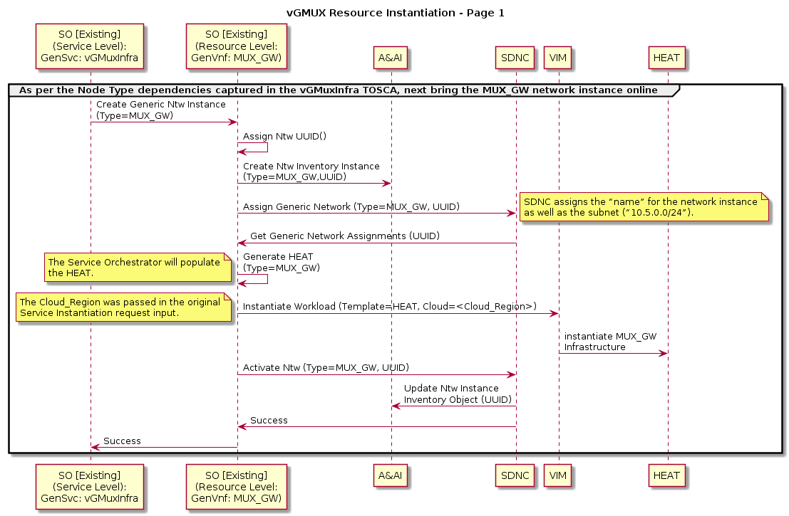
vGMuxInfra Resource Level Processing (MUX_GW Network)

Slide 36
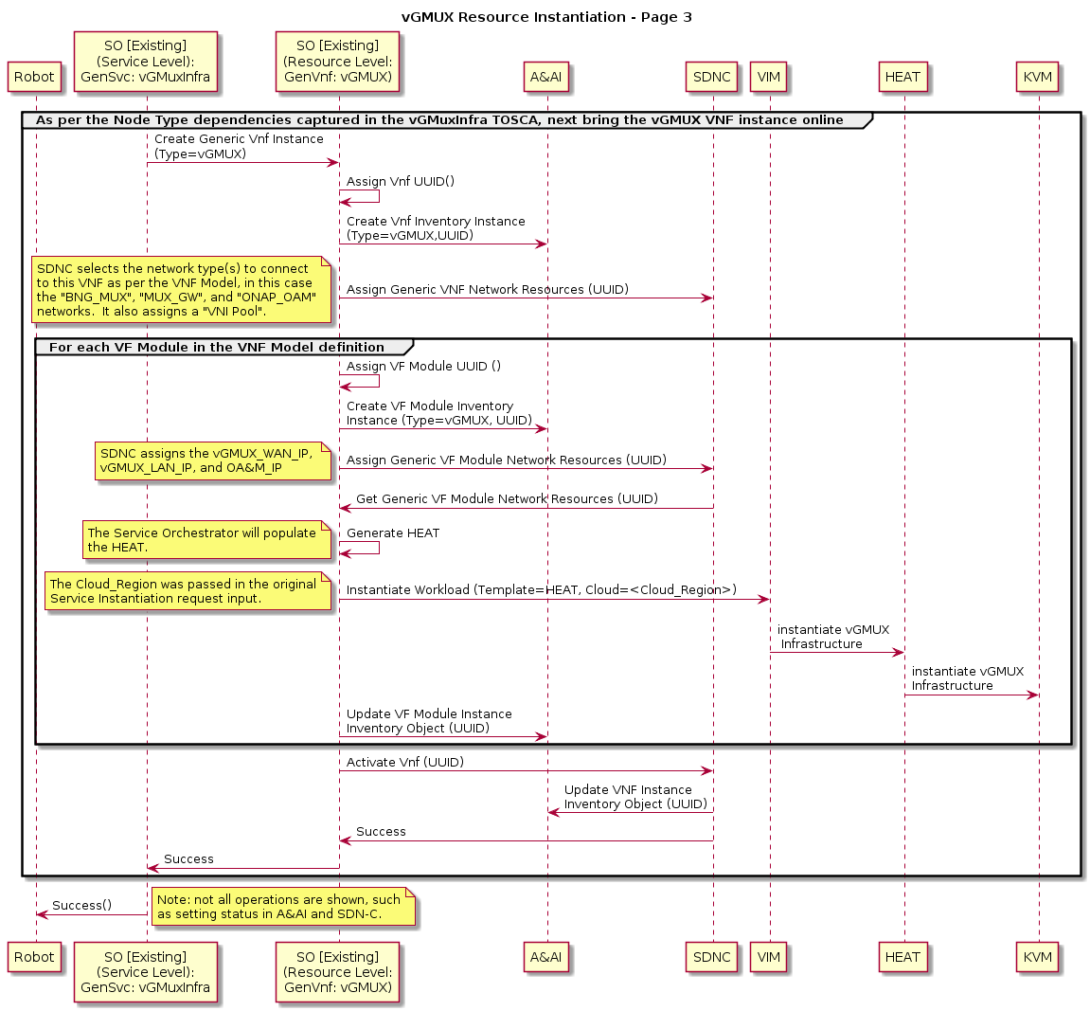
vGMuxInfra Resource Level Processing
(VNF)

Slide 37
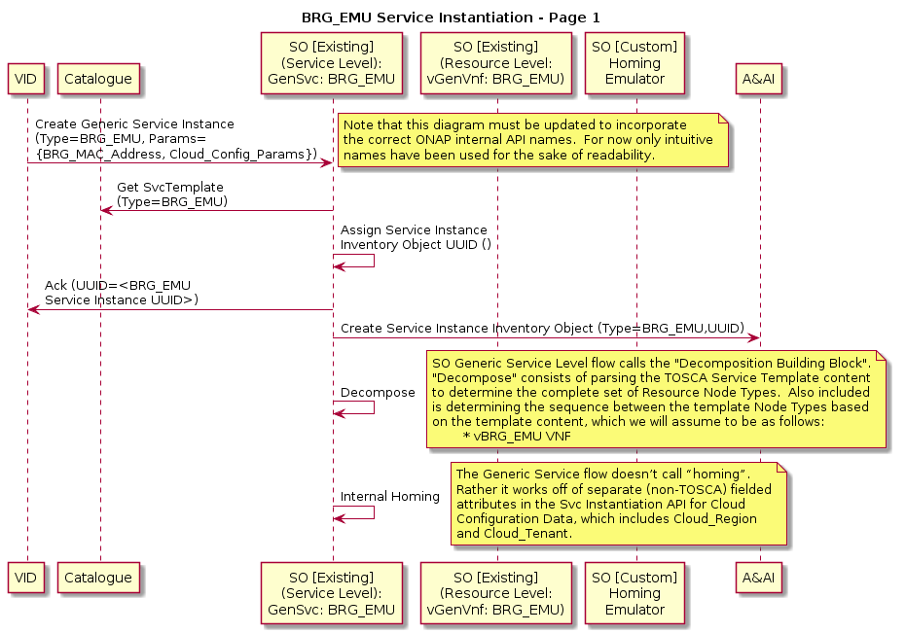
BRG_EMU Service Level Processing
Note that because the BRG_EMU Service is an artificial construct, this orchestration flow would have no analogue in the “real world”.

Slide 38
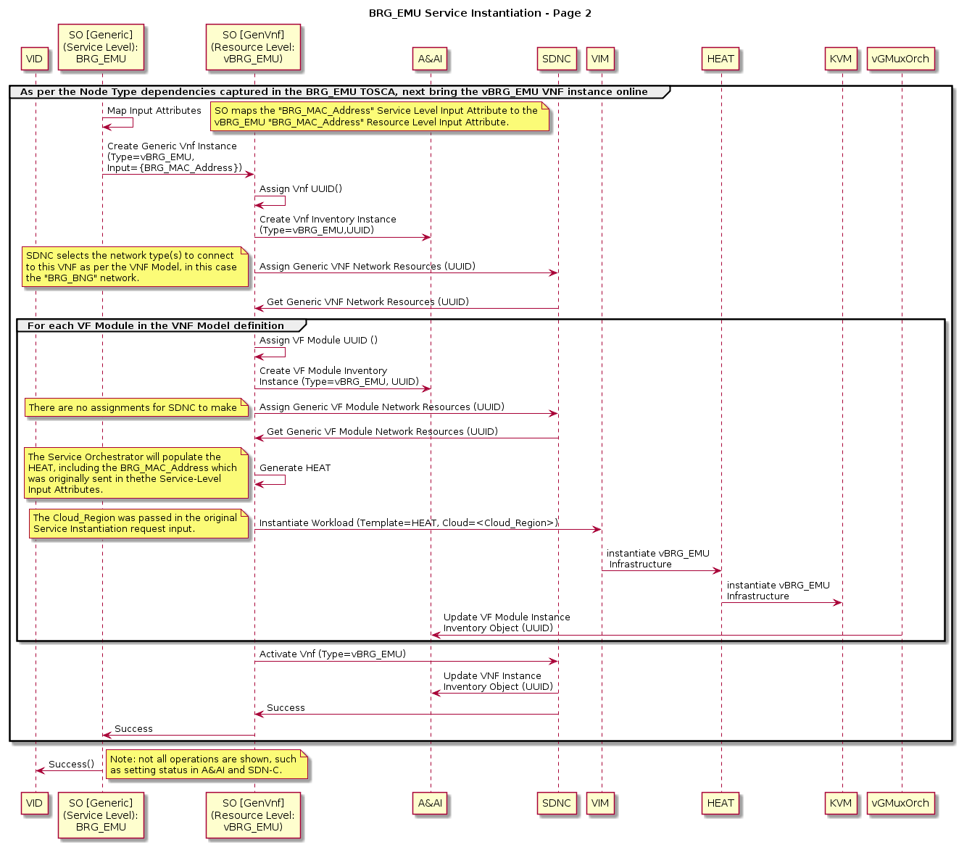
BRG_EMU Service Resource Level Processing

Slide 39
Assumptions
Once the BRG_EMU VNF Controller configures the vBRG_EMU VNF (see prior slide), that VNF will initiate DHCP interactions. This will result in an event being generated, which will be intercepted by the BRG Allotted Resource Controller. Note that the BRG_EMU VNF Controller shown in the prior sequence diagram is a *different* Controller function, and hence may be a different Controller instance, than the BRG Allotted Resource Controller which receives this event.
Being independent of each other, the vCpeResCust service instantiation request may be received in ONAP before the BRG Allotted Resource Controller receives this event notification, or it may be received after. The following sequence diagrams show both possibilities. However, in Release 1, only the latter will be supported.

Slide 40
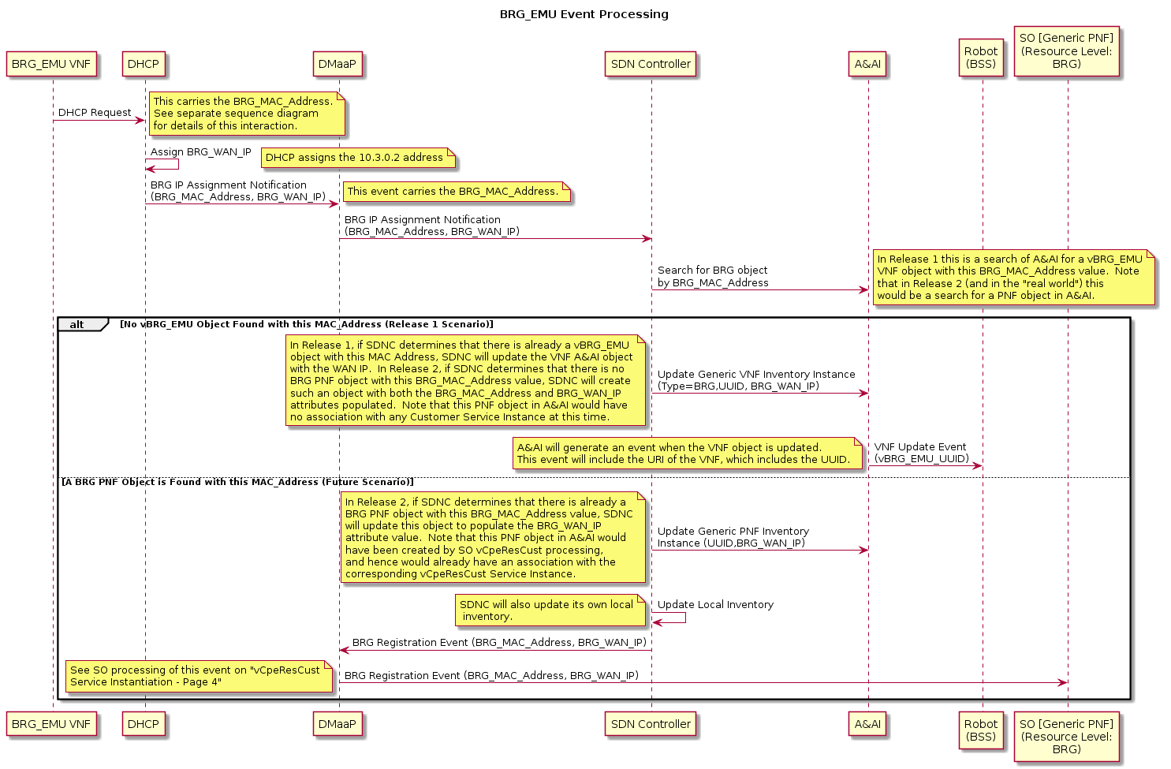
BRG_EMU Event Processing
In Release 1 Use Case we will support only this alternative.
We will defer this alternative until Release 2 or beyond.

Slide 41
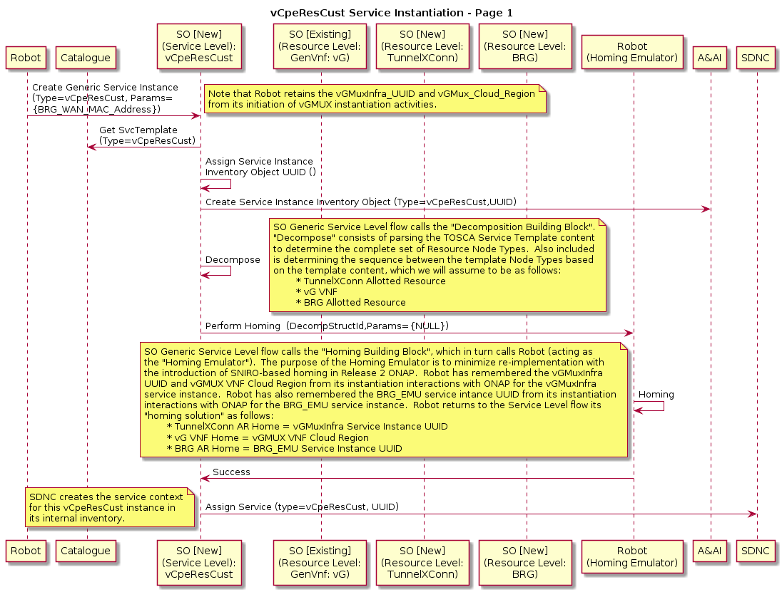
Release 1 View
vCpeResCust Service Level Processing
Because the vCpeResCust service involves an Allotted Resource, the generic Service Level (“top level”) SO flow will not support this Service. So in Release 1 we either need to extend the generic Service Level flow to support Allotted Resources or build a Custom flow for vCpeResCust.

Slide 42
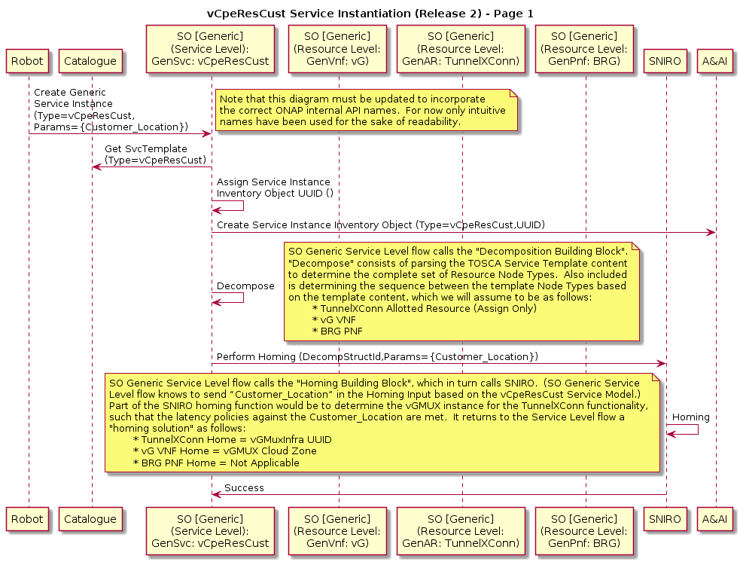
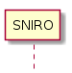
Release 2 View
vCpeResCust Service Level Processing
Aspirational goal: In Release 2 we will have support for a Generic Service-Level (“top level”) flow that handles both Allotted Resources and PNFs, as well as integration with SNIRO.

Slide 43
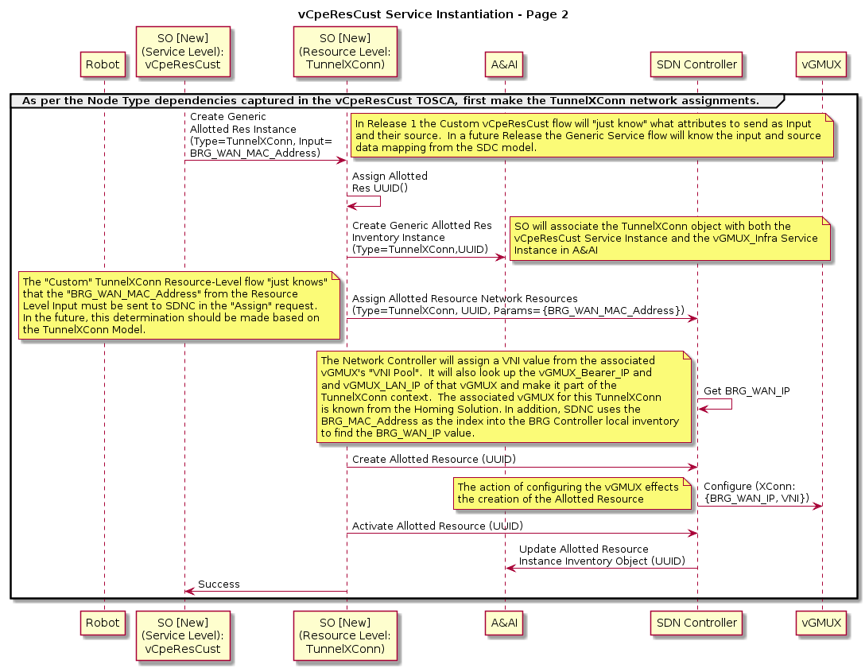
vCpeResCust Resource Level Processing:
TunnelXConn Allotted Resource

Slide 44
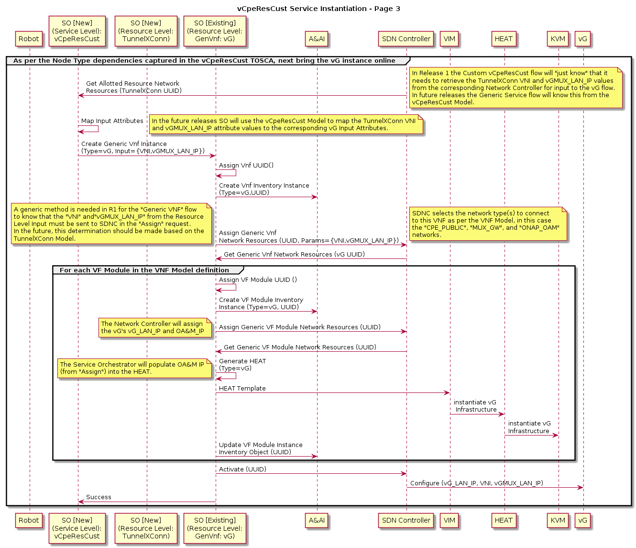
vCpeResCust Resource Level Processing:
vG VNF

Slide 45
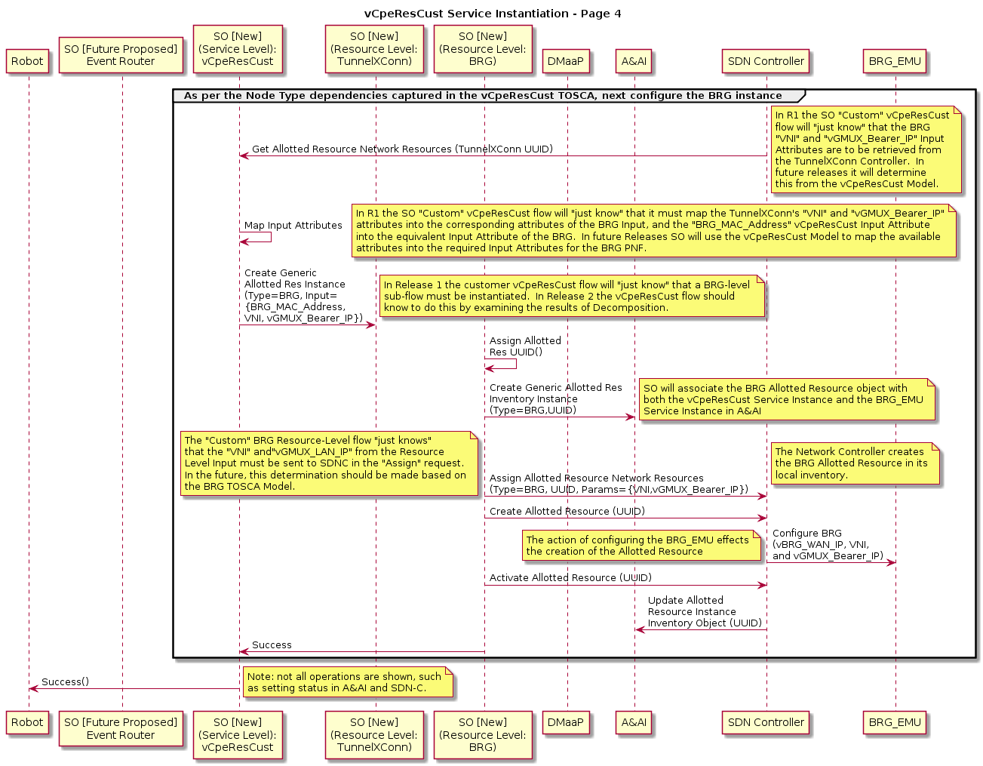
vCpeResCust Resource Level Processing:
BRG Allotted Resource
Future:
Add step to get monitoring in place at the Service and Resource level (via REST call)
Add step to get Security in place
Add step to notify turn up to Ops; need to define a REST call to an external system.

