Slide 1


ONAP 5G USE CASE ENHANCEMENTS FOR PNF DEPLOYMENTS
ONAP and 5G USE CASE Enhancements
PNF (Radio Network) Deployments
R3 CASABLANCA RELEASE
5G Use Case Team
Apr 05, 2018 version 3

Slide 2
ONAP PNF Plug and Play Enhancements
ONAP and PNF Plug and Play Enhancements
PNF (Radio Network) Deployments
For R3 Casablanca (and onwards)
5G Use Case Team
Apr 05, 2018 version 3

Slide 3
PNF PNP ENHANCEMENTS OVERVIEW
PNF PLUG AND PLAY ENHANCEMENTS OVERVIEW FOR CASABLANCA
Plug and Play enhancements – PNF registration handler (PRH) improvements
Plug and Play enhancements – Security Enhancements
Plug and Play enhancements – SO Workflow enhancements
Plug and Play enhancements – Modeling enhancements
Plug and Play enhancements – PNF Onboarding / PNF Package
Plug and Play enhancements – Service Configuration Enhancements

Slide 4

PNF PnP: PNF REGISTRATION HANDLER ENHANCEMENTS
DESCRIPTION
PNF Registration Handler (PRH) Enhancements.
(1) Stand-alone own domain – New PRH domain. In Beijing used an adder (Beijing work around). For Casablanca, we propose using a dedicated domain. VES separation of events.
(2) VES CONTENT - As a result, VES collector content will change with additional fields. VES may also be extended Physical PNF location.’
OVERVIEW
DMaaP
AAF
PROJECTS
PNF Registration Handler, AAF

Slide 5
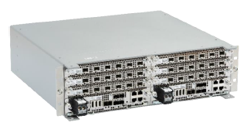

PNF PnP: SECURITY ENHANCEMENTS
DESCRIPTION
PNF AUTHENTICATION – VES authentication framework integrated. DCAE needs to authenticate the PNF.
VENDOR CERTIFICATES – Handling Vendor Certificates for TLS.
USER NAME & PASSWORDS – Provisioning. DCAE & PNF management of User Name & Passwords.
SECURITY BETWEEN COMPONENTS – DMaaP & PRH to authenticate w/ other ONAP components.
OVERVIEW
PNF
(DU)
PNF
Registration
Handler
26
PNF Discovery (VES Event) (periodic)
PNF ID, PNF IP@, Vendor Name
Event Collection
PROJECTS
PNF Registration Handler, DCAE, AAF, ONAP Controller, DMaaP

Slide 6
PNF PnP: SO WORKFLOW ENHANCEMENTS
DESCRIPTION
SO WORKFLOW ENHANCEMENTS – Dedicated 5G BTS Workflow in SO.
5G PNF WORKFLOW – Extensions to Beijing SO Workflow (part of VCPE workflow)
OVERVIEW
PROJECTS
PNF Registration Handler, DCAE

Slide 7
PNF PnP: MODELING ENHANCEMENTS
DESCRIPTION
PNF MODELING – Modeling enhancements to support 5G PNF in ONAP. Inheritance, and PNF characteristics for sharing. Focusing on PNF connectivity. PNF-SDK (from vendors). Modeling the Physical “Box” (PNF).
OVERVIEW
Notes:
1) EXTERNALS - Not trying to model the internals of PNFs. What is exposed by the box is what is modeled.
2) INTERRELATIONS - Focus on relations of PNFs/VNFs. Interworking between PNFs/VNFs.
3) VISIBILITY - CP/UP visibility
Not M-Plane (as this is 3GPP standardized)
4) MODELING ANALYSIS - Modeling activity to assess PNF, and check SDC model is sufficient to cover Casa use cases if additional parameters need to be added (e.g. relations between other NFs). Expanding the “Release 0 model” for Casa. PNF type vs PNF instance. Design-time vs Run-time model.
PROJECTS
SDC, CDT

Slide 8
PNF PnP: PNF ONBOARDING / PNF PACKAGE
DESCRIPTION
PNF Onboarding and PNF Package
PNF PACKAGE DEFINITION – Defining PNF Onboarding Package. Extending framework to work with PNFs. Defining Package framework.
  PNF ARTIFACTS DEFINITION – Vendor specific/provided artifacts to add to the (new PNF) package.
  PNF ARTIFACTS DISTRIBUTION
OVERVIEW
PROJECTS:
SDC, APP-C

Slide 9

PNF PnP: SERVICE CONFIGURATION ENHANCEMENTS
DESCRIPTION
(1) Service configuration Enhancements to ONAP Controller to PNF service configuration exchange with PNF. Better definition around the Protocols supported (and/or support more protocols).
What ONAP controller supports what PNF
And what protocols are supported.
(2) Configuration Extensions – New parameters needed for Casablanca use cases. Vid script to pushing data, ID config, ID where data comes from. Generic configuration support.
(3) PNF PnP Config – Finishing PNF PnP by sending down config data.
OVERVIEW
PNF
(DU)
ONAP
Controller
Ansible (SSH), NetConf, Chef
37
Service Configuration
(Config Param, Location) – Optional
Transport Configuration
ONAP communicates to PNF in
approved protocol (Ansible, NetConf, Chef)
Template defines Protocol
PROJECTS
PNF Registration Handler, ONAP Controller VID

Slide 10
5G USE CASE: OPTIMIZATION
ONAP and Event Collection
PNF (Radio Network) Deployments
5G Use Case Team
Apr 05, 2018 version 3

Slide 11
EVENT COLLECTION OVERVIEW
VNF & PNF EVENT COLLECTION OVERVIEW FOR CASABLANCA
FAULT MANAGEMENT
PERFORMANCE MANAGEMENT
HIGH-VOLUME DATA COLLECTION

Slide 12

EVENT COLLECTION – PERFORMANCE MANAGEMENT
DESCRIPTION
Events Collection with ONAP. Development and evolution of event collection through VES collector.
Forms basis of Performance Measurements collection through ONAP.
COLLECTION MECHANISM – How will data be moved to ONAP in RAN domain.
VOLUMETRICS – Volume of data.
OVERVIEW
ONAP
DMaaP
VES Collector
VES Agent
PNF
PROJECTS
DCAE, DMaaP, VES

Slide 13
EVENT COLLECTION – HIGH VOLUME COLLECTION
DESCRIPTION
High Volume Data Event Collection
COLLECTION MECHANISM – How will data be moved to ONAP in RAN domain vis-à-vis high volume events (for streaming)
STREAMING MANAGEMENT – Topics related to high volume management. VES Streaming collector.
VOLUMETRICS – Volume of data.
OVERVIEW
ONAP
DMaaP
VES Collector
VES Agent
PNF
RESP. Generic collector.
Sync/Async/Stream.
DMaaP/Kafka DDS or bus
Keep collectors agnostic from data distribution bus
Streaming collector in VES.
PROJECTS
DCAE, DMaaP, VES

Slide 14
ONAP PNF Deployment & Management
ONAP and PNF Deployment & Management
PNF (Radio Network) Deployments
5G Use Case Team
Apr 05, 2018 version 3

Slide 15
ENHANCEMENTS OVERVIEW
CASABLANCA ENHANCEMENTS OVERVIEW FOR CASABLANCA
CDT Integration to SDC
PNF Software Version Checking
Application Level Configuration
Life-Cycle Management Support
Edge Cloud Support
Mobility Edge VNF CU Integration
PNF Configuration Management

Slide 16
INTEGRATED CDT
DESCRIPTION
Next Generation Configuration Design Tool (CDT) which provides a GUI to build artifacts to be used by APP-C (using Tosca models) to configure Templates. However, this duplicates (in principle) the function of SDC.
This effort would integrate CDT (used by APP-C today) into SDC [for General Development]. The result would be an Integrated design tool for configuration design for 5G NEs.
Extend to allow use with any controller persona
OVERVIEW
CDT
SDC
PROJECTS:
SDC, APP-C

Slide 17
PNF S/W VERSION CHECKING
DESCRIPTION
Check version of PNF S/W Version
Reporting S/W version transmittable across ONAP controller & A&AI.
Demonstrate the S/W version has been updated in A&AI.
OVERVIEW
PROJECTS
A&AI, SDC, APP-C/SDN-C/R, DCAE/DMaaP
VNF-SDK

Slide 18
APPLICATION LEVEL CONFIGURATION
DESCRIPTION
SDN-R adaptation of SDN-C for PNFs (RAN Controllers).
“ONAP controller” (SDN-R vs APP-C) [Unified generic controller for wireless mobility]
SDN-R and PNF. [Currently supports NetConf-Yang]
Support Ansible API to configure PNF
Support full application level configuration & Ansible, allow various mobile network elements to be controlled from same controller persona created from CC-SDK.
Persona to control/create 5G PNFs.
OVERVIEW
PROJECTS
SDN-R, SDN-C, APP-C, CC-SDK

Slide 19
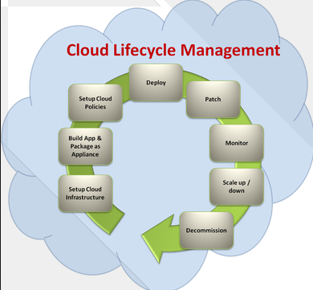
LIFE CYCLE MANAGEMENT FUNCTIONS
DESCRIPTION
Add lifecycle management functions to controller persona
Plan, setup, Build, Test, Deploy, Monitor, Manage, Meter, Charge, Optimize
Health Check, Software Upgrade
Setup, Build, Policies, Deploy, Patch, Monitor, Scaleup/Scale down
MULTI-RELEASE EFFORT
OVERVIEW
PROJECTS
SDC

Slide 20



EDGE CLOUD SUPPORT
DESCRIPTION
Support for deploying mobility virtual network element (e.g. CU) at the Edge Locations
MULTI-RELEASE EFFORT
OVERVIEW
RAN Network Elements
CU-CP-H
Antenna
CU
DU
CU-CP-L
RU
DU
CU-UP
Edge
Cloud
CPRI
Back Haul
PROJECTS

Slide 21
MOBILITY EDGE VNF (CU) INTEGRATION
DESCRIPTION
Support for deploying mobility virtual network element (e.g. CU) at the Edge Locations
MULTI-RELEASE EFFORT
OVERVIEW
RAN Network Elements
CU-CP-H
Antenna
CU
DU
CU-CP-L
RU
DU
CU-UP
Edge
Cloud
CPRI
Back Haul
PROJECTS

Slide 22
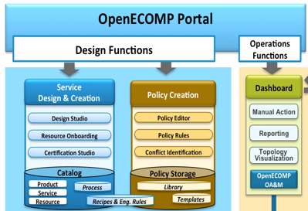

CHANGE AND CONFIGURATION MANAGEMENT
DESCRIPTION
Pre-provisioning with VID. Bulk Provision a 1000 PNFs. O&M IP@, model, configuration, radio parameters. Modeling for PNFs.
MULTI-RELEASE EFFORT
OVERVIEW
ONAP
Parameter
Configuration
APP-C
PROJECTS
A&AI, SDC, APP-C/SDN-C/R, DCAE/DMaaP, VID

Slide 23
ONAP PNF Deployment
PROJECT IMPACTS
ONAP and PNF Deployment Requirements for 5G RAN
For Casablanca (R3) Release
5G Use Case Team
Mar 23, 2018 version 1

Slide 24
PNF DEPLOYMENT – A&AI IMPACTS

Slide 25
PNF DEPLOYMENT – DCAE IMPACTS

Slide 26
PNF DEPLOYMENT – SO (Service Orchestrator) IMPACTS

Slide 27
PNF DEPLOYMENT – SDC IMPACTS

Slide 28
PNF DEPLOYMENT – VID IMPACTS

Slide 29
ONAP PNF Deployment
INTEGRATION AND SHOWCASING
ONAP and PNF Deployment Requirements for 5G RAN
For Casablanca (R3) Release
5G Use Case Team
Mar 23, 2018 version 1

Slide 30


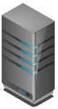





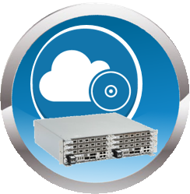
PNF DEPLOYMENT – INTEGRATION & SHOWCASING
VID, CLAMP, CDT
A&AI UI
2
VPN
3
ONAP PORTAL
User/Login ONAP
3
ONAP SERVERS
AT&T (T-Lab) / Intel Windriver lab
ONAP ECOSYSTEM (VMs)
R2 Beijing Release of ONAP
SDC – Configuration Templates
PNF Plug and Play Use Case
Robot VM
Mock server to control Provider Edge Router.
WAN Controller
PNF Registration Handler (PRH)
4
1
CONFIGURATION
SDC Templates
6
RECORDING
Recording stored
5
DU EMULATOR
DU (PNF) Emulator
(in ONAP Software)
In Casablanca may be using a real DU/PNF

Slide 31
PNF DEPLOYMENT – INTEGRATION & SHOWCASING
STEP | DESCRIPTION
1 | CONFIGURATION – SDC Design templates need to be configured in preparation of the Demo & Showcasing. The appropriate PNF and VNF designs are designed, validated and exported to the other components of ONAP.
2 | PORTAL & GUIS – The ONAP Portal is used to access the appropriate GUIs and interfaces necessary to operate and configure ONAP. The VID and CLMAP GUI are used to configure the appropriate information for the showcase. The A&AI GUI are used to show the created entries in A&AI for the PNF.
3 | VPN – The appropriate security gateways and/or VPN networks are configured. The appropriate security setups are authenticated against. Passwords and IP addresses that are needed to connect to the ONAP servers go through this VPN or security gateway (as appropriate) ONAP SERVERS – The ONAP Servers that host the ONAP ecosystem are connected to
4 | ONAP ECOSYSTEM (VM) – The ONAP ecosystem has all of the appropriate Virtual Machines necessary to operate. This has the R2 Beijing Release of ONAP. All of the PNF Plug and Play Use Case updated software is available in the ONAP Ecosystem. The Robot VM, Mock server to control Provider Edge Router, and WAN Controller are established. The PNF Registration Handler a new DCAE plug-in are available in this ONAP ecosystem which is used to register the PNF into ONAP.
5 | DU EMULATOR – The DU Emulator is used to emulate the responses and connection to ONAP. The DU emulator establishes a VES HTTPS connection with the PRH during the registration process and receives a APP-C response back via ansible.
6 | RECORDING – A recording is made of the showcase and demo for later upload/download and playback for demonstration purposes.

Slide 32
ONAP PNF Deployment
APPENDIX
ONAP and PNF Deployment Requirements for 5G RAN
For Casablanca (R3) Release
5G Use Case Team
Mar 23, 2018 version 1

Slide 33
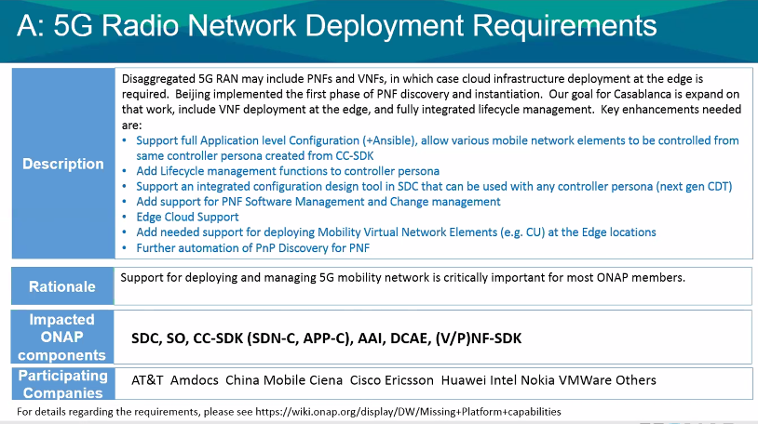

Slide 34
Apr 5, 2018
QUESTION – PNF Heart-beating (after PnP/Registration). Monitoring.
Updates to A&AI if PNF goes off-line.
VNF-SDK (package from vendors) wanted PNF-SDK a package the describes what
Can be done, what ONAP should do w/ the PNF.
Generic vs Vendor added PNF onboarding Package. Onboard a Generic PNF w/ a “generic PNF onboarding package.
Topic: Licensing PNF S/W. (Post Casablanca – Future)
Topic: Fault Management/Alarms, State-Stateful events.

Slide 35
POST CASABLANCA
ONAP and PNF Deployment Requirements for 5G RAN
For Casablanca (R3) Release
5G Use Case Team
Mar 23, 2018 version 1

Slide 36


SOFTWARE MANAGEMENT
DESCRIPTION
ONAP Integrated PNF software management and change management could be a long-term goal. In R3 Casablanca release, as a simple first step the software load for one PNF could be managed within a repository, but not actually downloaded to a PNF.
MULTI-RELEASE EFFORT
OVERVIEW
ONAP
Version checking
S/W upgrade
(Data Storage)
PNF Software Packages
PROJECTS
A&AI, SDC, APP-C/SDN-C/R, DCAE/DMaaP
VNF-SDK

