Slide 1


ONAP 5G USE CASE ENHANCEMENTS FOR PNF DEPLOYMENTS
ONAP and 5G USE CASE Enhancements
PNF (Radio Network) Deployments
R3 CASABLANCA RELEASE
5G Use Case Team
Apr 13, 2018 version 4

Slide 2
ONAP PNF Plug and Play Enhancements
ONAP and PNF Plug and Play Enhancements
PNF (Radio Network) Deployments
For R3 Casablanca (and onwards)
5G Use Case Team
Apr 13, 2018 version 4

Slide 3

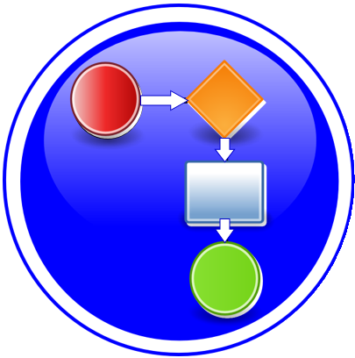




PNF PNP ENHANCEMENTS OVERVIEW
TOPIC | ICON | DESCRIPTION
PNF Registration Handler (PRH) Improvements |  | New VES Event domain for PNF registration with corresponding support in VES collector, DMaaP and PRH.
SO Workflow enhancements |  | Introduction of dedicated 5G use case work-flow
Service Configuration Improvement |  | Service configuration improvements from APP-C/SDN-R to PNF after PNF registration to PRH
Security Enhancements |  | Authentication, Certificates, User name & password and intra-ONAP security.
Modeling enhancements |  | Modeling enhancements to support 5G PNF in ONAP. Inheritance, and PNF characteristics for sharing. Focusing on PNF connectivity. PNF-SDK.
PNF Onboarding / Package |  | Defining PNF Onboarding Package. Extending framework to work with PNFs. Defining PNF Package framework.

Slide 4

PNF PnP: PNF REGISTRATION HANDLER ENHANCEMENTS
DESCRIPTION
PNF Registration Handler (PRH) Enhancements.
(1) Stand-alone own domain – New PRH domain. In Beijing used an adder (Beijing work around). For Casablanca, we propose using a dedicated domain. VES separation of events.
(2) VES CONTENT - As a result, VES collector content will change with additional fields. VES may also be extended Physical PNF location.’
OVERVIEW
DMaaP
AAF
PROJECTS
PNF Registration Handler, AAF

Slide 5
PNF PnP: SO WORKFLOW ENHANCEMENTS
DESCRIPTION
SO WORKFLOW ENHANCEMENTS – Dedicated 5G BTS Workflow in SO.
5G PNF WORKFLOW – Extensions to Beijing SO Workflow (part of VCPE workflow)
OVERVIEW
PROJECTS
PNF Registration Handler, DCAE

Slide 6
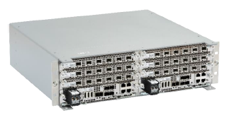

PNF PnP: SERVICE CONFIGURATION ENHANCEMENTS
DESCRIPTION
(1) Service configuration Enhancements to ONAP Controller to PNF service configuration exchange with PNF. Better definition around the Protocols supported (and/or support more protocols).
What ONAP controller supports what PNF
And what protocols are supported.
(2) Configuration Extensions – New parameters needed for Casablanca use cases. Vid script to pushing data, ID config, ID where data comes from. Generic configuration support.
(3) PNF PnP Config – Finishing PNF PnP by sending down config data.
OVERVIEW
PNF
(DU)
ONAP
Controller
Ansible (SSH), NetConf, Chef
37
Service Configuration
(Config Param, Location) – Optional
Transport Configuration
ONAP communicates to PNF in
approved protocol (Ansible, NetConf, Chef)
Template defines Protocol
PROJECTS
PNF Registration Handler, ONAP Controller VID

Slide 7

PNF PnP: SECURITY ENHANCEMENTS
DESCRIPTION
PNF AUTHENTICATION – VES authentication framework integrated. DCAE needs to authenticate the PNF.
VENDOR CERTIFICATES – Handling Vendor Certificates for TLS/SSH for PNFs.
USER NAME & PASSWORDS – Provisioning. DCAE & PNF management of User Name & Passwords.
SECURITY BETWEEN COMPONENTS – DMaaP & PRH to authenticate w/ other ONAP components.
OVERVIEW
PNF
(DU)
PNF
Registration
Handler
26
PNF Discovery (VES Event) (periodic)
PNF ID, PNF IP@, Vendor Name
Event Collection
PROJECTS
PNF Registration Handler, DCAE, AAF, ONAP Controller, DMaaP
Notes:
AAF is a critical project that relates to security, and it is a vital project for each of these security initiatives in this slide.

Slide 8
PNF PnP: MODELING ENHANCEMENTS
DESCRIPTION
PNF MODELING – Modeling enhancements to support 5G PNF in ONAP. Inheritance, and PNF characteristics for sharing. Focusing on PNF connectivity. PNF-SDK (from vendors). Modeling the Physical “Box” (PNF).
OVERVIEW
Notes:
1) EXTERNALS - Not trying to model the internals of PNFs. What is exposed by the box is what is modeled.
2) INTERRELATIONS - Focus on relations of PNFs/VNFs. Interworking between PNFs/VNFs.
3) VISIBILITY - CP/UP visibility
Not M-Plane (as this is 3GPP standardized)
4) MODELING ANALYSIS - Modeling activity to assess PNF, and check SDC model is sufficient to cover Casa use cases if additional parameters need to be added (e.g. relations between other NFs). Expanding the “Release 0 model” for Casa. PNF type vs PNF instance. Design-time vs Run-time model.
PROJECTS
SDC, CDT
Notes:
There are versions of 5G PNFs that have the capabilities of a CU.

Slide 9
PNF PnP: PNF ONBOARDING / PNF PACKAGE
DESCRIPTION
PNF Onboarding and PNF Package
PNF PACKAGE DEFINITION – Defining PNF Onboarding Package. Extending framework to work with PNFs. Defining Package framework.
  PNF ARTIFACTS DEFINITION – Vendor specific/provided artifacts to add to the (new PNF) package.
  PNF ARTIFACTS DISTRIBUTION
OVERVIEW
PROJECTS:
SDC, APP-C

Slide 10
5G USE CASE: OPTIMIZATION
ONAP and Event Collection
PNF (Radio Network) Deployments
5G Use Case Team
Apr 13, 2018 version 4

Slide 11


EVENT COLLECTION OVERVIEW
TOPIC | ICON | DESCRIPTION
Bulk Performance Measurements (PM) Collection |  | Performance Measurements Collection with ONAP. Development and evolution of event collection through VES collector.
High Volume & Real-Time Performance Measurements (RTPM) Collection |  | Performance Measurements Collection for Real-Time collection from PNF for sub-minute intervals (configurable). Introduces a High-Volume VES collector for high-volume data management (in DCAE) using a persistent connection. Introduces new data encoding (GPB). Distributed collection at cloud edge (for scalability).

Slide 12

EVENT COLLECTION – PERFORMANCE MANAGEMENT
DESCRIPTION
Events Collection with ONAP. Development and evolution of event collection through VES collector.
Forms basis of Performance Measurements collection through ONAP.
COLLECTION MECHANISM – How will data be moved to ONAP in RAN domain.
VOLUMETRICS – Volume of data.
OVERVIEW
ONAP
DMaaP
VES Collector
VES Agent
PNF
PROJECTS
DCAE, DMaaP, VES

Slide 13
EVENT COLLECTION – HIGH VOLUME COLLECTION
DESCRIPTION
High Volume Data Event Collection
COLLECTION MECHANISM – How will data be moved to ONAP in RAN domain vis-à-vis high volume events (for streaming)
STREAMING MANAGEMENT – Topics related to high volume management. VES Streaming collector.
VOLUMETRICS – Volume of data. High volume applications will see use in 5G.
OVERVIEW
ONAP
DMaaP
VES Collector
VES Agent
PNF
RESP. Generic collector.
Sync/Async/Stream.
DMaaP/Kafka DDS or bus
Keep collectors agnostic from data distribution bus
Streaming collector in VES.
PROJECTS
DCAE, DMaaP, VES

Slide 14
ONAP PNF Deployment & Management
Enhancements
ONAP and PNF Deployment & Management
PNF (Radio Network) Deployments
5G Use Case Team
Apr 13, 2018 version 4

Slide 15




ENHANCEMENTS OVERVIEW
TOPIC | ICON | DESCRIPTION
CDT Integration to SDC |  | Configuration Design Tool (CDT) which provides a GUI to build artifacts to be used by APP-C (using Tosca models) to configure Templates incorporated into SDC.
PNF Software Version Checking |  | Reporting PNF S/W version to ONAP controller (SDN-R) & A&AI. Demonstrate the PNF S/W version has been updated in A&AI.
PNF & CU Application Level Configuration |  | Enhancements for SDN-R. Single Persona to control/create 5G PNFs (NE).
Life-Cycle Management Support |  | Change management and CLAMP for life-cycle support for PNF.

Slide 16
INTEGRATED CDT
DESCRIPTION
Next Generation Configuration Design Tool (CDT) which provides a GUI to build artifacts to be used by APP-C (using Tosca models) to configure Templates. However, this duplicates (in principle) the function of SDC.
This effort would integrate CDT (used by APP-C today) into SDC [for General Development]. The result would be an Integrated design tool for configuration design for 5G NEs.
Extend to allow use with any controller persona
OVERVIEW
CDT
SDC
PROJECTS:
SDC, APP-C

Slide 17
PNF S/W VERSION CHECKING
DESCRIPTION
Check version of PNF S/W Version
Reporting S/W version transmittable across ONAP controller & A&AI.
Demonstrate the S/W version has been updated in A&AI.
OVERVIEW
PROJECTS
A&AI, SDC, APP-C/SDN-C/R, DCAE/DMaaP
VNF-SDK
Notes:
Related to CHANGE MANAGEMENT (in ONAP) also
Dana is leading a VNF S/W management team.
We will not do full PNF S/W management (but PNF S/W version checking is a step towards possible ultimate goal).
It has not been decided if PNF S/W managed would event be an ultimate goal.
Objective is multi-vendor support of PNF S/W version checking.

Slide 18
APPLICATION LEVEL CONFIGURATION
DESCRIPTION
SDN-R adaptation of SDN-C for PNFs (RAN Controllers).
“ONAP controller” (SDN-R vs APP-C/MNF-C) [Unified generic controller for wireless mobility]
SDN-R and PNF. [Currently supports NetConf-Yang]
Support Ansible API to configure PNF
Support full application level configuration & Ansible, allow various mobile network elements to be controlled from same controller persona created from CC-SDK.
Single Persona to control/create 5G PNFs (NE)
OVERVIEW
PROJECTS
SDN-R, SDN-C, APP-C, CC-SDK
Notes:
VFC capabilities? – overlay w/ orchestration; overlap w/ IP@ assignment (from SDNC)
“Full application” level (vs cell site/TA)? – configure in a single controller
Controller setting values? Or a tool to determine for network optimization
New Upstream API (taking output from network optimization tools) to incorporate into ONAP?

Slide 19
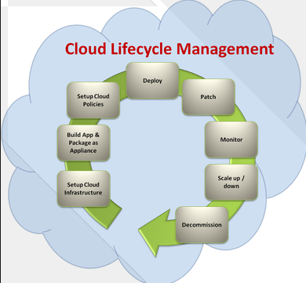
LIFE CYCLE MANAGEMENT FUNCTIONS
DESCRIPTION
Add lifecycle management functions to controller persona
Plan, setup, Build, Test, Deploy, Monitor, Manage, Meter, Charge, Optimize
Health Check, Software Upgrade
Setup, Build, Policies, Deploy, Patch, Monitor, Scaleup/Scale down
MULTI-RELEASE EFFORT
OVERVIEW
Network Management
PROJECTS
SDC
Notes:
Design, deploy, instantiate, monitor, … what do we need to do for microsvcs for change management, health checking … put a foundation in place so people can build on that. That allows a service provider to build upon.
“Cloud” LCM – VNF & PNF
Want NE performing the way we want to ; assume the cloud provider is doing the cloud management.

Slide 20



EDGE CLOUD SUPPORT
DESCRIPTION
Support for deploying mobility virtual network element (e.g. CU) at the Edge Locations
MULTI-RELEASE EFFORT
OVERVIEW
RAN Network Elements
CU-CP-H
Antenna
CU
DU
CU-CP-L
RU
DU
CU-UP
Edge
Cloud
CPRI
Back Haul
PROJECTS
Notes:
Ramki meetings … 5G & beyond incl. edge applications.

Slide 21
MOBILITY EDGE VNF (CU) INTEGRATION
DESCRIPTION
Support for deploying mobility virtual network element (e.g. CU) at the Edge Locations
MULTI-RELEASE EFFORT
OVERVIEW
RAN Network Elements
CU-CP-H
Antenna
CU
DU
CU-CP-L
RU
DU
CU-UP
Edge
Cloud
CPRI
Back Haul
PROJECTS

Slide 22
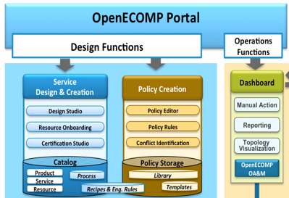

CHANGE AND CONFIGURATION MANAGEMENT
DESCRIPTION
Pre-provisioning with VID. Bulk Provision a 1000 PNFs. O&M IP@, model, configuration, radio parameters. Modeling for PNFs.
MULTI-RELEASE EFFORT
OVERVIEW
ONAP
Parameter
Configuration
APP-C
PROJECTS
A&AI, SDC, APP-C/SDN-C/R, DCAE/DMaaP, VID

Slide 23
ONAP PNF Deployment
PROJECT IMPACTS
ONAP and PNF Deployment Requirements for 5G RAN
For Casablanca (R3) Release
5G Use Case Team
Mar 23, 2018 version 1

Slide 24
PNF DEPLOYMENT – A&AI IMPACTS

Slide 25
PNF DEPLOYMENT – DCAE IMPACTS

Slide 26
PNF DEPLOYMENT – SO (Service Orchestrator) IMPACTS

Slide 27
PNF DEPLOYMENT – SDC IMPACTS

Slide 28
PNF DEPLOYMENT – VID IMPACTS

Slide 29
ONAP PNF Deployment
INTEGRATION AND SHOWCASING
ONAP and PNF Deployment Requirements for 5G RAN
For Casablanca (R3) Release
5G Use Case Team
Mar 23, 2018 version 1

Slide 30









PNF DEPLOYMENT – INTEGRATION & SHOWCASING
VID, CLAMP, CDT
A&AI UI
2
VPN
3
ONAP PORTAL
User/Login ONAP
3
ONAP SERVERS
AT&T (T-Lab) / Intel Windriver lab
ONAP ECOSYSTEM (VMs)
R2 Beijing Release of ONAP
SDC – Configuration Templates
PNF Plug and Play Use Case
Robot VM
Mock server to control Provider Edge Router.
WAN Controller
PNF Registration Handler (PRH)
4
1
CONFIGURATION
SDC Templates
6
RECORDING
Recording stored
5
DU EMULATOR
DU (PNF) Emulator
(in ONAP Software)
In Casablanca may be using a real DU/PNF

Slide 31
PNF DEPLOYMENT – INTEGRATION & SHOWCASING
STEP | DESCRIPTION
1 | CONFIGURATION – SDC Design templates need to be configured in preparation of the Demo & Showcasing. The appropriate PNF and VNF designs are designed, validated and exported to the other components of ONAP.
2 | PORTAL & GUIS – The ONAP Portal is used to access the appropriate GUIs and interfaces necessary to operate and configure ONAP. The VID and CLMAP GUI are used to configure the appropriate information for the showcase. The A&AI GUI are used to show the created entries in A&AI for the PNF.
3 | VPN – The appropriate security gateways and/or VPN networks are configured. The appropriate security setups are authenticated against. Passwords and IP addresses that are needed to connect to the ONAP servers go through this VPN or security gateway (as appropriate) ONAP SERVERS – The ONAP Servers that host the ONAP ecosystem are connected to
4 | ONAP ECOSYSTEM (VM) – The ONAP ecosystem has all of the appropriate Virtual Machines necessary to operate. This has the R2 Beijing Release of ONAP. All of the PNF Plug and Play Use Case updated software is available in the ONAP Ecosystem. The Robot VM, Mock server to control Provider Edge Router, and WAN Controller are established. The PNF Registration Handler a new DCAE plug-in are available in this ONAP ecosystem which is used to register the PNF into ONAP.
5 | DU EMULATOR – The DU Emulator is used to emulate the responses and connection to ONAP. The DU emulator establishes a VES HTTPS connection with the PRH during the registration process and receives a APP-C response back via ansible.
6 | RECORDING – A recording is made of the showcase and demo for later upload/download and playback for demonstration purposes.

Slide 32
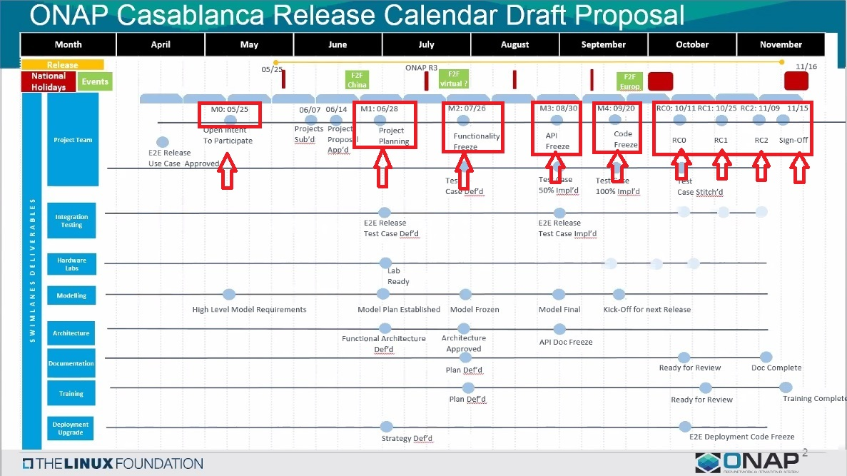
Training
Completed

Slide 33
First Stage / RC0 -
Component Integration, Integration tests, S/W Run-time
Complete system
Second Stage / RC1
Neighboring modules (module connections)
CSIT completed
RC2
Neighboring tests completed
Third Stage / RC3
End-to-End Use Case (all modules, all ONAP components)

Slide 34
ONAP PNF Deployment
APPENDIX
ONAP and PNF Deployment Requirements for 5G RAN
For Casablanca (R3) Release
5G Use Case Team
Mar 23, 2018 version 1

Slide 35
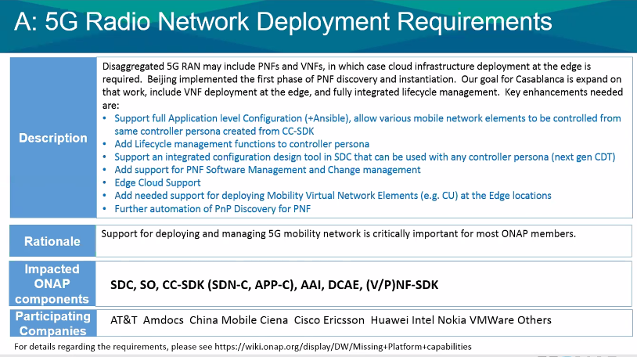

Slide 36
Apr 5, 2018
QUESTION – PNF Heart-beating (after PnP/Registration). Monitoring.
Updates to A&AI if PNF goes off-line.
VNF-SDK (package from vendors) wanted PNF-SDK a package the describes what
Can be done, what ONAP should do w/ the PNF.
Generic vs Vendor added PNF onboarding Package. Onboard a Generic PNF w/ a “generic PNF onboarding package.
Topic: Licensing PNF S/W. (Post Casablanca – Future)
Topic: Fault Management/Alarms, State-Stateful events.

Slide 37
POST CASABLANCA
ONAP and PNF Deployment Requirements for 5G RAN
For Casablanca (R3) Release
5G Use Case Team
Mar 23, 2018 version 1

Slide 38


SOFTWARE MANAGEMENT
DESCRIPTION
ONAP Integrated PNF software management and change management could be a long-term goal. In R3 Casablanca release, as a simple first step the software load for one PNF could be managed within a repository, but not actually downloaded to a PNF.
MULTI-RELEASE EFFORT
OVERVIEW
ONAP
Version checking
S/W upgrade
(Data Storage)
PNF Software Packages
PROJECTS
A&AI, SDC, APP-C/SDN-C/R, DCAE/DMaaP
VNF-SDK

Slide 39
Apr 12, 2018 5G Use Case team
Benjamin Cheung (Nokia), Oskar Malm (Ericsson), Vimal Begwani (ATT), Ulas Kozat, Aaron Hay,
Eric Multanen, Pasi Vaananen, Shekar Sundaramurthy (ATT), Sigmar Lust
Yang Xu, Yoav Kluger (Amdocs), Slawek Stawiarski (ATT), Tracy Van Brakle,
Abinash (Netcracker), Gershon Schatzberg (Intel), Itamar Eshet, John Burgess (Nokia)
John Quilty (Ericsson), Kenneth Shi, Linda Horn (Nokia), Marge Hillis (Nokia),
Michela Bevilacqua (Ericsson), Mohamad Yassin,
Padma Sudarsan (Nokia) , Peter Loborg (Ericsson), Run Yue, Ulas Kozat,
Vishnu Ram OV, Shekar Sundaramurthy (ATT), Michael Z (ATT), MHuan12, Melanie Sater
Ramki Krishnan
Apr 16, 2018 Use Case subcommittee
Gil Bullard (ATT), Oskar Malm (Ericsson), Ram Krishnan, Vimal Begwani (ATT) Ajay Mahimkar, Phil Blackwood (ATT), Scott Blandford (ATT), Srini Addepalli (Intel), Sumithra Bhojan, Vladimir Yanover (Cisco), Yoav Kluger (Amdocs), Arash Hekmat (Amdocs), David Perez (Swisscom), Evgeniy Zhukov (Netcracker), Benjamin Cheung (Nokia), Joe Bullimore, Linda Horn (Nokia), Mao Peng, Marcus, Marge Hillis (Nokia), Matti Hiltunen (ATT), Mohamad Yassin, Ranny Haiby, Shankar Narayanan (ATT), Shawn Ying, Timo Perala (Nokia), Vivien Yang (Intel), Yang Xu, Yayoi Kobayashi, Yusuke Nakano (KDDI), Zhuoyao Huang, Parviz Yegani, Shekar Sundaramurthy (ATT)

