Slide 1
Casablanca Platform Enhancements to Support
5G Use Case
Summary of Planned Enhancement Areas (TSC Review)
5G Use Case Team
May 10, 2018

Slide 2











Contributors:
Supporting Companies
And Others

Slide 3
High Level Objectives for Casablanca:
  Deployment of the hybrid 5G Radio Network (PNFs & VNFs)
    Complete PNF Support
    Platform Enhancements to Deploy Edge PNF & Virtual Radio Network Functions (e.g. CU)
      PNF PlugNplay, Configuration Enhancements, Performance Analysis & Optimization, Target Software Management
  Optimization of the deployed 5G network
    OOF enhancements for optimal placement of edge resources
    Edge Analytics to Support 5G Network Optimization
  Support for Modeling, Creation & Management of Network Slice
    Design & Lifecycle Management of Slice & Slice Subnet Instances

Slide 4
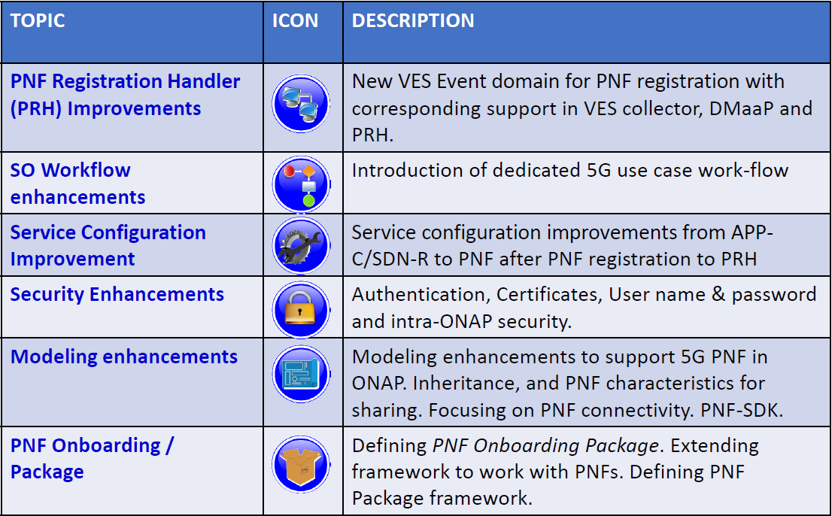
PNF PnP Enhancements

Slide 5
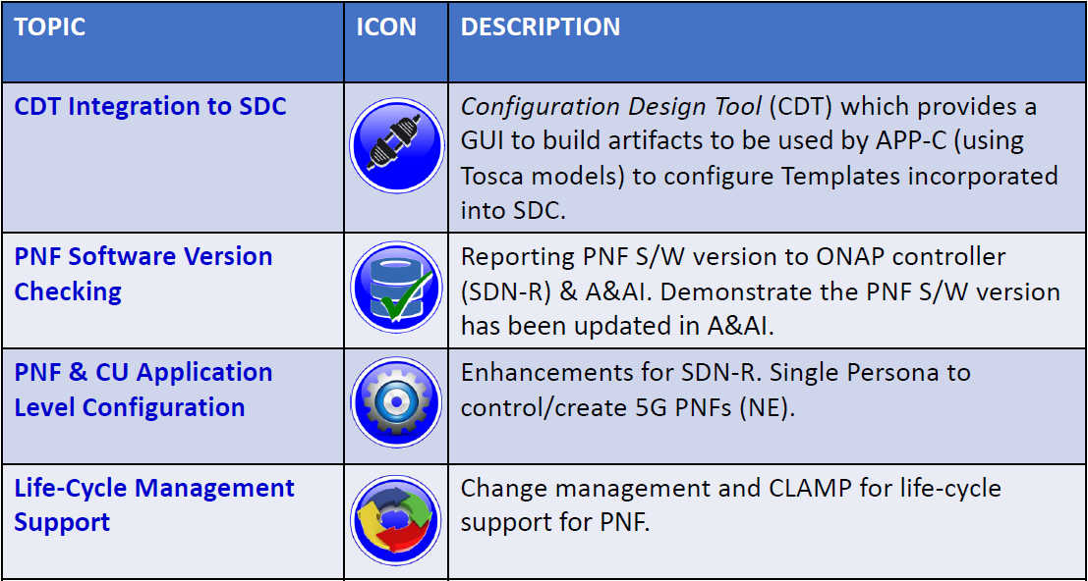
Service Configuration Enhancements

Slide 6
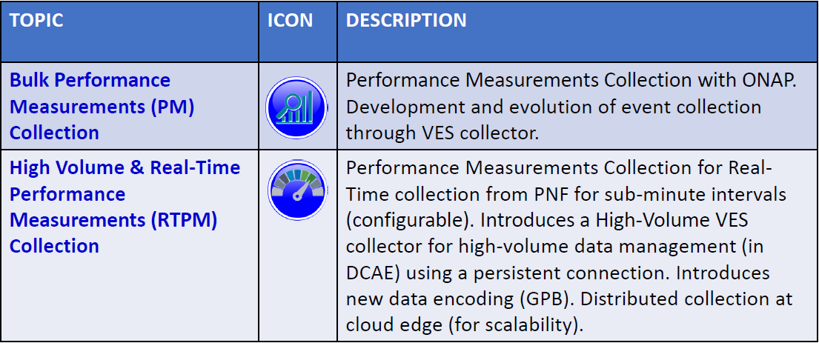
PERFORMANCE ANALYSIS & OPTIMIZATION

Slide 7
  Optimization Framework Enhancements
TOPIC | ICON | DESCRIPTION
Optimal placement of vNF |  | Placement of Mobility Virtual Network Elements (CUs) across the highly distributed edge clouds is a fundamental requirement. Service Providers must also optimize the performance of the 5G RAN in real-time.
Slice optimization problem formulation |  | Ability to model the problem as a constrained optimization problem, closely tied up policies
Slice optimization problem solving |  | Ability to use appropriate algorithms and solvers to solve the problem in acceptable time frames.
SON - problem formulation |  | Ability to formulate SON problems as constrained optimization problems, policy driven. Potential use cases - (1) Energy optimization (2) Load balancing
SON - problem solving |  | Ability to use appropriate algorithms and solvers to solve the problem in acceptable time frames.
 |  | Impacted systems: SO, Policy, AAI, DCAE, MultiCloud (possibly), SDN-R

Slide 8



  Modeling & Management of Network Slice (Proposed)
TOPIC | ICON | DESCRIPTION
Design/SDC Enhancements For Modeling |  | – Design/SDC Enhancements For Modeling – Multiple Allotted Resources Per Service – Nested Allotted Resources Per Service – Service Hierarchy
SO Workflow enhancements |  | To Support Slice Model/Hierarchy
Controller & Inventory Enhancements |  | To Support Slice Model/Hierarchy
Note: |  | Domain Models For Slicing – From SDOs are not mature & have not been standardized; however, the identified enhancements will be needed when Operators implement slices as models become available (whether using vendor-specific or standardized models) With the identified enhancements implemented in the Casablanca timeframe, we hope to have vendor/operator implementations post-Casablanca This still allows for slicing work/demonstrations (on existing networks using existing ONAP capabilities)

Slide 9
Thank You!

