Slide 1
5G RAN Deployment – Casablanca
PNF software and configuration management
Huawei, 2018-4-28

Slide 2
5G Radio Network Deployment Requirements
High Level Objectives
Deployment of the hybrid 5G Radio Network (PNFs & VNFs)
Complete PNF Support
Platform Enhancements to Deploy Edge Virtual Radio Network Functions (e.g. CU)
Description
Disaggregated 5G RAN may include PNFs and VNFs, in which case cloud infrastructure deployment at the edge is required. Beijing implemented the first phase of PNF discovery and instantiation. Our goal for Casablanca is expand on that work, include VNF deployment at the edge, and fully integrated lifecycle management. Key enhancements needed are:
Support full Application level Configuration (+Ansible), allow various mobile network elements to be controlled from same controller persona created from CC-SDK
Add Lifecycle management functions to controller persona
Support an integrated configuration design tool in SDC that can be used with any controller persona (next gen CDT)
Add support for PNF Software Management and Change management
Edge Cloud Support
Add needed support for deploying Mobility Virtual Network Elements (e.g. CU) at the Edge locations
Further automation of PnP Discovery for PNF
Src: 5G UC Team, Casablanca Platform Enhancements to Support 5G Use Case

Slide 3
PNF Support
Based on PNF Plug-and Play and Registration procedure from Beijing
  PNF registers to ONAP through VES/PRH.
  ONAP knows PNF, that A&AI has a complete/valid PNF entry.
After the registration, service configuration and activation need:
  Support for software management
  Application-level configuration for 5G RAN PNF, e.g. DU

Slide 4
Software Management (partly vendor-specific) (Option a)
Software Categories:
  ONAP bootstrap software, e.g. VES client
  PNF bootstrap software(vendor Specific)
  PNF target software(vendor Specific)
Management:
  ONAP and PNF bootstrap software are download before the registration, from initial EM directly.
  PNF target software are download according to the specified sw version after the registration. (see figure)
Portal
VID
Onboard
PNFD*
Service instantiation
target sw version=“xxx”
1
target sw version
2
SDC
SO
APP-C
Vendor
Adapter
3
InitialEM
5G-DU
5G-CU
4
PNF target software download
PNFD*: not aligned with ETSI NFV’s VNFD, need to be defined further.

Slide 5
Software Management (partly vendor-specific) (Option b)
Software Categories:
  ONAP bootstrap software, e.g. VES client
  PNF bootstrap software(vendor Specific)
  PNF target software(vendor Specific)
Management:
  ONAP and PNF bootstrap software are download before the registration, from initial EM directly.
  PNF target software are download according to the specified sw version after the registration from EM. (see figure)
Portal
VID
Onboard
PNFD*
Service instantiation
target sw version=“xxx”
1
target sw version
2
SDC
SO
APP-C
3
EM
InitialEM
PNF target software download
4
5G-DU
5G-CU
PNFD*: not aligned with ETSI NFV’s VNFD, need to be defined further.

Slide 6
Application-level configuration for 5G RAN PNF (Option a)
Design time
  (1) Onboarding PNFD
    PNFID
    Templates, including PNF/VNF templates, Configuration templates
Run time
  (2) service instantiation
  (3) generate configuration data from Vendor Adapter
  (4) configure PNF/VNF separately (for DU, cfg data contains CU IP for DU homing to a CU)
  (5) CU-DU inter-connect
VID
Portal
Service instantiation
PNFID=“xxx”,
Instance_planning={“key”:“xx”}
cfg_tmp_name=“xxx”
1
PNFD*
2
PNFID, templates
SDC
SO
APP-C
Vendor
Adapter
3
4
cfg data
(vendor Specific ）
5G-DU
5G-CU
5
PNFD*: not aligned with ETSI NFV’s VNFD, need to be defined further.

Slide 7
Application-level configuration for 5G RAN PNF (Option b)
Design time
  (1) Onboarding PNFD
    PNFID
    Templates, including PNF/VNF templates, Configuration templates
Run time
  (2) service instantiation
  (3) generate configuration data
  (4) configure PNF/VNF via EM
  (5) CU-DU inter-connect
VID
Portal
Service instantiation
PNFID=“xxx”,
Instance_planning={“key”:“xx”}
cfg_tmp_name=“xxx”
1
PNFD*
2
PNFID, templates
SDC
SO
APP-C
EM
3
4
cfg data
(vendor Specific ）
5G-DU
5G-CU
PNFD*: not aligned with ETSI NFV’s VNFD, need to be defined further.
5

Slide 8
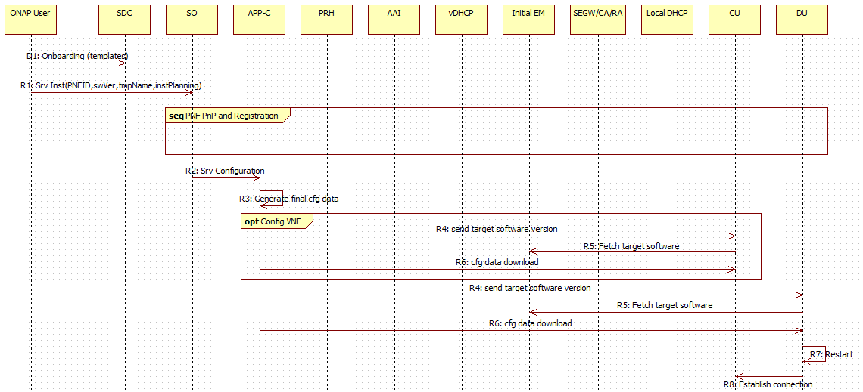
Sequence Diagram (option a)
Based on PNF Plug-and Play and Registration procedure from Beijing release

Slide 9
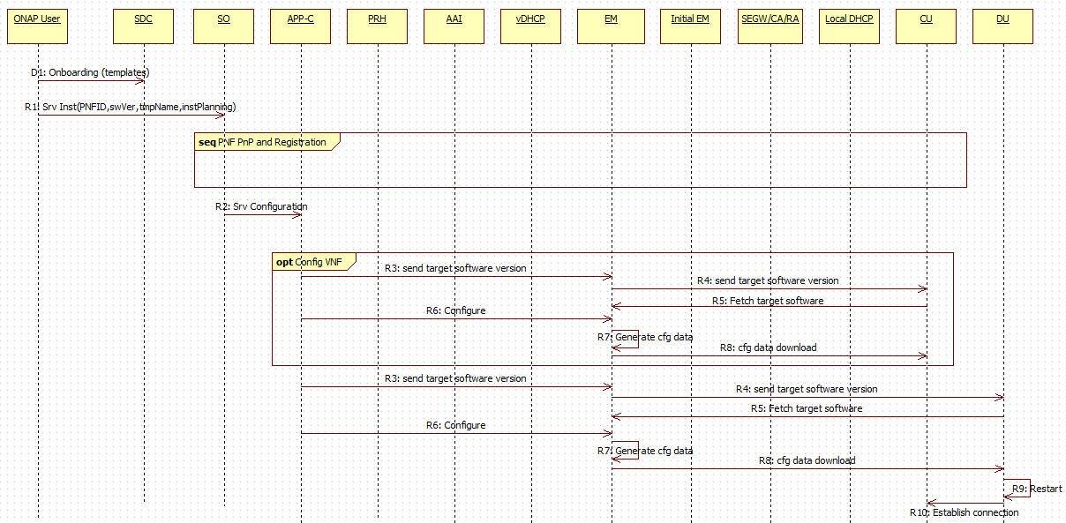
Sequence Diagram (option b)
Based on PNF Plug-and Play and Registration procedure from Beijing release

Slide 10
Thank You!

