Slide 1
PNF and Mixed Infrastructure Support for EtE Network Slicing
--Cloud Infrastructure Controller
Vivien Yang

Slide 2
Agenda
Why the need for a Cloud Infrastructure Controller
Cloud Infrastructure Controller
5G E2E Network Slicing Implementation with Infrastructure Controller

Slide 3
Why the need for a Cloud Infrastructure Controller

Slide 4

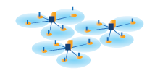

Why Need a Cloud Infrastructure Controller
Moving to the Edge
Mixed Infra.
NFV Multi-Layer Decoupling
Hardware infra. Modeling
Run-Time Network Optimization
HA, SA and Beyond
Comms’ Edge has variety PNFs and HW accelerators beyond VMs
5G requires support:
  Physical peripherals
  Bare metal server
  Hardware (FPGA) acceleration card
An independent cloud infrastructure controller is equally important to VIM:
  Cloud scheduling
  Run-time infra. monitor/Update.
  Pooled resource manage.
Modelling
  Service model temp.
  VNF/PNF model temp.
  Infra. model temp.
Infra. model need to be extensible to support legacy and future platform.
Awareness of Location; Awareness of the topology of cloud
Support SON
  Fast Auto-scale within 1S.
  Efficient auto selection of infra resource.
OOB manage channels for RAS and Five 9’s support
Policy driven infra. Control
Telemetry for SA.
…
NFV network Decouple
Cloud Infrastructure
VNFs/APPs
Compute Pool
Storage
Pool
Infrastructure Attributes
CloudOS/VIM
ONAP (MANO)
Power
Perf.
Sec.
Therm
Utiliz
Locat
Virtualization/System SW
Network Pool
Accelerator Pool
HW Infrastructure/COTS
NFV Automation need better awareness of cloud infrastructure and run-time control capability

Slide 5

Infra Controller to support ONAP 5G use case and requirements:
Functional Platform Requirements | SDC | AAI | SO | SDN-C | APP-C | Portal | DCAE | Policy | OOF
Support for PNF - Onboarding
Support for PNF - Configuration & Control
Support for PNF - Data Collection & Monitoring
Slice Management - Definition
Slice Management - Composition
Slice Management - Orchestration & Control
Slice Management - Data Collection & Monitoring
Optimization - Onboarding
Optimization - Configuration & Control
Optimization - Data Collection & Monitoring
OOF - Multi-cloud
OOF - Optimization
GAPs
Applicable with Cloud infrastructure controller Enhancement
Limited PNFs/DC hardware provisioning capability supported by Open stack and K8S etc.
Network Slicing requires Run-Time monitor, modify, control of the services and resources.

Slide 6
Cloud Infrastructure Controller

Slide 7
Enhancement of current NFV MANO Resource Management
Orchestration
Controller
BSS/OSS
NFV Service Orchestration
VNF Controller/
Manager
SDN Controller
Service/APPs
Manage
NS Life-Cycle
Automated Operation
Multi-VIM
(Open Stack/Kubernetis/etc.)
Local/site
Infrastructure Controller
Infrastructure
Resource
Manage
Orchestrated infrastructure
FCAPS
Run-time Monitoring
Dynamic scheduling and allocation
Fine granularity service support
Physical Resource
Infrastructure
Bare Metal, Container, VM,
Network accelerators & PNFs (SmartNIC, RRU, Baseband...)
Virtualized resource
Currently VIM can only manage virtualized infrastructure with limited control of the non-virtualized resources

Slide 8
Cloud Infrastructure Controller Functionality
PNF onboarding and Infrastructure
run-time manage/control
Support Optimization
Framework and SON
Support Telco
S3P through OOB channel
Physical infra on-boarding:
  Bare metal servers
  SmartNIC /PCIE acceleration cards
  Proprietary PNFs
Support Model-driven infra.
Dynamic patching of new hardware Json data template
Report location and hardware features to SO and OOF (SON).
Grouping management of infra. resources with specific feature set, to support SLA/SLO of NSI.
Policy based fast auto-scale, auto-healing within local cloud.
Run-time update infra. change
Support both In-band and Out-of-band (OOB) management.
With all the platform awareness and run-time monitoring, a hardware level data analytic and policy-based action (execution) can be achieved in longer term

Slide 9
Support PNF/Bare Metal On-boarding & Manage
Install new PNFs
PNF on-boarding can be implemented in multiple ways through generic Rest API (e.g. Redfish) .
  Can be directly scheduled and activated from SO/NFVO through API calling.
  Can be run-time scheduled and provisioned through Cloud Infra Controller
  Can be instantiated through Open stack with various enhancements.
Resource Control SW
PNF
PNF
Workload daemon
Controller
Master
PNF
Instantiate new
NSI/Service
PNF
Send characteristics
Bare Metal Server
SO/NFVO
Compute
Service
Bare Metal Server
/Accelerator Card
Storage
Service
Rest API
Run-time
PNF template update
Network
Service
A&AI
Redfish (Sushy ) driver
Accelerator
Service
Redfish (Sushy ) driver
Nova Compute
Redfish (Sushy )
Two type of PNFs:
Proprietary NF with OS, software fully integrated.
Non virtualized hardware infrastructure resources.
Cloud Infra
Controller
Ironic conductor
Nova DB
ONAP
OpenStack
9
Template v5.1

Slide 10
How To Support 5G Use Case?
Add Infrastructure controller to Multi-Cloud module and further integrated with OpenStack, K8S etc. Support run-time resource provisioning and status monitor.
Add Network Slice manager to SO to handle groupings, connections, security, sharing etc. for NSI/NSSI service instantiation.
SDC
Policy
SO
OF
A&AI
Run-time update
Of Infra. template
Geographical /location of nodes
Enhanced model template with mixed infra. info
DCAE
Network Slice manager
2
Collector Interface
Analysis
Micro Service Bus
gVNF-Controller/VF-C
SDN-C
Multi-VIM/Cloud
Infrastructure Controller
VNF
VNF
VNF
VNF
1
YANG-Redfish
Converter
Restful API (Redfish etc.)
Run-time Monitor and Control of Infrastructure Attributes
Support Network controller with Yang-Redfish converter
OpenStack
k8S
Vmware
WRS
PNFs
HW accelerators
Bare Metal
VMs
VMs
Containers
Logical Nodes (Resource Pool)
Redfish is a modern interface for DC management which provides common resource models that extensible to other management domains. It is matured and many on-going efforts in open source.

Slide 11
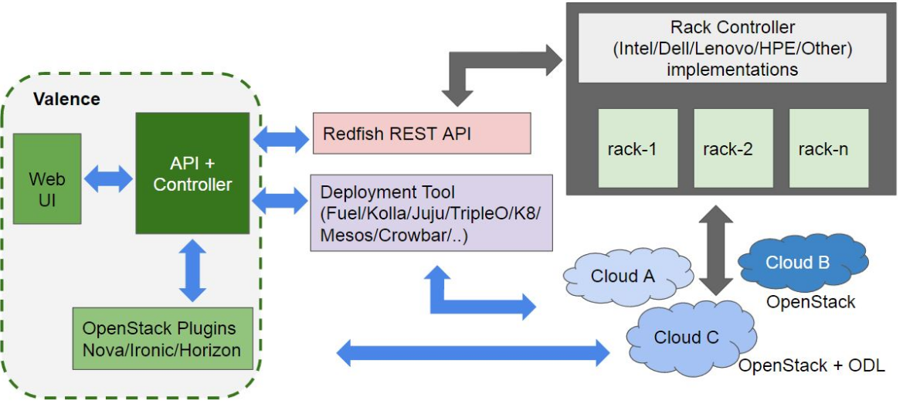
Current Solution of Valence Open Source Project
Valence can be used today to do PNF on-boarding and Run-time monitoring, configuration and management
Based on Valence, will build a generic Cloud Infrastructure Controller with Rest API communicate with different type of DC/Comms hardware platform.
Intel Confidential - Internal Use only

Slide 12
Mapping to ONAP R2+ Architecture –Long Term
ONAP API
Design-time (SDC)
Run-time
Dashboard OA&M (VID)
PNF
on-boarding
Common
Services
Resource Onboarding
SO/NFVO(VF-C)
(hierarchical)
A&AI/ESR
Policy Framework
Service Design
DCAE
PNF
Provisioning
PNF Template
AAF
Policy Creation & Validation
OOM
Analytic Application Design
MSB / DMaaP (see Note 1)
OOF
VNF / PNF SDK
Closed Loop Design
Logging
Change Management Design
Generic VNF Controllers (L4-L7)
Multi-VIM/Cloud
CCSDK
Design Test & Certification
SDN-C
(L0-L3)
APPC / VF-C (GVNFM) (see Note 2)
Infrastructure Adaptation Layer
Cloud
Infra Controller
…
Adaptation Layer
Catalog
External Systems
3rd Party Controller
sVNFM
EMS
CLAMP
…
Rest API Daemon
Managed Environment
Network Function Layer
VNFs
PNFs
…
Hypervisor / OS Layer
OpenStack
VMware
Azure
AMZ
RackSpace
Cloud Infrastructure Controller target to integrate to Multi-Cloud module as a independent engine

Slide 13
5G E2E Network Slicing Use Case Demo

Slide 14
5G Network Slicing Demo System –Phase1
Communication
Services
Service 1
Service 2
Service 3
GAPs
NSI A
NSI B
NSI C
RAN modelling
NSI service modeling
SO enhanced with NSI management
PNF run-time control
CP/SMF
PCRF/PCF
Core Network
NSSI
MME/AMF
eMBB Slice
(Smart
Phone)
mIoT Slice
(Video Surveillance)
URLLC Slice
(Autonomous Driving)
DP/UPF-Slice1
DP/UPF-Slice2
Bearer Network
Access Network
NSSI
BBU (Server based)
BBU
(Proprietary PNF)
Slice 1
Slice 2
Front
Haul
FE
FE
FE
FE
Transport
Transport
Transport
Transport
RF
RF
RF
RF
Support CUPS; 4G/5G VNF/PNF are both fine as demo
VNF/PNF co-exist; VM/Container/bare metal co-exist
RRH, Front-haul, Bearer slicing will be consider later

Slide 15
Nested Service Modelling design for Network Slice
Network Slice Segment(Sub Slice)
Service CN
SDN Controller
1
:
:
Topology Template
SDN-C
3rd Party SDNC
:
KPI
/
QoS Policy
:
Network configuration and controle
Node
_
template
Network Slice Service X
:
:
VNF
1
Topology Template
:
VNF
2
KPI
/
QoS Policy
:
PNF
Node
_
template
:
...
Cloud resource Orchestration and Control
NSSI
-
CN
Network
NSSI
-
AN
Infra. Controller
OpenStack
K8S
Network
...
Network slice segments
AN
CN
Service AN
1
:
vAMF
/
vBBU
SMF
-
CU
Topology Template
:
vBBU
-
Network Slice and Network Slice Segment (Sub Slice) both are special type of Services, can be defined and driven by service modeling.
PNF model template need to be defined the same way as VNF template.
KPI
DP
vUPF
/
QoS Policy
:
Node
_
template
:
vRBF
vPCF
(
baseband
VNF
)
1
VNF
2
PNF
-
L
1
/
PNF
RH
vUDM
...
Network
...
1
Network
Network
2
Nested service orchestration and Infrastructure controller is required to implement model-driven EtE slicing

Slide 16
5G E2E network slicing demo functional break-down
SDC
A&AI
DCAE
Policy
Run time update of PNF, NSI/NSSI inventory
Collector Interface
Analysis
Create PNFSDK for onboarding
Create NSI/NSSI service/products
Create NSI grouping Policy driven recipes
Support NSI Policy
Support NSI/NSSI and infrastructure monitor data processing
SO
OOF
Support NSI life cycle management
Support NSST (NSI selection)
gVNF-Controller
5G SON
NSI optimize
Support NSSI/PNF life cycle management
Multi-Cloud
Infrastructure Controller
Support PNF and physical infrastructure provisioning, monitor and control
Support SON with optimization, auto-configure, auto-scale, auto-healing
VIM Driver (Openstack, K8S…)

Slide 17
Summary
Cloud Infrastructure Controller is a generic function module that can support PNF and physical infrastructure run-to-completion management, as well as support different VIM: OpenStack, K8S etc.
It can solve the ONAP functional gaps to support 5G RAN, network slicing, MEC etc. enabling the automation of Carrier’s operation all the way to the infrastructure (NFVi, Cloud, Edge)
Plan and Target:
    R2 5G network slicing use case demo with minor enhancement to several existing modules
    Integration to Mutli-Cloud in ONAP R2 beyond release in longer term.

Slide 18
Call to Action
Collect feedback from the community, align with other related proposals to support PNF life cycle management.
Discuss and work with Multi-Cloud team to define and solve the current gaps.
Collaborate with parties in ONAP community that interested in 5G use case to build the demo together.
Thanks!
Contact: vivien.yang@intel.com

Slide 19
BACKUP SLIDES

Slide 20
Back up
5G E2E Slicing Modeling and Policy Design

Slide 21
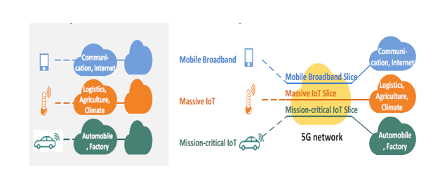
Slice & Service Definition, Deployment, and Management
Requirement Statement
Each Service Provider (SP) needs to support a rich set of advanced 5G wireless services, such as enhanced Mobile Broad Band (eMBB), massive Internet of Things (mIoT), and Ultra-Reliable, Low-latency Communications (URLLC ), for mission critical communications
These services have very different requirements on latency, reliability, availability, mobility, and bandwidth
Deploying multiple separate networks to support these varying requirements is not practical
End to End network slicing as defined by 3GPP provides specifications for efficient creation of multiple logical networks sharing a common network infrastructure while meeting the specified service levels for each of the services
ONAP must support the complete lifecycle management of such network slicing
Automated configuration of a slice during the instantiation, configuration, and activation phases, a newly created set of identifying parameters collection is automatically configured
Automated reconfiguration happens during run-time e.g. an active slice can be reconfigured automatically because of a change in the service requirements or service conditions

Slide 22
Terminology and Abbreviations
Term | Definition
Network Slice | A logical network that provides specific network capabilities and network characteristics
Network Slice Instance (NSI) | A set of Network Function instances and the required resources (e.g. compute, storage and networking resources) which form a deployed Network Slice NSI contains Core Network part and Access Network part
NSSI | Network Slice Subnet Instance
NST | Network Slice Template
NSST | Network Slice Subnet Template
NSMF | Network Slice Management Function
NSSAI | Network Slice Selection Assistance Information
PNF | Physical Network Function
DP | Data Plane
OOB | Out of Band

