Slide 1
ONAP 5G RAN Network Slicing
ONAP and Network Slicing for 5G RAN
5G Use Case Team

Slide 2






5G Radio Access – Network Architecture
SO – Service Orchestrator
SDN-C – Service Design Network Controller
DCA&E – Data Collection Analytics & Events
A&AI – Available & Active Inventory
APP-C – Application Control
ONAP Run Time Management
OSS
BSS
SO
SDN-C
DCAE
A&AI
APP-C
5G
Application
Ecosystem
RAN Network Elements
Core Network Elements
CU-CP-H
Disaggregated Core
Antenna
5G
Base Station
UPF
SMF
UDM
AUSF
CU-CP-L
RU
DU
CU-UP
Edge
Cloud
Back Haul
Centralized
Cloud
Internet
Front Haul
Mid Haul
External Content
UE
RU – Remote Radio Unit
DU – Distributed Unit (5G Base Unit)
CU-UP – Centralized User Plane
CU-CP – Centralized Control Plane (low and high)
UPF – User Plane Function
SMF – Session Management Function
UDM – Unified Data Management Function
AUSF – Authentication Service Function

Slide 3
5G Network Slice – Network Architecture
ONAP
Management - Design
ONAP
Management - Runtime
Mobile Slice Services (e.g. eMBB, Massive IoT, Mission-critical IoT)
E2E Slice Instances (NSIs)
RAN Network Slice Segment (NSSIs)
Transport Slice Segments (NSSIs)
Core Slice Segments (NSSIs)
RAN Abstraction Model
Transport Abstraction Model
Core Abstraction Model
5G
Application
Ecosystem
RAN Network Elements
Core Network Elements
CU-CP-H
Disaggregated Core
Antenna
5G
Base Station
UPF
SMF
UDM
AUSF
CU-CP-L
RU
DU
CU-UP
Edge
Cloud
Back Haul
Centralized
Cloud
Internet
UE
Front Haul
Mid Haul
External Content

Slide 4
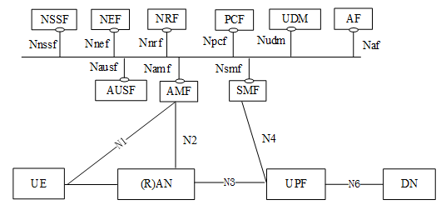
5G Network Slice – Network Architecture

Slide 5

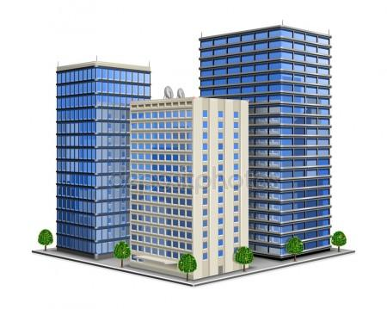

5G RAN Architecture
RAN Network Elements
5G
Base Station
DU #1
Cell #1
Tracking Area
Cell #2
RU #1
Registration
Area
Edge
Cloud
RU #2
DU #2
CU
Cell #n
…
…
Tracking Area
RU #n
DU #n

Slide 6
5G RAN Configuration
RAN Network Elements
5G
Base Station
Configuration
Instantiating a Slice on a CU/DU
You could send an “activation” command
To active a service (e.g. Video streaming) w/
Parameters pre-provisioned.
Services can be “on demand”
Slices are defined in the CU
DU #1
RU #1
RU #2
DU #2
CU
…
…
RU #n
DU #n

Slide 7
5G RAN Architecture
A Cell is a Sector – Frequency
An antenna “stacked dipole”
Which can “Shape the Radio frequency
Energy”
Alpha Sector & f1 = Cell #1
Alpha Sector & f2 = Cell #2
Alpha Sector & f3 = Cell #3
Beta Sector & f1 = Cell #4
Gamma Sector & f1 = Cell #5
Alpha
Beta
Gamma

Slide 8
Registration Area & Tracking Area Configurations
u The Registration Area may have any
Number of Tracking Areas
v And Tracking Areas may have any number of
Cells.
w Multi-Carrier Cell, f1-f2-f3 in same sector
are in the same Tracking Area
x Cells might be serviced by different DUs
1
Tracking Area
Cell #1
Tracking Area
Cell #2
Registration
Area
Tracking Area
Cell #3
4
Cell #1
Tracking Area
Cell #4
Tracking Area
Cell #2
Cell #5
Tracking Area
Registration
Area
Cell #n
2
Cell #1
3
Cell #1
f1 Alpha Sector
Tracking Area
Cell #2
Tracking Area
Cell #2
f2 Alpha Sector
Cell #3
Tracking Area
Cell #3
f3 Alpha Sector
Cell #4
Registration
Area
Cell #5
Tracking Area
Cell #4
Registration
Area

Slide 9
UE in a Tracking Area
UE & TRACKING AREAS
A Mobile (UE) is in one Tracking Area (TA)
A UE is in one Registration Area
A UE is in one Cell
UE can support up to 8 slices (simultaneously)
PHYSICAL
A UE is physically in a geographical location
That geographical location is served by a RU/DU
That is, “physical” RF resources (RF waves)
LOGICAL
A UE is in a “logical Cell”
And simultaneously a UE is in a “logical Tracking Area”
Tracking Areas comprise a Registration Area
And thus a UE is simultaneously in a Cell, Tracking Area and Registration Area
Cell #1
Tracking Area
#1
Cell #2
RU #1
Registration
Area
Cell #n
Tracking Area
#2

Slide 10
A Cell has only one Tracking Area
Per PLMN, there is a one-to-one correspondence between a Cell and a Tracking Area Code.
i.e. You cannot assign more than one Tracking Area Code to a Cell.
Cell has a parameter (Tracking Area ID = TAI)
TAI = PLMNID + Tracking Area Code (TAC)
In multi-operator cell can have 6xPLMN IDs, but Every cell has a Primary PLMN. Thus there is still just one TAI.
A UE subscribes to one PLMN only (thus a cell belongs to exactly one TA)
Cell has one Tracking Area
Cell #1
Tracking Area Code
Note: 3GPP36.300 section 10.1.7: If the E-UTRAN is shared by multiple operators, the system information broadcasted in each shared cell contains the PLMN-id of each operator (up to 6) and a single tracking area code (TAC) valid within all the PLMNs sharing the radio access network resources.

Slide 11
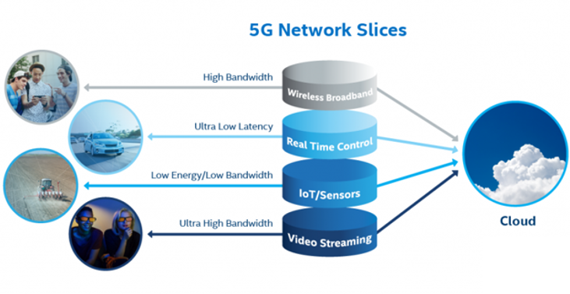




5G Network Slices (Example)

Slide 12

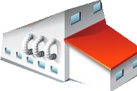
Slice Groups
VERTICAL SLICE
VERTICAL SLICES (examples):
-Hospitals,
-Companies,
-Airports
-Stadium
-University Campus
-Disaster Area or Security forces
-Regional Trials
-High Density Urban Community
-Railway
HORIZONTAL SLICES (examples):
Wireless Broadband
Real-Time Control
IoT & Sensors
Video Streaming
5G AVANTAGE OVER 4G:
End to End Accounting
Built in to 5G framework (report, verify, account)
FUNCTIONALLY:
NSSP configures device.
NSSP Maps applications to Slices
A valid slice over multiple RegAreas would have
Valid NSSAIs in multiple RegAreas
HORIZONTAL SLICE
FACTORY #1
Wireless Broadband
Cell #1
Cell #2
Real-Time Control
Tracking Area #1
IoT Sensors
Registration Area #1
Video Streaming

Slide 13
Slice within a Tracking Area
OPERATION:
- A slice must be consistent throughout a Tracking Area (e.g. the Real-Time Control Slice is the same for the UE throughout the Tracking Area #1)
- A slice must be consistent for all of the Cells that comprise a Tracking Area.
- Slices are only valid within the PLMN.
- NSSAI (Network Slice Selection Assistance Information) are PLMN specific
- Two PLMNs have NSSAI independent of each other.
REGISTRATION AREAS:
- Registration Areas are tied to NSSAI
- UE registers with AMF (which provides the UE with the TAI and thus the registration area it is in)
- Note: Cells don’t announce slices
- If you stay within the Registration Area the NSSAI is valid.
CONFIGURATION
- Core control is done in CU, CallP is in CU.
- “Race condition” of CU provisioning
- Slice supported in a TA List
- Configuration, Activation/Operation
Cell #1
Real-Time Control Slice
Cell #2
Tracking Area #1
Real-Time Control Slice
Registration Area #1
PLMN

Slide 14
Isolation between Slices
OPERATION:
- Factory #1, #2 each with their own Tracking Area
- Typically, two different “Factories” (vertical slices) will have different horizontal slices tailored to that vertical slice. So there is typically “isolation” between slices.
“Cross Breeding”:
- If isolation is not desired, you can define the same slices between the two tracking areas. For example if Cell #1, #3 with same Slices accomplished by defining the same slices.
FACTORY #1
FACTORY #2
Cell #1
Cell #3
Cell #2
Cell #4
Tracking Area #1
Tracking Area #2
Registration Area #1
Registration Area #2

Slide 15
Similar services (slices) over a large area
OPERATION:
- Services for slices of the same type over a number of cells/tracking areas
Services made available in two different areas.
- Core serves a list of Tracking Areas.
- A registration area = a List of Tracking Areas
- A slice is available in TA
- A cell is exactly on TA
- Core network functions must be instantiated on a set of Tracking Areas.
-
-
Cell #1
Cell #3
Cell #2
Cell #4
Tracking Area #1
Tracking Area #2
Registration Area #1
Registration Area #2

Slide 16
Core Network functions on a set of TAs
OPERATION:
- Core network functions must be instantiated on a set of Tracking Areas.
- Core tells RAN elements which slices are supported
- OAM puts cells in Tracking Areas, Connect CUs to the Core Network Elements that correspond to the TAs that the cells are in.
- Define Cells, group into TAs; DU, CUs.
-
-
-
Core Network Elements
Disaggregated Core
UPF
SMF
UDM
AUSF
Back Haul
Centralized
Cloud
Internet
External Content
Tracking Area #1
Tracking Area #2
Tracking Area #3
Tracking Area #4
Tracking Area #5
Tracking Area #n

Slide 17
Customized Horizontal & Vertical Slices
VERTICAL SLICE
Factory #1
Factory #2
Factory #1’s Wireless Broadband Slice
Customizations of the “general” Wireless broadband slice. Customized for particular monitoring
Factory #2’s Wireless Broadband Slice
Customizations of the “general” Wireless broadband slice. Is hosting a general assembly meeting and wants more dedicated wireless broadband usage.
Wireless Broadband
Factory #1’s Real-Time Control Slice
Customizations of the “general” Wireless Real-Time Control slice. Installed with specialized factory vehicular controls
Factory #2’s Real-Time Control Slice
Customizations of the “general” Wireless Real-Time Control slice. Is testing a trial prototype proof of concept vehicular control platform.
Real-Time Control
HORIZONTAL SLICE
Factory #1’s IoT Slice
Customizations of the “general” Wireless IoT slice. Security Sensors tailored to the unique location of the Factory.
Factory #2’s IoT Slice
Customizations of the “general” Wireless IoT slice. Has recently installed IoT sensors in their HVAC systems.
IoT Sensors
Factory #1’s Video Streaming Slice
Customizations of the “general” Wireless Video Streaming slice. Currently is using a training video to all employees.
Factory #2’s Video Streaming Slice
Customizations of the “general” Wireless Video Streaming slice. Is currently setting up a video streaming slice for their CEO to give a presentation.
Video Streaming

Slide 18


UE moves to new Tracking Area
UE MOVES FROM CELL #3 to CELL #6:
AMF provides TAI List (registration area)
AMF > UE TAI List Cell #3 (with TA #1, #2)
UE moves from Cell #3 to Cell #6
UE moves to a new Registration Area
Cell #6 broadcasts its TAI List
UE may get different slice support
UE may initiate a registration procedure (PDU session slice ID registration procedure to get a slice ID)
FACTS:
IE (Info Element) list of TAI
Reg-Area is all of the TAs in the TAI List.
A Reg Area doesn’t have a “ID” itself
SERVICES:
UE sees if that same service it still available on the new TA, based on SLA. If we desire the same service should have the same identifier. Moving to a new TA though you may not (as well).
Cell #1
Cell #4
Cell #2
Cell #5
Tracking Area #1
Tracking Area #3
Cell #3
Cell #6
Tracking Area #2
Tracking Area #4
Registration Area #1
Registration Area #2
Tracking Area ID List (TAI) has Tracking Area #1, #2
TAI Updated. New TAI list has Tracking Area #3, #4

Slide 19
Slicing “Costs”
Slice “Costs”
There are “costs” (OPEX, CAPEX) associated with Slices
4G & 5G TA sharing/or not sharing a PLMN (from design)
TOPIC | DESCRIPTION
Counters / KPIs | Performance measurements & monitoring of slices
Definition, Network Provisioning | Defining parameters for operation of slices and RA/TA Configuration
Network Standardization | Network usage and corporate communication
Instantiating Slices | Maintenance of slices and “cataloging” slices & SLAs
Cell #1
Tracking Area
Cell #2
Registration
Area
Cell #n
Tracking Area

Slide 20
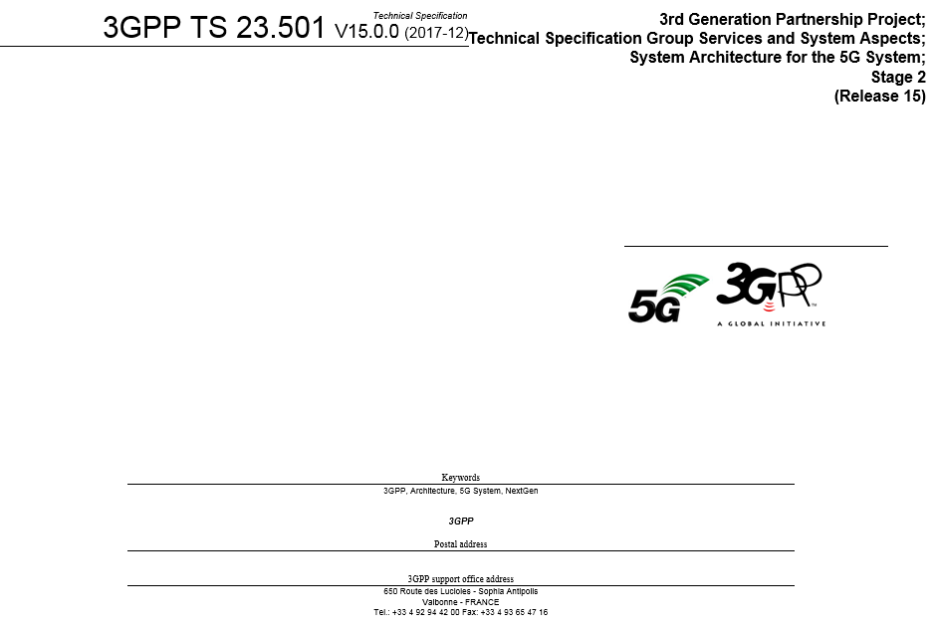
3GPP TS23.501 Standards

Slide 21
Slicing & Network Sharing
CONCEPTS:
- Slicing is independent of Network Sharing
- Slice is only valid in one PLMN
Network Sharing is between PLMN
- One or more Cells may also belong to multiple PLMN Networks.
- PLMNs in the same geographical area could each have a set of registration areas.
- Cell has exactly one and only one Tracking Area (though it might be shared by operators)
PHYSICAL
Multiple Operators may share the same cell
Possibly same RAN (physical CU/DU/RU)
Possibly same Frequency MLCN
UE BEHAVIOR:
UE attaches to whatever PLMN it belongs to
The PLMN are independent and mutually exclusive
Cell #4
Cell #1
Cell #5
Cell #2
Tracking Area #3
Tracking Area #1
Cell #6
Tracking Area #4
Cell #3
Tracking Area #2
PLMN Network #1
PLMN Network #2

Slide 22
5G Slice Management using ONAP
Description
ONAP managing slicing is done by extending the cloud sharing network/compute/storage to share network functions and services implemented across PNFs & VNFs. ONAP enhancements in SDC/AAI modeling and service definition, lifecycle management of slices. Slices will have state, metrics and scaling procedures different from the network functions (e.g. service/slice across multiple NFs from different providers). :
Enhance SDC to model & define slice segments (RAN, Transport, core), E2E slice, and Mobility services
Enhance SO Instantiate and lifecycle manage nested slice segments, E2E slicing and slicing services
Enhance A&AI to inventory and store state of slice segments, slice instances, and 5G slicing services
Integrated design (e.g. complex service composition)
Support Service Aggregation (e.g. complex service hierarchy)
Support Service Chaining (e.g. across multiple clouds, service path)
Support Service Modification Capability (e.g. modifying without downtime)
Monitoring and management of complex nested slice segments, slice instances and slice services

Slide 23
UE not recognized (corner case)
UE MOVES OUT OF RECOGNIZED AREA
When network cannot support slices currently in use by the UE, the network shall release affected PDU sessions, and it is up to UE policy to handle such PDU sessions – UE may initiate change of NSSI during Registration procedure; change in NSSAI in use may result in AMF change. This is from 3GPP 23.501
Cell #1
Cell #2
Tracking Area #1
Cell #3
?
Tracking Area #2
Registration Area #1
UE Starts in known Reg Area & Tracking Area
UE moves out of known area

Slide 24
Public Safety Service (Slice)
PUBLIC SAFETY Service (Slice)
Wireless frequency allocations have the concept of a dedicated wireless spectrum for Public Safety. The FCC (USA) government mandates and allocates particular spectrum dedicated to Public safety. So it is a special problem that needs attention and a unique solution.
The actual implementation and solution of a public safety slice is up to the operator to architect.
Access Class barring,
Public devices AcCl 0
Config cell, only dev w/ AcCl 0 can access this cell.

Slide 25
Notes
UE gets communication service
Offering service, service model & requirements,
Service model w/ attributes, with these behaviors.
End-to-end SLAs. Map that to resources RAN, Transport, Core
In 4G services (e.g. Cat-M) vendors provide BTS S/W algorithms for Cat-M; & parameters. Acceptance phase. Accept new S/W version. Sufficient Quality (SLA). Pre-tested that on CU/DU. Pre-tested 4KVideo on tiger sites, found best optimized parameters. Parameters are pre-determined and “activated”. Baseline understanding of network behavior. Divide the end to end SLA such that the end to end could be met e.g. path selection.

