Slide 1
ONAP Optimization Framework (OOF)
POC for Physical CellID (PCI) Optimization:
PCI Microservice, Policy & RAN simulator
August 10, 2018

Slide 2
ONAP Optimization Framework (OOF) and PCI
ONAP Optimization Framework (OOF) provides a policy-driven and model-driven framework for creating optimization applications for a broad range of use cases
For Casablanca, OOF enhancements include formulation and solving of optimization problems
We propose an OOF enhancement and Proof of Concept (POC) for Casablanca for
Physical Cell ID (PCI) Optimization
  PCI Optimization is a well-understood problem
  The reading/writing of the Physical Cell ID (PCI) configuration parameter has been included in SDN-R POC
Objective of the POC is to demonstrate disaggregation of the PCI SON functionality, and the data flows needed to implement this in ONAP using OOF
We envision a new PCI-Handler Microservice to facilitate the data flow and trigger mechanism
The focus is on data flow and interfaces, and the role of OOF, PCI-Handler-MS, SDN-C Controller and Policy etc
  Objective is to incorporate an algorithm in ONAP using OOF, not to develop an algorithm

Slide 3
ONAP Casablanca: PCI Optimization using OOF
7
4a, 4b
Config change
Change Notifn
6
Simulated RAN
~2000 Cells
Nbr_list, PCI values
OOF
Policy
10
SDN-C
1d
(Netconf/Yang)
1c
8
PCI Handler MS
9
1b
1a
Config DB
2
3
11
5
(SDN-C work done in SDN-R team)
Step | Functionality |  | Step | Functionality
1a-1d | All modules loaded to support PCI |  | 6 | OOF fetches PCI optimization policies from Policy
2 | PCI-Handler MS fetches configuration policies from Policy |  | 7 | OOF queries SDN-C database to fetch data for cells in the region.
3 | Config change notification from RAN to SDN-C (e.g. Nbr list change) |  | 8 | OOF provides PCI Optimization result to PCI Handler MS
4a | SDN-C publishes config data change on DMaaP to PCI-Handler-MS. |  | 9 | PCI-Handler-MS provides PCI recommendation to Policy
4b | PCI-Handler-MS gets additional information from SDN-C . |  | 10 | Policy sends message to SDN-C with instruction for PCI configuration changes
5 | PCI-Handler MS invokes OOF for pre-defined workflow for PCI Optimization. |  | 11 | SDN-C applies config changes via Netconf

Slide 4
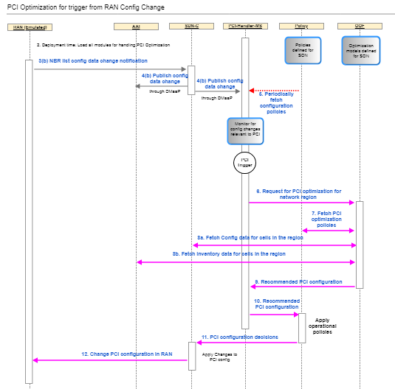
Flow / test case
See latest flow and test case at:
ONAP OOF-based PCI wiki page
https://wiki.onap.org/display/DW/5G+-+OOF+(ONAP+Optimization+Framework)+and+PCI+(Physical+Cell+ID)+Optimization

Slide 5
PCI Microservice architecture
Spring boot application
Core Logic
Upon notification from SDN-R, process it appropriately, including:
  Waiting for more notifications
  Buffering notifications if OOF has been triggered for same cluster
  Checking if OOF has to be triggered, and triggering OOF
Upon receiving response from OOF, trigger policy
Fetch and store policy updates
Core Logic (thread2)
Database
DMaaP client
(thread1)
OOF
SDN-R
Policy
Other ONAP components
Note: This architecture depicts a standalone PCI micro-service. When this is moved to DCAE, the interfaces will be adapted appropriately.
Config information
Processed notifications (but not sent to OOF)
Buffered notifications
State information
RAN-Sim

Slide 6
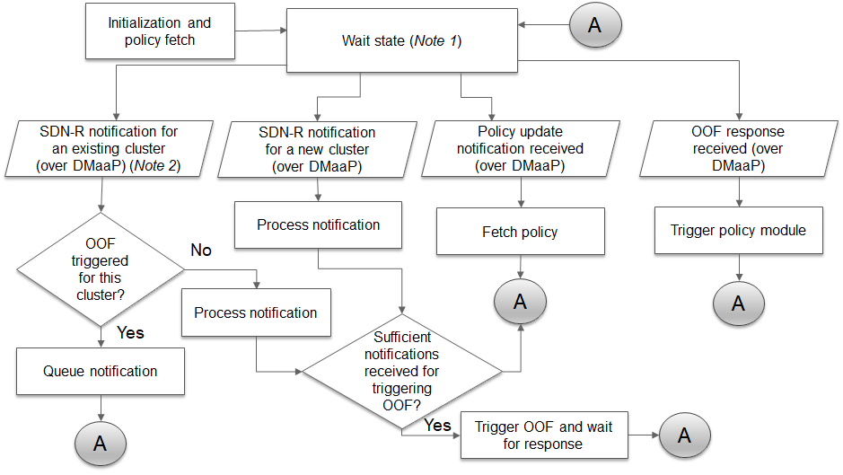
PCI Microservice – workflow illustration
Notes:
Every time when coming to this state, the queue is checked for any buffered SDN-R notifications.
‘Existing’ – a cluster for which a notification has already been received and under processing. Cluster definition is explained along with the algorithm.

Slide 7
PCI Microservice - Functions
Setup and initialization, fetch policy via REST interface
Fetch config policy upon DMaaP notification from Policy (do this whenever notification is received)
Upon reception of notification from SDN-R
  Logic to determine if OOF has to be triggered (including waiting for more notifications in a given time period, temporary storage of notifications in database)
  If OOF has to be triggered, send a DMaaP notification to OOF to trigger PCI optimization, along with relevant details (algorithm name, impacted cells, etc.).
While waiting for response from OOF
  Buffer/queue any new notifications from SDN-R for the same cluster
Upon receipt of response from OOF, prepare DMaaP notification for Policy and send it
After sending DMaaP notification to Policy, check for any pending notifications in the buffer/queue, if present, go to Step 3, else wait for next notification/policy fetch action

Slide 8
PCI Microservice – Interfaces & Dependencies
SDN-R
  DMaaP notification topic (to PCI-MS), json contents (PCI, anr list, cell id)
OOF
  DMaaP notification topic and json contents for PCI optimization trigger
  DMaaP notification topic and json contents for PCI optimization response
Policy Module
  Config policy input format and contents (REST)
  DMaaP notification json contents for PCI config policy update
  DMaaP notification topic and json contents for config changes recommendation by PCI-MS to Policy

Slide 9
PCI MS interface to OOF: Proposal
Producer | Consumer | Topic | Contents (Note)
PCI | OOF | "distrNotificationTopicName": “PCI-NOTIF-TOPIC-PCI-OPT-RQST" | PCI optimization algorithm name Set of PCI, unique cell identifier? and associated ANR list
OOF | PCI | "distrStatusTopicName": “PCI-NOTIF-STATUS-PCI-OPT-RQST" | Status
OOF | PCI | "distrNotificationTopicName": “PCI-NOTIF-TOPIC-PCI-OPT-RESULT" | PCI optimization algorithm result (format – tbd, unique cell identifier?)
PCI | OOF | "distrNotificationTopicName": “PCI-NOTIF-STATUS-PCI-OPT-RESULT" | Status
Note: Notification contents will be in json format, with fields as AVPs.
To discuss
Agree on Producer & Consumer id, and owner/registration – OOF or PCI-MS.
UEB Key generation

Slide 10
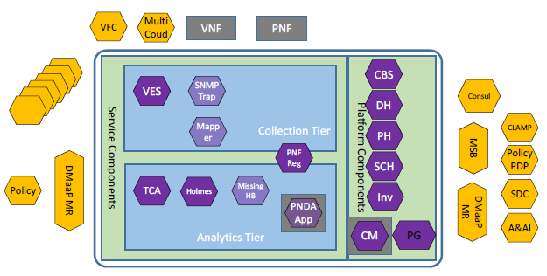

PCI MS as part of DCAE (based on ONAP R2)
SDN-C
PCI
K8s pod
New PCI microservice

Slide 11
PCI MS as part of DCAE – initial actions
Ref: https://wiki.onap.org/pages/viewpage.action?pageId=36963506
Action | Status | Remarks
Review new service proposal with architecture team and project team. | Not started
Identify use case this service will be targeted under (optional). | Ongoing | Use case identified as SON PCI optimization.
Capture external and internal dependencies and API consumed/provided. | Ongoing | Interface impacts identified and being discussed.
Repository creation (PTL will submit request to RM, who will coordinate with TSC/LF support) | Not started
After completion of above actions, subsequent implementation and integration actions as described in the ONAP wiki page to be carried out.
Query: Database for storing state and other data (redis, pg or ??? – any recommendations?)

Slide 12
Policy Component
Provision new config policies for PCI-MS operation (PCI opt. algo name, conditions for triggering OOF) via REST; condition for approving PCI changes, etc.) as Drools policy via REST/GUI, and store it in DB (no code change foreseen).
Upon reception of new PCI config policy, send a DMaaP notification to PCI-MS.
Subscription to new DMaaP topic for ‘PCI change action trigger’ (PCI-MS notification).
Upon reception of information from PCI-MS on ‘PCI change action trigger’ (via DMaaP), check if SDN-R needs to be triggered for PCI changes (based on config policies).
If SDN-R has to be triggered for PCI change, invoke relevant SDN-R recipes.

Slide 13
Policy: Inputs (Proposal)
Policy (Drools)
Policy GUI
VNFs, NW
Template
Notification
PolicyConfig :
{
Type:Config,
ConfigPolicyType: Base,
Param1: Value1,
Param2, Value2
}
Template
PCIAction:
{
Type: Action
RuleAlgo: {
Source: PCIHandler,
Target:SDNR,
Action:updateConfig}
actionPerformer:{
Actor: SDNR,
Action: updateConfig
}
Data Change Notif
OOF
SDN-R
PCI HandlerMS
Note: DMaaP is not shown here.
Call Recipes of SDN-R

Slide 14
Policy Component - changes
Name | Status | Description
policy/parent | New in Casablanca | Parent repository containing the POM and any other information required to build all the sub-projects
policy/core | New in Casablanca | Core code shared among all policy repositories
policy/common | Used in Beijing | Policy common shared modules
policy/models | New in Casablanca | This repository will hold model code agnostic to PDP engines
policy/pap | Unused in Beijing, used in Casablanca | Policy Administration
policy/distribution | New in Casablanca | This repository will hold the SDC Service Distribution code
policy/pdp | Unused in Beijing Used in Casablanca | Common code shared between PDP engines
policy/xacml-pdp | New in Casablanca Code moved from engine repository | The XACML PDP implementation
policy/drools-pdp | Used in Beijing and Casablanca | The Drools PDP implementation
policy/apex-pdp | New in Casablanca | This repo will hold the next generation Apex PDP engine
policy/drools-applications | Used in Beijing | APIs and helper code for accessing other ONAP components from PDPs
policy/docker | Used in Beijing | Policy Docker support
policy/engine | Used in Beijing, will be deprecated | Contains the Policy GUI, client SDK, API's and XACML PDP Engine
Code changes involved

Slide 15
SDN-R -> PCI MS interface
Info from SDN-R – to be discussed
  networkId;
  nodeId;
  physicalCellId;
  nodeName;
  nodeType;
  latLong;
  pciCollisionDetected (bool);
  pciConfusionDetected (bool);
  neighborList

Slide 16
Approach for RAN Simulator
Simulated Network
  Yang model defined by SDN-R module will be used for simulation
  ConfD Basic Netconf Server will be used to simulate the RAN. C- API extension will be used to update the phy-cell-id values , to send ran-neighbor-list changes
  Each netconf server will run as standalone process or Docker container
  The netconf servers will be spawned by RANSim Controller based on the topology specified.
  Python scripts and client will seed the initial configuration for each Node.
  Each netconf server can send a mount request to SDN-R when they are spawned.
  ran-neighbor-list update notification will be sent by netconf server to SDN-R based on the trigger from RANSim Controller
  Will be able to accept phy-cell-id update trigger from SDN-R and forward same to RANSim Controller
ONAP
PCI MS
Policy
Web GUI
Robot Framework/
Python scripts
SDN-R
Simulated Network
Netconf server 1
RANSim
Controller
Netconf server n
ConfD
ConfD
Extension
Config DB
Extension
Yang Model
Yang Model
Initial configuration
Python Script

Slide 17
Approach for RAN Simulator
ONAP
RANSim Controller
  Spring Boot based micro service
  RAN topology of ~2000 nodes to be simulated is defined into a Config DB
  RAN Simulator spawns the Nodes based on this topology
  Exposes following rest APIs to
    Retrieve the current topology
    Update phy-cell-id of a node to simulate collision or confusion
    Drop a cell or create a new cell
    Retrieve the new phy-cell-id set by SDN-R to a node
    Start/Stop the network simulation
  MariaDB will be used as the config database to store the topology
  Robot scripts will drive the complete test sequences
  Web GUI will show the current topology, phy-cell-id collision/confusions, ran-neighbor-list changes, updates from SDN-R, etc. Pictorial representation will be a stretch goal
PCI MS
Policy
Web GUI
Robot Framework/
Python scripts
SDN-R
Simulated Network
Netconf server 1
RANSim
Controller
Netconf server n
ConfD
ConfD
Extension
Config DB
Extension
Yang Model
Yang Model
Initial configuration
Python Script

Slide 18
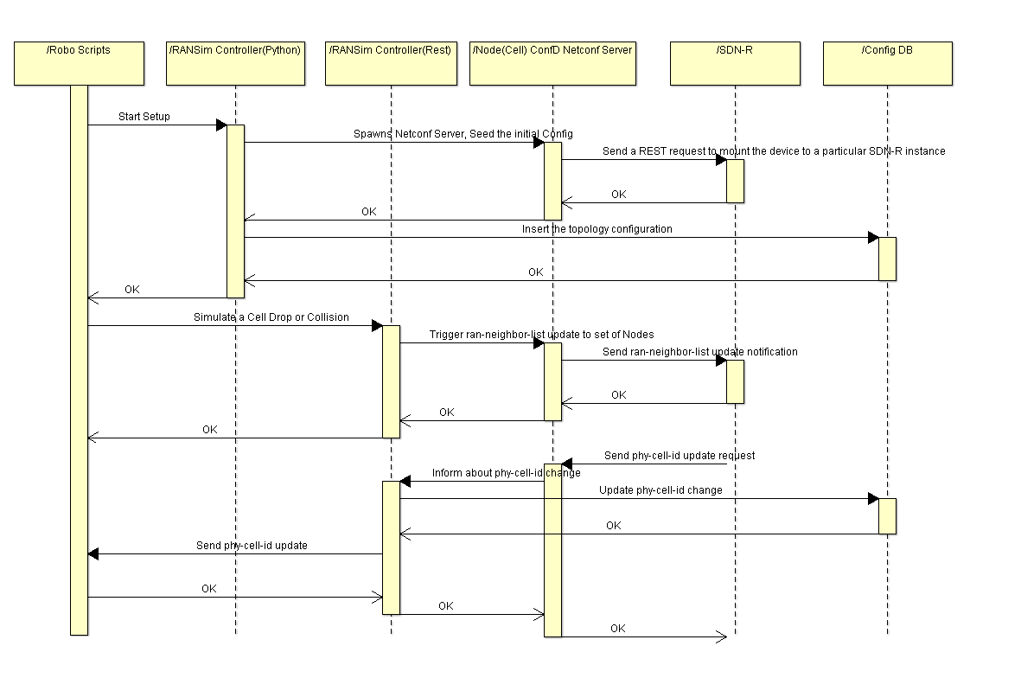
Illustrative sequence for a test scenario

Slide 19
Thank You!

Slide 20
Backup

