Slide 1


ONAP PNF Plug and Play
for Casablanca (R3, 4Q 2018)
ONAP and PNF Plug and Play for 5G RAN
5G Use Case Team
Jul 16, 2018 version 7

Slide 2
PNF Plug and Play
CASABLANCA IMPROVEMENTS OVERVIEW
ONAP and PNF Plug and Play for 5G RAN
5G Use Case Team

Slide 3

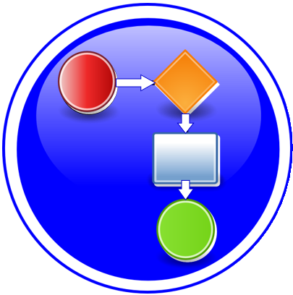




Casablanca R3 Summary Overview
TOPIC | ICON | DESCRIPTION
PNF Registration Handler (PRH) Improvements |  | New VES Event domain for PNF registration with corresponding support in VES collector, DMaaP and PRH.
SO Workflow enhancements |  | Introduction of dedicated 5G use case work-flow
Service Configuration Improvement |  | Service configuration improvements from PNF Controller (APP-Cr, SDN-Cr) to PNF after PNF registration to PRH
Security Enhancements |  | Authentication, Certificates, User name & password and intra-ONAP security.
Modeling enhancements |  | Modeling enhancements to support 5G PNF in ONAP. Inheritance, and PNF characteristics for sharing. Focusing on PNF connectivity. PNF-SDK.
PNF Onboarding / Package |  | Defining PNF Onboarding Package. Extending framework to work with PNFs. Defining PNF Package framework.

Slide 4
ONAP Links
PAGE | LINK
Use case proposal: 5G- RAN deployment, Slicing, SON | https://wiki.onap.org/display/DW/Use+case+proposal%3A+5G-+RAN+deployment%2C+Slicing%2C+SON
5G Functional Requirements Tracking | https://wiki.onap.org/display/DW/5G+Functional+Requirements+Tracking
Casablanca Release Requirements | https://wiki.onap.org/display/DW/Casablanca+Release+Requirements
NFModeling-SDC_R324Jul2018v1 | https://wiki.onap.org/display/DW/Casablanca

Slide 5
PRH Enhancements
DESCRIPTION
PNF Registration Handler (PRH) Enhancements.
(1) New VES Event domain for PNF Registration – Create new VES event domain for PNF registration with corresponding support in VES collector, DMaaP and PRH. In Beijing the PnP Use case used the “other” domain to register VES events. For Casablanca, we propose using a dedicated domain “pnfRegistration“. New DMaaP topic corresponding to new domain.
(2) VES EXTENSIONS - As a result, VES collector and VES agent content will change with field updates using the new domain. Extensions for pnfRegistration fields. Corresponding VES Schema change.
(3) DU SIMULATOR UPDATE – The registration VES event used by the DU Simulator (or actual PNF) will need to update its JSON payload to match the changes above.
(4) PRH & AAF INTEGRATION – PRH needs to interface to AAF for Intra-ONAP security. PRH needs to use certificates and tokens for authentication to be allowed to exchange events. PRH needs this authorization to publish to DMaaP topics.
(5) REVIEW LIBRARIES – comply to Linux foundation requirement for licensing & security vulnerabilities. Risk estimation.
(6) DEMO – Demo of PRH w/ PNF PnP in 5G Use Case
PROJECTS
PNF Registration Handler, DMaaP, DCAE

Slide 6
PNF PnP: SO Workflow Enhancements
DESCRIPTION
SO WORKFLOW ENHANCEMENTS – Dedicated 5G BTS Workflow in SO. (If not model-driven would need special 5G BTS workflow)
PNF WORKFLOW – Extensions to Beijing SO Workflow (part of VCPE workflow). Developed in Beijing not tested or integrated.
MODEL DRIVEN – SO not yet model driven. Need to solve vis-à-vis a SO work flow specific to service & resource use case.
UPDATE PNF WORKFLOW – needs to be officially tested, accepted (in Casablanca).
PNF Controller TO SO INTERACTION –SO calls PNF Controller (SDN-R, Generic API call vs REST call)
DFX (Design for Excellence) – Resilience, Performance, Scalability, Stability, Multi-site.
PROJECTS
SO

Slide 7
SERVICE CONFIGURATION ENHANCEMENT
DESCRIPTION
Service configuration Enhancements to ONAP Controller to PNF service configuration exchange with PNF.
PROTOCOL DEFINITION – Better definition around the Protocols supported (and/or support more protocols). What ONAP controller supports what PNF and what protocols are supported. NetConf, Ansible, Chef.
Configuration Extensions – New parameters needed for Casablanca use cases. Vid script to pushing data, ID config, ID where data comes from. Generic configuration support.
PNF PnP Config – Finishing PNF PnP by sending down config data.
(OPTIONAL) Vendor Data – Extensions to Service Configuration with Vendor specific configuration data can be developed (vendor dependent).
PROJECTS
ONAP Controller (SDN-R), VID, SO, SDC/CDT

Slide 8
SECURITY ENHANCEMENTS
DESCRIPTION
PNF AUTHENTICATION – DCAE must authenticate the HTTP/TLS connection from the PNF. DCAE to integrate the HTTP and TLS authentication functionality by AAF.
VENDOR CERTIFICATES – Handling Vendor Certificates for TLS/SSH for PNFs.
USER NAME & PASSWORDS – Provisioning. DCAE & PNF management of User Name & Passwords.
SECURITY BETWEEN COMPONENTS – DMaaP & PRH to authenticate w/ other ONAP components.
PROJECTS
PNF Registration Handler, DCAE, AAF, ONAP Controller, DMaaP

Slide 9
PNF PnP: MODELING ENHANCEMENTS
DESCRIPTION
PNF MODELING – Modeling enhancements to support 5G PNF in ONAP. Model Inheritance definitions for PNF. SDC modeling improvements from Beijing PnP use case.
PNF SHARING – SDC model updates for PNF characteristics focusing on PNF inter-connectivity.
PNF-SDK – SDK provided from Vendors. This will help modeling the Physical “Box” (PNF) and network functions.
CDT ENHANCEMENTS - Improving CDT to handle complex config templates, multiple templates per PNF, identify different sources for template data, integrating CDT into SDC, expanding CDT usage to other controllers.
PROJECTS
SDC, CDT

Slide 10
PNF ONBOARDING / PNF PACKAGE
DESCRIPTION
PNF Onboarding and PNF Package
PNF PACKAGE DEFINITION – Defining PNF Onboarding Package. Extending framework to work with PNFs. Defining PNF Package framework.
  PNF ARTIFACTS DEFINITION – Vendor specific/provided artifacts to add to the (new PNF) package.
  PNF ARTIFACTS DISTRIBUTION
PROJECTS:
SDC, APP-C

Slide 11
PNF Plug and Play
IN CASABLANCA (R3)
ONAP and PNF Plug and Play for 5G RAN
5G Use Case Team

Slide 12



PNF Plug and Play Stages
1
Resources Definition/Services Definition
SDC: PNF (physical element) Modeling
Distribution of types
Design Time
PNF Modeling
2
  PNF Infrastructure Service Declaration
  First part of PNF instantiation
  DCAE & AAI Entry with PNF ID (e.g. MAC address)
PNF Instance
Declaration
15
16
17
18
19
20
21
22
3
PNF Powers up and Boot-straps
PNF performs a “Plug and Play” procedure
Equipment vendor proprietary steps
PNF
Boot-strapping
4
PNF connects to ONAP via a Registration Event
PNF Registration Handler (PRH) processes the event
PNF
Contacts ONAP
25
26
27
28
29
30
31
Run-Time (Instances)
5
Connection points configured
Second part of PNF service instantiation
PNF configured and ready to provide service
PNF
Activation
34
35
36
37
38
39
40
41
42

Slide 13
ACTORS | DESCRIPTION
PNF | PHYSICAL NETWORK FUNCTION (PNF) – A Network Function that is hosted on a physical hardware device, not in the cloud infrastructure.
DHCP | DYNAMIC HOST CONFIGURATION PROTOCOL (DHCP) – Protocol to assign IP addresses to a network element (NE). The IP address can be dynamically assigned or static based on MAC address of PNF.
SEGW | SECURITY GATEWAY – Used to set up IPSec tunnels to protects against unsecured traffic entering an internal network of a operator; used by enterprises to protect their users from accessing and being infected by malicious traffic.
CA/RA | CERTIFICATE AUTHORITY / REGISTRATION AUTHORITY – Used to generate a service provider certificate for the PNF.
Initial EM | INITIAL EM – Provides basic configuration and software download services to the PNF. This might be a equipment vendor specific solution. Also, responsible for identifying a PNF.
SDN-C | SOFTWARE DEFINED NETWORK CONTROLLER (SDN-C) – A controller for Layer 0 to 3 devices. Manages transport and network connections.
DCA&E | DATA COLLECTION, ANALYTICS AND EVENTS (DCAE)– Gathers performance, usage, and configuration data from the managed environment. Collect, store data and provides a basis for analytics within ONAP. For PNF Plug and Play can potentially perform analytics on the Plug and Play process, statistics, logs.
A&AI | ACTIVE & AVAILABLE INVENTORY – The PNF is identified as available inventory and tracked through a key which is the PNF ID. When onboarded the PNF gets an entry in A&AI and can then be tracked, requested, and seen by the ONAP components for service requests or other queries.
SO | SERVICE ORCHESTRATOR – Serves as a mediator and coordinator of service requests.
APP-C | APPLICATION CONTROLLER (APP-C) - A controller for Layer 4 to 7 applications. Manages the life cycle of virtual applications, virtual network functions (VNFs), and components. APP-C manages the 5G DU & 4G DU.
PNF Registration Handler | PNF Infrastructure Manager – A microservice in DCAE used during PNF Plug-n-Play to process the PNF Registration event.

Slide 14


Design Time (ONAP)
SDC
SDN-C
SDN-R
APP-C
DCAE
AAI
SO
1
Resource Definition
CASABLANCA
PNF Onboarding Package
PNF type
INPUT: PNF Descriptor (PNFD) (Vendor Provider)
ACTION: User builds a resource definition customizing vendor’s PNF description. “blue print” of PNF
OUTPUT: SDC Resource Definition
2
Service Definition
2
Service Definition
2
Service Definition
Customization
of Resource Definition
CASABLANCA
PNF Modeling Enhancements
INPUT: SDC Resource Definition
ACTION: Designer: Customizes the SDC Resource Definition with service specific parameters. Define the PNF types “object Model” e.g. 5G DU, 4G, Legacy DU. Infrastructure services, services for PNF.
OUTPUT: Service Definition
3
Type Modeling Artifacts Distribution
Listener
UEB Listener
Service Change Handler
Listener
INPUT: SDC Service Definitions
ACTION: Type Modeling Artifact (from SDC) are distributed to other ONAP components (DCAE, SO, AAI). SDC artifacts include policies & Work-flows related to that type are defined.
Context-sensitive distribution based on PNF type.
OUTPUT: ONAP components are prepared to manage PNFs of that new type.
Vendor Specific Step

Slide 15
PNF PnP: MODELING ENHANCEMENTS
DESCRIPTION
PNF MODELING – Modeling enhancements to support 5G PNF in ONAP. Model Inheritance definitions for PNF. SDC modeling improvements from Beijing PnP use case.
PNF SHARING – SDC model updates for PNF characteristics focusing on PNF inter-connectivity. DCAE-DS Micro-service modeling.
PNF-SDK – SDK provided from Vendors. This will help modeling the Physical “Box” (PNF) and network functions.
CDT ENHANCEMENTS - Improving CDT to handle complex config templates, multiple templates per PNF, identify different sources for template data, integrating CDT into SDC, expanding CDT usage to other controllers.
PROJECTS
SDC, CDT

Slide 16
PNF ONBOARDING / PNF PACKAGE
DESCRIPTION
PNF Onboarding and PNF Package
PNF PACKAGE DEFINITION – Defining PNF Onboarding Package. Extending framework to work with PNFs. Defining Package framework.
  PNF ARTIFACTS DEFINITION – Vendor specific/provided artifacts to add to the (new PNF) package.
  PNF ARTIFACTS DISTRIBUTION
TOSCA Meta data - main service template, TOSCA template.
Artifact Package. Separated by types of artifacts. Separations by folder for different types. Place artifacts in categories. Anyone can choose which artifacts to receive.
Definitions – Specifies definitions such as CM, FM and PM definitions
Protocols Supported – PNF package. CM Protocol is in PNF onboarding package. (Chef, Ansible, NetConf)
Controller – What is the PNF controller
PROJECTS:
SDC, APP-C

Slide 17
STEP | DESCRIPTION
1 | RESOURCE DECLARATION – A user on the VID performs a Resource Declaration. This uses the Service definition created in SDC. The user on the VID can define known information about the PNF. The user can (optional) provide the following information PNF RESOURCE Definition Resource Type – Type of Resource. NEW type: PNF (pre-defined in SDC) NAME – Name of the PNF type CATEGORY – e.g. Infrastructure TAGS – User-definable tags (default name of the PNF) DESCRIPTION – Textual description CONTACT ID – Designer (user of ONAP) VENDOR – PNF Vendor (e.g. Nokia) VENDOR RELEASE – Vendor release VENDOR MODEL NUMBER – PNF Model value (link to A&AI) EVENTS – Monitoring Event definitions. Define design-time templates. CLAMP (runtime monitoring), DCAD (design time design template attach to VNF). Define templates & attach them. Note: The user may provide whatever information in the above fields they know. Note: Consumer vs Enterprise deployments. Consumer systems pre-registered, distributed throughout a region. For a consumer deployment you might not know the MAC address/Serial number (PND IF) until the PNF connects to ONAP.
2 | SERVICE Definition (uses a PNF) NAME – Name of the Service (mandatory) CATEGORY – e.g. Network L1…L4, VOIP call Control, Mobility TAGS – User-definable tags (default name of the PNF) DESCRIPTION – Textual description of service (mandatory) CONTACT ID – Designer (user of ONAP) (mandatory) PROJECT CODE – ID (mandatory) Ecomp-Generated Naming – Name Naming Policy – Policy to be used to assign a name to a service by SO/SDNC SERVICE TYPE – Type of service SERVICE ROLE – The Role of this service. ENVIRONMENTAL CONTEXT – distributed environments Specific Service(?) – PNF, allotted resource from a CU Service The “basic” model are extended. Inherit (OO) from existing model. Vendor takes standard node types and creates their own extension. CDT (Configuration Design Tool) (GUI) to build artifacts to be used by APP-C (Tosca models) for a configure Template.
3 | DISTRIBUTION – Event Monitoring Templates distributed. (?)

Slide 18

Deployment Handler (VES Collector)
Clamp
GUI
Deployment
Handler
Deploying a PNF Blueprint
To make a VES Collector in DCAE work properly
PNF Blueprint will be docker container. May be deployed from CLAMP or Cloudify Orchestrator.
Within VES Collector schema uses “Adder” (existing)

Slide 19
STEP | DESCRIPTION
1 | DEPLOYMENT HANDLER PNF BLUEPRINT – The Deployment handler is necessary to use, to give it the PNF blueprint so that later on in the Plug and Play flow, DCAE will recognize the PNF. The PNF Blueprint will be docker container. The PNF blueprint May be deployed from CLAMP or Cloudify Orchestrator to DCAE. Within VES Collector schema uses “Adder” (existing).

Slide 20

PNF Resource Declaration
BSS Portals
AAI
VID
AAI UI
OPT
4
Resource Declaration & Create A&AI PNF Entry
A&AI entry of Inactive PNF, PNF Type Resource Declaration
Inactive PNF A&AI entry
Steps 15-22 accomplishes this purpose but service providers can choose to implement this flow to augment (e.g. service providers inventory management system)

Slide 21
STEP | DESCRIPTION
4 | RESOURCE DECLARATION – A user on the VID performs a Resource Declaration. This uses the Service definition created in SDC. The user on the VID can define known information about the PNF. The user can (optional) provide the following information PNF RESOURCE Definition Resource Type – Type of Resource. NEW type: PNF (pre-defined in SDC) NAME – Name of the PNF type CATEGORY – e.g. Infrastructure TAGS – User-definable tags (default name of the PNF) DESCRIPTION – Textual description CONTACT ID – Designer (user of ONAP) VENDOR – PNF Vendor (e.g. Nokia) VENDOR RELEASE – Vendor release VENDOR MODEL NUMBER – PNF Model value (link to A&AI) EVENTS – Monitoring Event definitions. Define design-time templates. . The PNF entry in AAI is created by the PRH with the PNF ID (or correlation ID) address. After this step, the PNF is considered to be created but inactive within ONAP. It can then be later used in the second part of service instantiation. See Step 28. (OPTIONAL) IP address of PNF may be set during this step

Slide 22

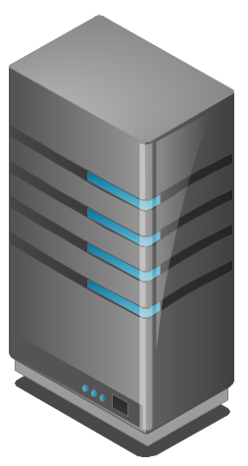


PNF Plug and Play Component Interaction
42
BSS/
OSS
ONAP
Portal
VID
15
ONAP Deployment
DESIGN-TIME
1
2
SDC
CLAMP
CATALOG
3
RUN-TIME
Policy
Framework
Common
Services
34
16
22
40
41
DCAE
38
36
SO
MSB / DMaaP
21
31
pnfReady
27
35
SDN-C
19
A&AI
ESR
PRH
39
APP-C
20
29
30
26
37
OPERATIONAL NE
28
pnfRegistration
Certificate
Authority
Security
Gateway
25
-
DHCP Server
6
14
5G DU (PNF)

Slide 23
PNF Plug and Play Component Interaction
BSS/
OSS
ONAP
Portal
VID
ONAP Deployment
DESIGN-TIME
SDC
CLAMP
CATALOG
RUN-TIME
Policy
Framework
Common
Services
DCAE
SO
MSB / DMaaP
pnfReady
PRH
SDN-C
APP-C
A&AI
ESR
pnfRegistration
Security
Gateway
(Optional)
Docker container
Lab – one VM (2 containers)
Cont#1 Sends pnfReg
Cont#2 NetConf Server
Emulated DU (PNF)

Slide 24
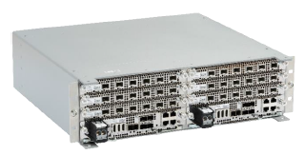
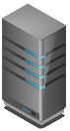





PNF Plug and Play Steps (for 5G DU)
Factory
Software
Local
DHCP
SEGW
CA/RA
Initial
EM
6
Preplanning, Pre-provisioning
Work order updated w/ Correlation ID
7
HW Install
8
DHCP Discover
VLAN Scanning
IPv4/IPv6 discovery
9
DHCP Response
PNF IP@(m)*, Initial EM IP@ (m), SEGW IP@(o), CA IP@(o)
*Temporary PNF IP@
10
IPSec Tunnel Setup (optional)
11
Certificate Enrollment (optional)
12
Identity Service (Identifies NE), Gives ONAP IP@
13
Download ONAP Compliant Software
14
PNF Restart
Activates SW
Vendor Specific Step

Slide 25
STEP | DESCRIPTION (Plug and Play Vendor steps for Infrastructure components)
6 | PRE-PLANNING, PRE-PROVISIONING – There is data which is programmed into the system for the PNF Plug and Play operation. The user programs the local DHCP IP address(@), the Security Gateway IP@, the CA/RA certificate information, the management plane IP address (the ONAP IP@), the software service IP@ for use by the PNF during the onboarding process. Note: The CU is instantiated ahead of time with the expected DUs that it should be connected to (that is outside the scope of this flow). Note: The user name & password which the PNF needs to know to contact and get through the vAAA server before it contacts ONAP.
7 | HW INSTALL – The physical hardware is installed at the site. Site licensing, real estate contacts, zoning, and physical hardware of the PNF is installed by technicians. Power, backhaul, and antennas are installed and connected.
8 | INITIAL NETWORK ACCESS – A DHCP Discover procedure is executed when the PNF powers on, VLAN Scanning is performed, and IPv4/IPv6 discovery is done. The DHCP Discover message exchange provides an entryway into the network and is designed as an procedure for a network element to be able to find connection to the network from “scratch”. VLAN Scanning and IPv4 vs IPv6 discovery is done as well.
9 | DHCP RESPONSE – The DHCP response returns a PNF IP address, the initial EM IP address, Security Gateway IP address (optional), and certificate authority IP address (opt). It is possible the PNF IP address is a temporary IP address used for initial connectivity purposes, and that a permanent PNF IP address will be granted later.
10 | IPSEC TUNNEL – An IP Sec Tunnel is established which uses cryptography to provides a secure connection. IPSec has two security services: Authentication header and an encapsulating security payload with tunnel and transport modes.
11 | CERTIFICATE ENROLLMENT – The process where the PNF gets a service provider certificate from the Certificate authority. The certificate is then used to authenticate and verify the PNF.
12 | IDENTITY SERVICE – The identity service is there to identify the PNF. It also returns the ONAP (DCAE) IP address.
13 | ONAP COMPLIANT SOFTWARE – The PNF contacts the initial EM and downloads the ONAP Bootstrap software. This is a software package that is meant to perform the remaining steps of PNF registration and activation onto ONAP
14 | PNF RESET – The PNF is reset so that the downloaded ONAP Bootstrap software becomes activated and is then ready to continue to PNF registration
Vendor Specific Step

Slide 26
PNF Bootstrapping Steps (for Routers)
Router
Local
DHCP
SEGW
CA/RA
Initial
EM
6
Preplanning, Pre-provisioning
ID
7
HW Install
8
DHCP Discover
VLAN Scanning
IPv4/IPv6 discovery
9
DHCP Response
Router IP@(m)*, Initial EM IP@ (m), SEGW IP@(opt)
*Temporary PNF IP@
11
Certificate Enrollment (optional)
12
Identity Service (Identifies NE), Gives ONAP IP@
13
ONAP Compliant Software
14
PNF Restart
Activates SW
ONAP Flag = True
Vendor Specific Step

Slide 27
STEP | DESCRIPTION (Plug and Play Vendor steps for Infrastructure components)
6 | PRE-PLANNING, PRE-PROVISIONING – There is data which is programmed into the system for the PNF Plug and Play operation. The user programs the local DHCP IP address(@), the Security Gateway IP@, the CA/RA certificate information, the management plane IP address (the ONAP IP@), the software service IP@ for use by the PNF during the onboarding process. Note: The CU is instantiated ahead of time with the expected DUs that it should be connected to (that is outside the scope of this flow). Note: The user name & password which the PNF needs to know to contact and get through the vAAA server before it contacts ONAP.
7 | HW INSTALL – The physical hardware is installed at the site. Site licensing, real estate contacts, zoning, and physical hardware of the PNF is installed by technicians. Power, backhaul, and antennas are installed and connected.
8 | INITIAL NETWORK ACCESS – A DHCP Discover procedure is executed when the PNF powers on, VLAN Scanning is performed, and IPv4/IPv6 discovery is done. The DHCP Discover message exchange provides an entryway into the network and is designed as an procedure for a network element to be able to find connection to the network from “scratch”. VLAN Scanning and IPv4 vs IPv6 discovery is done as well.
9 | DHCP RESPONSE – The DHCP response returns a PNF IP address, the initial EM IP address, Security Gateway IP address (optional), and certificate authority IP address (opt). It is possible the PNF IP address is a temporary IP address used for initial connectivity purposes, and that a permanent PNF IP address will be granted later.
11 | CERTIFICATE ENROLLMENT – The process where the PNF gets a service provider certificate from the Certificate authority. The certificate is then used to authenticate and verify the PNF.
12 | IDENTITY SERVICE – The identity service is there to identify the PNF. It also returns the ONAP (DCAE) IP address.
13 | ONAP COMPLIANT SOFTWARE – The PNF contacts the initial EM and downloads the ONAP Bootstrap software. This is a software package that is meant to perform the remaining steps of PNF registration and activation onto ONAP
14 | PNF RESET – The PNF is reset so that the downloaded ONAP Bootstrap software becomes activated and is then ready to continue to PNF registration
Vendor Specific Step

Slide 28
Service Instantiation Process (Part 1)
BSS / OSS / VID
SO
OOF
AAI
15
Work Order
CASABLANCA
5G Dedicated SO Workflow
CorrelationID,
location
16
Service Instantiation
(Correlation ID)
Decomposition 5G DU Service
DU resource Type assumes SO has info to
determine PNF SDC model w/ Location
17
Homing (OOF Sniro) / NoOp
18
Resource level flow RLF
ALT: A&AI Entry exists
19
Check A&AI Entry (PNF has A&AI entry)
(If found associate w/ svc instance object go to wait state)
ALT: A&AI Entry missing
20
Create A&AI Entry with Correlation ID & no IP@
Resource Level Flow
21
Subscribe
VES event
RLF thread terminates
Inactive PNF A&AI entry
22
Pending on PNF VES event with Correlation ID
Wait up to 2 weeks

Slide 29
PNF PnP: SO Enhancements
DESCRIPTION
PNF WORKFLOW – Coded in Beijing but needs yet to be integrated, tested, and accepted. Note: One PNF workflow (SO) that has two entry points: (1) instantiate & wait (Step 16) (2) Update (Step 34). One BPMN.
SO TO PNF Controller INTERACTION – SO calls SDN-R (Generic API call vs REST call (?)). How should SO recognize which controller to use. List of operations.
PNF WORKFLOW ENHANCEMENTS –Investigate the use of a Generic PNF workflow (will it work for 5G PNF). Investigate if enhancements (customizations) are needed to the PNF Workflow.
MODEL DRIVEN – SO not yet model driven. Need to solve vis-à-vis a SO work flow specific to service & resource use case. Controller type to be used w/ PNF should be modeled in SDC.
DFX (Design for Excellence) – Resilience, Performance, Scalability, Stability, Multi-tentants (multi-tenants access). Multi-site (single instances of SO).
PROJECTS
SO, SDN-R, SDC, AAI

Slide 30
# | DESCRIPTION
15 | WORK ORDER – The work order (AT&T work order process) determines which PNF to use for this Service/work order. BSS is told the correlation ID. Typically, the PNF will be known before the PNF comes on-line. Orchestrated with a equipment order (to vendor) and location value for the PNF.
16 | SERVICE INSTANTIATION – The user on the VID creates a service instantiation providing a correlation ID. The service is decomposed for a 5G DU PNF. The DU resource types assumes that there is enough information to determine the PNF SDC model. The configuration parameter is provided manually (as part of service instantiation data).
17 | HOMING – The SO instantiation is homed with the OOF. Dependencies stated on PNF. The homing latency constraints are based on CPE address (location). As part of the service definition a latency needs to be less than [x]. This is a service constraint. Homing dependencies should come from SDC or VID. PNF homes to a CU. [FUTURE] Homing identifies the place where a VNF is instantiated. For PNF there is no “cloud” resources needed (CU); ONAP instantiations/data-centers want to define which ONAP instantiation takes care of a PNF [FUTURE].
18 | RESOURCE LEVEL FLOW (RLF)- The resource level flow thread starts. This thread is responsible for carrying out the creation of an A&AI entry in the following steps (steps 18 through 21).
19 | CHECK A&AI ENTRY – The RLF thread in SO checks the A&AI entry for the PNF. If SO discovers that there is an A&AI entry with both the correlationID and the PNF IP@ then it can continue. If found it can associate it with the service instance.
20 | CREATE A&AI ENTRY – A&AI entry created by SO for PNF using the available information and the correlation ID. This is done in anticipation of the PnP PNF VES event.
21 | CREATE DMaaP TOPIC LISTENER – The RLF thread (process) subscribes to the DMaaP Topic that will complete the service instantiation. It allows ONAP to intercept the VES event that will eventually come from the PNF when it reaches a point in the PNF Plug and Play process that it is ready to contact ONAP. The RLF specific resource thread indicates that it cares about the VES event with this correlation ID. Essentially it activates a “listener” of the PNF VES event. DCAE is the normal VES event Listener which creates a DMaaP Topic. SO saves the state information looks and sees if it is one of the DMaaP topics it is waiting for.
22 | RLF THREAD TERMINATES – The Resource Level Flow (RLF) thread in SO terminates. When the VES event is received at a later point in time, it can be processed accordingly. Additionally, these steps 15-22 prepare ONAP with the pre-requisite information so that when the VES event comes from the PNF it will not be discarded. This is denoted by stopwatch icon . At a later step in the PNF Plug and Play this thread becomes relevant again at the other stopwatch icon. The RLF thread/process stops processing and wait for an asynchronous event (to avoid a long running event). Writes a process, kamunda handler for an event that rehydrates it. (this reuses the SO rainy day handling)

Slide 31
PNF Registration Steps
PNF
(DU)
DCAE
PNF
Registration
Handler
AAI
CASABLANCA
Security Enhancements
25
Authenticates PNF Connection
HTTP, TLS Certificates
HTTPS
26
PNF Registration (VES Event) (periodic) [Ignore]
PNF ID, PNF IP@, Vendor Name
CASABLANCA
PRH VES Dedicated Domain
Event Collection
27
Inventory Query
PNF Not Found
Service Instantiation Process Flow (step 19)
HTTPS
28
PNF Registration (VES Event) (periodic) [Keep]
Event Collection
29
Inventory Query
30
Update PNF Entry
Update A&AI Entry with PNF IP address
31
PNF Ready
PNF A&AI entry
PNF_READY DMaaP Topic

Slide 32
pnfRegistration VES Event
Field | Type | Required? | Description
version | number | Yes | Version of the event header (currently: 3.0) 3.0
eventName | string | Yes | pnfRegistration_vendor_pnfName where pnfName is specified by the vendor and is a PNF type; e.g. pnfRegistration_Nokia_5gDu
domain | string | Yes | Event domain enumeration: ‘fault’, ‘heartbeat’, ‘measurementsForVfScaling’, ‘mobileFlow’, ‘other’, ‘sipSignaling’, ‘stateChange’, ‘syslog’, ‘thresholdCrossingAlert’, ‘voiceQuality’, ‘pnfRegistration’
eventId | string | Yes | Event key that is unique to the event source registration_yyyyyyyy where yyyyyyyy is an integer starting at 0 and incremented by 1 for every pnfRegistration event sent by this PNF
eventType | string | No | pnfRegistration
nfcNamingCode | string | No | Network function component type: 3 characters (aligned with vfc naming standards) Not used
nfNamingCode | string | No | Network function type: 4 characters (aligned with vnf naming standards) Not used
sourceId | string | No | UUID identifying the entity experiencing the event issue (note: the AT&T internal enrichment process shall ensure that this field is populated) Not used
sourceName | string | Yes | Name of the entity experiencing the event issue PNFid (unique PNF instance ID = PNF correlation ID = pnf-name stored in AAI ; e.g. NOK6061ZW3)
reportingEntityId | string | No | UUID identifying the entity reporting the event, for example an OAM VM (note: the AT&T internal enrichment process shall ensure that this field is populated) Not used
reportingEntityName | string | Yes | Name of the entity reporting the event, for example, an EMS name. May be the same as the sourceName. For synthetic events generated by DCAE, it is the name of the app generating the event. PNFid (unique PNF instance ID = PNF correlation ID = pnf-name stored in AAI ; e.g. NOK6061ZW3)
priority | string | Yes | Processing priority enumeration: ‘High’, ‘Medium’, ‘Normal’, ‘Low’ Normal
startEpochMicrosec | number | Yes | the earliest unix time aka epoch time associated with the event from any component--as microseconds elapsed since 1 Jan 1970 not including leap seconds current time
lastEpochMicrosec | number | Yes | the latest unix time aka epoch time associated with the event from any component--as microseconds elapsed since 1 Jan 1970 not including leap seconds current time
sequence | integer | Yes | Ordering of events communicated by an event source instance (or 0 if not needed) 0
internalHeader Fields | internalHeader Fields | No | Fields (not supplied by event sources) that the VES Event Listener service can use to enrich the event if needed for efficient internal processing. This is an empty object which is intended to be defined separately by each provider implementing the VES Event Listener. Empty Not used

Slide 33
pnfRegistration VES Event
Field | Type | Required? | Description
pnfRegistrationFieldsVersion | number | Yes | Version of the pnfRegistrationFields block (currently: 1.0)
serialNumber | string | Yes | TS 32.692 serialNumber = serial number of the unit; e.g. 6061ZW3
vendorName | string | Yes | TS 32.692 vendorName = name of manufacturer; e.g. Nokia. Maps to AAI equip-vendor.
oamV4IpAddress | string | No¹ | IPv4 m-plane IP address to be used by the manager to contact the PNF. Maps to AAI ipaddress-v4-oam.
oamV6IpAddress | string | No¹ | IPv6 m-plane IP address to be used by the manager to contact the PNF. Maps to AAI ipaddress-v6-oam.
macAddress | string | No | MAC address of unit.
unitFamily | string | No | TS 32.692 vendorUnitFamilyType = general type of HW unit; e.g. BBU.
unitType | string | No | TS 32.692 vendorUnitTypeNumber = vendor name for the unit; e.g. Airscale. Maps to AAI equip-type.
modelNumber | string | No | TS 32.692 versionNumber = version of the unit from vendor; e.g. AJ02. Maps to AAI equip-model.
softwareVersion | string | No | TS 32.692 swName = active SW running on the unit; e.g. 5gDUv18.05.201.
manufactureDate | string | No | TS 32.692 dateOfManufacture = manufacture date of the unit in ISO 8601 format; 2016-04-23.
lastServiceDate | string | No | TS 32.692 dateOfLastService = date of last service in ISO 8601 format; e.g. 2017-02-15.
additionalFields | hashMap | No | Additional registration fields if needed, provided as key-value pairs.

Slide 34
PRH Enhancements
PNF Registration Handler (PRH) Enhancements.
(1) New VES Event domain for PNF Registration – Create new VES event domain pnfRegistration for PNF registration with corresponding support in VES collector, DMaaP and PRH. PnP Use case was using the “other” domain to register VES events. For Casablanca, we propose using a dedicated domain. VES separation of events. VES agent update in PNF.
(2) VES EXTENSIONS - As a result, VES collector and VES agent content will change with field updates using the new domain. Extensions for PNF registration fields. Corresponding VES Schema change (VES message 6.0 standard)
(3) PNF REGISTRATION EXCHANGE UPDATE – The registration VES event used by the DU Simulator (or actual PNF) will need to update its JSON payload to match the changes above.
(4) TOPIC CREATION – Once DMaaP is secured, creation of new pnfRegistration DMaaP Topic. Topic needs to be pre-provisioned. pnfReady event.
(5) AAF & PRH – Intra-ONAP Security. PRH integration with AAF for security. Refactor VES.
(6) FAILURE HANDLING – Error handling for when registration fails. (1) send response didn’t find AAI keep sending (2) avoid multiple PNF ready to SO for same PNF. (3) AAI unavailable ONAP components not running (4) PNF sending erroneous info. (5) Failures on (a) PNF registration (b) DMaaP PNF Ready (c) AAI (d) Platform (6) VES Schema validation (7) PNF timeout & max# tries (actual DU).
(7) SO INTEGRATION – SO WF Integration. Service Instance (Timeout = wait for 2 weeks). External inventory monitoring system.
(8) REQUIREMENTS PROJECT – Add requirements: for all equipment providers their PNFs have to use this event.
PROJECTS
PNF Registration Handler, DMaaP, DCAE

Slide 35
SECURITY ENHANCEMENTS
HTTP
ONAP to eliminate username and password for HTTPS.
TLS
DCAE authenticates Vendor or Service Provider X.509v3 certificate for TLS connection.
ONAP User is able to install Vendor Root CA certificate as trust anchor in ONAP.
ONAP supports 3 level chain (Root CA, Sub CA and End-Entity certificates).
Vendor is able to install ONAP Root CA as trust anchor on NF for mutual TLS authentication.
CA
Provide CA services to NFs in ONAP for development and testing; enrollment, authentication.
Support CMPv2 for NF for certificate enrollment and end-entity key renewal in ONAP for development and testing.
Support integration with Service Provider CA/PKI in ONAP.
SSH/SFTP
Create RSA public/private key pair for ONAP Controllers and File Collector for SSH/SFTP access into the NF for CM/PM.
Provision SSH username/public key on NF for Ansible or NetConf access from ONAP Controllers for CM and SFTP.
Client shouldn’t accept username / password for SSH authentication.
PROJECTS
PNF Registration Handler, DCAE, AAF, ONAP Controller, DMaaP

Slide 36
STEP | DESCRIPTION
23 | DHCP Request –ONAP Onboarding S/W performs a DHCP procedure with vDHCP
24 | DHCP Response – DHCP response returns a ONAP IP address
25 | Authenticate PNF – The PNF is authenticated through a vAAA.
26 & 28 | PNF REGISTRATION – The PNF periodically generates a VES Event (json schema extend for discovery event) to DCAE which is the “triggering” event that tells ONAP that the PNF is trying to register. This event contains the Correlation ID (PNF ID), which will serve as an identifying key within A&AI to seek for that particular PNF instance. The event also contains the PNF OAM IP address and the vendor name. PNF sends the Event over an HTTPS connection which may be authenticated with a username and password. The Event is “standardized” and is the same for all hardware (PNF) irrespective of equipment vendor, thus there needs to be ONAP compliant software. The PNF must natively support or have an adapter to be ONAP capable. Note [FUTURE]: A (new) “PNF Infrastructure Manager” may evolve in the future to include other management functions, as there may be a need for an entity that owns the interactions with device interactions w.r.t. ONAP. Management of devices vs containers. I/F manages & consumes services. VIM/Multi-Cloud. Multi-VIM PNF plugin. Multi-VIM would call the PNF infrastructure manager.
27 & 29 | INVENTORY QUERY – PNF Registration Handler performs an inventory Query to A&AI using the Correlation ID (based on the PNF ID) as the key. The AAI instance for this PNF ID must have already been created. If it has, then this is a valid, expected PNF. If not, then this is not a valid or not found a response is given to the PNF. In Step 32, PNF A&AI entry is found.
30 | UPDATE PNF ENTRY IN AAI – The PNF entry in AAI is updated with the PNF IP address. After this step, the PNF is considered to be active in ONAP and becomes available as an network element to fulfill service requests.
31 | PNF READY - PRH publishes a PNF Ready event on the DMaaP bus to which SO subscribes. SO receives the PNF Ready event, determines that it is an event it is waiting for and rehydrates the appropriate RLF to restart the Service Instantiation
(15-22) | SERVICE INSTANTIATION PROCESS (PART 1) – Steps 15-22, the Service Instantiation Process (part 1) occurs in parallel to these steps. When that process reaches the pending point (denoted by ) it rejoins the flow here. PNF previously declared.
32 | PNF REGISTRATION RESPONSE - There is discussion whether in the failure cases of PNF registration if a response back from ONAP should be sent. Under consideration for Casablanca release (R3)
Patch AAI MO command
If (!entry) {error & exit}
If (entry) {overwrite & send PNF Ready}

Slide 37
PNF Activation Steps (ONAP)
PNF
(DU)
SDN-C
Controller
SO
PNF
Registration
Handler
DCAE
AAI
34
Update: PNF workflow
Rehydrate PNF Event, Query PNF READY event
35
Network Assignments
(assigns PNF UUID in A&AI)
Transport configuration. Setup links from
PNF to network.
x
Query PNF A&AI for Controller
#34-#37 PNF Configuration
36
Configure
Configuration & Activation,
Config Parameters
Ansible (SSH), NetConf, Chef
37
Service Configuration
Sends Config Parameters (optional)
CASABLANCA
Service Configuration Improve
Configuration Parameters - Optional
38
SO updates with Network Assignments
39
SDN-R replies to SO
#38-#42 Normal ONAP Flow
40
Service Running
41
Monitors Service
42
Inform OSS
Vendor Specific Step

Slide 38
SERVICE CONFIGURATION ENHANCEMENT
DESCRIPTION
Service configuration Enhancements to ONAP Controller to PNF service configuration exchange with PNF.
PROTOCOL DEFINITION – Framework for how SDN-R will support NetConf, Ansible, Chef. All 3 are expected to be supported with PNFs. How is the protocol agreement done?
Configuration Extensions – New parameters needed for Casablanca use cases. Vid script to pushing data, ID config, ID where data comes from. Generic configuration support.
PNF PnP Config – Finishing PNF PnP by sending down config data.
(OPTIONAL) Vendor Data – Extensions to Service Configuration with Vendor specific configuration data can be developed (vendor dependent).
PROJECTS
ONAP Controller (SDN-R), VID, SO, SDC/CDT

Slide 39
STEP | DESCRIPTION
34 | SO NOTIFIED - PNF Infrastructure Manager Notifies SO. SO listens to the DMaaP hook. A trigger. Wait for PNF onboarded. Calls SDN-C.
35 | NETWORK ASSIGNMENTS – SDN-C assigns an IP Address for PNF. The IP @ assigned to the PNF is drawn either from the DHCP server, IP address Pool, or a Static IP@. Managing physical/virtual links to PNF. Between CU & DU. Transport connectivity setup. SDNC makes assignments, the resource model have external/internal connection points (named). For each point, attributes say L1/L2 connection. If L3 who assigns the IP address. Each point, SDNC knows if and what to assign. Set either through SDNC (L0-L3) or APP-C (L4-L7). Driven by TOSCA Model.
36 | ACTIVATE – Configuration & Activation of the PNF Depends on the resource type. The controller requires input data based on PNF type. Either VF-C or APP-C orchestrate with SO. The IP@ is retrieved SDNC instance manager for PNF and the DHCP server may be updated. Pass on configuration parameter(s). (Future) retrieve VNF a configuration parameter.
37 | SERVICE CONFIGURATION – APP-C calls Ansible to configure PNF’s (Configuration Parameter) NetConf messages from SDN-C to PNF. (1) Configuration Parameter (optional) – SDN-R/APP-C gives the Controller IP@ to the DU. In R3, SDN-R/APP-C may pass configuration parameter(s) to the 5G DU, this will also give a configuration parameter (e.g. CU IP@). (2) OAM IP@ (optional) - The permanent OAM IP address is given to the PNF. The IP address may come from vAAA, or drawn local pool of IP addresses. SDN-C performs the IP address selection. SDN-C knows if a permanent IP address should be assigned. (3) Transport configuration (optional) – Transport configuration is given to the PNF. (4) Location (optional) – the Location configuration may be given to the PNF. (5) Software Version (optional) – In Casablanca it could be specified a Software Version. http://onap.readthedocs.io/en/latest/submodules/appc.git/docs/APPC%20LCM%20API%20Guide/APPC%20LCM%20API%20Guide.html
38 | SDN-C Updates A&AI – SO updates A&AI with Network Assignments (from step 35)
39 | SDN-C replies to SO – SDN-C replies to SO are the service configuration step.
40 | Service Running – SO publishes a “Service running” event to which DCAE subscribes.
41 | Monitors Service - DCAE reads A&AI entry and sets up monitoring for the new service. DCAE publishes “Service monitored” event to which SO subscribes. For monitoring events, the DU will be managed by the CU (in the FUTURE an M-Plane will be setup to ONAP to DU
42 | OSS Inform - SO responds to User/BSS/OSS that the service is active.

Slide 40
PNF Final Download & Activation (Vendor Specific)
PNF
(DU)
ONAP
EM
or NF
43
Configuration (optional)
44
Software Download (optional)
45
Ready for
Service
Vendor Specific Step

Slide 41
STEP | DESCRIPTION
43 | CONFIGURATION (Optional) – The configuration information is downloaded from [ONAP, EMS, or another PNF] to the DU. This information provides operational configurations and settings which are vital for service. They would be pre-provisioned and allow the PNF to operate with specified configurations, optimizations, RF settings, connectivity, and L1/L2 algorithmic settings.
44 | SOFTWARE DOWNLOAD (Optional) – Software download from [ONAP, EMS, or another PNF] to the DU. This software download is optional and is specific to a vendor.
45 | DU RESTART – The 5G PNF (DU) is ready to provide service using the configuration provided to it. Typically, a test call is performed to verify service is working end-to-end.
Vendor Specific Step

Slide 42
VNF vs PNF Comparison
TOPIC | VNF | PNF
Concept | Application fulfills the role of a network function. | It is a network element, a physical entity, which can implements the role of a network function.
Physical Characteristic | Application without dedicated hardware; Virtualized applications require specific capabilities; Run on different vendor servers. SRIOV, Inter-DPDK. Hardware capabilities. | Has an actual physical asset that is deployed and associated directly with the PNF.
On-boarding | To onboard a VNF is to “bring it into ONAP” i.e. the VNF images, component VNF-C provide descriptors of these NFs. Deployment model, # components, functions. Configuration parameters. VNF is not tied or optimized for a specific hardware, only requiring perhaps some capability to be supported. | For PNF provide the descriptors. Only provide the meta-data. PNF S/W specifically optimized to run on dedicated hardware. (Now) Not the software image. (Future) ONAP will provide the software image repository.
Plug and Play | The model triggers the orchestration. | (See this slide package for PNF Plug and Play) at the end of PnP the PNF can provide service.
Characteristics | 5G CU could be a VNF since there is no need to have an association to a physical environment. | 5G DU must be PNF. PNFs are Elements which may need to interact with the physical environment. PNF is “High-Touch” technology. E.g. Emit radio waves in a geographical area.
Configurability & Deployment | Easily adaptable to functions that you expect. E.g. Packet gateway to reconfigure as different NFs. Services easily create instances reconfigures including deployments (for different applications). Use a different instances of the VNF to provide a new service. For a VNF you can easily “delete” and “create” a new VNF to perform a new function. Configured dynamically. | PNF has a “fixed” set of capabilities but can’t easily reconfigure it. One PNF in multiple services. Different capabilities exposed by the PNF. Reuse the same PNF with different services configuration. For a PNF you would not “destroy” a PNF but rather re-configure it. Can be configured dynamically.
ONAP Interaction | ONAP is started with VNF. VNF is “deployed” on-demand. Control from the ONAP perspective when a deployment of a VNF happens. DCAE – same Configure – Chef, Ansible | PNF do not “deploy” application. Do not use multi-VIM. Only “configure” the application, the PNF is deployed. A technician goes to site and “deploys” a PNF. DCAE – same Configure –Implementation of PNF client. Communication protocol, Client
Design Time Modeling | Model VNF. Templates. Onboarded before. In Run-time. Make sure properly identify specific PNF instance already deployed. Vs a dynamically created instances. VNF instances could be created & instantiated dynamically. SDC may assumed instantiation of network function. | PNF cannot be instantiated, a PNF is only instantiated when it “powers up” and connects to ONAP. Service Orchestration. PNF is instantiated by nature of a PNF installation & commission procedure.
Service Orchestration | VNF cloud, #VM resources consumption, define components implement different functions. Where & What will be deployed. | Physical location, pre-provisioned capabilities, performance monitoring. Components installed. RUs for specific functions.
Resources | VNF dynamically assigned resources. | PNF statically associated (hardware) resources.
Capacity | VNF Capacity can be dynamically changed | PNF is static (number of cells supported)

Slide 43
PNF Plug and Play
Project Impacts
ONAP and PNF Plug and Play for 5G RAN
5G Use Case Team

Slide 44

VID IMPACT
ONAP Project | IMPACT
Management Design | (After modeling, and instantiation) “in the middle” Policy Design changes? (check w/ Policy Project) CDT (APPC) - Networking Design – SDN-C design tool for networking design. Creates Yang files. Config Design
VID & PNFID SUPPORT | With Seshu (SO) decided will continue vCPE work-flow extensions. Show in integration team, interim test. VID Impact, the API of that SO work-flow is extended, which must consume the CORRELATION ID (PNF ID). The PnP registration workflow can be included into a broader use case work-flow. i.e. can “Cut & paste” to the vCPE/VOLTE work-flow. Any workflow that deploys a service. VID uses different APIs of different ONAP components. VID deploy VCPE. VID creates a new cell, format; calls extended API. Client call. GUI to SO/AAI. VID GUI uses REST APIs of other modules. Display parameters of other ONAP modules. #1 – PNFID SUPPORT – VID to support PNFID (Correlation ID) for SO instantiate VCE/VoLTE Work-flow from Beijing (R1). SO work-flow API.
VID & INSTANTIATION | #2 – SERVICE INSTANTIATION – For R3, a 5G RAN deployment work-flow, want pnfRegistration use case supported by 5G RAN work-flow, with new SO work-flow API. Kamunda BPMN engine & external API. SO API internal calls mapped to Kamunda. Sub-work flow to deal w/ pnfRegistration. VID needs to support instantiation of that work-flow. Maybe a new VID screen
VID & MULTI-PNF | #3 – MULTI-PNFID - today we are asking VID to provide an additional PNFID to the work-flow. Integration want to use VOLTE have 2 instances of PNF (need 2 PNF ID). Infrastructure w/ 2 routers PNF create 1 service. 1 PNF:1 Service > n PNFs:1 Service. Slices share 1 PNF. 1 PNF:n Services. PNFID = Correlation ID. Study item (backlog).
VID & WORK ORDER [FUTURE] | #4 – WORK ORDER (Optional) – Supporting Work Order. Supported with service specific applications. Inventory systems (optional). Future extension to ONAP. Interface w/ BSS-OSS systems (API). ACTION: Error cases (check if SDC model parameters != A&AI PNF entry)
VID & AAI CREATION [FUTURE] | #5 – VID A&AI INSTANCE CREATION – (optional) (slide 19/Step 4) – VID supporting a PNF A&AI Instance creation.

Slide 45
PNF REGISTRATION HANDLER IMPACTS
PNF Registration Handler (PRH) Project Impacts
NEW pnfRegistration DOMAIN | (1) New VES Event domain for PNF Registration – Create new VES event domain pnfRegistration for PNF registration with corresponding support in VES collector, DMaaP and PRH. PnP Use case was using the “other” domain to register VES events. For Casablanca, we propose using a dedicated domain. VES separation of events. VES agent update in PNF. (2) VES EXTENSIONS - As a result, VES collector and VES agent content will change with field updates using the new domain. Extensions for PNF registration fields. Corresponding VES Schema change (VES message 6.0 standard) (3) PNF REGISTRATION EXCHANGE UPDATE – The registration VES event used by the DU Simulator (or actual PNF) will need to update its JSON payload to match the changes above. (4) TOPIC CREATION – Once DMaaP is secured, creation of new pnfRegistration DMaaP Topic #1 (Static). DMaaP Topic #2 (Static) needs to be pre-provisioned. pnfReady event.
AAF | (5) AAF & PRH INTEGRATION – Intra-ONAP Security. PRH integration with AAF for security. (6) VES INTEGRATION – To authenticate VES collector and authentication of PNFs connecting to VES Collector. To facilitate this development, the VES S/W is being refactored.
FAILURE HANDLING | (7) FAILURE HANDLING – Error handling for when registration fails. (1) send response didn’t find AAI keep sending (2) avoid multiple PNF ready to SO for same PNF. (3) AAI unavailable ONAP components not running (4) PNF sending erroneous info. (5) Failures on (a) PNF registration (b) DMaaP PNF Ready (c) AAI (d) Platform (6) VES Schema validation (7) PNF timeout & max# tries (actual DU).
SO INTEGRATION | (8) SO INTEGRATION – SO WF Integration. Service Instance (Timeout = wait for 2 weeks). External inventory monitoring system. RH to support AAF authentication between RH and SO
REQUIREMENTS PROJECT | (9) REQUIREMENTS PROJECT – Add requirements: for all equipment providers their PNFs have to use this event. PNF side: Requirement for PNF Time/Max# Tries ONAP side: Timeout (e.g. 2 weeks)
DMaaP meeting – sunil unnava (MR), Dominic lunanova dgl@research.att.com (Bus controller)
Requirements Meeting – steven wright su622b@att.com
VID meeting - Ofir Sansino

Slide 46
SERVICE ORCHESTRATOR (SO) IMPACTS
SERVICE ORCHESTRATOR (SO) PROJECT IMPACTS
WORK FLOW Integration/ Testing (SO executor) | Create work-flow for PNF (Srini) For configuration for SO Coded in Beijing but needs yet to be integrated, tested, and accepted. Note: One PNF workflow (SO) that has two entry points: (1) instantiate & wait (Step 16) (2) Update (Step 34). One BPMN.
AAF & PRH Integration | SECURITY - SO enhancement to support using AAF authentication between PRH and SO (will SO integration to AAF in general). ACTION: need more details on PRH to SO security – TLS, Certificates, Client/Server interaction, DMaaP. [Security Development]
SO TO Controller INTERACTION | 1. IDENTIFY THE CONTROLLER: How should SO recognize which controller to use. STEP37 SO calls (Controller: APP-C, SDN-C, SDN-Cr/APP-Cr (SDN-R), VF-C Identified in PNF A&AI Entry) (Generic API call vs REST call (?)). List of operations. PNFID > PNFD > Controller 2. HOW TO CALL THE CONTROLLER - API to the identified Controller. SDN-C (Generic API). North-bound would be SDN-C API. ACTION: How does SO Call the Controller
PNF WORKFLOW ENHANCEMENTS | Investigate the use of a Generic PNF workflow (will it work for 5G PNF). Investigate if enhancements (customizations) are needed to the PNF Workflow. Sub-Flow. BPMN (separate WF). PNF Auto-discovery WF. Stand-alone WF that can be “plugged” into other WFs.
MODEL DRIVEN | SO not yet model driven. Need to solve vis-à-vis a SO work flow specific to service & resource use case. Controller type to be used w/ PNF should be modeled in SDC.
DFX (Design for Excellence) | Resilience, Performance, Scalability, Stability, Multi-tentants (multi-tenants access). Multi-site (single instances of SO).
Controller Type ID | ACTION: Identifying the PNF Controller (set in Design time). What is the API
Slide 19/Alt-2 Step 20 | ACTION: “Manual” (Slide 19) vs Automated (Slide 26) (w/ Vimal, Gil)

Slide 47
PNF Modeling IMPACTS in SDC Project
See the Slides
NFModeling-SDC_R324Jul2018v1

Slide 48
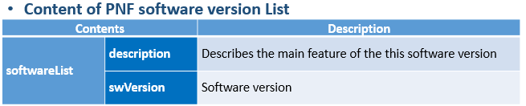
ACTIVE INVENTORY (A&AI) IMPACTS
ACTIVE & AVAILABLE INVENTORY (A&AI) PROJECT IMPACTS
New A&AI PNF Parameters | PNF GEOLOCATION - geographical location (e.g. coordinates or address of the building, etc.). Latitude/Longitude. THIS ALREADY EXISTS VIA ASSOCIATION TO THE “COMPLEX” OBJECT. The Complex Object represents a BUILDING or location with geographical information. The AAI PNF will have a UML association to the Complex object.
Software Version | DETECTED SOFTWARE PNF VERSION(S) – in Run-Time when PNF registers with ONAP it can report its (list) of PNF Software that is currently has installed. This will be tracked in A&AI entry for that PNF. Entry will also have Active/Passive. A&AI already has PNF active S/W version.
Homing | PNF [#1:CU/#2:ONAP] CLOUD HOME (CLOUD SERVER LOCATION) – PNF is served by some regional ONAP cloud servers. Serves in “Rehome” PNF. CLLI Code (specifies location, street address, CloudID, physical server is deployed). [Potentially a list of locations] OOF determine the homing of a NF. Anything you home is determined in the context of a deployment. (Homing) Policy used as a f(service). Data center might have been divided into cloud regions. Service VMME running in NE area (distances, regions, tenants where to instantiate PNF). AAI has COMPLEX node. “Physical Location ID” (8 char CLLI code, lat/long = geolocation info of data center. Cloud region doesn’t span data centers.
Manager IP Address | Manager IP Address – provides an additional IP address for the BTS that is vendor-specific and relevant to the OAM management of the BTS. SUGGESTION (from Christina A&AI PTL) model the NMS as a PNF itself (and the NMS will have parameters to represent itself; and then PNF can be associated with it).
S/W Image Repository | S/W Image Repository – Where the S/W is located
Christina: This will require schema changes in A&AI to support Passive S/W

Slide 49
ACTIVE INVENTORY (A&AI) IMPACTS
PNF A&AI ENTRY (From Beijing)
• PNF has a “pnf-name” = Key in AAI.
Pnf-name is first 3 letters of vendorName concatenated with serialNumber for a unique PNF instance ID = PNFid = PNF Correlation ID = pnf-name. Example: PNFid = NOK123451ZW3. The PNFid is in A&AI pnf-name field.
PNFid = [VENDOR][SERIALNUMBER]
equip-type (PNF Type). equip-vendor (optional); equip-model (optional); pnf-id (PNF ID) = UUID.
(Step 33) adds ipaddress-v4-oam; ipaddress-v6-oam This is the “manager IP Address” which for a DU might be a CU IP address. IP address on the PNF address itself.
(FYI/ ipaddress-v4-loopback-0).
mac-address & serial-number,
PNF:: proxy IP address
Active Software Version
Image Repository (Directory URL, S/W image, URI in OpenStack)
NMS
Manager
ipaddress
ipaddress-v4-oam;
ipaddress-v6-oam
PNF
PNF
OAM
FCAPS
Logging
SWM
Identity
1. ONAP -> NMS command
2. Relay (NMS trusted source)
3. Network Analytics – (DCAE AA)

Slide 50

COMPLEX OBJECT
Physical Location
Manhattan
Freedom Tower
123 Main St.
ONAP
Regional Deployment #1
Staten Island
LATA
PNF
Cloud Region
Object
PNF
Controller
Cloud Region #1
Complex
Object
Complex
Object
Complex
Object

Slide 51
DCAE IMPACTS
DCAE PROJECT IMPACTS
Security Validation | Authenticate Connection
MONITORING | Monitoring definitions – SDC has a side monitoring template designer. Way to define monitoring alarms etc; In AT&T there is a project; IN ONAP code is there finalizing code; pluggable modeler for monitoring. DCAE as part of onboarding specify what VES template. DCAD define microservices for monitoring. How is PNF monitored & correlated. If [x] goes down how is this correlated. SDC would define the Modeling what needs to be monitored and how they would correlated with other events from other NE. Thresholds. [Baby step to process get an alarm from PNF, YAML file describes fault VES event, Fault meta-data; alarms generate].
(PRH DCAE Plug-in) | (see PRH Impacts)

Slide 52
SDN-R (Controller) IMPACTS [APP-C]
SDN-R APP-C PROJECT IMPACTS
CC-SDK (SDN-R)
Artifacts from CC-SDK, APP-C
Mobility controller
Artifacts “borrowed” will become part of CC-SDK
Available for all controller persona.
QUESTION: moving towards CC-SDK & common foundation is there anything
On top of that planned for SDN-R.
Some thing specific to wireless, … perhaps they do not belong in CC-SDK.
Things borrowed from CC-SDK and libraries that are common.

Slide 53
PNF Controller (SDN-R) w/ PnP in R3
PNF
(DU)
SDN-R
SO
36
Configure
Ansible (SSH), NetConf, Chef
37
Service Configuration
(Config Param, Location)
SDN-R Is ONAP controller derived from CC-SDK that combines functionality of APP-C & SDN-C and includes wireless artifacts.
SDN-R FUNCTIONS | DESCRIPTION
PROTOCOLS SUPPORTED | Ansible, Chef, and NetConf (all 3 will be supported)
PNF SUPPORTED | (5G Radio RAN Wireless) PNF
PNF DATA SUPPORTED | (1) Configuration Parameter (optional) – SDN-R/APP-C can give the Controller IP@ to the PNF. (2) OAM IP@ (optional) - The permanent OAM IP address is given to the PNF. The IP address assigned from SDN-C may come from the vAAA, or it may draw from a local pool of IP addresses. SDN-C performs the IP address selection. It knows if a permanent IP address should be assigned to the PNF. Note: this IP@ assignment optional. (3) Transport configuration (optional) – Transport configuration is given to the PNF. (4) Location (optional) – the Location configuration may be given to the PNF. [in A&AI Complex Object association] (5) Software Version (optional) – The expected PNF Software Version(s) is given to PNF (Controller reads the Detected PNF S/W version).

Slide 54
SDN-R w/ PnP in R3
SDN-R FUNCTIONS | DESCRIPTION
PROTOCOL SPECIFIED | PNF onboarding package defines of PNF (protocol). PNF info model (SDC) will have (1) protocol (2) controller: Protocols Supported – PNF package. CM Protocol is in PNF onboarding package. Controller type – defined in design time. Controller type is specified in design time. Design time designer specifies which controller is used. Distributed in PNF Modeling artifacts R3 CONCLUSION: This is still an open point (July 25, 2018)
MODEL DRIVEN DESIGN | APP-C, SDN-C, SDN-R, VF-C as possible controllers. Modeling which controllers will be used by the PNF. Also needs to standardize what it expects from controller. Things controller needs to support. R3 CONCLUSION: SDN-C is fixed PNF controller.
VENDOR SPECIFIC ADAPTOR | Customized DG (directed graph) element ODL (node in graph database) added with Java. Substitute a value and add fields in a template. SDN-R is following DG abstraction. If there is a vendor specific plug-in in the service model it can be represented as a node in DG and the interaction will be captured in that model. R3 CONCLUSION:
UPDATING PNF & CONTROLLER RELATION INFO | Updating the PNF controller/protocol (“lifecycle management”). R3 CONCLUSION: This will not be in R3, PNF has hardcoded Controller
ERROR LEGS (ERROR FLOWS) | Errors when SDN-R interacts w/ a PNF R3 CONCLUSION:
Vendor Specific Step

Slide 55
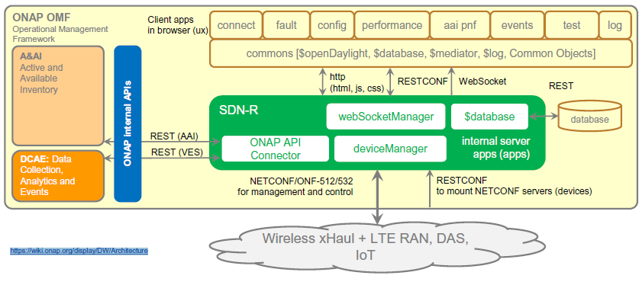
SDN-R w/ PnP in R3
SDN-R Is ONAP controller derived from CC-SDK that combines functionality of APP-C & SDN-C and includes wireless artifacts.
SDN-R is a sub-project of SDN-C.
“Is SDN-R is a sub-project of SDN-C. If not what is it? ”
SDN-R = APP-C for RAN. “ how is SDN-R common to APP-C “
ISSUE:
Concern that SDN-R replicates functions (e.g. SDN-C does IP assignments).
SDN-C configures/creates Networks.
SDC would need to be aware of another SDN-controller, new logic to pass DGs.
ISSUE:
“SDN” implies a networking controller vs an PNF “App” controller
SDN-R app controller for PNF/VNFs vis a vis LCM.

Slide 56
CC-SDK based Mobility Network Function Controller (MNFC) for Mobility/Wireless
CCSDK
DCAE
ONAP Operations Manager
CCSDK
CDAP clusters
CCSDK
Deploying and
Monitoring
Resources of
DCAE and other
ONAP
components
Common microservices
Common health checks
Common APIs
Common logging
Common model management
Common resource management
DCAE service
Deployment APIs
Common microservices
Common health checks
Common APIs
Common logging
Common model management
Common resource management
Configuration
Policy updates
etc
SDN-C
APP-C
CCSDK
sdnc-northbound
CCSDK
appc-northbound
sdnc-core
sdnc-parent
sdnc-plugins
sdnc-oam
sdnc-adapters
sdnc-core
sdnc-parent
sdnc-plugins
sdnc-oam
sdnc-adapters
sdnc-logic
appc-adapters
appc-logic
SDN-R
sdnc-northbound
CCSDK
sdnc-core
sdnc-parent
sdnc-plugins
sdnc-oam
sdnc-adapters
appc-adapters
sdnc-logic
appc-logic
ran-logic
wireless-logic
spectrum-logic
SDN-R
Evolving to become the
one ONAP Controller for
Mobility/Wireless PNF/VNF
Sub-project in SDN-C
SDN-R intended to be a stand-alone controller
Only organizationally is SDN-R a sub-project of SDN-C
SDN-R uses SDN-C Northbound (verify - ?)

Slide 57
A&AI
2. RestConf: mount
DCAE
SDN-R
SDN-R Device Discovery
3. NetConf: hello by ODL
1. VES event
Is such event already defined?
PNF
DCAE
A&AI
3. Forward to … (currently not tested) VES collector
SDN-R Event Flow
SDN-R
2. Translating in proper VES message format
1. NetConf: notification
PNF
DCAE
A&AI
After discovery
1. Check if device is expected
5. Update
SDN-R
3. Translating in proper AAI-API (v8, REST)
SDN-R A&AI Flow
1. NetConf: Get Equipment
2. NetConf: Response Equipment
PNF

Slide 58
PNF Plug and Play
INTEGRATION & SHOWCASING
ONAP and PNF Plug and Play for 5G RAN
5G Use Case Team

Slide 59
PnP Flow STEP | TEST CASE SECTION | RELEASE
1 Resource Definition | PnP1 Resource Definition | R2 (Beijing)
2 Service Definition | PnP2 Service Definition | R3 (SDC: new PNF model)
3 Type Modeling Artifacts | PnP3 Type Modeling Artifacts | R2 (Beijing)
4 Resource Declaration | PnP4 Resource Declaration | R3 (Alt Operator`s Inventory Management system)
5 Create A&AI PNF Entry | PnP5 Create A&AI PNF Entry | R3 (ibid)
13 ONAP Compliant S/W | PnP13 ONAP Compliant S/W | R2 (Beijing)
15 Work Order to SO | PnP15 Work Order to SO | R3 (SO R2 Integration)
16 Service Instantiation | PnP16 Service Instantiation | R3 (SO R2 Integration)
17 Homing OOF Sniro | PnP17 Homing OOF Sniro | R3 (SO R2 Integration)
18 Resource RLF | PnP18 Resource RLF | R3 (SO R2 Integration)
19 Check A&AI Entry | PnP19 Check A&AI Entry | R3 (SO R2 Integration)
20 Create A&AI Entry | PnP20 Create A&AI Entry | R3 (SO R2 Integration)
21 Subscribe VES Event | PnP21 Subscribe VES Event | R3 (SO R2 Integration)
22 RLF Thread Terminates | PnP22 RLF Thread Terminates | R3 (SO R2 Integration)
25 Authenticates PNF Connection | PnP25 Authenticate PNF Connection | R3 (Casablanca)
26 PNF Registration VES Events | PnP26 PNF Registration VES Events | R3 (pnfRegistration domain)
27 Inventory Query | PnP27 Inventory Query | R3 (pnfRegistration domain)
29 Inventory Query | PnP29 Inventory Query | R3 (pnfRegistration domain)
30 Update PNF Entry | PnP30 Update PNF Entry | R3 (pnfRegistration domain)
31 PNF Ready | PnP31 PNF Ready | R3 (pnfRegistration domain)
34 Update PNF WF | PnP34 Update PNF WF | R3 (SO R2 Integration)
35 Network Assignments | PnP35 Network Assignments | R3 (SO R2 Integration)
36 Configure | PnP36 Configure | R3 (SO R2 Integration)
37 Service Configuration | PnP37 Service Configuration | R3 (controller updates)
38 SO Updates w/ Assginments | PnP38 SO Updates w/ Assginments | R2 (Beijing)
39 Controller Replies | PnP39 Controller Replies | R2 (Beijing)
40 Service Running | PnP40 Service Running | R2 (Beijing)
41 Monitors Service | PnP41 Monitors Service
42 Inform OSS | PnP42 Inform OSS

Slide 60
INTEGRATION TEAM IMPACTS
INTEGRATION TEAM IMPACTS
SHOWCASING | DEMO CONTENT – [Closed] What will be showcased? Test send registration event. Instantiation Pt1/Pt2 (Update A&AI). PRH service request (VES event & DMaaP topic). APP-C Ansible configure. PNF sends event, receives ansible event. Start with R1 use case (VoLTE / vCPE) upgraded w/ mechanisms of R2. DU Emulator (for registration).
ACTUAL PNF, DU Emulator | DU EMULATOR – [Closed] Nokia will provide a simple DU emulator [Mar 16 2018]. Capable of sending PNF registration request (Step 26, 28). Capable of receive configuration command from APP-C via Ansible (Step 37) and recording result of successful reception (or failure) in a log.
Test Case Description (Demo Document) [Open Point] | (1) Demo Document – Document describing demo (use case group?) https://wiki.onap.org/display/DW/vCPE+Use+Case+Tutorial%3A+Design+and+Deploy+based+on+ONAP+Amsterdam+Release (2) Test case description – Documenting the test case. Start with VoltE and modify it.
LOGISTICS (Open Point) | (1) DEMO ANNOUNCEMENT – “come see this demo” – Integration ONAP Wiki. Video. Schedule ONAP Wiki Events Calendar. Integration project. (SME = x). (2) LOGISTICS – Contacts Helen Chen, Yang Xu. Intel Windriver Lab, T-Lab (AT&T Lab, Bedminster), and/or use CMCC Lab. ONAP “Open Lab”. ONAP installed in a lab. Demo shown via conference. Virtual Demo (dial in). (3) RELEASE MANAGER – Coordinate w/ Joe Gildas. Joe Gildas release manager (status of project). M4 Voting.
AUTHENTICATION | AUTHENTICATION – Authentication is optional, and for R2 Demo we will not have any authentication. Could be considered for Casablanca (R3). Amsterdam authentication flow not useful for PNFs. Not use second vDHCP & vAAA.
CONTROLLER CONFIGURATION | CONFIGURATION: IP address (from DHCP). Username & Password. Configured in controller (manually added to ONAP). VES configuration (do not need username & password to be configured on VES)

Slide 61







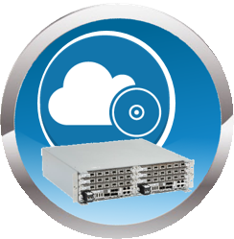
DEMO ARCHITECTURE
VID, CLAMP, CDT
A&AI UI
ONAP PORTAL
User/Login ONAP
2
3
VPN
3
ONAP SERVERS
AT&T (T-Lab) / Intel Windriver lab
Kubernetes, OPENStack
1
CONFIGURATION
SDC Templates
6
4
ONAP ECOSYSTEM (VMs)
R2 Beijing Release of ONAP
SDC – Configuration Templates
PNF Plug and Play Use Case
Robot VM
Mock server to control Provider Edge Router.
WAN Controller
PNF Registration Handler (PRH)
RECORDING
Recording stored
5
DU EMULATOR
DU (PNF) Emulator
(in ONAP Software)

Slide 62
STEP | DESCRIPTION
1 | CONFIGURATION – SDC Design templates need to be configured in preparation of the Demo & Showcasing. The appropriate PNF and VNF designs are designed, validated and exported to the other components of ONAP.
2 | PORTAL & GUIS – The ONAP Portal is used to access the appropriate GUIs and interfaces necessary to operate and configure ONAP. The VID and CLMAP GUI are used to configure the appropriate information for the showcase. The A&AI GUI are used to show the created entries in A&AI for the PNF.
3 | VPN – The appropriate security gateways and/or VPN networks are configured. The appropriate security setups are authenticated against. Passwords and IP addresses that are needed to connect to the ONAP servers go through this VPN or security gateway (as appropriate) ONAP SERVERS – The ONAP Servers that host the ONAP ecosystem are connected to
4 | ONAP ECOSYSTEM (VM) – The ONAP ecosystem has all of the appropriate Virtual Machines necessary to operate. This has the R2 Beijing Release of ONAP. All of the PNF Plug and Play Use Case updated software is available in the ONAP Ecosystem. The Robot VM, Mock server to control Provider Edge Router, and WAN Controller are established. The PNF Registration Handler a new DCAE plug-in are available in this ONAP ecosystem which is used to register the PNF into ONAP.
5 | DU EMULATOR – The DU Emulator is used to emulate the responses and connection to ONAP. The DU emulator establishes a VES HTTPS connection with the PRH during the registration process and receives a APP-C response back via ansible.
6 | RECORDING – A recording is made of the showcase and demo for later upload/download and playback for demonstration purposes.
Need a integration details on SDC modeling/CSAR package

Slide 63

PNF Plug and Play
ROADMAP (After Casablanca)
ONAP and PNF Plug and Play for 5G RAN
5G Use Case Team

Slide 64
FUTURE FUNCTIONS (Dublin R4)
PnP DUBLIN WORK ITEM | DESCRIPTION
Licensing Management | Having meta-data manage licensing. This at first (in Dublin) might be very simple but can be expanded
VNF & PNF 5G Flow | Use case for VNF & PNF bring-up. (CU with a DU)
PNF Artifacts (PNF Package) & PNF Modeling | In Casablanca we did not get in artifacts in time, and for Dublin we are looking to incorporate actual Artifacts. Some parameters were identified for PNF model and pushed to Dublin for example the Package version.
SO Model Driven | The PNF controller caused quite a stir in Casablanca, the tension between Design/Platform Model vs Run-Time/Deployment Model. As a result the SO controller design was sub-optimal and should be addressed in Dublin
PRH with Actual DU | It would be nice if in Dublin (or Frankfurt) if the Plug and Play Use Case actually worked with a real DU.
Security Enhancement | Security enhancements slated for Dublin will need to be working for PnP Use Case
Software Management | A first step in S/W management was version reporting incorporated into the PNF model. Further or next steps can be taken in Dublin
NMS as a PNF | Christina (PTL A&AI) had suggested the NMS be modeled as a PNF. This was brought up quite late in the Casablanca development cycle, and even if rudimentarily implemented needs to be further evolved in Dublin
Controller | Controller definition (SDN-C) came so late in Casablanca, we had defined some additional optional parameter for the step37 Service Configuration but likely more evolution needs to be done. SDN-C was not the theoretical proper controller and people objected as this is conceptually the L0-L3 controller.
PRH | There might be more integration or development for the PRH in Dublin.
Integration from Casablanca | Experience shows that there are integration things that were often started in the previous release but not yet fully integrated or finished.

Slide 65

APPENDIX
& Meeting Notes

Slide 66
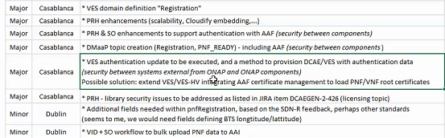
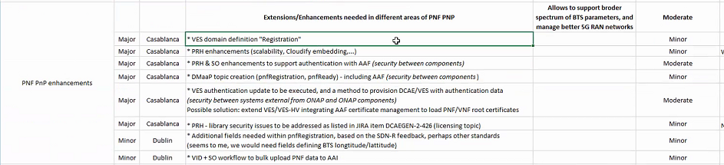
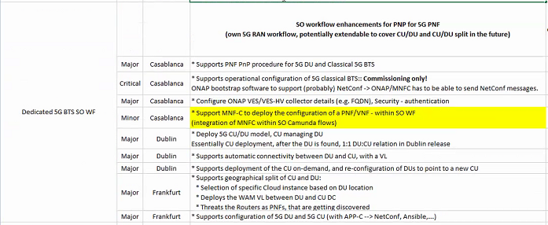
DISCUSSION MAY 03, 2018
SDN-R supports all 3
CC-SDK controller
Should support all 3
How does that get implemented
PNF agnostic/future-proof
PNFs will support one
ADAPTORS/MEDIATORS
Adaptor – No adaptor
PNF talks directly to ONAP
Adap/transl/mediators
For embedded base.
5G “going native”
PNF – Descriptor
Protocols supports
PNF Package defines
The Meta-models Tbsupported
mm microwave PNF unchanged

Slide 67
ID PNF
PNF #62
SDN-C
UUID
PNF #62
A&AI
Mac Address
IP Address
Correlation ID
(UUID)
PNF #62
Gets Assigned a UUID
Just like any VNFID
From then on processes of ONAP
Work on UUID
CorrelationID is no longer used.
UUID assigned by SDN-C (rules how UUIDs assigned)

Slide 68
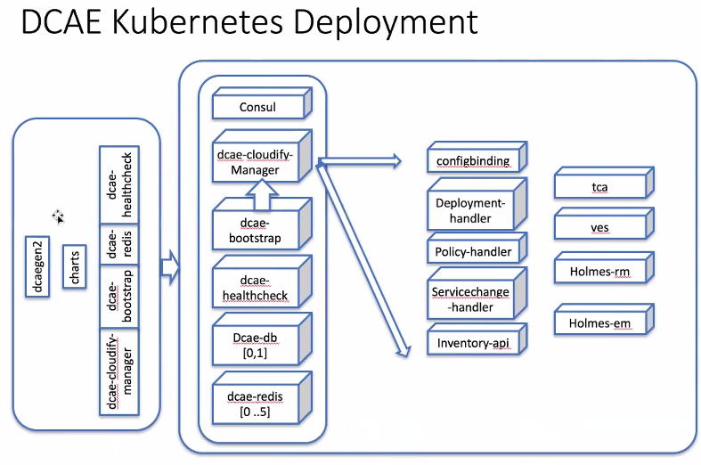

Slide 69
VID
Portal
Service instantiation
PNFID=“xxx”,
Instance_planning={“key”:“xx”}
cfg_tmp_name=“xxx”
1
PNFD*
2
PNFID, templates
SDC
SO
APP-C? + SDN-R
Vendor
Adapter
SDN-R
CC-SDK (functionality of APP-C & SDN-C)
EM
5G-DU
5G-CU
Design time
  (1) Onboarding PNFD
    PNFID
    Templates, including PNF/VNF templates, Configuration templates
Run time
  (2) service instantiation
  (3) generate configuration data
  (4) configure PNF/VNF via EM
  (5) CU-DU inter-connect

Slide 70
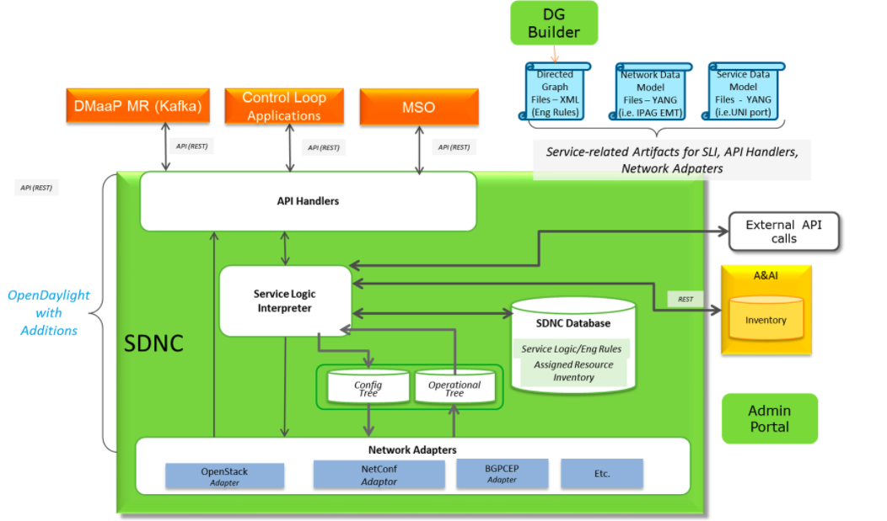
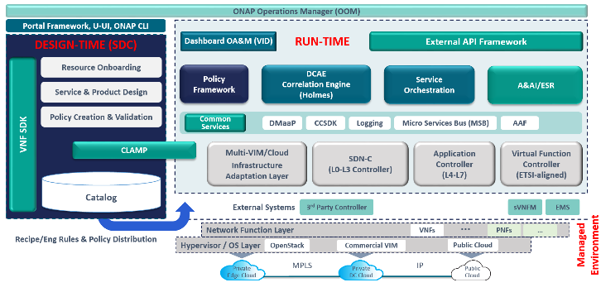

Slide 71
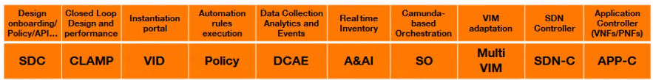

Slide 72

MEASUREMENTS DICTIONARY FIELD
Suggested format is XML
MEASUREMENT FIELDS
MEASUREMENT FIELD | DESCRIPTION
Meas Id | Gives the Identifier for the Measurement.
Meas Type | Meas Type is the Measurement Name in Camel Format
Meas Type 3GPP | Measurement Name in 3GPP Standards defined in 3GPP TS32.425.
Meas Obj Class | Managed object (MO) associated with this Measurement. The objects will be vendor specific and it indicates the NF object for that vendor related to that measurement.
Meas Collection Method | The Collection method for the measurement. Cumulative (CC), Lead, Max, Snapshot, Value
Meas Unit | Unit type for the Measurement. Typical unit values include: watt (power), dB, bits/s (throughput), PRB, Packets, Sequence.
Meas Range | Numerical Value Range for the measurement in the units given by the meas units.
Meas Family | Family or grouping of measurements.
Meas SubFamily | Subgrouping for the measurement.
Meas Description | This field provides a textual description of the measurement. This is intended for an operator to understand the meaning of the measurement.
Meas Condition | Provides the Measure Conditions.
COUNTER FIELDS
COUNTER FIELD | DESCRIPTION
Criteria | Criteria to determine which counter to peg (same for all counters associated with the measurement. If there are no criteria there will also not be counters associated with the meas.
Counter ID | Gives the identifier of the Counter
Counter Name | This is the name of the counter
Counter Description | This field provides a textual description of the counter. This is intended for an operator to understand the meaning of the counter.
Counter Suffix 3GPP | The 3GPP standardized Suffix. The suffix value is defined in the 3GPP TS32.425 standard.
Counter Condition | This field describes the trigger condition that trips the counter. Triggering events are specific exchanges that happen in the flow of call management

Slide 73
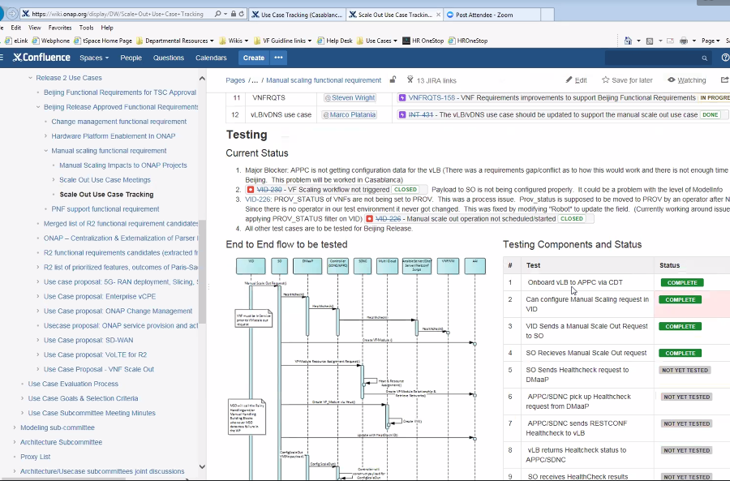

Slide 74
DESIGN TIME
PNF
Type – Model-A
PNF
Type – Model-B
Serial Number = 1234567890
SDC Run-time attribute; optional; expected to be filled in run time
Logical Resources
RUN TIME
A&AI
PNF #821
PNF #822
PNF #823
PNFB #824
PNFB #825
Serial Number
Serial Number
Serial Number
Serial Number
Serial Number
Physical Infrastructure

Slide 75
SAMPLE YAML FAULT DEFINITION
event: {presence: required, action: [ any, up, overTemperature, RECO-rebootPnf, null ],
structure: {
commonEventHeader: {presence: required, structure: {
domain: {presence: required, value: fault},
eventName: {presence: required, value: Fault_Nokia_5GCU_Overtemperature},
  eventId: {presence: required},
priority: {presence: required},
reportingEntityName: {presence: required},
sequence: {presence: required},
sourceName: {presence: required},
startEpochMicrosec: {presence: required},
lastEpochMicrosec: {presence: required},
version: {presence: required, value: 3.0}
}},
faultFields: {presence: required, structure: {
alarmCondition : {presence: required, value: Overtemperature},
eventSeverity: {presence: required, value: MAJOR},
eventSourceType: {presence: required, value: BaseStation},
faultFieldsVersion: {presence: required, value: 3.0},
specificProblem: {presence: required},
vfStatus: {presence: required, value: “Active"}
alarmInterfaceA : {presence: required},
additionalInformation: {presence: optional, array: {
keyValuePair: {presence: required, structure: {
key: {presence: required, value: Temperature},
value: {presence: required}
}
}}
}}

Slide 76
VES FAULT EVENT (faultFields)
Field | Type | Required? | Description
alarmAdditional Information | hashMap | No | Additional alarm information (note: for SNMP mapping to VES, for hash key use OID of varbind, for value use incoming data for that varbind )
alarmCondition | string | Yes | Short name of the alarm condition/problem, such as a trap name. Should not have white space (e.g., tpLgCgiNotInConfig, BfdSessionDown, linkDown, etc…)
alarmInterfaceA | string | No | Card, port, channel or interface name of the device generating the alarm
eventCategory | string | No | Event category, for example: ‘license’, ‘link’, ‘routing’, ‘security’, ‘signaling ’
eventSeverity | string | Yes | Event severity enumeration: ‘CRITICAL’, ‘MAJOR’, ‘MINOR’, ‘WARNING’, ‘NORMAL ’
eventSourceType | string | Yes | Examples: ‘card’, ‘host’, ‘other’, ‘port’, ‘portThreshold’, ‘router’, ‘slotThreshold’, ‘switch’, ‘virtualMachine’, ‘virtualNetworkFunction’
faultFieldsVersion | number | Yes | Version of the faultFields block
specificProblem | string | Yes | Description of the alarm or problem (e.g., ‘This event is sent when the LG is asked to perform a location for a CGI that is not in its configuration’)
vfStatus | string | Yes | Virtual function status enumeration: ‘Active’, ‘Idle’, ‘Preparing to terminate ’, ‘Ready to terminate’, ‘Requesting Termination’

