Slide 1

Producer & Consumer Testing
(fun with Lego)
Toine Siebelink
Ericsson Software Technology
Jan 2022

Slide 2



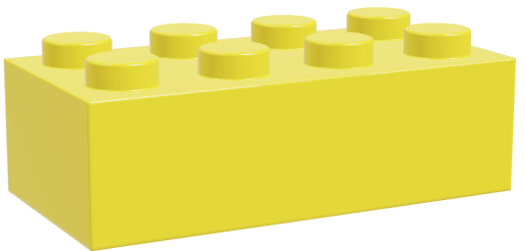
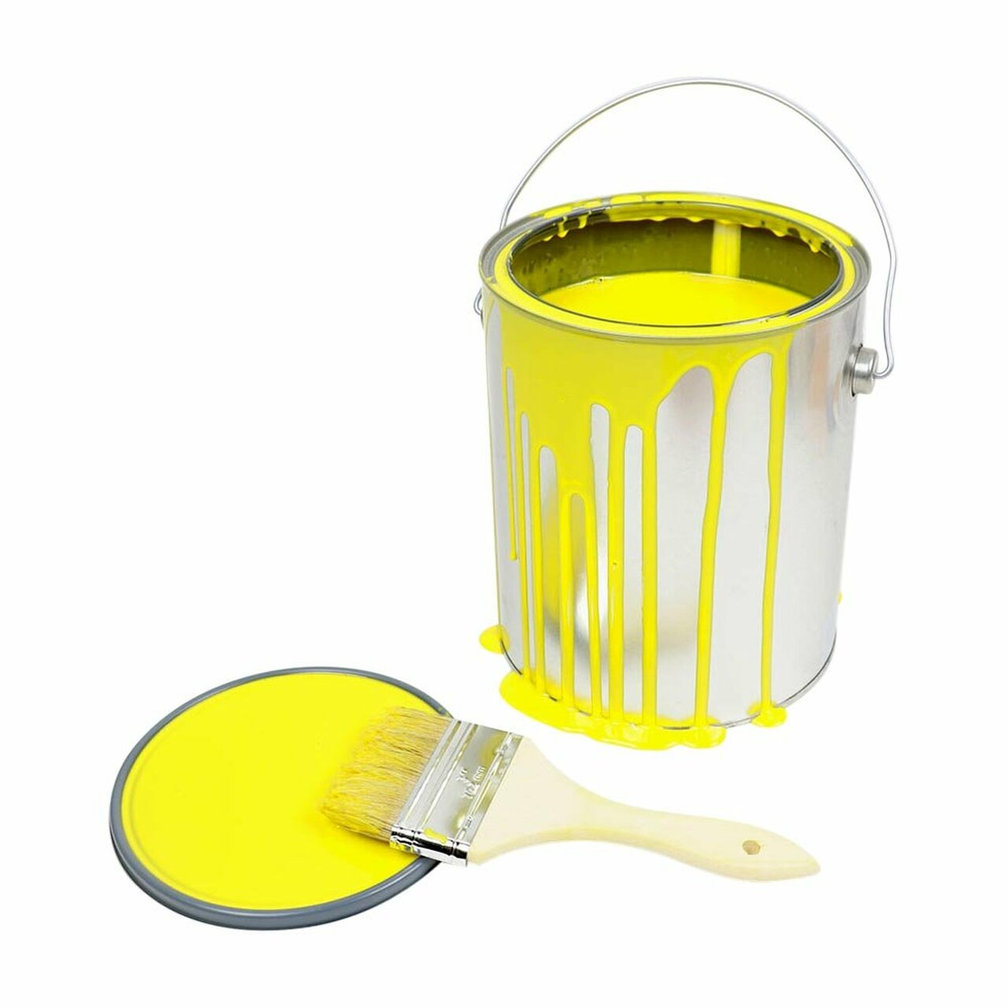
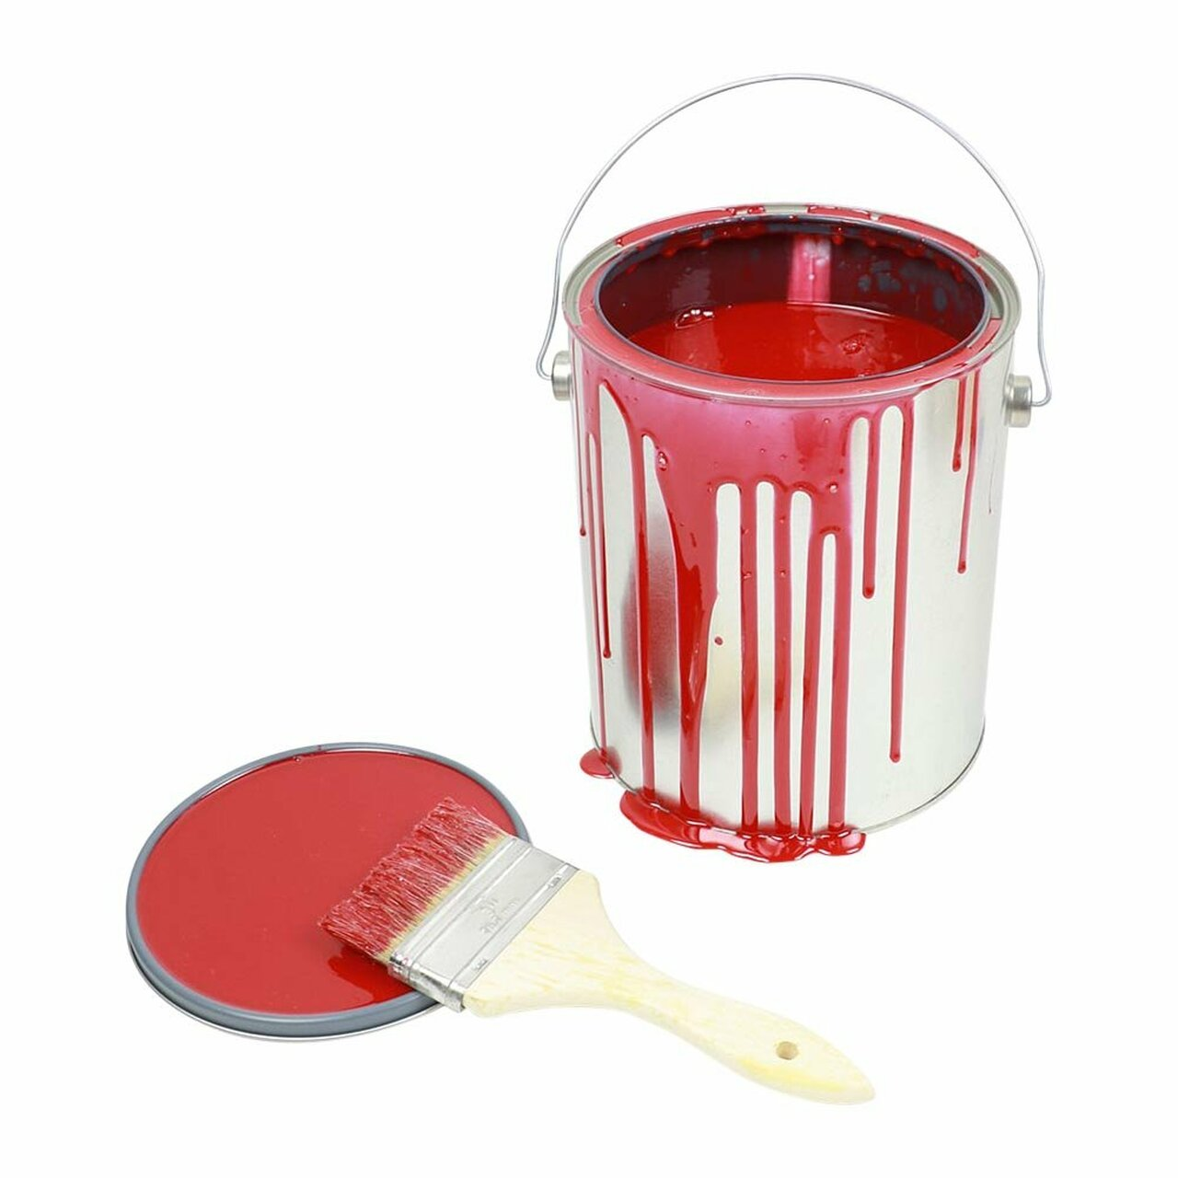
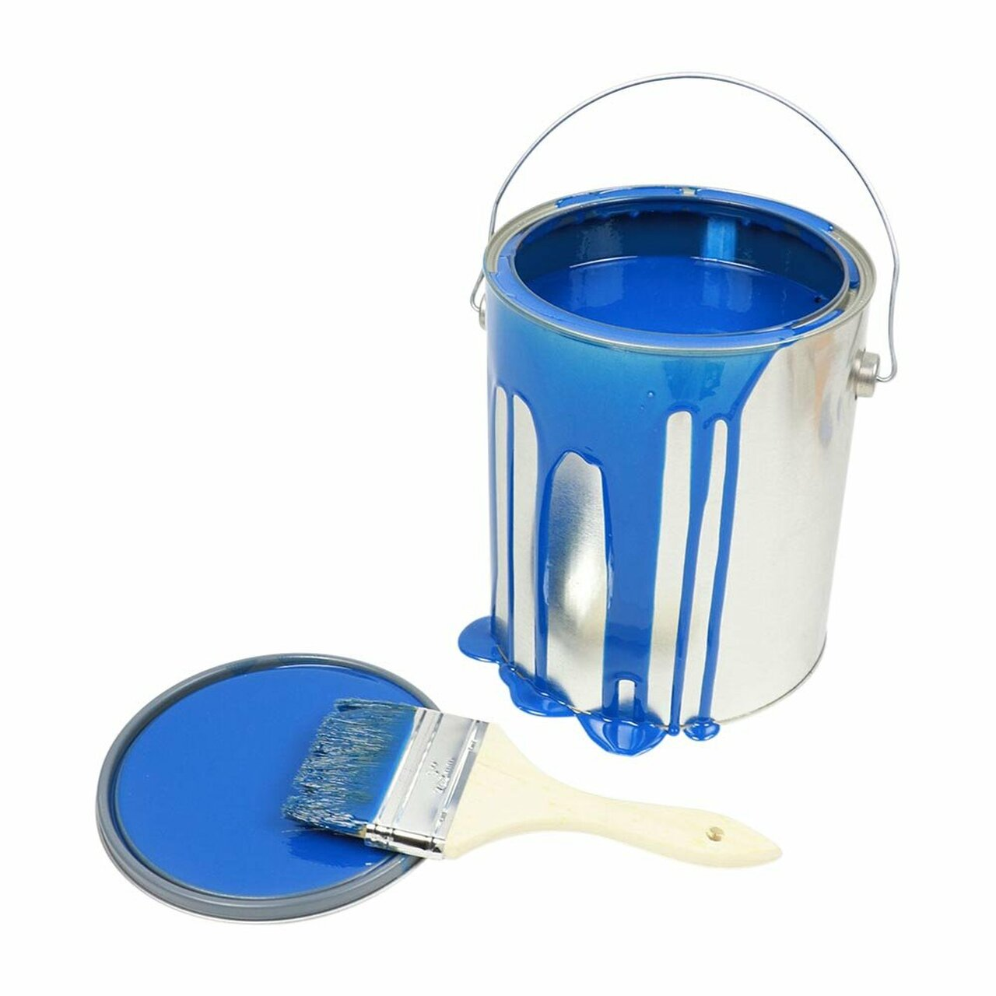



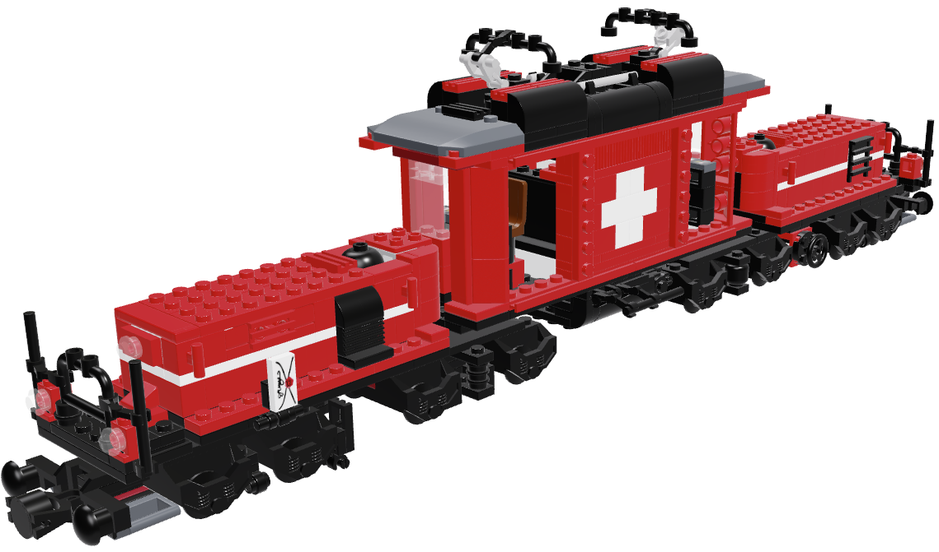
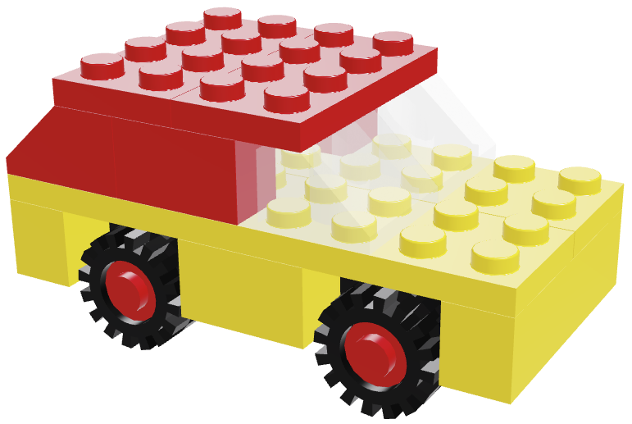
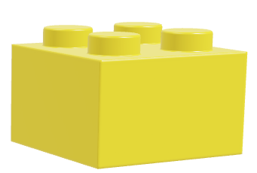
Three Factories (dependent services)
Lego Model Workshop | Lego Brick Factory | Paint Factory

Slide 3




System Integration Test
(Lego Model Workshop)
Test | Output | Check
GET ../modesl?type=Dino
GET ../models?type=Duck
Verifies
Top service (e.g. REST) Interface
E2E functionality i.e. all systems working together

Slide 4
Service Producer Test Strategies
(responsibilities)
Unit Test
Integration Testing
Producer Contract Testing
Optional: deliver Client Contract Test Stubs

Slide 5







Unit Test
(Lego Brick Factory)
Test BaseBrickBuilder | Output | Check
createBaseBrick(1,1)
createBaseBrick(1,2)
createBaseBrick(1,3)
createBaseBrick(2,2)
createBaseBrick(2,3)
BaseBrickBuilder.class
Verifies (assuming 100% coverage)
All code paths 1 small component (might incl. helper components)

Slide 6




Unit Test, with Mock
(Lego Brick Factory)
Test BrickDecorator | Output | Check
paintBrick( ,Red)
BrickDecorator.class
Verifies (assuming 100% coverage)
All code paths 1 small component (might incl. helper components)
Interaction with dependencies
BaseBrickDecorator.groovy (mock setup)
def mockPaintFactory = Mock(PaintFactory)
def mockRedPaint = Mock(Paint)
mockPaintFactory.getPaint(’Red’) >> mockRedPaint
MockPaintFactory

Slide 7



Producer Contract Test
(Lego Brick Factory)
Test https://legoBrickFactory | Assert | Check
GET /bricks?color=red&w=2&l=3 | RestController. getBrick(2,3, “red”)
 | HTTP.Status == 200 response.body == { … }
GET /bricks/special/eyes?color=red | RestController. getSpecialBrick(“eyes”, “red”)
 | HTTP.Status == 200 response.body == { … }
REST + Json
RestController.class
Verifies
REST -> java interface
Parameter mapping
Response Status Code & Format

Slide 8
Producer Contract Test (extended with unit test)
(Lego Brick Factory)
Test https://legoBrickFactory | Asserts | Check
GET /bricks?color=red&w=2&l=3 | 1 * BrickBuilder. getBaseBrick(2,3)
 | 1 * BrickDecorator. paintBrick(?,Color.RED)
 | HTTP.Status == 200 response.body == { … }
Verifies
REST -> java interface
Parameter mapping
Parameter Transformation
Delegation
Response Status Code & Format
RestController.class

Slide 9

Integration Test
(Lego Brick factory)
Test | Output | Check
GET /bricks?color=yellow,w=2&l=4
GET /bricks?color=red,w=2&l=2
Verifies
Top service (e.g. REST) Interface
E2E functionality i.e. systems working together

Slide 10
Contract Producer Stubs
(Lego Model Workshop)
Method Call https://LegoBrickFactoryStub | Response | Object
GET /bricks?color=yellow&w=2&l=4 | 201 { … }
GET /bricks?color=red&w=2&l=2 | 201 { … }
GET /bricks/special/eyes?color=red | 201 { … }
*
*
Stubs are not test themselves but can be used for testing to verify
REST Interface compatibility
Response Status Code & Format
Client Response transformation
*Stubbed methods always return the same (example) result irrespective of parameters
Enhanced Stubs do NOT test (or guarantee) Producer functionality
LegoBrickFactoryStub

Slide 11


Enhanced Client Stubs
(Lego Model Workshop, Consumer)
Method Call https://LegoBrickFactoryStub | Response | Object
GET /bricks?color=yellow&w=2&l=4 | 201 { … }
GET /bricks?color=red&w=2&l=2 | 201 { … }
GET /bricks/special/eyes?color=red | 201 { … }
Enhanced Stubs can be used for testing to verify
REST Interface compatibility
Response Status Code & Format
Client Response transformation
Test more diverse scenarios in Consumer code
EnhancedLegoBrick
FactoryStub
Enhanced Stubs do NOT test (or guarantee) Producer functionality

Slide 12
Proposal: Using Open API 3.0
Interface Documentation (contract)
Contract-first Producer Implementation
Producer Generated Stubs
  swagger.io (or tooling?)
  Generated Java Interface
Client Extended Stubs

Slide 13








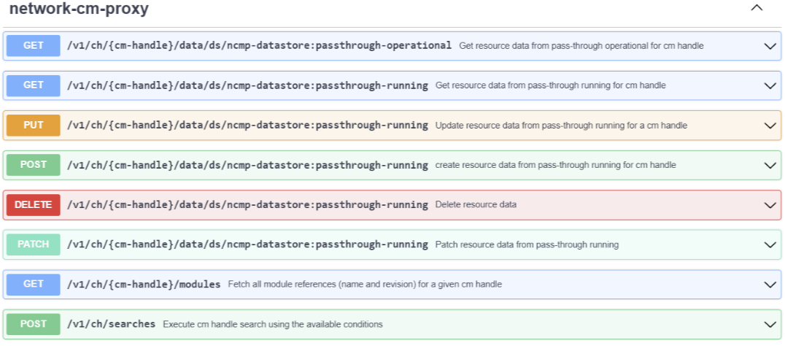

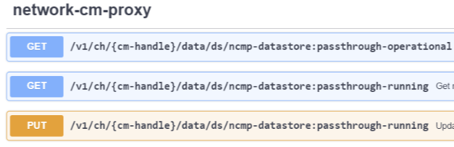
openapi.yml
Using Open API 3.0 (a.f.n.a. Swagger)
Generated
Swagger UI
Interface NetworkCmProxyApi
client
jaxrs-cxf-client
etc.
server
jaxrs-resteasy
etc.
/org.onap.cps.ncmp
/editor.swagger.io
Enhanced stubs

Slide 14
Benefits of Using Open API 3.0
Single Source of contract
rule-out human error & maintenance cost
Producer generated interface code, automatically tied to contract definition
no need for producer contract testing
Incompatible Interface changes detected at compile time!
Generated interface can be easily be used to create and deliver Client Contract Stubs
Incompatible Interface changes detected at compile time!
Swagger UI : human friendly way to explore interface documentation and try it out
Clients can easily extend basic stubs for their specific needs
Incompatible Interface changes detected at compile time!

Slide 15
Swagger UI Demo

