Slide 1
Application Flow Visualizer
A tool to visualize application codebases.
Jared Chester
October 5th, 2021

Slide 2






Today’s Agenda
Tool Overview
Motivation
Current Capabilities
Data Representations
Demo
Version 2 Sneak Peak

Slide 3
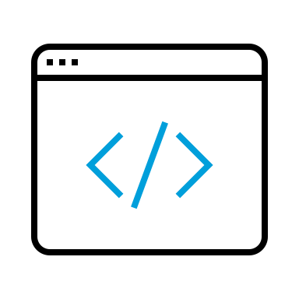



Tool Overview
Key
User
Tool
30s – 1min
3s-5s
Invoke tool on command line
Point tool to directory containing source code
Scan code starting at entry point
Dynamically build AST
Get some coffee
Check Outlook
Send Q emojis
Walk AST and build up data structures
Serialize into a JSON file
Open HTML template files
Explore data in workspace
Compute clustering and other metrics
(Optional) Write AST to disk

Slide 4




Motivation
Visualize services and components
  Milestone 0 has around 40 services and around 50 components.
  We needed a way to visualize how the application is organized and how the components use these services.
Simplistic and powerful solution
  We wanted a tool that matched the simplicity and usefulness of some of the already existing Milestone 0 tools.
  The tool is configurable via command line arguments and these arguments shape the assumptions the tool makes to produce data.
Portable, robust data format
  We didn’t want to have another clunky tool that needed to be installed or configured to work.
  The tool uses the JSON file format, and the frontend display is static HTML. There are 4 total files needed to get data up on the screen (one of which is the data itself).
Easy to view and understand data
  We wanted the data to be useful and actionable.
  The UI is an interactive workspace you can pan and zoom around in. Data can be re-clustered if necessary, and color keys help visually organize the data.

Slide 5
Current Capabilities
Underlying Technologies
Language and Framework Support
Data Visualization Diagrams
Data Manipulation and Re-clustering
Python 3 and HTML
The tool is written in Python 3 and uses HTML and the Web Browser Engine to generate and display data. It uses the JavaScript library D3 for plots.
TypeScript and AngularJS
Currently, the tool can only support TypeScript AST generation and AngularJS component syntax parsing.
*Additional languages are actively being developed
Cluster Graphs and Flow Diagrams
The tool will display data in cluster graphs and flow diagrams.
HTML and Web Engine
The tool leverages the web browser’s graphics engine to allow for data manipulation and re-computation on the fly.

Slide 6
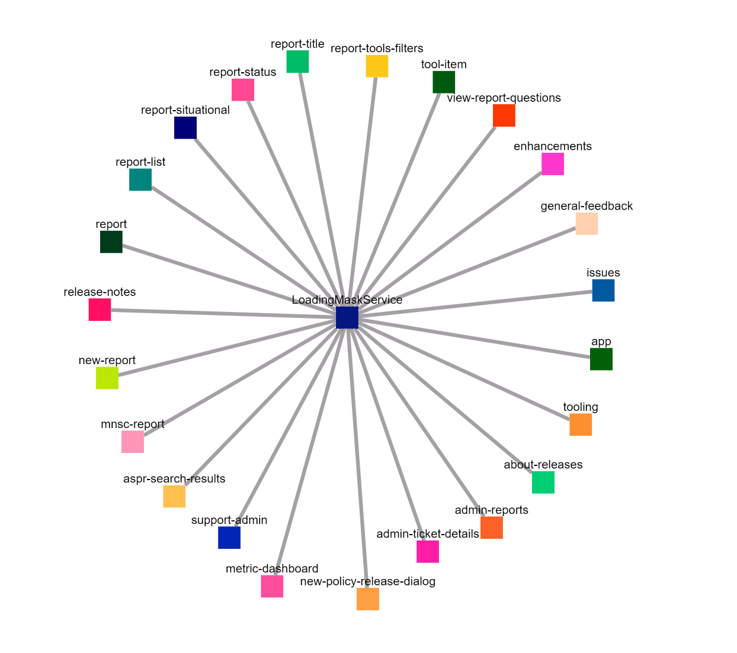
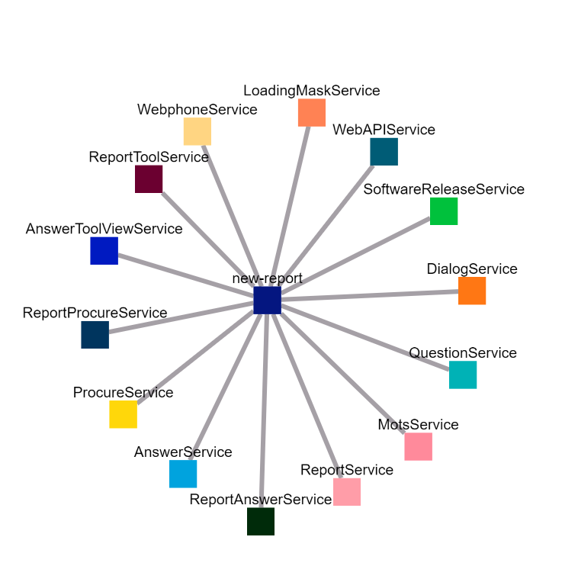
Data Representations
Service Centric View
Component Centric View
Services are the independent variable
All clustering is centered around services
Components are the independent variable
All clustering is centered around components
Component
Service
Service
Component

Slide 7
DEMO

Slide 8
Version 2 Sneak Peek
Backend Changes
User Interface Changes
Language Support
  Java and Python
Framework Support
  SpringBoot and ReactJS
Code Best Practice Enforcement
  Determine if methods and variables should be private or public
  Auto-generate documentation
  Service and component initialization and destruction enforcement
Data scoping
  Determines if service and component state be leaked to other components and services
CSS Utilization Metrics
  Determine if CSS classes are duplicated or unused
  Cut down on CSS class bloat and style conflicts
Component HTML Support
  Access HTML template for a given component and display the DOM nodes and attributes
Graph Data Organization
  The ability to click on nodes in the graph to find out more in-depth information about them
    CSS classes
    Variables and method declarations
Code Accessibility
  Direct clickable links to view nodes in the source code
Interface Improvements
  Ability to select projects from the application UI to run the tool on (no more command line)

Slide 9
