Slide 1
Summary of Modeling Subcommittee work in 2021
Co-chairs: Andy Mayer, Hui Deng

Slide 2
Modeling Subcommittee work in 2021
Model Proposals & Approvals
Modeling Workshop
Modeling documentation improvement
Modeling Tool update

Slide 3
Model Proposals & Approvals
Existing Model Updates and Documentation:
  VES 7.2 update (approved)
  VNFD IM update to align with ETSI latest spec (approved)
  A&AI schema reverse engineering (ongoing)
Container Related Models:
  CNF design time model (approved)
  Simplified K8S resource model (approved)
  ASD model (ongoing)
New Area:
  CPS model (approved)
  Topology model (ongoing)

Slide 4
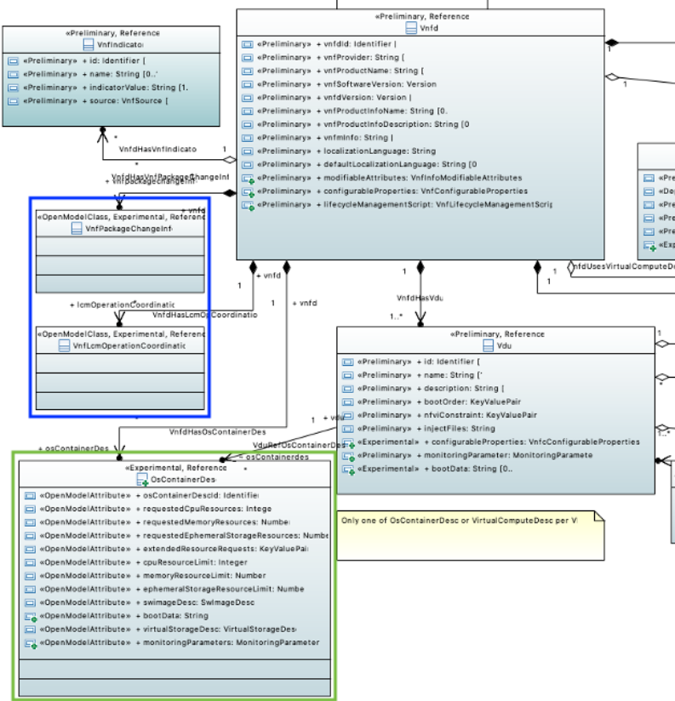
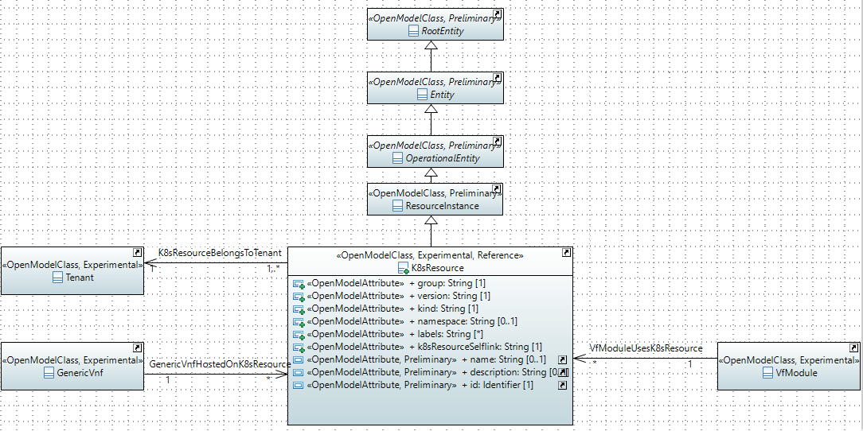
Model Proposals Cont'd
Container Related Models:
Design Time Model for CNF
-enhance the VNFD with container information
Runtime Model for K8S Resource
-enhance the A&AI model with K8S resource objects

Slide 5
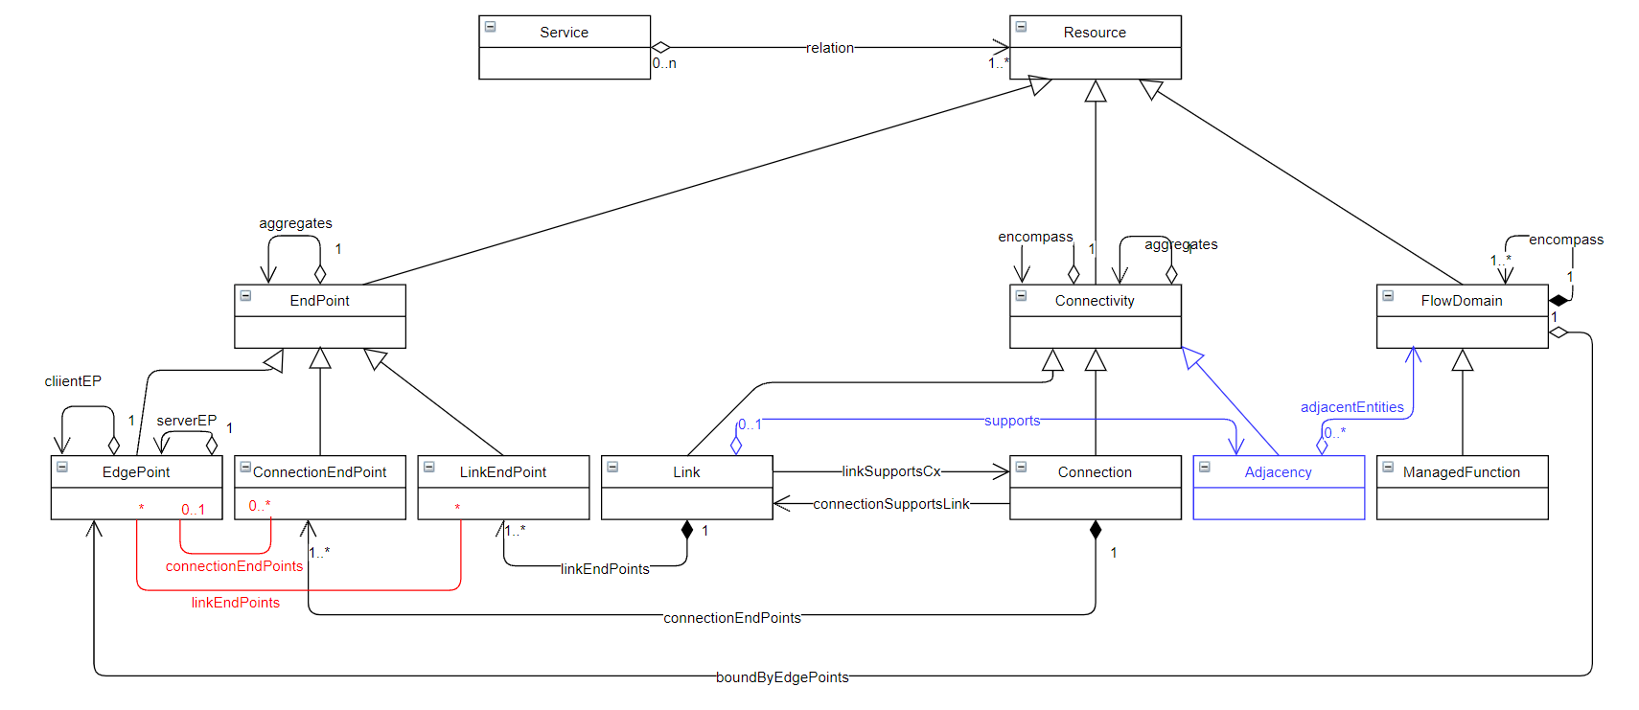
Model Proposals Cont'd
Topology Model:
Design Time model to capture the endpoint and connectivity within a certain Topology (collaborate with O-RAN use cases)

Slide 6
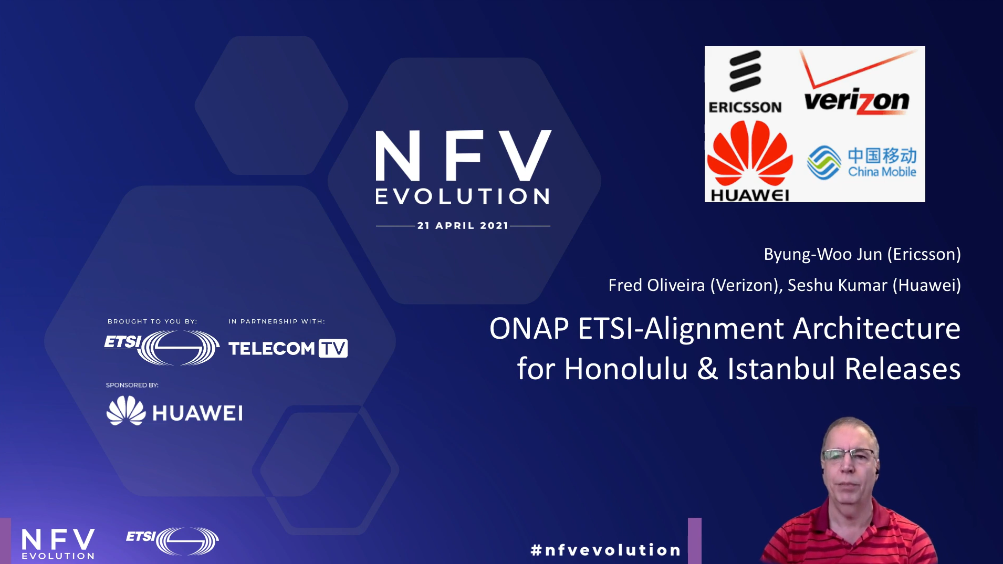
Modeling Workshop
Container modeling workshop with ETSI NFV
Present on behalf of ONAP in online NFV workshop
  (https://www.telecomtv.com/content/etsi-nfv-evolution-event/onap-etsi-alignment-architecture-for-honolulu-istanbul-releases-41269/)

Slide 7
Modeling Documentation and Tool
Modeling documentation improvement:
  Single wiki page to capture all approved models
    https://wiki.onap.org/display/DW/ONAP+Information+Model+-+Clean+and+approved+models+across+ONAP+releases
  Modeling documentation update for Guilin, Honolulu and Istanbul release
Modeling Tool update:
  Papyrus version upgrade to 2020-06
  Update user guidance for tool installation and model creation
    https://wiki.onap.org/display/DW/Using+Papyrus+for+Modeling

Slide 8
Thank you

