Slide 1
ONAP Security Meeting
We start at 2 PM CET = 1 PM UTC
2021-11-16

Slide 2
Agenda & Minutes 1/2
Detailed Minutes of the Meeting available here:
Filebeat containers and potential to be used for log aggregation – Bob/Amy
Synch of versions with OOM and Integration teams
PTL meeting update:
  Sec/Doc started the discussion here: https://wiki.onap.org/x/WoEEBw
  Extra TSC session – release sign-off process started
  LFN Developer and Testing Forum, Jan. 10-13, 2022 (4h topics + 30 mins break)/day , Virtual Event PLEASE NOTE CORRECTED DATES! Registration: https://community.lfnetworking.org/events/details/linux-foundation-lfn-developer-testing-forums-presents-lfn-developer-testing-forum-january-2022/
  Topics Page - Call for proposals - Target: December 3rd, 2021
ONAP code quality improvement – update by Fabian
  Meeting with Jess done, new job created in gerrit for cps
  New metrics to be approved by TSC for Sonar quality gates
Software BOMs:
  Ranny involved, follow-up with Krzysztof, ticket to opened to LFN IT to create BOM and then review it ith PTLs

Slide 3
Agenda & Minutes 2/2
TSC meeting this Thursday – we present non functional requirements for Jakarta release.
Sonarcloud dashboard has gone and no longer supported!
  Tony is checking alternatives
Jakarta release schedule image:
  https://wiki.onap.org/display/DW/Release+Planning%3A+Jakarta
Jakarta requirements page:
  https://wiki.onap.org/display/DW/Jakarta+release+-+functional+requirements+proposed+list
  https://wiki.onap.org/display/DW/Jakarta+release+-+non-functional+requirements+proposed+list
Kubescape
  Fabian had a meeting with Michal Jagiello. Fabian will do the comparison between Kubescape and existing tools.
  https://wiki.onap.org/display/DW/Integration+Security+tests
Kubernetes hardening
  Muddasar and Bob provided some feedback to NSA team related to logging requirements

Slide 4
Quality improvements in Istanbul release
sdc
  Security hotspot : 1
  Bug Major : 100
aai
  Security hotspot : 97
  Bug : 74
  vulnerability : 29
dmaap-messagerouter-dmaapclient
  Security hotspot : 10
  Bug blocking : 17
  Bug critical : 63
  Bug Major : 119

Slide 5
Hot spot definition:
A Security Hotspot highlights a security-sensitive piece of code that the developer needs to review. Upon review, you'll either find there is no threat or you need to apply a fix to secure the code. Another way of looking at hotspots may be the concept of defense in depth in which several redundant protection layers are placed in an application so that it becomes more resilient in the event of an attack.
Vulnerability or Hotspot? The main difference between a hotspot and a vulnerability is the need of a review before deciding whether to apply a fix:
  With a Hotspot, a security-sensitive piece of code is highlighted, but the overall application security may not be impacted. It's up to the developer to review the code to determine whether or not a fix is needed to secure the code.
  With a vulnerability, a problem that impacts the application's security has been discovered that needs to be fixed immediately.An example is the RSPEC-2092 where the use of cookie secure flag i.
Why are Security Hotspots Important? While the need to fix individual hotspots depends on the context, you should view Security Hotspots as an essential part of improving an application's robustness. The more fixed hotspots there are, the more secure your code is in the event of an attack. Reviewing Security Hotspots allows you to:
  Understand the risk – Understanding when and why you need to apply a fix in order to reduce an information security risk (threats and impacts).
  Identify protections – While reviewing Hotspots, you'll see how to avoid writing code that's at risk, determine which fixes are in place, and determine which fixes still need to be implemented to fix the highlighted code.
  Identify impacts – With hotspots you'll learn how to apply fixes to secure your code based on the impact on overall application security. Recommended secure coding practices are included on the Hotspots page to assist you during your review.
Source: https://docs.sonarqube.org/latest/user-guide/security-hotspots/

Slide 6
Istanbul SECCOM achievements 1/2
Global Requirements follow-up
  Java [REQ-801] & Python [REQ-800] upgrades – under control, majority succeded
  Packages upgrades [REQ-863] - vulnerabilities removed: 679/776
  CII Badging requirements
    Better coverage in CII Badging Dashboard (included 4 repos/projects?)
    Code Quality improvements with SonarCloud fixes:
      AAI fixes (95 security hotspots fixed)
      DMaaP: security 400+ issues fixed,
      SO: security issues fixed
Removal of unsupported code – repos removed: ESR, Portal, Portal-SDK, others?
All the efforts on security logging requirements development
  Events to be captured
  Required fields for each event
  Proposed PoC for Jakarta

Slide 7
Istanbul SECCOM achievements 2/2
Efforts during Istanbul release to propose new Best Practices for Jakarta to come:
  [REQ-xxx] SECURITY LOGS FIELDS
  [REQ-xxx] Feature intake template
  [REQ-xxx] Using basic image from OOM
  [REQ-xxx] Software BOMs – more informative, no impact on pipeline

Slide 8
Backup
Security Risk Assessment and Acceptance – revisit Brian’s statement
  Data map to show elements moving through the system is needed
CII badging update by Tony:
  As Amdocs colleague is not contributing anymore in ONAP, with David Wheeler support 2 projects (2315 and 2316) can be edited by David McBride, so he could fix the ONAP naming from here on.
  Action for David McBride for AAF-1215 – update?
Software BOMs:
  Nexus upgraded to latest version, LFN decision to use SPDX format and not cyclone or DX
  Research on how the missing information can be collected (plugin to be used?), info.yaml, plugin for Maven and jira

Slide 9
SECCOM Istanbul requirements
Global requirements
  [REQ-437 -> REQ-800 ] COMPLETION OF PYTHON LANGUAGE UPDATE (v2.7 → v3.8)
  [REQ-438 -> REQ-801] COMPLETION OF JAVA LANGUAGE UPDATE (v8 → v11)
  [REQ-439 -> REQ-863] CONTINUATION OF PACKAGES UPGRADES IN DIRECT DEPENDENCIES
  [REQ-443] CONTINUATION OF CII BADGING SCORE IMPROVEMENTS FOR SILVER LEVEL
Best Practice
  [REQ-441] LOGS MANAGEMENT - PHASE 1: COMMON PLACE FOR DATA
Define complete security logging requirement as part of the larger log management effort

Slide 10
SECCOM Jakarta requirements
Global requirements
  [REQ-437 -> REQ-800 ] -> REQ-xxx COMPLETION OF PYTHON LANGUAGE UPDATE (v2.7 → v3.8)
  [REQ-438 -> REQ-801] -> REQ-xxx COMPLETION OF JAVA LANGUAGE UPDATE (v8 → v11)
  [REQ-439 -> REQ-863] -> REQ-xxx CONTINUATION OF PACKAGES UPGRADES IN DIRECT DEPENDENCIES
  [REQ-443] -> REQ-xxx CONTINUATION OF CII BADGING SCORE IMPROVEMENTS FOR SILVER LEVEL
  [REQ-441] LOGS MANAGEMENT - PHASE 1: COMMON PLACE FOR DATA – PROPOSAL FOR JAKARTA
Best Practice
  [REQ-xxx] SECURITY LOGS FIELDS
  [REQ-xxx] Feature intake template
  [REQ-xxx] Using basic image from OOM
  [REQ-xxx] Software BOMs – more informative, no impact on pipeline

Slide 11
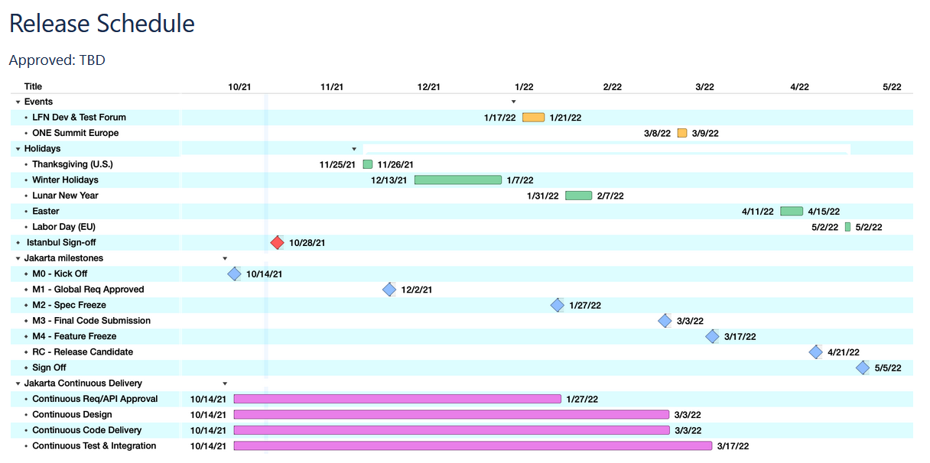
Jakarta release schedule

Slide 12
New topics to be covered on next SECCOM (9th of November)
Reviewing requirements by SECCOM as part of the process.

