Slide 1
ONAP Next Generation Logging
Architecture, Design and Roadmap
November 16th, 2021
Byung-Woo Jun (Ericsson)
@twitter

Slide 2



ONAP Container Logging in Kubernetes
ONAP Container Logging Background:
Allow users to access application logs event even if a container crashes, a pod get evicted or a node dies
Require a separate backend to store, analyze and query logs
Write to standard output and standard error streams
  A container engine handles and redirects any output generated to a containerized application’s STDOUT and STDERR streams
Support multi-tenancy logging
Options:
REQ-441
Currently a Best Practice since Istanbul.
  Approved by TSC on 22 APR 2021.
Proposal presented at PTL Meeting Oct 18 and 25. Open comment period to 11/5.
Clarification to PTLs that this not meant as a replacement to current logging but an addition to existing logging.
About 90% of (G release) projects already log to STDOUT as discovered from empirical testing.
Applications can easily implement this with a configuration file change (e.g., adding a STDOUT/STDERR appender to the log configuration)
Option | Architecture Highlights | Choice
A | Use a node-level logging agent (e.g., DaemonSet) that runs on every node Node-level logging creates only one agent per node and does not require any changes to the applications running on the node Containers write STDOUT and STDERR A node-level agent collects these logs and forwards them for aggregation
B | Use separate log streams (sidecar) from applications, which can lack support for writing to STDOUT or STDERR For the case, applications do not send log events to STDOUT/STDERR
C | If the node-level logging agent is not flexible, write an application-specific sidecar

Slide 3
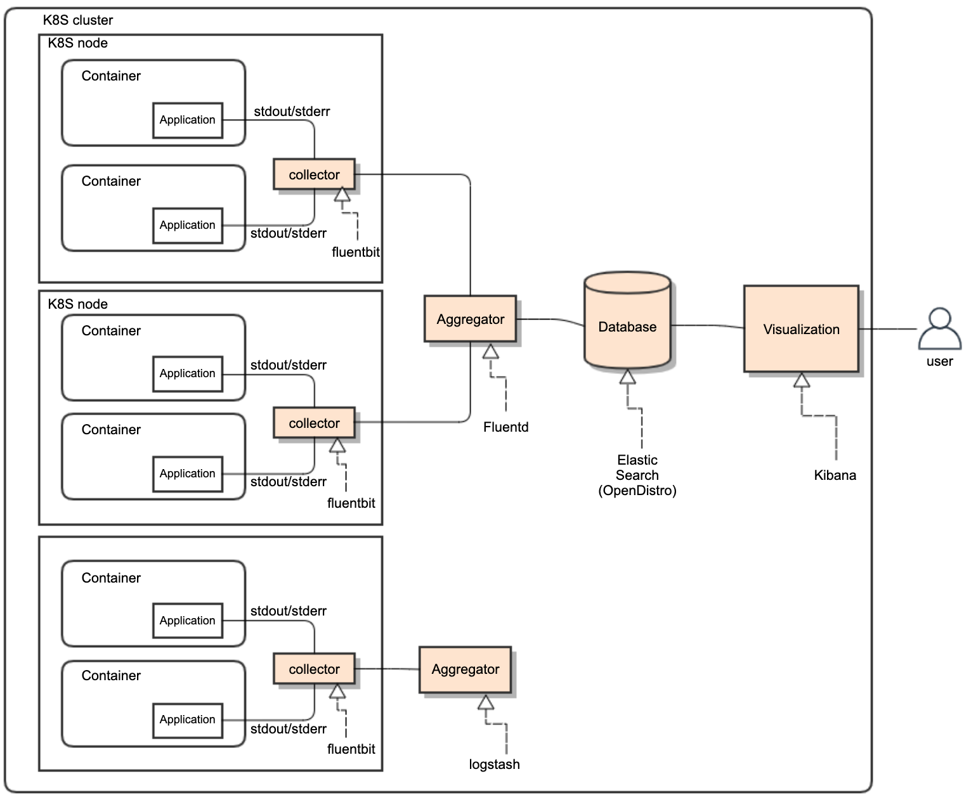
ONAP Logging Functional Architecture
ONAP supports open-source- and standard-based Logging architecture.
Once all ONAP components push their logs into STDOUT/STDERR, any standard log pipe can work.
  Allowing the logging component stack is realized by choices of vendors
  ONAP provides a reference implementation/choice
ONAP logs will be exported to a different and centralized location for security, persistent and aggregation reasons
  Log collector sends logs to the aggregator in a different container
  Aggregator sends logs to the centralized database in a different container
Logging Functional Blocks:
  Collector (one per K8S node)
  Aggregator (few per K8S cluster)
  Database (one per K8S cluster) – could use multiple PODs for HA
  Visualization (one per K8S cluster)
ONAP reference implementation choice:
  EFK: Elastic Search, Fluentd, Fluentbit, Kibana
  LFG: Loki, Grafana, Fluentd / Flentbit
ONAP logging conforms to SECCOM Container Logging requirements
  Standardized Logging Fields – proposed as a best practice
  https://wiki.onap.org/display/DW/Jakarta+Best+Practice+Proposal+for+Standardized+Logging+Fields

Slide 4
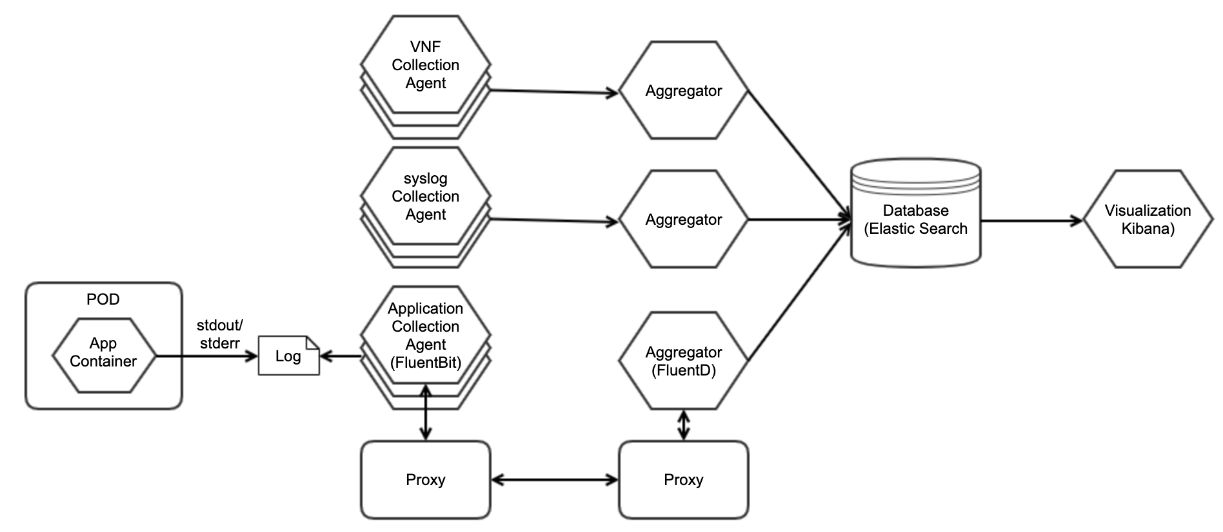
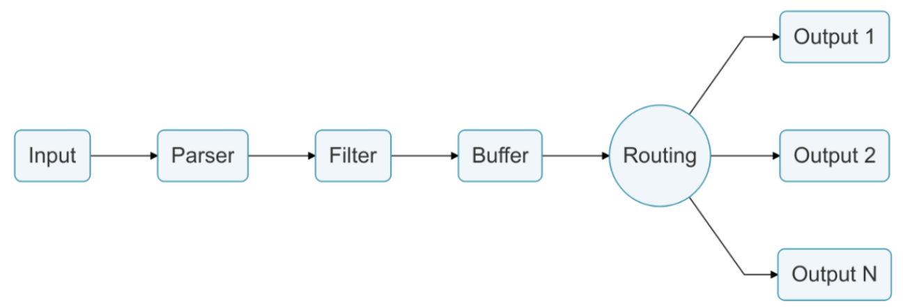
ONAP Reference Implementation
  ONAP provides reference implementation, but the implementation can be overwritten by vendors, by leveraging their own logging stack
  As a log driver, FluentBit (node-level logging agent) needs to be run on every node to collect logs from every POD, so FluentBit is deployed as a DaemonSet (a POD that runs on every node of the cluster). Note: grant privileged (root) access for the pod is TBC.
  When FluentBit runs, it will read, parse and filter the logs of every POD and could enrich each entry with the following information (metadata):
      POD Name & ID
      Container Name & ID
      Labels & Annotations
  To obtain this information, a FluentBit built-in filter plugin called Kubernetes talks to the Kubernetes API server to retrieve relevant information. All of this is handled automatically, no intervention is required from a configuration aspect.
  Flentd acts as logging aggregator for log events from FluentBit.
  FluentBit and FluentD could use Service-Mesh for secure communication
    mTLS between FluentBit and FluentD could be based on Service-Mesh. Note: heaviness of Service-Mesh is TBC.
  ElasticSearch is a centralized log data indexing and storage
  Kibana is used for log data visualization

Slide 5
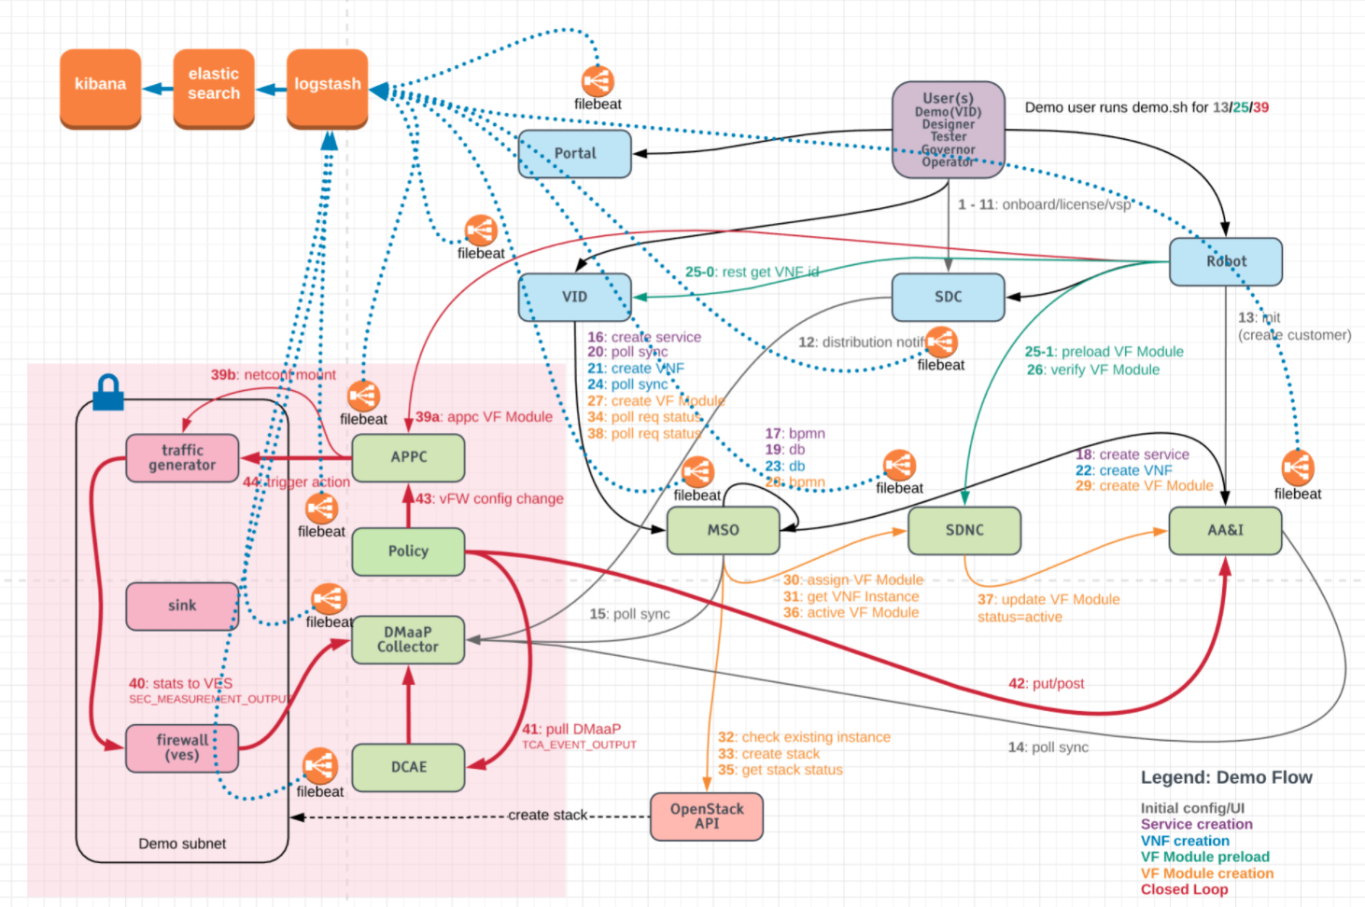
ELK -> EFK Stack in ONAP (Old View)
- Will be replaced by the new Logging Architecture
We plan to move from ELK to EFK / LFG
ONAP provides reference implementation, but the implementation can be overwritten by vendors, by leveraging their own logging stack.
There are the 3 elk containers in the log pod in K8S off the OOM deployment
Currently all 3 ports are exposed, logstash, elasticsearch and kibana
Due to the licensing issue, we are thinking about:
  OpenDistro for Elastic Search
  Fluentd as aggregator
  Fluentbit as collector
  Kibana for visualization
We use K8S with Helm charts via the OOM project deployment
The ports are all mapped as node ports in the external 302xx namespace
Each participating ONAP component pushes STDOUT/STDERR
filebeat is used as a sidecar container for all the ONAP components, as a collector
filbeats pushes logs to the logstash node port
Logstash collects logs and pushes them to elastic search
Elastic search stores logs, indexes log contents and make them accessible
Kibana is used to visualize logs based on filtering criteria

Slide 6
References
Logging Architecture Proposal, https://wiki.onap.org/display/DW/Logging+Architecture+Proposal
Logging Enhancements Project proposal, https://wiki.onap.org/display/DW/Logging+Enhancements+Project+Proposal
SECCOM Container Logging Requirements, https://wiki.onap.org/display/DW/CNF+2021+Meeting+Minutes?focusedTaskId=239&preview=/93004634/100896899/2021-02-22_LoggingRequirementEvents_v8.pptx

