Slide 1
CCVPN Closed-loop changes in Jakarta
Henry Yu, Hesam Rahimi, Decheng Zhang (Huawei)
Lin Meng (CMCC)
Dong Wang, Lei Shi (China Telecom)

Slide 2
Contents
Overview and background of Intent-based Cloud Leased Line
CCVPN Closed-loop
DCAE questions

Slide 3
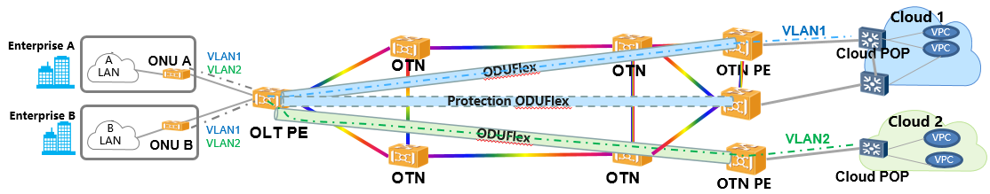
Background (1): Framework for Intent-based Cloud Leased Line
IBN
Input/recognize
instantiate
Intent Instance Life Cycle Management
report
verify
translate
control
intelligence
data collection
orchestration
analytics
Closed-loop
CCVPN
Cloud leased line network configurations

Slide 4
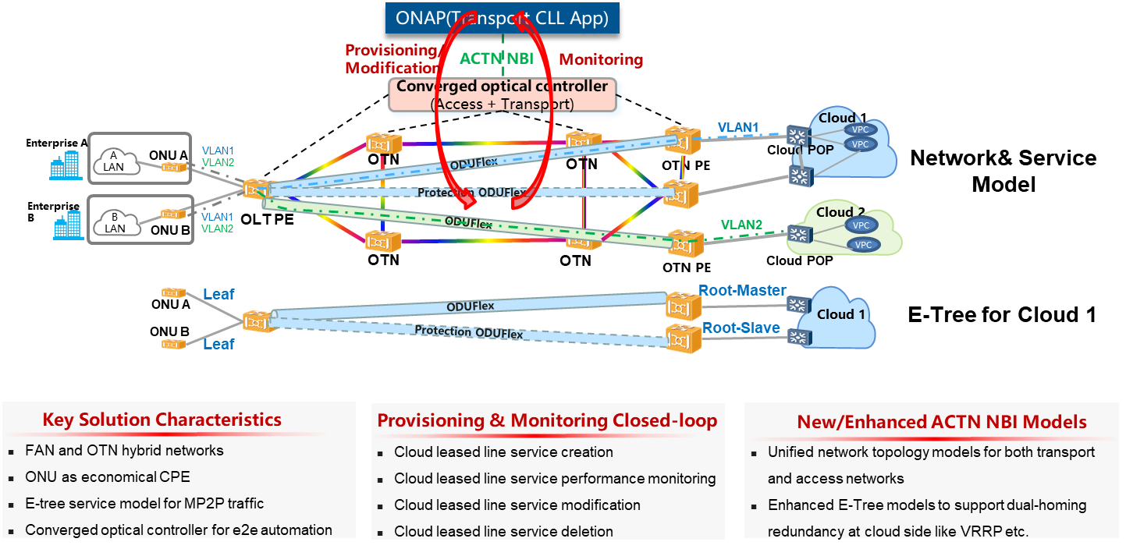
Background (2): E-Tree implementation for Cloud Leased Line based on IETF/ACTN standards

Slide 5
Background (3): Design overview on impacted modules
ONAP
NOTE: UUI changes are made together with the Intent-Based Networking use-case, which initiates the Cloud leased line (CLL) service.
UUI
OOF
SO
Service-instance REST API handler
AAI
Policy
CLL definition model
Invoke BPMN WF
SDC
CLL implementation models (e.g., te-topology, te-tunnel, etc.)
CLL Work Flow
Generic-resource-API
SDNC
CLL NBI-to-SBI Mapping
Existing ONAP code with modifications
ACTN MPI Adaptor (SBI)
New ONAP code for TN NSSMF Functionality added in Istanbul
Optical domain controller

Slide 6
Contents
Overview and background of Intent-based Cloud Leased Line
CCVPN Closed-loop
DCAE questions

Slide 7
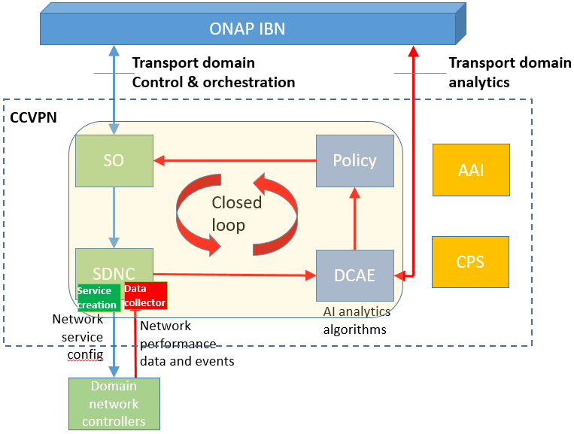
CCVPN Closed-loop overview

Slide 8
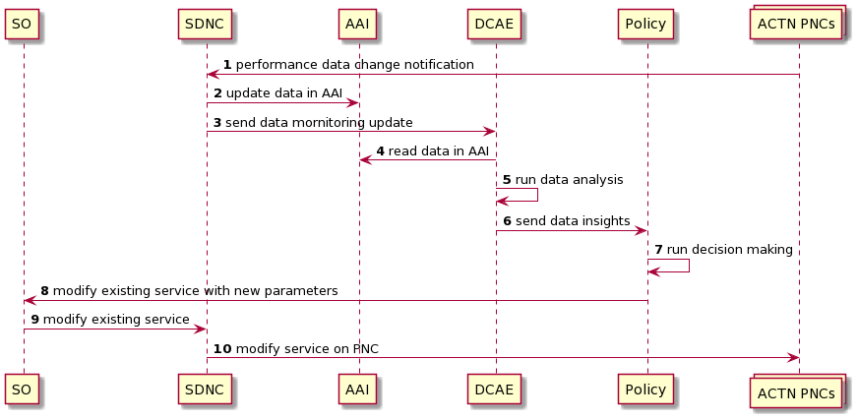
Closed-loop high level call flow

Slide 9
Closed-loop high level walk-thru
ONAP IBN
SDNC collects performance data from domain controllers (e.g., bandwidth usage)
SDNC sends performance data (VES) to DCAE for analysis
DCAE performs data analytics (e.g., check if bandwidth usage is continuously above threshold for x reported times).
If DCAE detects the anomaly, it send data insights (e.g., bandwidth usage too high) to Policy
Policy translates data insights into decision (e.g., if bandwidth usage too high, then increase max-bandwidth of the CLL service, i.e., modify CLL )
Policy calls SO NBI to modify CLL service (e.g., increase max-bandwidth)
SO calls SNDC to modify CLL on physical network
IBN monitors performance data and reports to user, by querying DCAE
8
D2E
decision
6
5
SO
Policy
7
AAI
4
A2D
analysis
data
E2M
execution
SDNC
2
DCAE
Service creation
Data collector
3
M2A
monitoring
7
1

Slide 10
Contents
Overview and background of Intent-based Cloud Leased Line
CCVPN Closed-loop
DCAE questions

Slide 11
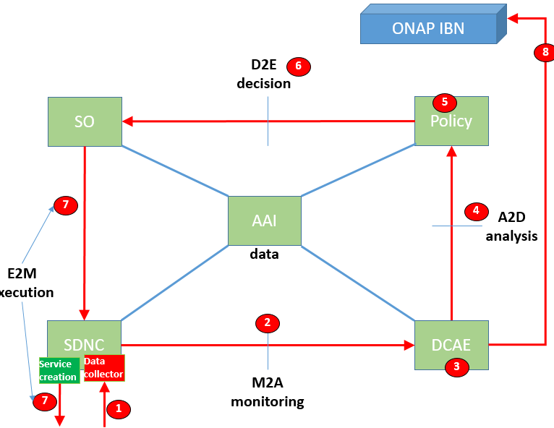
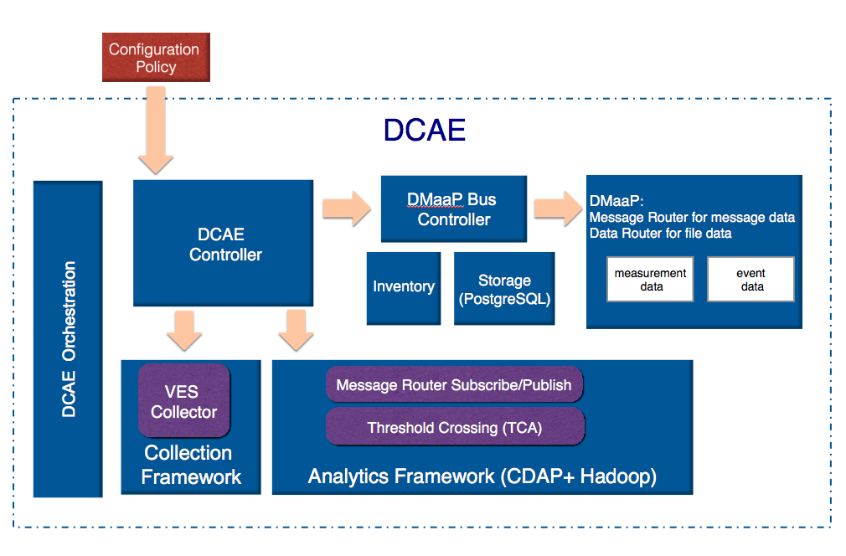
DCAE Control Plane Question
How to set configuration policy to check if bandwidth usage is continuously above threshold for x reported times? Is there any DCAE code changes required?

Slide 12
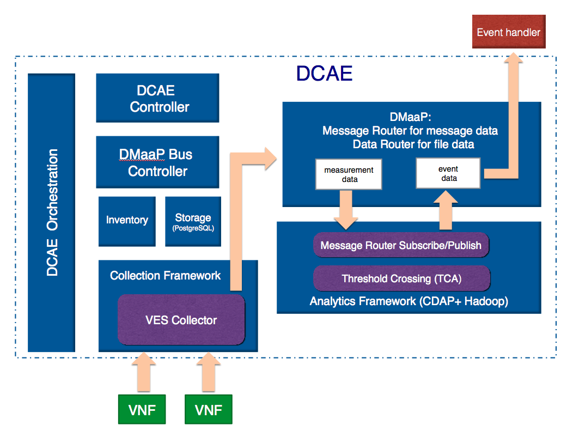
DCAE Data Plane Question
For step 2, what is the interface (REST?) for SDNC to send VES data to DCAE? Is there an example?
For step 4, is there any DCAE code changes required to generate the DMaaP event which is consumed by Policy?

Slide 13
Thank You!

Slide 14
Transport MD closed loop data and control flow (based on ZSM 009)
Closed loop control flow contains the following stages:
M2A (monitoring): SDNC receives (or collects) telemetry and performance data from the domain network controllers, and forwards the data to DCAE
A2D (analysis): DCAE performs data analytics on the received data changes, and generates and sends the data insights to Policy
D2E (decision): Policy makes the decision on how to modify the existing services based on the data insights and calls SO to make service modification
E2M (execution): SO executes the service modification by instructing SDNC to apply new network configurations to domain controllers
D2E
decision
SO
Policy
AAI
A2D
analysis
E2M
execution
data
SDNC
DCAE
Service creation
Data collector
M2A
monitoring
Domain controllers

Slide 15

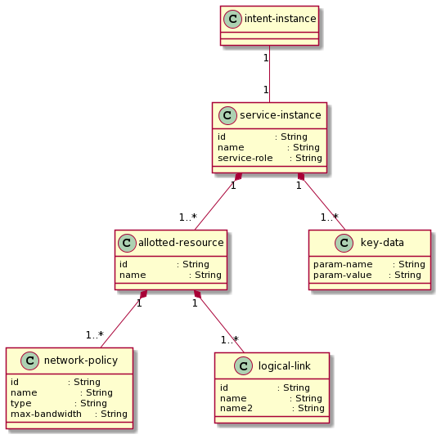
Update performance data in AAI: step 8
cll-id in simulator payload matches service-instance ID
Write uni-id-xxx as param-name in AAI
Write value into AAI

Slide 16
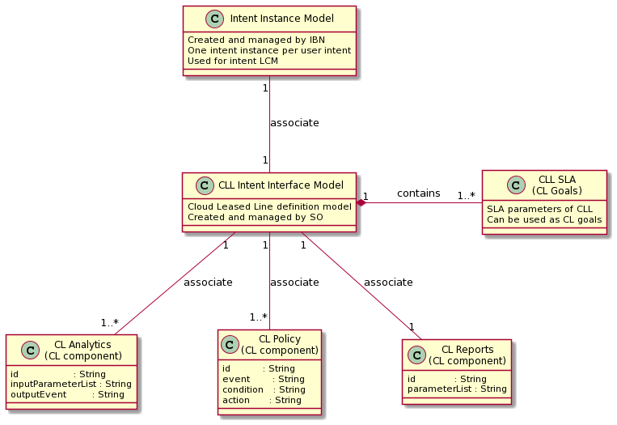
Model relationship overview (1): Intent and closed-loop models
Data models manipulated by IBN
Data model in AAI
IBN manages the life cycle of an Intent instance
For simplicity, CL Life Cycle states could be coincide with that of the Intent instance. i.e., When or if IBN LCM updates the Intent state, it also calls the relevant TN MD NBI, which updates the CL state accordingly
Data models manipulated by SO
Data model in AAI
SO manages the Cloud Leased Line (CLL) definition model. The model is so-called service intent, which is technology agnostic, declarative, and derived from the user intent
The SLA portion of the definition model represents the CL goals
Data models manipulated by DCAE and Policy
Java classes (for data objects in runtime), no need to persist in AAI
There are three CL component classes: Analytics, Policy, and Reports.
DCAE needs to auto-derive Analytics and Reports from CL goals, and also needs to tune them. (Note that AI may be needed for this task)
Policy needs to auto-derive and tune CL Policy component .(Note that AI may be needed for this task)

