Slide 1
ASD PoC Update & Plans
Prepared by Ericsson
Byung-Woo Jun
Marian Darula
Zu Qiang
2022-07-14
Ericsson Development Team:
Michael Morris, Andre Schmid de Albuquerque, Krupa Nagabhushan, Vasyl Razinkov
Waqas Ikram, Sagar Shetty, Raviteja Karumuri, Gerard Nugent

Slide 2
ASD PoC Status
SDC Onboarding is in progress by the Ericsson SDC team (https://wiki.onap.org/display/DW/Application+Package+Onboarding+to+SDC)
  Creating Resource VF based on ASD (and SDC internal model mapping; preserve the original ASD package in ASD_PACKAGE dir)
  ASD specific metadata is copied to Resource VF
  SDC code has been contributed to Kohn including enhanced TOSCA parser, under https://jira.onap.org/browse/REQ-993 and https://jira.onap.org/browse/SDC-3777
Ericsson SO team is working on AS orchestration PoC (https://wiki.onap.org/display/DW/ASD-Based+CNF+Orchestration+PoC )
  Initial PoC Scope is set (ASD CNF package handling, and AS Orchestration for Create AS, Instantiate AS, Delete AS) for Day 0 and 1
  Day 2 will be handled separately (Currently it is out-of-scope)
  ASD PoC code is being contributed to SO PoC branches (as-orchestration, coming so-cnfm), under https://jira.onap.org/browse/REQ-1043 and https://jira.onap.org/browse/SO-3808
User Story Group | Status
SDC shall support Application Package onboarding and distribution | Done. (Kohn release SDC feature)
Onboarding SDC ASD CNF package and storing its metadata to SO Catalog DB | Done
ASD LCM Restful Protocols swagger | Done (https://wiki.onap.org/display/DW/AS+LCM+RESTful+Protocols+for+SO+CNF+Manager )
Create AS | Done
Instantiate AS | Done: Registration of external K8S clusters; Deployment of Helm charts that are defined in the ASD, based on the order, to external K8s clusters In progress: Monitoring K8S deployment and ASD deployment status In progress: Generating and replacing values based on instance tag-value sets defined in ASD
Delete AS | In Progress: Defining Workflows and business logic
Query ASInstance | Done

Slide 3

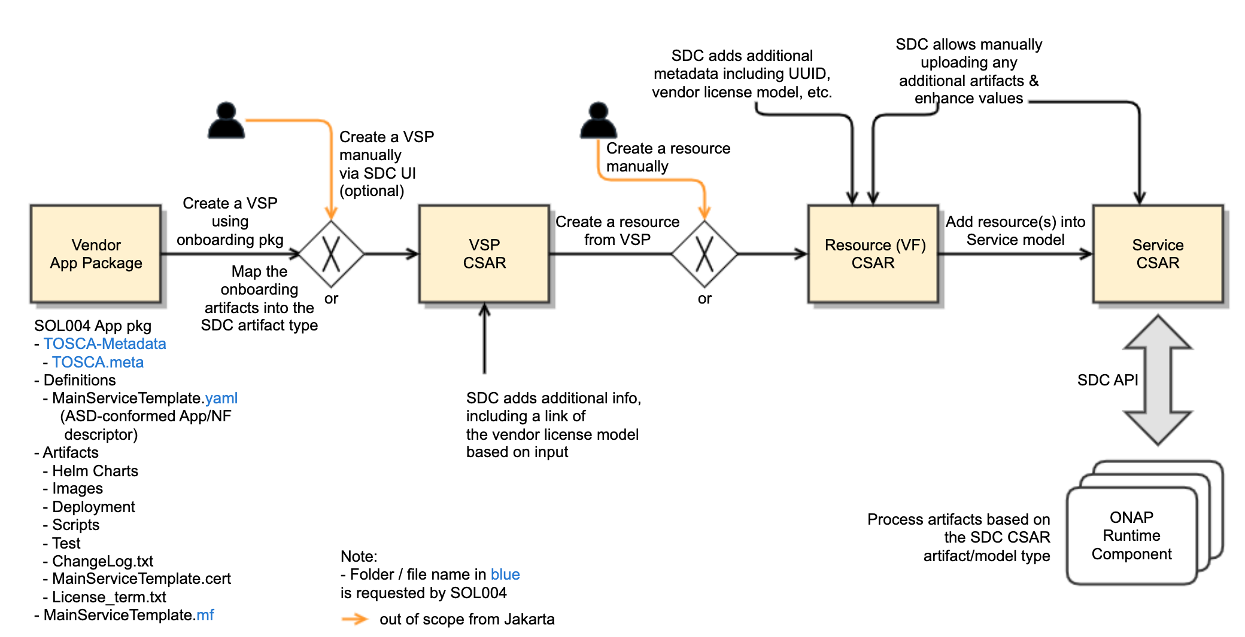
ASD Onboarding to SDC - Done
ASD package conforms to the SOL004 App Pkg with the TOSCA-Metadata directory
ASD metadata (e.g., asd.mf) contains the ”entry_definition_type” attribute for asd indication
The ‘Definitions’ directory contains the asd_type.yaml and vendor asd definition yamls
The Definitions directory contains the asd_type.yaml and vendor asd definition yamls
  for ASD IM v1.0, see https://wiki.onap.org/pages/viewpage.action?pageId=128715159
  for ASD DM, see https://wiki.onap.org/display/DW/Application+Service+Descriptor+%28ASD%29+Resource+Data+Model
The vendor ASD yaml(s) contain asd properties and deploymentItems (under the ‘artifacts’ section)
SDC maps ASD to SDC Resource VF, and maps ASD DeploymentItems to VF-Modules in the SDC Resource VF group section
The original vendor ASD package will be preserved in the ”ASD_PACKAGE” directory
Helm Charts and Images will be stored in the Resource VF HELM and IMAGE directories
There is no change on how Service CSAR is certified and distributed

Slide 4
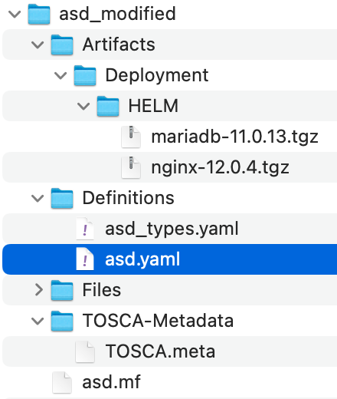
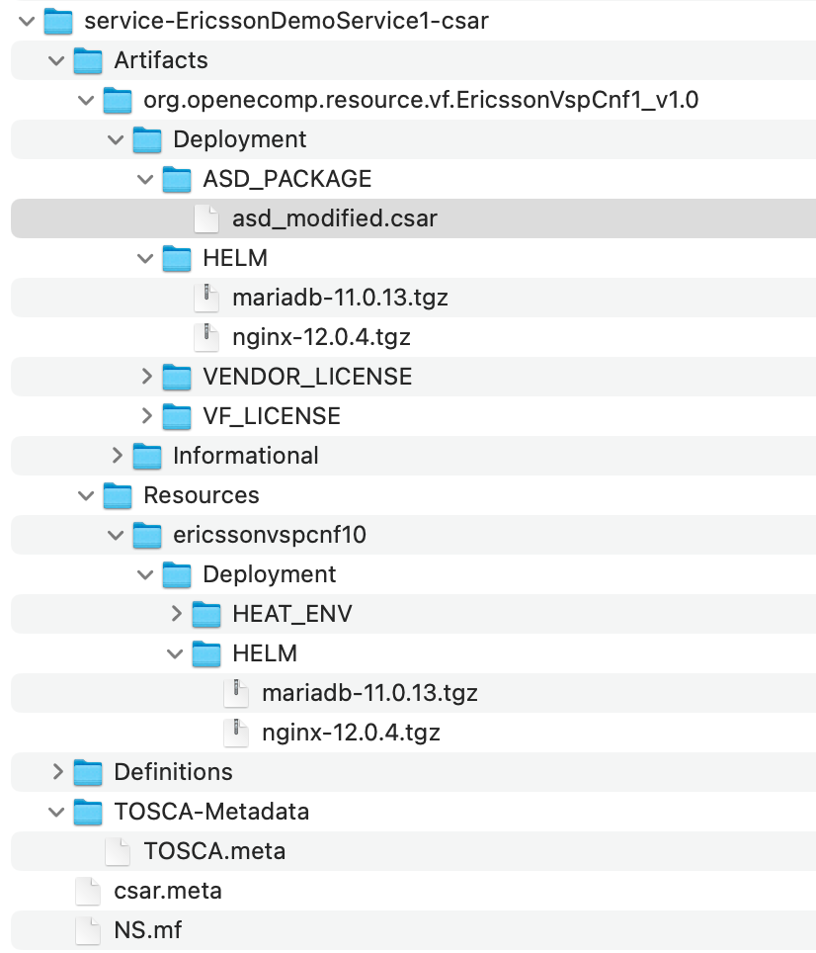
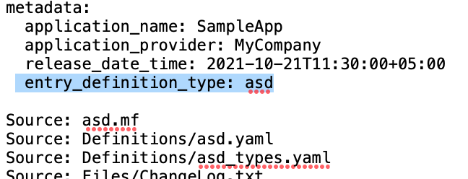
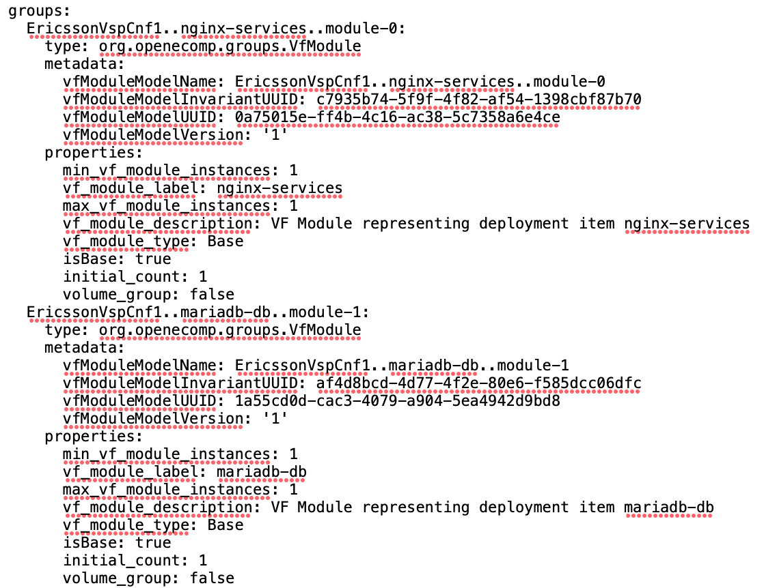
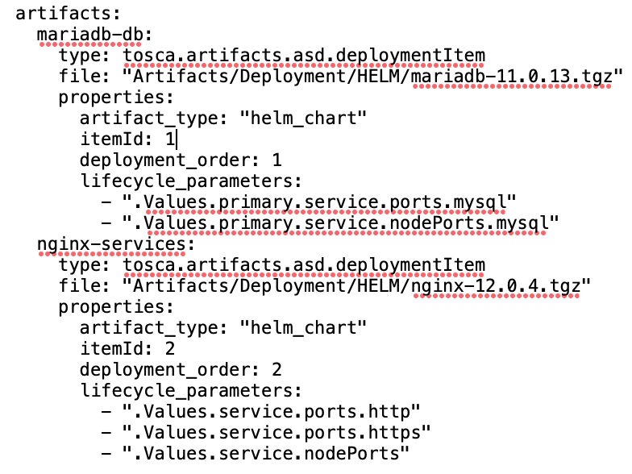
ASD Onboarding Example - Done
- with two Helm Charts (MariaDB, Nginx)
ASD Package example (asd_modified.csar)
onboarding
SDC Service Package example (service-ericssonDemoService1-csar.csar)
preserve the original ASD package
copied original helm charts
asd.mf
copied helm charts
mapping

Slide 5
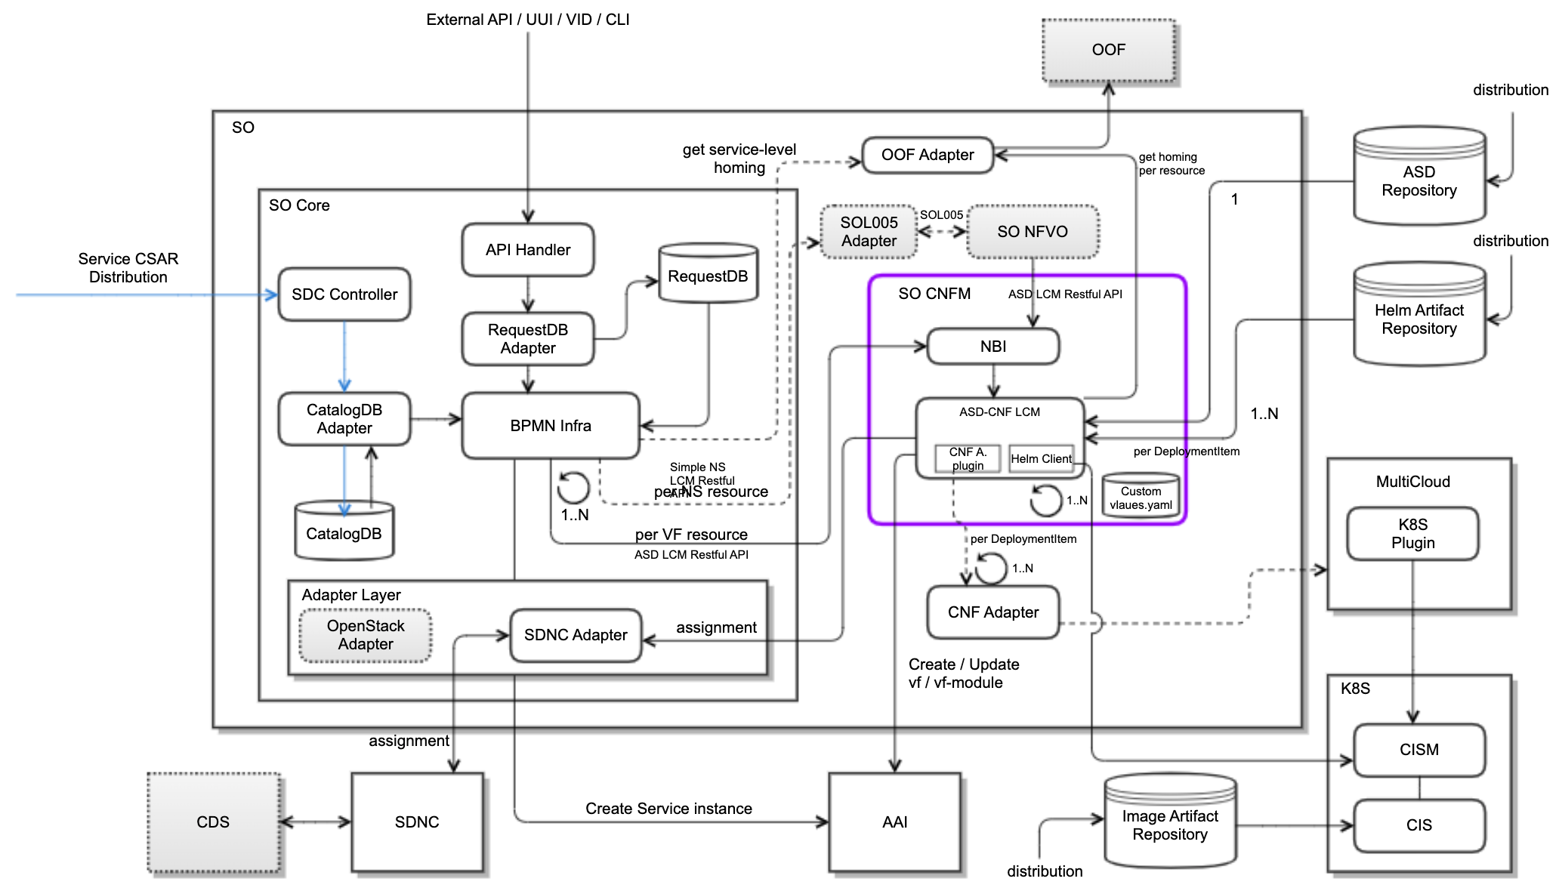
ASD Onboarding & Orchestration In SO Core – In Progress
- ~80% done
Supports SDC Service CSAR onboarding thru DMaaP and SDC Query API
Saves SDC Service CSAR metadata (no need to store ASD packages themselves) to SO Catalog DB (for now, Ericsson decided to use the existing vnf_x db tables)
  vnf_resource_customization
  vnf_resource
Supports a new SO endpoint for cnfs
  /onap/so/infra/serviceInstantiation/v1/serviceInstances/<instanceid>/cnfs
  Note: if the existing vnf endpoint is preferred, the modeltype can be used to separate cnf from vnf orchestration (TBD)
Handles SO request parameters
  use the modelVersionId as the asdId for CreateAS
  use the userParams for AsInstantiate request parameters
  use the cloudConfiguration (lcpCloudRegionId, cloudOwner, tanentId) for selecting a target cluster; later, Ericsson plans to use the ASD enhancedClusterCapabilities to select a target cluster dynamically (based on required capabilities)
Configures Database tables for SO Building Block to invoke CnfInstantiateBB and CnfDeleteBB workflows in BPMN Infra
  northbound_request_ref_lookup
  orchestration_flow_reference
  building_block_detail
Creates a Service Instance in AAI
Invokes WorkflowActionBB (main), CnfInstantiateBB.bpmn and CnfDeleteDB.bpmn based on the BB configuration
Built a new CnfInstantiateBB workflow to invoke SO CNFM for CreateAS and InstantiateAS
  Invokes SO CNFM per AS (VF resource)
Built a new CnfDeleteBB workflow to invoke SO CNFM for DeleteAS
currently, getting ASD package & image from SDC
TBD
1
EMCO
1
Future consideration
M
M
currently, getting images from SDC
TBD

Slide 6
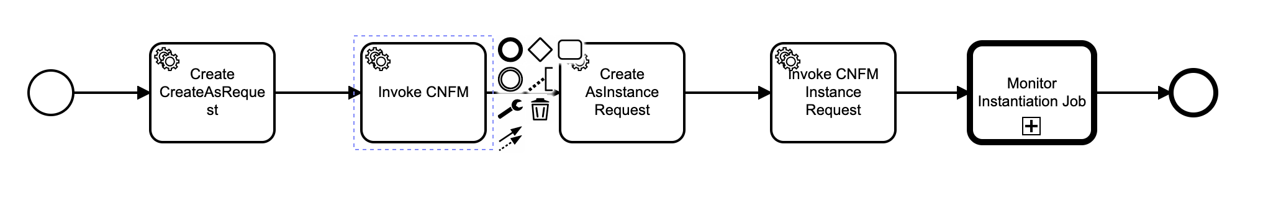
BPMN Infra CnfInstantiateBB workflow - Done
Processes SO user requests of AS LCM, which came thru the API Handler
Formulates CreateAS and InstantiateAS requests, based on ASD LCM Restful Protocols (https://wiki.onap.org/display/DW/AS+LCM+RESTful+Protocols+for+SO+CNF+Manager )
Invokes SO CNFM for the CreateAS and InstantiateAS orchestration
Monitors AS Instance asynchronous Job status, to complete AS LCM workflow instance(s)
for CreateAS request
invoke CNFM for CreateAS
for InstantiateAS request
invoke CNFM for InstantiateAS
monitor InstantiateAS async job

Slide 7
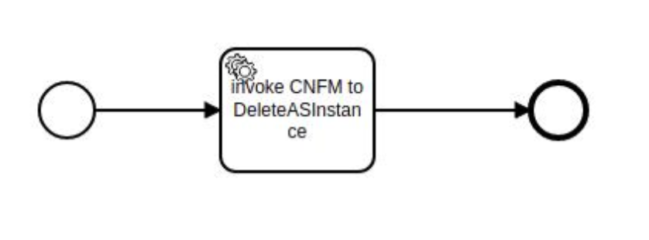
BPMN Infra CnfDeleteBB workflow – In Progress
Processes SO user requests of AS LCM, which came thru the API Handler
Formulates DeleteAS requests, based on ASD LCM Restful Protocols
Invokes SO CNFM for the DeleteAS orchestration
Note: Ericsson plans to add additional Service Tasks in this workflow, as needed
invoke CNFM for DeleteAS

Slide 8

Orchestration In SO CNFM (1/2) – In Progress (~70% done)
Introduced an optional SO CNFM to make it focus on ASD manipulation
  Hides ASD and Helm Charts details and handling from the SO core
  Provides normalized NBI to be called not only from SO but also from other components (as needed) which meet the NBI (future considerations); so, CNFM location could be flexible; for now, focus on AS LCM functionalities
Supports external/operator K8s clusters registration
  Creates external K8s cluster pools
Gets ASD and Helm Chart artifacts for the given asdId
  Gets associated Helm Charts that are defined in the ASD DeploymentItems
  Currently, gets the artifacts from SDC, but once Artifacts Registries are available, gets the artifacts from the Registries
Gets Image artifacts from SDC. In the future, gets them from the Registries
Processes ASD and ASD DeploymentItems (which points to Helm Charts) with sequencing information
Based on the defined DeploymentItem order, deploys Helm Charts to a selected target K8sCluster, by leveraging Helm commands
  Monitors deployed K8s resources thru the kubectl command
For the CNFM South Bound connections, Helm Client is used for deploying Helm Charts (note: it can be changed, as needed; e.g., ORAN, EMCO, etc.)
  For now, no plan to interface with MultiCloud and K8s Plugin
  Once the SO connection to EMCO is fully available, SO CNFM could leverage the connection (TBD)
ASD supports Day 0 and Day 1 Use Cases. Day 2 support is currently out-of-scope from ASD
  Day2 configuration is under discussion; The options could be O1, 3gpp, Netconf, etc.
  Currently, CBA/CDS is not used
currently, getting ASD packages including Helm Charts from SDC
This is to prove ASD capabilities
TBD
1
EMCO
1
Future consideration
M
M
TBD
currently, getting images from SDC

Slide 9
Orchestration In SO CNFM (2/2)– In Progress
Supports the existing AAI CNF schema (following CNFO proposals)
  Generic VF
    Creates/updates Generic VF objects in AAI
  VF-Module
    Creates/updates VF-Module objects in AAI
  K8s-Resource
    CNFM gets information of the deployed K8s resource kinds thru kubectl commands (not based on pre-description)
    CNFM stores deployed K8s kinds in AAI for purposes of inventory, metrics, closed-loop, VES events, etc. (future enhancements; collaboration effort between CNFO and AS Orchestration would be good)
Ongoing work
  CNFM needs to finish the Monitoring K8s Resource status work
  Allowing SO Clients to pass the following SO request userParams for overriding instance-level Helm Charts values:
    asdExtCpdinputParms (for IPs and NAD)
    deployments.lifecycleParameterKeyValues (for overriding helm charts values)
    additionalParams (any parameters for SO CNFM operations)
  SO CNFM processes userParams and then creates instance-level Helm Charts with overridden values for deployment
currently, getting ASD packages including Helm Charts from SDC
TBD
1
EMCO
1
Future consideration
M
M
TBD
currently, getting images from SDC

Slide 10
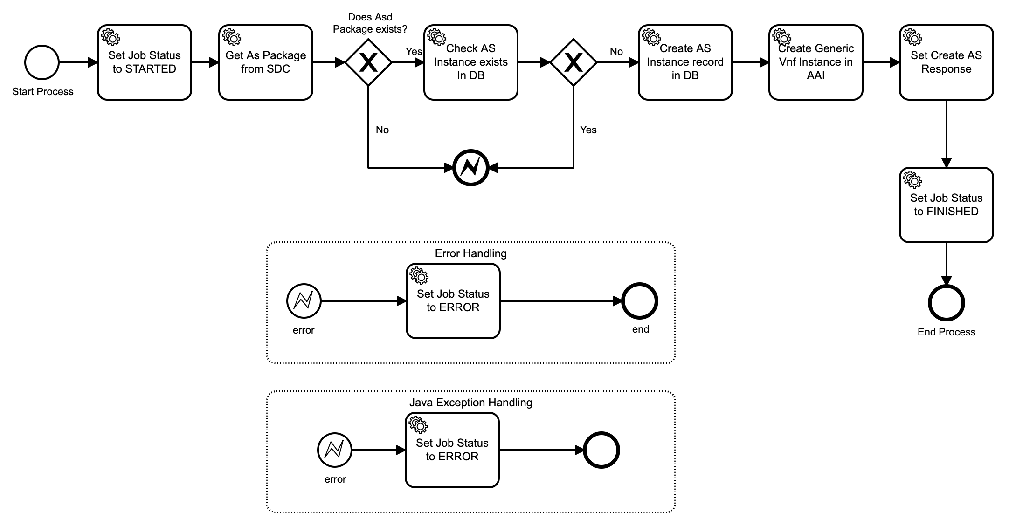
CNFM CreateAS workflow – Done
Processes the BPMN Infra CreateAS requests
  Gets ASD artifacts from SDC for now; later from the registries (TBD)
Creates an AS instance in CNFM & a Generic Vnf in AAI
  Leverages Generic Vnf, VF-Module and K8-Resources in AAI

Slide 11
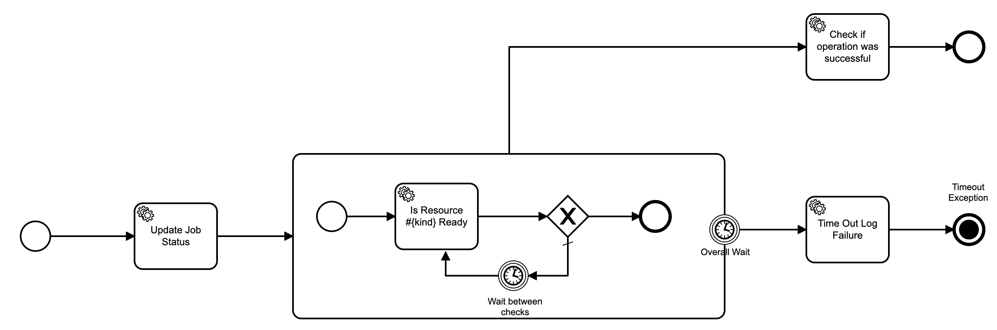
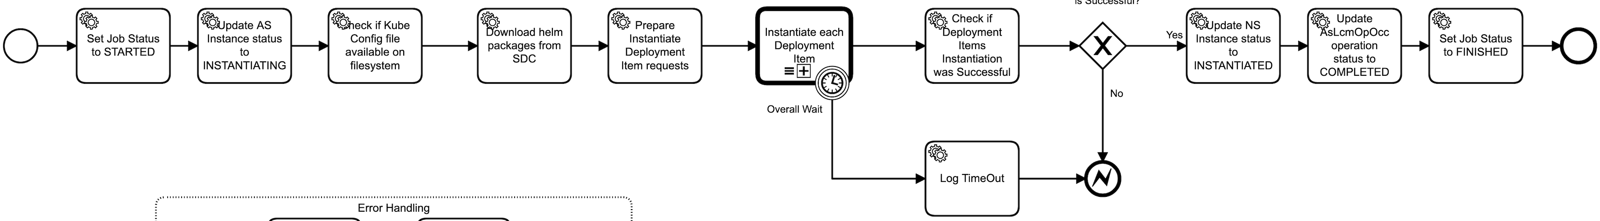
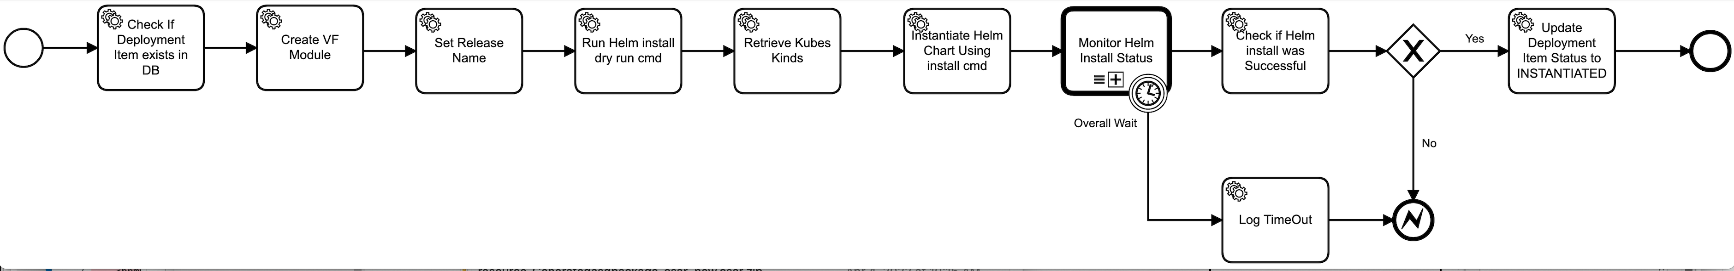
CNFM InstantiateAS workflow – In Progress
Processes the BPMN Infra InstantiateAS requests
  Gets ASD artifacts and Helm Charts from SDC for now; later from the registries (TBD)
  Creates Vf-Modules and K8s-Resource objects in AAI
Handles each ASD DeploymentItem and invokes Helm Install for deployment
  Follows the deployment sequences that are defined in the ASD DeploymentItems
Monitors Helm Install status for each Helm Charts
  Makes sure the current deployment is successful and ready before invoking the next Helm Charts

Slide 12
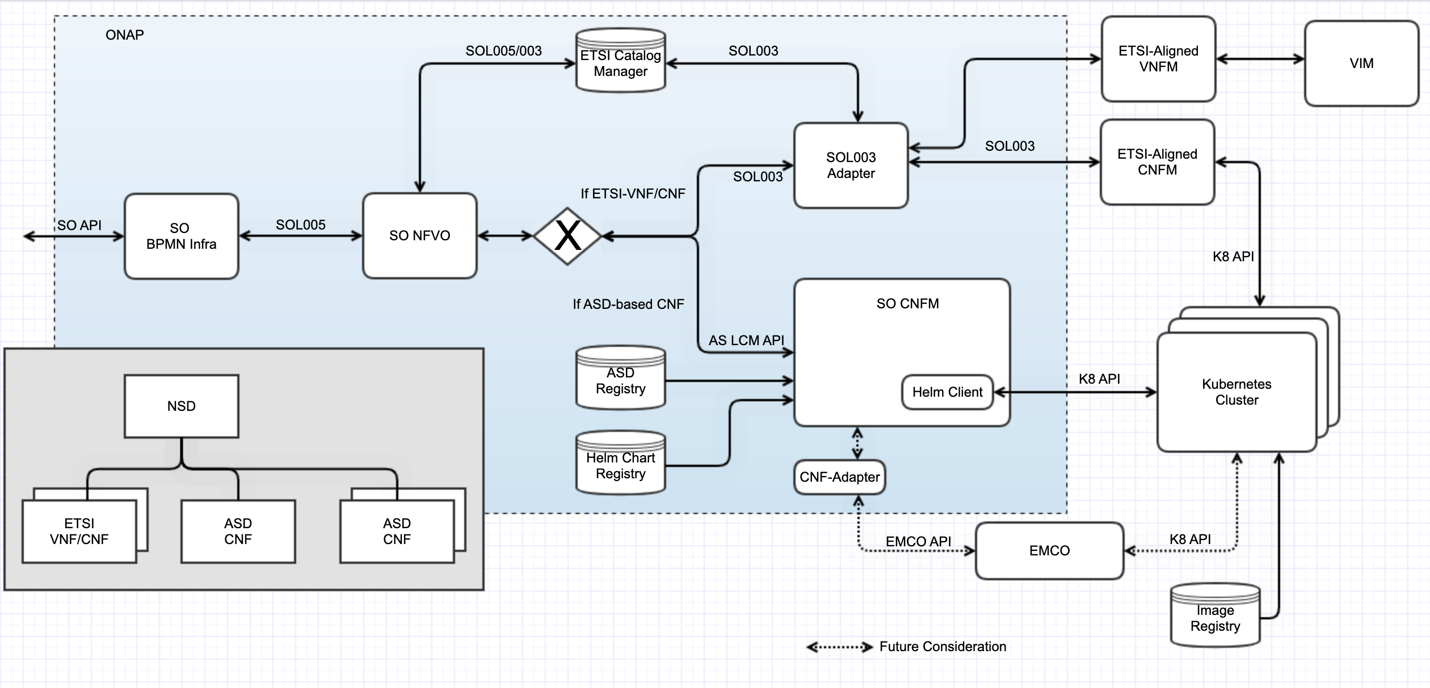
Future Consideration on NSD and ASD
NSD can contain both ETSI-Aligned VNF/CNFs and ASD-based CNFs
NS LCM Orchestration uses SO NFVO thru SOL005
SO NFVO decomposes embedded VNFs/CNFs
If the model is ETSI-VNF/CNF, SO NFVO will invoke SOL003 Adapter thru SOL003
  Depending on the vendor VNFM / CNFM capabilities, the orchestration path can be for Kubernetes clusters or VIM
If the model is ASD-based CNF, SO NFVO will invoke SO CNFM thru AS LCM API
  SO CNFM will manipulate instance-level deployment artifacts (e.g., helm charts), based on the user input parameter

Slide 13
Next Plans Topics and Discussions
Builds ASD Packages for 5G
Builds ASD, Helm Charts and Image Registries that can be shared
  Both AS Orchestration and CNFO could use the common ASD and Helm Charts Registries
  Image Registries need to be securely accessed by external K8s Clusters
  Secure Communications are a must (e.g., secure connections to/from the Registries)
SO CNFM supports Service Mesh for secure communication (from/to SO and others)
  It is under discussion with the OOM team
Leverages EMCO for supporting multi- and heterogeneous-clusters
  Seshu’s team built a CNF Adapter PoC for EMCO; waiting for more info
  Based on that, SO CNFM South Bound interface could be changed
Build Use Cases for Day 2 configuration support for K8s Resources, which were deployed thru AS Orchestration
  To discuss it further with CNFO team, ORAN and others
Collaborate work between AS Orchestration and CNFO
  CNFO leverages ASD Package and SDC ASD onboarding
  Discuss on workflows / APIs sharing
More…

