Slide 1
ONAP security meeting
2017-08-02

Slide 2
Agenda
Vulnerability Management
Reflections from Developers event.
CII Badging program
  CLAMP
  AAF
Recommendation on storage of passwords - how to achieve.
PKI infrastructure and CA
Update on vulnerability scanning discussion status
AOB

Slide 3
Vulnerability Managed
Select one vulnerability and send to send in to “clean the cobwebs” from our process.

Slide 4
Reflections from Developers event

Slide 5
CII Badging Program
Two volunteer projects
  CLAMP
  AAF
Next Steps:
  CII Badging programe presentation from David Wheeler
    Focus on projects that volunteer, but open to all
  Support to go through
  Feedback from two projects
Meeting discussion: Agreed to follow the above.

Slide 6
Recommendation on storage of passwords
- how to achieve?
Received Request:
  We are discussing about multi vim/cloud registry scenario with AAI/ESR team, Zli is on the copy list. When registry a vim, we need to save authentication information into AAI. Zili and Multi VIM team is discussing about encryption for this. I am wondering if you would like to share some security rules for ONAP community for this.
Two approaches:
  A: We have a recommendation that we provide
    Anything from CII badging programe
  B: We don’t have a recommendation, but we facilitate the community to get one
    Onap-discuss list.
    Drive to conclusion
  Either way:
    Need to Document them:
      Security Best Pracices page?
      Or maybe a general best practices page in a wiki?
Meeting Discussion
  Amy has thoughts around this
  Steve Goeringer raised the question of why passwords, why not certificates (or such approaches).
  Stephen to create a security best practice sub-page – Amy/Steve Goeringer create a proposal to discuss in the community. Different ambition levels (R1 may not be able to achieve what we want, but at least we should point out the “gotchas”). Two weeks.
    Maybe a common module for R2 …

Slide 7
PKI infrastructure and CA (1/2)
The ASK from Chris
Does the Security Team have a PKI strategy? Anyone planning to host an ONAP CA? The reason I ask is that VNF SDK is considering implementing SOL-04, which has some vnf package integrity and authenticity options that require digital signatures. We’d like to align with other projects such as SDC, SO, VFC, and APPC that may need to validate the VNFs as part of the onboarding process, and we’re interested in taking advantage of any PKI mechanisms already in place.
Not that we’re looking for more work, but if no one else is working on PKI, VNF SDK wouldn’t be a bad place to home it, given that we’re building a reference “marketplace” for VNFs and will have a relationship with VNF vendors. Also, if the Security team wants to take this on, I’d like to recommend checking out Kyrio (http://www.kyrio.com/security-services/). To my knowledge, they’re the largest issuer of device certificates on the planet (cable modems, passpoint, smart grid, and medical devices). As they say, “Kyrio is the preferred security provider for CableLabs, OpenADR, Wi-Fi Alliance, and Center for Medical Interoperability (CMI).”
    .

Slide 8
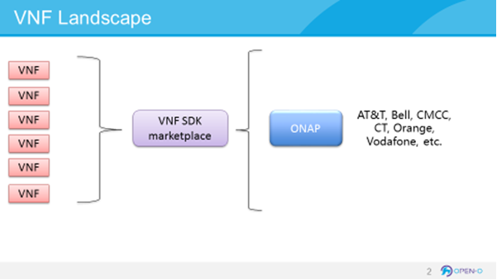
PKI infrastructure and CA (2/2)
From the VNF SDK perspective, we are supplying VNF packaging tools to vendors and then validating the uploaded VNF packages. If you think about a potential marketplace environment, where vendors upload their VNFs to a neutral marketplace (think Apple App Store or Google Play) and operators download the ones they’re interested in, operator certs may not make sense. We were thinking that vendors would acquire certificates from a central place (from ONAP CA? From a defined third-party (such as Kyrio) which ONAP would use as a trusted root? Something else?). The vendors would sign their VNF packages with that cert, and vnf sdk would then validate the digital signatures as part of the VNF package validation prior to onboarding.
Meeting notes:
Organize a discussion with VNF SDK team .
Avoid Mon-Wed (7-9) next week.
If next Thu, same hour as seccom is good

Slide 9
Static Scanning
Update

Slide 10
Reflection
Way of working?
I just noted a few times that there was no feedback on questions sent to the list:
  Not on the onap-secom@lists.onap.org list?
  No interest?
  Should we do it another way?

