Slide 1
ONAP security meeting
2017-08-02

Slide 2
Agenda
Vulnerability Management
Information update:
  CII Badging program
Follow-up
  Recommendation on storage of passwords - how to achieve.
  PKI infrastructure and CA
  Follow-up on vulnerability scanning discussion status
Preparation for Adhoc seccom/SDC/VNF SDK meeting
AOB
  September Developers event

Slide 3
Vulnerability Management
Select one vulnerability and send to send in to “clean the cobwebs” from our process.

Slide 4
CII Badging Program
Two volunteer projects
  CLAMP
  AAF
Next Steps:
  Proposed presentation from David to teams (Ram – AAF not yet confirmed).
    David, Catherine (CLAMP) confirmed.
  Propose to use the meeting slot next week.

Slide 5
Recommendation on storage of passwords
- how to achieve?
Conclusion from last meeting:
  Amy has thoughts around this
  Steve Goeringer raised the question of why passwords, why not certificates (or such approaches).
  Stephen to create a security best practice sub-page – Amy/Steve Goeringer create a proposal to discuss in the community. Different ambition levels (R1 may not be able to achieve what we want, but at least we should point out the “gotchas”). Two weeks.
    Maybe a common module for R2 …
  Note: Evgeny Zemlerub also expressed views to incorporate
Any update:
  Meeting note:
    Ongoing.

Slide 6
PKI infrastructure and CA (1/2)
For thte called ad-hoc meetings
The ASK from Chris
Does the Security Team have a PKI strategy? Anyone planning to host an ONAP CA? The reason I ask is that VNF SDK is considering implementing SOL-04, which has some vnf package integrity and authenticity options that require digital signatures. We’d like to align with other projects such as SDC, SO, VFC, and APPC that may need to validate the VNFs as part of the onboarding process, and we’re interested in taking advantage of any PKI mechanisms already in place.
Not that we’re looking for more work, but if no one else is working on PKI, VNF SDK wouldn’t be a bad place to home it, given that we’re building a reference “marketplace” for VNFs and will have a relationship with VNF vendors. Also, if the Security team wants to take this on, I’d like to recommend checking out Kyrio (http://www.kyrio.com/security-services/). To my knowledge, they’re the largest issuer of device certificates on the planet (cable modems, passpoint, smart grid, and medical devices). As they say, “Kyrio is the preferred security provider for CableLabs, OpenADR, Wi-Fi Alliance, and Center for Medical Interoperability (CMI).”
    .

Slide 7
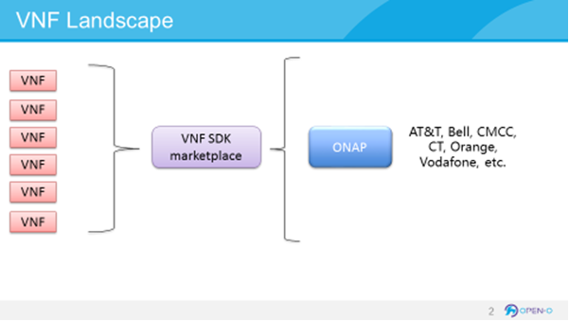
PKI infrastructure and CA (2/2)
For thte called ad-hoc meetings
From the VNF SDK perspective, we are supplying VNF packaging tools to vendors and then validating the uploaded VNF packages. If you think about a potential marketplace environment, where vendors upload their VNFs to a neutral marketplace (think Apple App Store or Google Play) and operators download the ones they’re interested in, operator certs may not make sense. We were thinking that vendors would acquire certificates from a central place (from ONAP CA? From a defined third-party (such as Kyrio) which ONAP would use as a trusted root? Something else?). The vendors would sign their VNF packages with that cert, and vnf sdk would then validate the digital signatures as part of the VNF package validation prior to onboarding.
Meeting notes:
Organize a discussion with VNF SDK team .
Avoid Mon-Wed (7-9) next week.
If next Thu, same hour as seccom is good

Slide 8
Static Scanning
Met with Steve Winslow
Explained Nexus IQ lifecycle.
  Good for identifying the known vulnerabilities of the use code and in which version there is a fix.
  Doesn’t do the active static scanning as such with fortify
Reflection
  Could be good for the project leads to know which versions of components they have and which they should take.
Next Steps::
  Meeting Discussion:
    Nexus IQ lifecycle
      Ask the LF to make it open to the PTLs.
      Create communication to inform the PTLs about the possibility to do so. Could be good to inform Gildas to tie to a release.
    Look at static code scanning tools to come with a recommendation
      E.g. Fosology, fortify
      Amy to propose a list of tools
      When we align, we can take it to the LF.

Slide 9
Preparation for the Adhoc meeting
If we have something to propose regarding pwd handling etc, then we can propose it, otherwise take a discussion
  For this meeting, the ambition should be to understand the questions/needs.
  Maybe we have initial recommendations based on seccom’s collective experience, or maybe we have to take actions
For the CA discussion
  We should listen to the proposal and take a discussion.
Other thoughts?

Slide 10
September developers event
Possible topics to raise
  Known vulnerability scanning
  Update from CII badging programe certification attempt feedback.
  Static code scanning.
Purpose:?
  Status update or pro-active security advise regarding best practices.
    Don/zyg can help put together material
      Still open to who will present due as its best to be physically present.
    Stephen to include security as a topic in the September Developers event list of topics.

