Slide 1
ONAP security meeting
2017-11-14

Slide 2
Agenda
Information Update
Topics to advance
  Follow-up on Credential Management (Srinivasa)
    The expectation is that discussion with the AAF PTL has been done.
  Implications of TSC decision on 1 maintenance release from Vulnerability Management Perspective
  Static Code Scanning.
    https://wiki.onap.org/display/DW/ONAP+security+Recomendation+Developement,
    Status update of using Coverity.
    Next steps
  IIf time: Sonatype CLM / Nexus IQ Tool (management of dependencies and known vulnerabilities)
    Volunteer to start drafting a process proposal
AOB

Slide 3
Static Code Scanning
Use: https://wiki.onap.org/display/DW/ONAP+security+Recomendation+Developement section 3

Slide 4
Credential Management
Use: https://wiki.onap.org/display/DW/ONAP+security+Recomendation+Developement section 2
Ambition: Are we ready to recommend. If not, what needs to be closed.

Slide 5
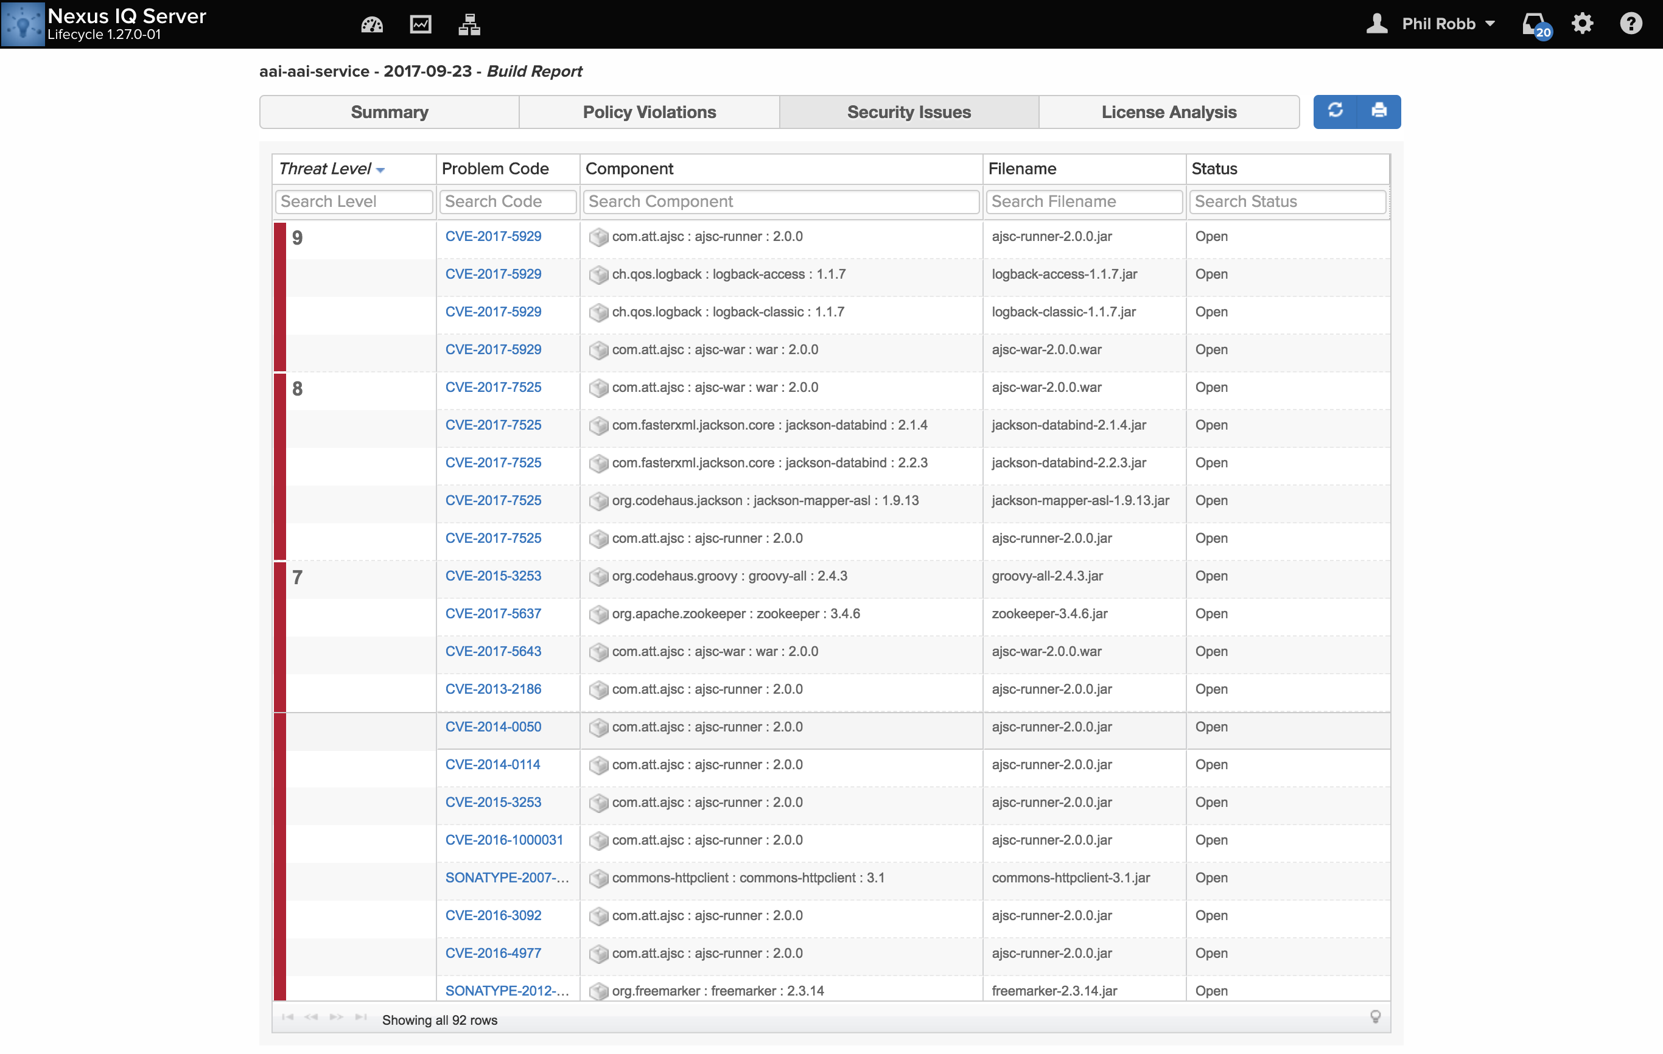
Nexus IQ
Who volunteers to drive
the process

Slide 6
Meeting Notes
A question was raised about the security view of scanning of images. Is that something that we want to discuss and have a view in the security sub-committee.
  The answer was that it is something that we take a look at.
Update on the proposal for certificate management.
  No discussion with AAF yet, dialogue started but ongoing.
  Proposal was updated to include broker capabilities as well as having CA capabilities.

Slide 7
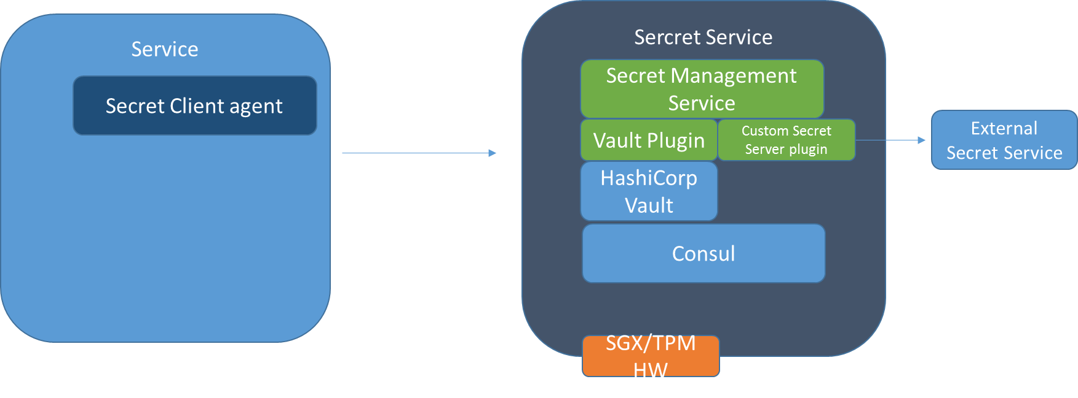
Meeting Notes
Secret Server Proposal (Srinivas Addepalli)
  Proposes a means to store information securely, one example and the focus is on passwords.
  How does the client authenticate to the secret service?
  3 Choices for technology are presented. K8S secret service, Barbican, Vault.
Security Code Scan.
  No blockers identified, to be checked with Phil.

