Slide 1
ONAP security meeting
2017-11-29

Slide 2
Agenda
Information Update
Topics to advance
    Static Code Scanning
      Status update of using Coverity.
      Next steps
    Credential Management Use Case List walkthrough and state management review.
    Next steps to close on our proposal on Sonatype CLM / Nexus IQ Tool (management of dependencies and known vulnerabilities)
AOB

Slide 3
Static Code Scanning
Use: https://wiki.onap.org/display/DW/ONAP+security+Recomendation+Developement section 3

Slide 4
Credential Management
Use: https://wiki.onap.org/display/DW/ONAP+security+Recomendation+Developement section 2
Ambition: Are we ready to recommend. If not, what needs to be closed.

Slide 5
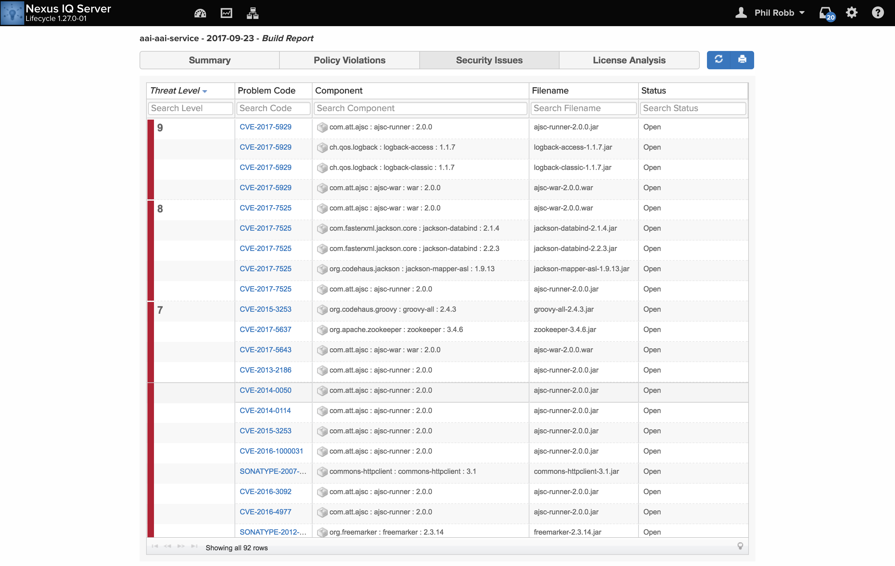
Nexus IQ
Who volunteers to drive
the process
Use: https://wiki.onap.org/display/DW/ONAP+security+Recomendation+Developement

Slide 6
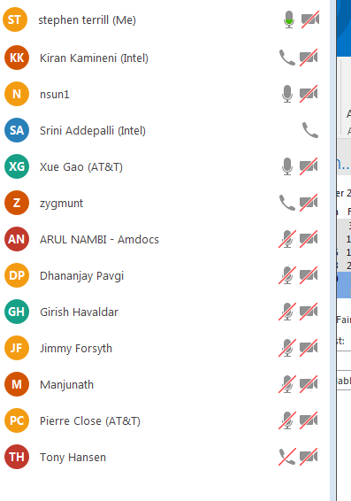
Meeting Notes

Slide 7
Meeting Notes

