Slide 1
ONAP security meeting
2017-12-20

Slide 2
Agenda
Information Update
  Developers Event Debrief
Topics to advance
  Action Follow-up
  Static Code Scanning
    Status
    Procedure
  Known Vulnerabilities
    Procedure
  CII Badging program projects support
    Produce the ONAP CII Badging program guide?
    CII badging program hackathon ….
Next Meeting
  Timing and topics:
AOB

Slide 3
ONAP Dev Event Reflections
General
  The interest and expectations from the security sub-committee is growing.
CII Badging program.
  As part of the S3P now that is approved and now the projects will be expected to work with it, the question that gets asked is how can we help the projects now. Some ideas:
    Create a CII guide for ONAP projects, detailing the answers that are common, and best practices to help the projects
    rganize a debrief of “CII badging hackathon” where the participants can start the badging process, and answer a few questions go get going, with support
Static code scanning
  The need of having a proposal for the how to use the results
    In the security session we were discussing a report once a week.
    When speaking with Phil Robb, he had an alternative suggestion:
      Create a group with representatives from the projects under the guidance of the security sub-committee
      Tie an analysis to a milestone, using that group to go through the report.
  In either case, we have to work to have a solid proposal. My proposal is to organize a session with a representative of a few projects that may be interested to create such a proposal.
Sonus/nexus IQ: finding known vulnerabilities.
  We need a proposal for how to use this.
Configuration Security scan:
  There was a proposal raised to look at scanning of the configuration (see: https://norad.gitlab.io/ https://norad.gitlab.io/docs/#test-documentation )
    This is scanning the basic infrastructure configuration
    Could be useful to integration (and the reference that we download as part of the release)
  My proposal: have a meeting with integration to see the use.
Credential management
  There was discussions also on the scope of the credential management, in particular to the ONAP_Foreign, and whether we cover more than just the credentials but also the interfaces (security perspective). We can add that on the backlog.
  AAF project scope check

Slide 4
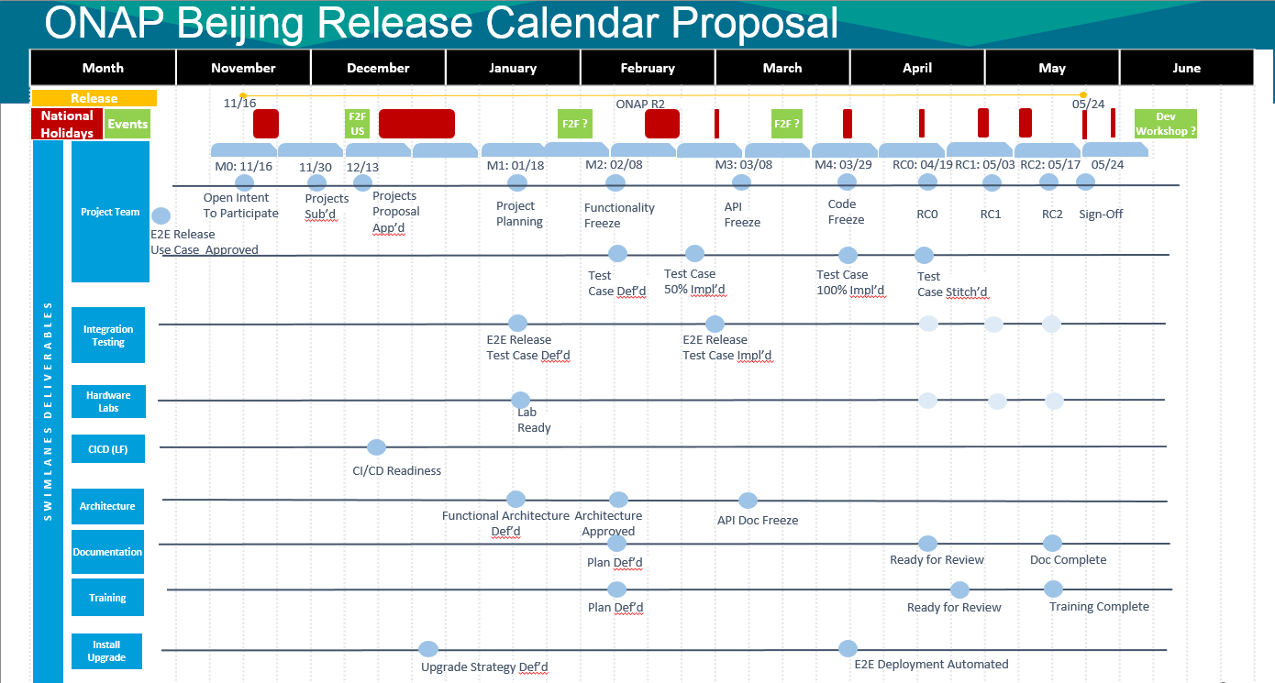

Slide 5
Static Code Scanning
Use for Update: https://wiki.onap.org/display/DW/ONAP+security+Recomendation+Developement section 3

Slide 6
Static Code Scanning – ONAP process?
We should propose a process to follow.
Two high level Approaches
  Scan analysis in project groups.
  Form a analysis group, with the support from Projects.
In either case, propose to include in MS4 checklist.

Slide 7
Static Code Scanning – ONAP process?
- Scanning of the project created code -
Proposal 1: Scan analysis in projects
Proposal 2: Create a team to support the scan analysis
The PTL is informed of the scan analysis results on a regular basis (e.g. weekly).
Project has the responsibility to analysis the scans and make required changes.
Note:
  The work scales with projects
  Security competence may not be in projects to understand the results
  Have to work through the false positives.
  Requires that the scan process is incorporated into Jenkins.
Under the guidance of the security sub-committee 1-2 team is created with project members (rally around timezones).
Perform walkthrough of the static code scan results before MS-4.

Slide 8
Static code analysis – way forward
From meeting
Proposal recommended by the security sub-committee:
  Recommend to use Coverity.
    Amy to update the security recommendations page.
  Recommend to request it to be included in the CI/CD tool chain, with a weekly report sent to the PTLs.
  Request to invite Luke Hinds (lhinds@redhat.com) to share their experiences.
  Security Team to host a session to support the projects who would like it.
    Amy (to look at the proposal on how to host such a meeting).
  Look at
    OPNFV is quite elaborate on scanning as I just found: https://wiki.opnfv.org/display/security/Security+Scanning
    OPNFV security working group: https://wiki.opnfv.org/display/security/Security+Home
  Recommend the following added to the MS checklists.
    No unresolved “high” priority items at MS-3
    No unresolved “medium” priority items at MS-4
    (Post meeting reflection – we need to define high and medium).

Slide 9
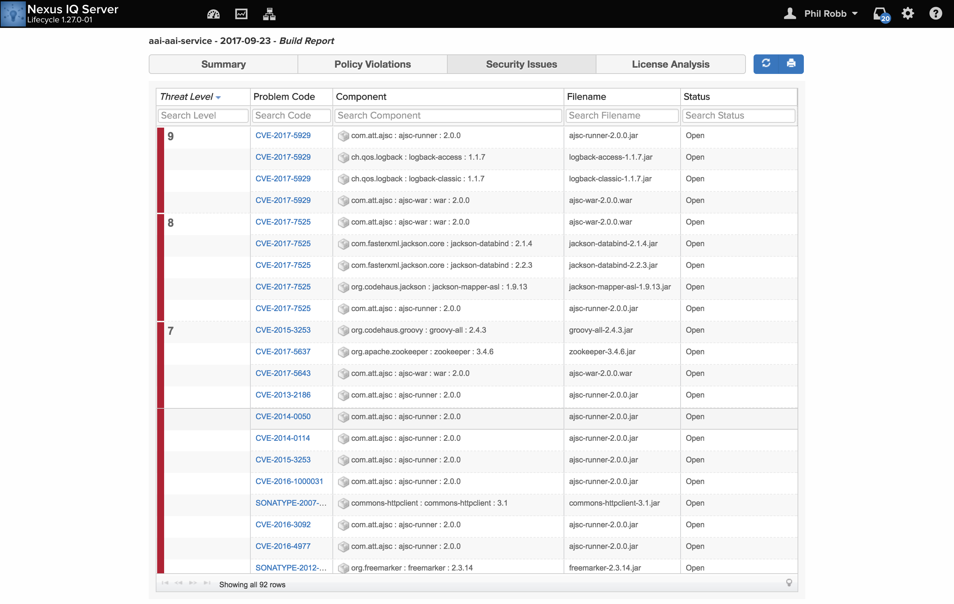
Nexus IQ/
Sonatype LCM
Use: https://wiki.onap.org/display/DW/ONAP+security+Recomendation+Developement

Slide 10
Known vulnerability analysis
From meeting
Proposal recommended by the security sub-committee
  Open the tool to the PTLs
  Request that the MS4 and release criteria: not releasing modules with vulnerabilities more than 60 days old.
    Exceptions raised and discussed with the TSC.
  Recommend to host a session to walkthrough the Nexut IQ tool with the PTLs if required.
    Note: A demo was done and is available from the December ONAP Developers Event from Phil Rob.

Slide 11
3SP support
Support would be beneficial to the projects regarding the CII badging program.
  Create: ONAP CII badging program lazy guide
  Start a “CII badging program start meeting”.
  Note: Internally companies can provide internal support.
Recommended proposal from the meeting:
Arul Nambi (arul.nambi@amdocs.com) will take the lead in producing the lazy guide. Plan to complete by the end of January, which means a draft ready 3rd week of January. The following volunteered to support:
  Rajeev Mheta (rajeevme@amdocs.com); Tony Hanson (tony@att.com ); Don Levy (dl2378@att.com )
Stephen to Establish a start meeting.

Slide 12
Credential Management
Not covered in the meeting.
Use: https://wiki.onap.org/display/DW/ONAP+security+Recomendation+Developement section 2
Need to elaborate on the use cases and the requirements

Slide 13
Configuration security scan
  There was a proposal raised to look at scanning of the configuration (see: https://norad.gitlab.io/ https://norad.gitlab.io/docs/#test-documentation )
    This is scanning the basic infrastructure configuration
    Could be useful to integration (and the reference that we download as part of the release)
  My proposal: have a meeting with integration to see the use.
Recommended proposal from the meeting:
The security sub-committee meeting thought that this was a good idea
Recomended to setup a meeting with Helen for integration.

Slide 14
Next Meeting topics
Propose to cancel 27/12/2017 and 03/01/2018
Next meeting topics:
Recommended proposal from the meeting:
Canel 27/12 2017 and 03/01/2018.

Slide 15
This meeting Minutes
Static code scan
  Proposal recommended by the security sub-committee:
    Recommend to use Coverity.
      Amy to update the security recommendations page.
    Recommend to request it to be included in the CI/CD tool chain, with a weekly report sent to the PTLs.
    Request to invite Luke Hinds (lhinds@redhat.com) to share their experiences.
    Security Team to host a session to support the projects who would like it.
      Amy (to look at the proposal on how to host such a meeting).
    Look at
      OPNFV is quite elaborate on scanning as I just found: https://wiki.opnfv.org/display/security/Security+Scanning
      OPNFV security working group: https://wiki.opnfv.org/display/security/Security+Home
    Recommend the following added to the MS checklists.
      No unresolved “high” priority items at MS-3
      No unresolved “medium” priority items at MS-4
      (Post meeting reflection – we need to define high and medium).

Slide 16
This meeting Minutes
Known vulnerability analysis
  Proposal recommended by the security sub-committee
    Open the tool to the PTLs
    Request that the MS4 and release criteria: not releasing modules with vulnerabilities more than 60 days old.
      Exceptions raised and discussed with the TSC.
    Recommend to host a session to walkthrough the Nexus IQ tool with the PTLs if required.
      Note: A demo was done and is available from the December ONAP Developers Event from Phil Rob.
Next meetings:
  The meetings of 27/12/2017 and 03/01/2018 are cancelled

Slide 17
This meeting Minutes
3SP Support
  Recommended proposal from the meeting:
  Arul Nambi (arul.nambi@amdocs.com) will take the lead in producing the lazy guide. Plan to complete by the end of January, which means a draft ready 3rd week of January. The following volunteered to support:
    Rajeev Mheta (rajeevme@amdocs.com); Tony Hanson (tony@att.com ); Don Levy (dl2378@att.com )
  Stephen to Establish a start meeting.
Configuration code scanning
  Recommended proposal from the meeting:
  The security sub-committee meeting thought that this was a good idea
  Recomended to setup a meeting with Helen for integration.

Slide 18
Action follow-up
Action slogan | Action Description | Driver
Update wiki recommendation to reflect recommending coverity | Update the recommendation wiki and the best practices wiki to reflect that we have recommended coverity and that it be included in the CI/CD tool chain with a weekly email to the PTLs. A session to support the PTLs will be hosted as well. | Amy
Invite Luke Hinds from OPNFV security to share their view | Invite Luke Hinds from OPNFV security to share their view | Stephen
Static Code scanning session with PTLs | Host a session for the PTLs regarding static code scanning and what it means to walk through the coverity report. | Amy to propose
Known vulnerability scanning | Request a presentation for the PTLs about the nexus IQ. | Stephen
Configuration scanning | Organize a session with integration (Helen) on configuration scanning | Stephen
CII badging ONAP guide | Create a ONAP guide for the CII badging with recommendations for the ONAP projects in particular on common questions. | Arul leads.

