Slide 1
ONAP Security Meeting
2018-05-09

Slide 2
Agenda Topics General
Agenda topics are driven from Jira.
Security sub-committee Jira Kanban board: https://jira.onap.org/secure/RapidBoard.jspa?rapidView=103
As viewed in the security sub-committee coordination page:
https://wiki.onap.org/display/DW/ONAP+Security+coordination

Slide 3
Agenda
Quickly (5 mins)
  Review of False Positives
  Static Scanning establishment Update
  Follow-up of any actions from 5G Use Case presentation
  Update on Risk Assesment Status (Samuli)
Plugable authorization – Andrew – 25 mins
Istio Presentation - Ramki Krishnan – 25 mins
  Look at it from a security perspective
(if time) JIRA walkthrough and Update
A.O.B
  CII badging question.

Slide 4
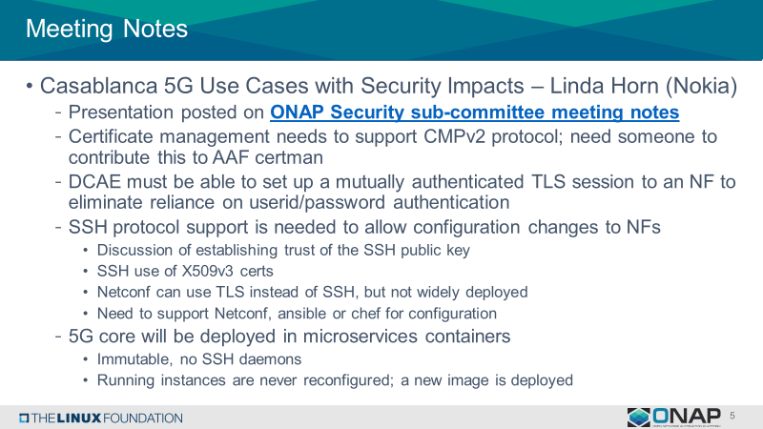
Follow-up on 5G Use Case Presentation

Slide 5
Meeting Notes
5G Use case
  Actions:
    Create a proposal for how to handle a CA and support of CMPv2 Protocol for testing/Integration
    Create a proposal for secure communication between ONAP and the NFs. Consider:
      Communication to DCAE
      Communication with the controllers
      SSH protocol support
ISTIO
  We only had time to go through the presentation, more time for questions will be done in the next meeting.
  It was anyway recommended to have a recommendation of how secure communication is achieved between ONAP components when ISTIO is used including how to communication to ONAP components not using ISTIO; and the overall ONAP cert management.

Slide 6
Meeting Notes
Attack Vector analysis
  Samuli presented the next level of detail in the proposal https://wiki.onap.org/download/attachments/11928162/ONAP%20Attack%20Vector%20Analysis%20-%20Overview%20of%20the%20Process.pptx?api=v2

Slide 7
Next Meeting
Next Meeting

