Slide 1
ONAP Security Meeting
2018-08-08

Slide 2
Agenda Topics General
Agenda topics are driven from Jira.
Security sub-committee Jira Kanban board: https://jira.onap.org/secure/RapidBoard.jspa?rapidView=103
As viewed in the security sub-committee coordination page:
https://wiki.onap.org/display/DW/ONAP+Security+coordination

Slide 3
Agenda
Status Updates:
  Silver badging: Static Code Scanning (Pawel)
  Silver badging: Code Coverage (Arul & Amy)
  Silver badging: [SECCOM-53] Cryptographic signing
  AAF documentation: certificate management and fine grained authorization (Pawel)
  Risk Assessment (Pawel)
  VES security: VNF → DCAE (Alok, will provide VNF requirement)
  Secure communication when using ISTIO
  [SECCOM-22] VNF Security Requirements
  [SECCOM-26] NORAD Update
Topics
  Security Testing (Helen)
  Security documentation
    What to document (in readthedocs)
    Documenting ONAP security architecture (discussion)
  [SECCOM-10] Security for 5G use cases (Linda)
JIRA walkthrough and Update
A.O.B

Slide 4
Security Testing
Hi, Stephen and other ONAP security pro,
The automatically testing tools have covered quite some security related testing with NEXUS IQ. I am curious how you handle other security related testing and where I could find the results, as in the attached file:
1. At p2, is there anyone to verify “all communication shall be able to be encrypted and have common role-based access control and authorization”? Or is this trust-based?
2. Do we have requirement for items at P3? Those are very serious security holes, for example XSS injection risk.
Regards,
Helen Chen

Slide 5
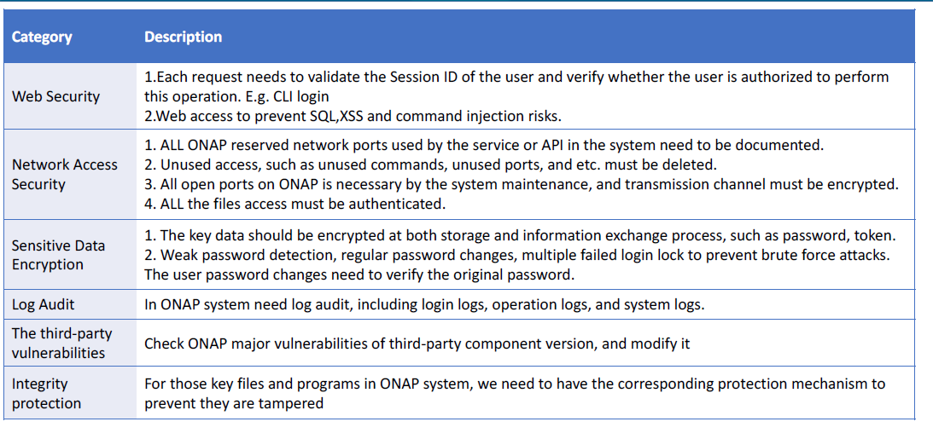
Security Testing
Deleted -> blocked/closed

Slide 6
Security Documentation
Output of the ONAP security risk analysis, need to consider what security documentation we need.
Currently there is:
  Readthedocs security architecture: https://onap.readthedocs.io/en/beijing/submodules/aaf/authz.git/docs/sections/architecture/security.html
  AAF documentation in readthedocs:
    https://onap.readthedocs.io/en/beijing/submodules/aaf/authz.git/docs/sections/architecture/aaf_architecture.html?highlight=aaf
  Known vulnerability analysis
  Support to projects (recommended and non recommended protocols).
Missing:
  Overall Security Architecture
  Guidelines for overall securing ONAP
    Need to create an ONAP communication matrix (SECCOM-55)
    Need to create a guide to securing ONAP.
  Guidelines for secure deployment from a project perspective
    Create a template for projects to fill in (SECCOM-56)
      Audience: for those that download the projects; also for building the overall ONAP security guide.
      Base it on openstack?

Slide 7
Documenting ONAP security architecture
General Security Architecture
  Purpose:
    To have an general architecture and terminology to discuss ONAP security issues:
      Security communication
      Securing access to ONAP
      Supporting RBAC
  Avoid, where possible, use of specific project names, but classify project components and artifacts.
    Exception; projects supporting security enabling functions (e.g. AAF).

Slide 8
Documenting ONAP security architecture
  We need a clear way to document the ONAP security architecture
    There is a basis in Beijing: https://onap.readthedocs.io/en/beijing/submodules/aaf/authz.git/docs/sections/architecture/security.html
Certificates
Secure communication
“using” External components
Access to allowed data only
Authentication & authorization
Allowed Requests
Component 1
Component 2
Secure communication
Authentication & authorization
“Used” External components
Certificates
Secure communication

Slide 9
Static code scanning:
  Setup a mtg with Jessica (Stephen)
Code Coverage:
  Defer all but Java and python code coverage
    PoC ongoing for Java script, but not clear its ready for Casablanca.
  Projects can provide “screenshots”.
  Need to sync with Gildas
RBA:
  Need to get an answer from the projects to see if there is an issue
Secure communication
  Strive to get f/b from projects for ALL communication.
Review the vulnerability management process, then re-commonuicate.

Slide 10
Review and consider what security guidelines that we may want to have
  E.g. showing how to avoid injection attacks, but others as well.

