Slide 1
ONAP Attack Vector Analysis
- Overview of the Process
- Terminology
- Assumptions
2018-05-09

Slide 2
The Process of Attack Vector Analysis
Preparation phase, need to have these clear before WS
  Scope (see separate slide) & ensure relevant participants
  Assumptions (see separate slide)
The Core of Attack Vector Analysis: F2F Workshop
  Make full use of the F2F aspect: Creativity, brainstorming.
Completion phase
  Put together the WS outcome eg. in form of mindmap
  Follow-up meeting: define the risk ratings
  Report = security sub-committee recommendation, including the risk mitigation plan for the risks with unacceptable high level
TSC(?) to sign off the report & risk mitigation plan

Slide 3
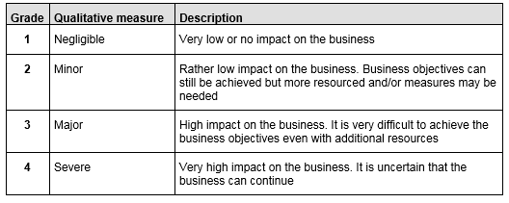
Concepts, Definitions
Impact values

Slide 4
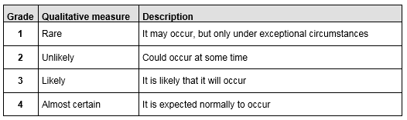
Concepts, Definitions
Probability values

Slide 5
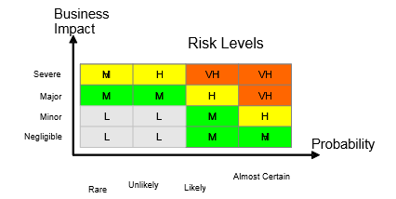
Concepts, Definitions
Risk Levels: Low (L), Medium (M), High (H), Very High (VH)

Slide 6
Identification of a Risk – A Fictious Example
Risk identification
  Asset: VNF O&M passwords at rest (in storage / other)
  Threat (can be several per asset): unauthorized disclosure
  Vulnerability (A vulnerability makes it possible for the treat to materialize. Can be several per threat): passwords included in plain text in a log file
  Existing controls: only specific user/group has read access to the log file
Risk rating, roughly: risk level = impact value x probability value
  Impact (business impact if the risk materializes): “high”
  Probability (of the risk to ever materialize): “likely”
→ HIGH risk level
Risk mitigation plan, eg. for all VERY HIGH and HIGH level risks
  Eg: do not include any secrets in any log files in plain text

Slide 7
Preparation Phase: The Scope
Proposals
  ONAP architecture level, of eg Data at rest, Data in transit (like DmaaS)
  Container deployment of ONAP: specifics for this case
  Selected, individual ONAP component(s)
  Send checklist of the few most important/typical risk items for all projects to be checked & reported back into ONAP threat analysis
  (to be checked, there was an earlier ~similar activity)

Slide 8
Preparation Phase: The Assumptions
ONAP deployment environment, possible aspects:
  Level of protection around ONAP: something between a “walled garden” and Internet
  Any assumed security mechanisms in the infra? Like self-encrypting storage.
  ONAP multitenancy? Ie: multiple organizations (w/o mutual trust) as users of one ONAP deployment
Responsibility between ONAP vs. “the rest of OSS/BSS”
  Personally Identifiable Information (PII) like subscriber data: ONAP or some other OSS/BSS entity needs support compliance with privacy regulations.
  Example of use case: data de-identification of PII data is needed when trouble-shooting data originating from VNFs is sent back to VNF vendor.

