Slide 1
ONAP Beijing Release Vulnerability Analysis Report – Status to TSC
Stephen Terrill on behalf of the security sub-committee
April 26, 2018

Slide 2
Background
Each project is filling in the known vulnerability analysis template as part of the M4 criteria.
  Addressing critical vulnerabilities in external – imported libraries and components.
  Address =
    updating to a new component without the vulnerabilities
    Indicating it is a false positive due to the way in which ONAP uses the imported library.
This is undergoing review for approval by the security sub-committee

Slide 3
Reflection
Good progress from projects.
= taken seriously.
The security sub-committee is trusting the input provided by the projects
  i.e. not doing a code review.
The status moves quickly, there maybe some late updates not reflected.

Slide 4
Important
As the template will be referred to in the release notes, removed vulnerabilities should be removed from the template.
  i.e. if a vulnerability has been removed due to upgrading the component and it no longer shows up in nexus-IQ, it can be removed.
False positives should remain.
  i.e. The vulnerabilities that show up in Nexus-IQ should remain in the template.

Slide 5
Status
The security sub-committee recommends the known vulnerability analysis of the following projects for approval.
Project
CLAMP
CLI
DMaaP
Holmes
Integration | No critical vulnerabilities
Logging
Modelling | No critical vulnerabilities
MSB
MUSIC
Multicloud | No critical vulnerabilities
OOF | No critical vulnerabilities
OOM | No critical vulnerabilities

Slide 6
Status
The security sub-committee recommends the known vulnerability analysis of the following projects for approval.
Project
SDNC | Note: vulnerabilities restricted to design time only. Still recommended for approval
SO
VFC
VID | Note: outstanding issues are due to onap project, address there
VNFSDK
VVP
CCSDK
External API

Slide 7
Status
This is N/A for the following projects.
Project
VNF Requirements
Documentation

Slide 8
Status
Re-review required
Project
AAF | Analysis ongoing for impacts. 2 vulnerabilities are still WIP.
AAI | Work ongoing to update components which will reduce a large number of the vulnerabilities. Reported False positives – recommend approval Upgrade to later components proposed by RC1.
APPC | Two items ongoing that are expected to be addressed next week.
DCAE | Work ongoing - Need to indicate whether ONAP is exposed or not.
Policy | False positives are OK to approve. Requested exemptions based on inclusion of ONAP portal SDK ok to approve (rely on ONAP portal project). 2 Dependencies to known vulnerabilities are being removed.
Portal | Some actions ongoing. Template needs statements about whether ONAP is exposed to the vulnerabilities.
SDC | Template needs to indicate whether SDC exposes the vulnerability in Jackson core or not. Also the aaf-uaz-docker, should that be there?
Usecase UI | Clarification required

Slide 9
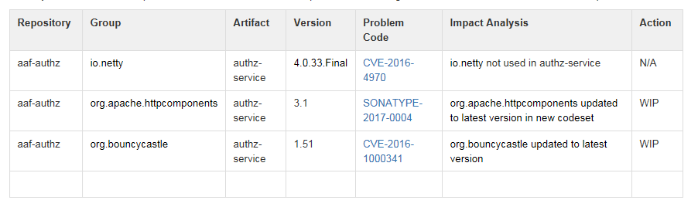
AAF
Indicate False Positive
Solved or still exposure?
exposure?

Slide 10
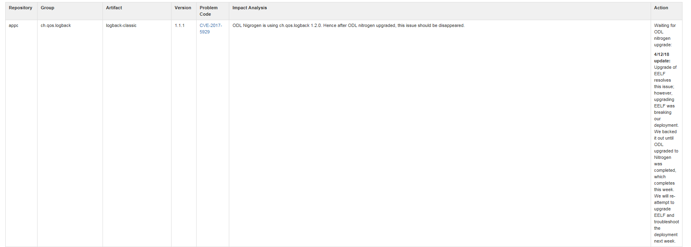
APP-C
2 more like this – status?

Slide 11
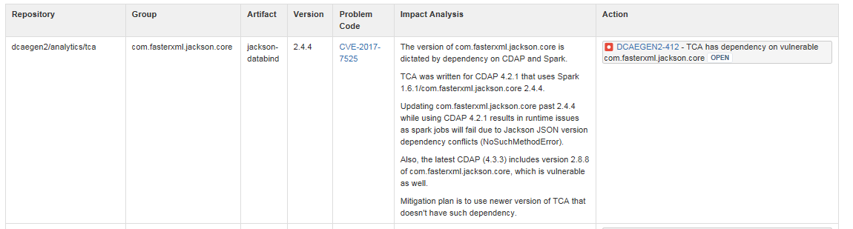
DCAE
Status?
Do we use it in such a way that the vulnerability is exposed (See MSB as an example)

Slide 12
Portal
Please clarify exposure and whether ONAP uses it
in such a way to expose the vulnerability.
Please clarify exposure and whether ONAP uses it
in such a way to expose the vulnerability.
Same request for other open CVEs.

Slide 13
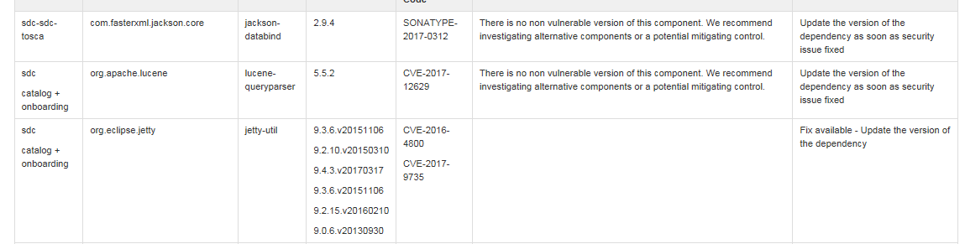
SDC
Please clarify exposure and whether ONAP uses it
in such a way to expose the vulnerability.
Status?
Simular for other CVEs

Slide 14
Use Case UI
Please clarify exposure and whether ONAP uses it
in such a way to expose the vulnerability.
Please state whether we are using it or not exposing the vulnerability.

