Slide 1
Security Subcommittee virtual developers event (September)
ONAP security committee
Stephen Terrill

Slide 2
Topics
Introduction
Structure and way of working
Vulnerability Management
Ongoing
CII Badging Feedback

Slide 3
Introduction
ONAP security page: https://wiki.onap.org/display/DW/ONAP+Security+coordination
Security sub-committee
  Identifying proposed activities to help the ONAP community create secure system
  ONAP is creating a mission critical system
  Onap-seccom@lists.onap.org
Vulnerability Management
  The process for managing identified and reported vulnerabilities.

Slide 4
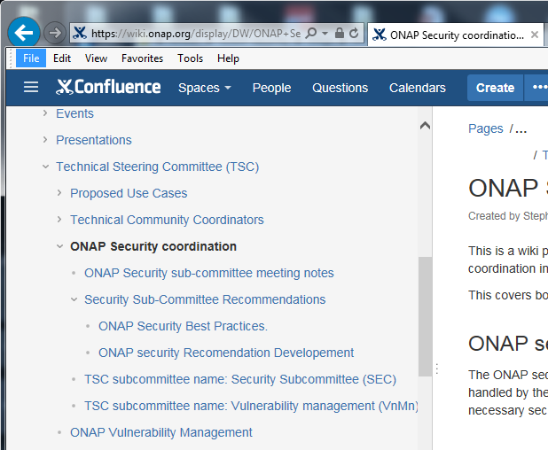
Main information page
Meeting Notes
Agreed Best Practices
Current work in motion
Vulnerability Management Procedures

Slide 5
Vulnerability Management
Vulnerability management is the process to handle identified vulnerabilities
  Approved Vulnerability Management procedures: https://wiki.onap.org/display/DW/ONAP+Vulnerability+Management
    How to submit a vulnerability, acknowledge a vulnerability, and manage the process to conclusion including communication.
    Email: security@lists.onap.org
  Vulnerability management team (volunteers) are in place:
    Arul Nambi (ambocs), Amy Zwarico (AT&T), Oliver Spatsh (AT&T). Raun He (orange) Support from Stephen Terrill (Ericsson, security coordinator), David Jorm, Linux foundation (Phil, Andy, Kenny).
    Will follow a
      Case lead on a “step-up” approach on per case by case basis.
      Support team to step in to ensure nothing falls through.
      Security coordinator also to ensure that all is working ok.
Note: The vulnerability management sub-committee cannot solve the vulnerabilities, but work with the teams to do so under embargo.
Your support will be critical.

Slide 6
CII (core infrastructure initiative) badging program
CII (core infrastructure initiative) has been created by the linux foundation in response to previous security issues in open-source projects (Heartbleed in openSSL).
The CII has created a badging program to recognize projects that follow a set of identifies best practices that could be adopted.
  There are three levels passing, silver and gold.
The security sub-committee has looked at these and feels that given ONAP is managing core critical infrastructure, the ONAP projects should follow the gold level.
  This is a challenge!
A stepwise introduction is proposed. CLAMP Feedback today

Slide 7
CII Badging program, 3 levels
Gold
More stringent criteria
  Security Review, project continuity, continues test integration,
  70%+ test coverage, secure design, ….
Silver
https://github.com/coreinfrastructure/best-practices-badge/blob/master/doc/other.md
Passing
Basic practices
Largely also covered by Release Best Practices
https://github.com/coreinfrastructure/best-practices-badge/blob/master/doc/criteria.md

Slide 8
Example criteria
Passing:
  The project website MUST succinctly describe what the software does (what problem does it solve?).
  The project MUST use at least one automated test suite that is publicly released as FLOSS (this test suite may be maintained as a separate FLOSS project).
Silver
  The project MUST document what the user can and cannot expect in terms of security from the software produced by the project. The project MUST identify the security requirements that the software is intended to meet and an assurance case that justifies why these requirements are met. The assurance case MUST include: a description of the threat model, clear identification of trust boundaries, and evidence that common security weaknesses have been countered
Gold:
  The project MUST have at least 50% of all proposed modifications reviewed before release by a person other than the author, to determine if it is a worthwhile modification and free of known issues which would argue against its inclusion.

Slide 9
CII Badging Scope and Sample Requirement Areas
General Project Areas
  Project description, OSS licensing, documentation, website, support TLS, change control, unique version numbering, release notes
Reporting
  Bug-reporting process, vulnerability report process
Quality
  Maintain golden source for rebuilding, use common tools, automate test suite, perform new-functionality testing, address compiler warning flags
Security
  Developers security knowledgeable, use good cryptographic practices, protection against man-in-the-middle (MITM) attacks, fix publicly known vulnerabilities, don’t leak valid private credential
Analysis
  Perform static code analysis, perform dynamic code analysis, fix vulnerabilities

Slide 10
CII badging program in ONAP
Current proposal:
  Stepwise introduction:
    Start with 1 project
    Any volunteer?
  Code producing project is gold for a release, exceptions taken to TSC.
    ONAP is mission critical software.
It was pointed out that we could tie this to the project maturity instead.
Release Based Approach
Project Maturity Based Approach
release
Archived
Core
Required to achieve
and maintain
Gold Level
CII Criteria
Mature
ONAP projects
Incubation
Projects
Proposal
Community View ????

Slide 11
Work in progress
Static Code Scans
Credential management
https://wiki.onap.org/display/DW/ONAP+security+Recomendation+Developement

Slide 12
CII Badging program feedback from CLAMP

Slide 13
ONAP, the Secure Open Networking Platform

