Slide 1
ONAP Installation
Eric Debeau, Orange
August 17, 2017

Slide 2

Objectives
Automate ONAP installation & verify with a service
  ONAP installation
  ONAP health check
  ONAP Service deployment (eg vFW)
  ONAP Service closed loop (eg vFW)
  Populate results
  Clean up
Pre-requisites
  OpenStack tenant created
  IP addresses pre-allocated for DCAE VM
  Default Security group : all ports open
  Existing internal network connected to external network
Inspired by

Slide 3
How ?
ONAP Installation
  Heat template
  openstack stack create -e onap_openstack.env -t onap_openstack.yaml ONAP
  Health Check via VM Robot
  ./runTags.sh -i health h -d ./html -V /share/config/integration_robot_properties.py -V /share/config/integration_preload_parameters.py -V /share/config/vm_properties.py
Service Deployment
  Robot Framework ?
Clean Up
  ./delete_stack.sh
  Scripts to remove resources launched by DCAE Controller
  Heat stack delete

Slide 4
Open questions
Which tool to use ?
  Robot FM
  Python script
  Bash script
  To be integrated in CI Jenkins Jobs
Timer to be setup before launching health check
  Which criteria to be selected ?
Where to populate results ?
  Using Tests_result_collection OPNFV data-base and API ?
  Need to deploy such data-base in Linux Foundation environment.

Slide 5
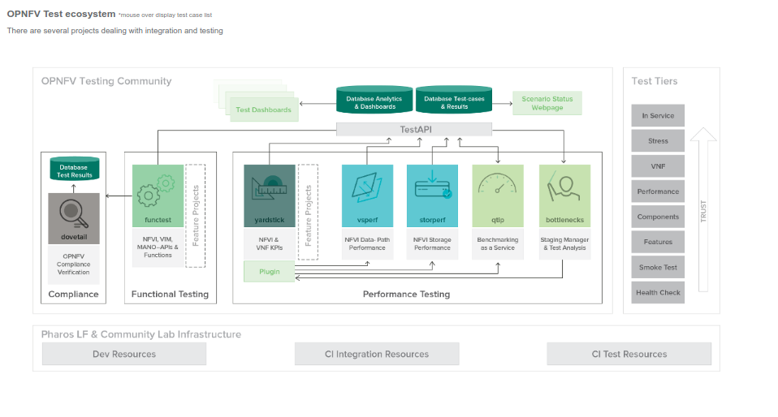
OPNFV Tests_result_collection
A mongo DB
A simple API

Slide 6
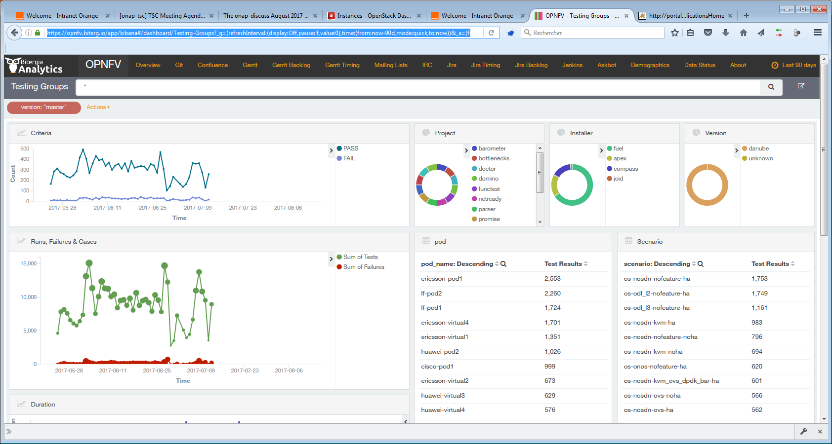

Slide 7
Detete_stack.sh
#!/bin/bash
# Delete resources created by DCAE controlers and delete the global ONAP stack
# OrpPenStack env variables must be configured
# Usage : ./delete_stack <stack_name>
# ONAP version: R1.1
openstack port delete $(openstack port list | grep zldc | awk '{print $4}')
openstack server delete $(openstack server list | grep zldc | awk '{print $4}')
openstack keypair delete $(openstack keypair list | grep dcae | awk '{print $2}')
openstack stack delete -y $(openstack stack list | grep ONAP | awk '{print $4}')

