Slide 1
SON Usecase - Test Automation

Slide 2
PCI Optimization
Physical cell ID (PCI) is a locally unique integer ID in 4G/5G
Used for handoff and physical layer design
PCI ranges:
LTE: 0 to 503
5G: 0 to 1007
PCI optimization: Assign PCI values to avoid PCI collision and minimize PCI confusion
PCI is re-optimized if neighbor relationship changes, (e.g. during Automation Neighbor Relations (ANR))
1
4
10
21
42
165
4
10
240
149
76
150
4

Slide 3
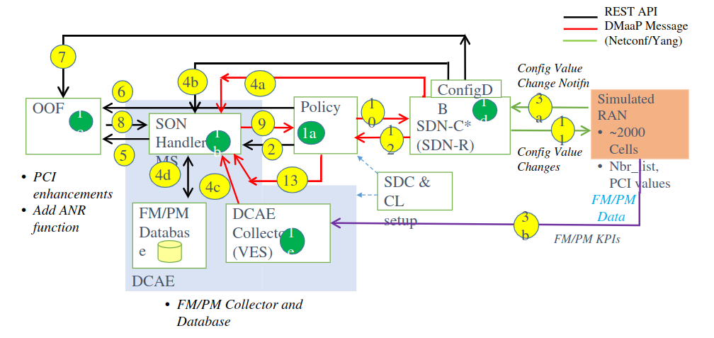
Use case flow diagram

Slide 4
Entry point and Validation
Entrypoint
  Creating Collision/Confusion in RANSIM which will post fault event towards VES collector
Success Criteria
  New configuration updated in the netconf server

Slide 5
Phase 1
Prerequisites
  Create and push son policies and contol loop policies
  Deploy SON Handler microservice
  Deploy and load Config DB
  Validate dmaap topics
Entrypoint
  Post Fault message to VES collector
Success Criteria
  Wait for dmaap message from Policy

Slide 6
Phase 2
Prerequisites
  Deploy SON Handler microservice
  Deploy and load Config DB
  Deploy Honeycomb netconf server
  Mount honeycomb to SDNC
  Validate dmaap topics
Entrypoint
  Post Fault message to VES collector
Success Criteria
  Wait for dmaap message from Policy
  Validate data from honeycomb

Slide 7
Phase 3
Prerequisites
  Deploy SON Handler microservice
  Deploy and load Config DB
  Deploy ransim
  Deploy Honeycomb
  Mount honeycomb to SDNC
  Topic validate
Entrypoint
  Post Fault message to VES collector
  Neighbor list update in ransim
Success Criteria
  Wait for dmaap message from Policy
  Validate data from honeycomb
  Validate data from ransim

Slide 8
Current Status

Slide 9
Open Points
Config DB setup
Config DB configuration in SONHMS and OOF

