Slide 1
VID Modern UI
Marcin Przybysz
NOKIA

Slide 2
Agenda
Idea of Modern UI
How to enable it?
Does it have impact on old UI?
How it looks like?

Slide 3


Idea
There was a need to have automatic instantiation for both: a la carte , macro services
Modern UI is provided to have ability for automatic Macro services instantiation.
It was designed to be more handsome and looks much better.
It will be used for PNF Instantiation.
Notes:
Because old UI supports only GR_API and A la carte instantiation there was a need to implement mechanism for supporting macro services instantiation.
One of the aspects also was to develop new functionalities in only some area and make flags to turn on/off those functionalities
After discussions and analyzes decision was to make new UI, because there will be too much work to adopt old one.
So new UI was developed at first to support instantiation of Macro services.
It will be used f.ex to PNF instantiation
And what is cool, new UI looks much better, is handsome.

Slide 4
How to enable?
Go to VID pod
1
Edit onap.features.properties file
2
Change FLAG_ENABLE_WEBPACK_MODERN_UI to true
3
Leave pod untouched.
Don’t delete/restart ..
4
Check if flag is changed in /vid/flags UI.
Enjoy Modern UI!
5
Notes:
kubectl -n onap get pod | grep vid
dev-vid-7666dd4ddb-km2kz 2/2 Running 0 4h41m
kubectl -n onap exec -it dev-vid-7666dd4ddb-km2kz bash
2. vi /usr/local/tomcat/webapps/vid/WEB-INF/conf/onap.features.properties
3. Set FLAG_ENABLE_WEBPACK_MODERN_UI = true
4. Don’t touch VID pod at all
5. Go to portal.api.simpledemo.onap.org:30200/vid/flags and check if flag is changed. If yes, then new UI should be available.

Slide 5
Does it have impact on Old UI?
NO!
Notes:
If we ask question, does it have impact on old ui, answer is – no.
VID Old UI is still available for “A la carte” services Instantiation.
New UI will appear when you want to deploy macro service.
The same impact is for testing. Once tests uses A la Carte instantiation then nothing changed. Old GUI will appear.
For tests where Macro services will be instantiated there is change – GUI is available and there is possibility for automatic Instantiation vis GUI (not possible in OLD UI). No need to prepare SO call for Instantiation.

Slide 6
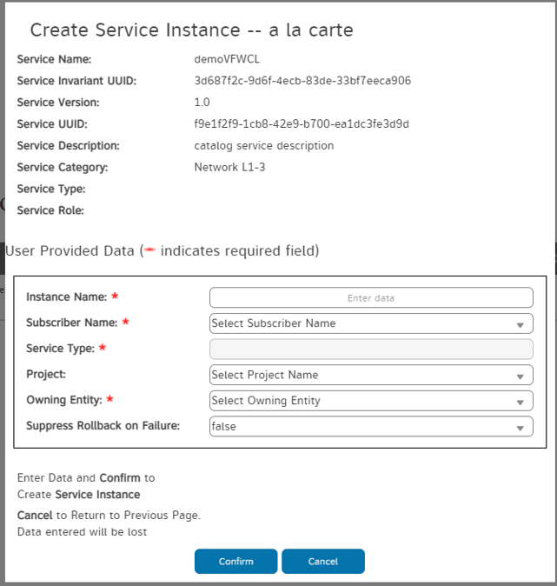
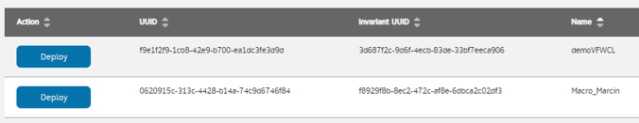
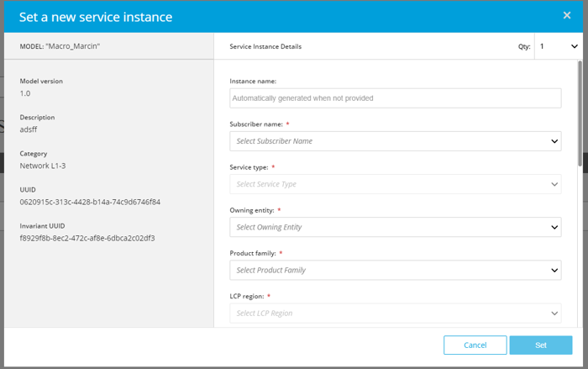
Old UI vs Modern UI
Notes:
On top you see VID UI with two services:
demoVFWCL – A la carte
Marcin – macro
Once you click on Deploy button magic will start.
By magic I mean that once you click on A la carte Service – old ui will appear, once macro service will be deployed new ui will appear
What is important: new ui with connection to backend will prepare correct call to SO , what was not available before. Every time SO call was prepared manually and send via API directly to SO. Now it is fully automated and it works.

Slide 7
Thank you
Marcin Przybysz
marcin.przybysz@nokia.com

