Slide 1
ONAP Data provider
ONAP Data Provider is a project which provides a tool to automate common ONAP resource creation. For many of tasks in ONAP some resources are needed and could be created once, like cloud region, complex or customer in A&AI. With this tool we can automate the creation process on every ONAP instance. It can be also used to create desired resource on existing ONAP instance on demand.

Slide 2
ONAP Data provider
Characteristics
cli tool
written in Python, with use of Python ONAP SDK project
uses yaml format to declare object definitions
currently supports creation only

Slide 3
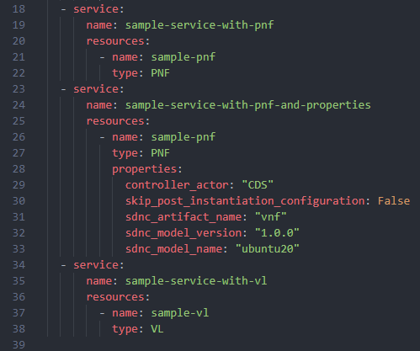
ONAP Data provider
User declares object definitions in yaml format

Slide 4
ONAP Data provider
Use cases
static data when new ONAP instance is created (complex, customer etc.)
various data for testing purposes

Slide 5
ONAP Data provider
Road map
Multi files support
Entities files versioning
Deletion of CNF Service instance
…

Slide 6
ONAP Data provider
DEMO

