Slide 1
OOF-SON: 5G Self-Organizing Network (SON) using ONAP Optimization Framework (OOF):
Release 10 Jakarta
November 08, 2021
Collaborators : STL, Wipro, AT&T, IBM, highstreet technologies,
Tech Mahindra, Ericsson, Nokia,
Reliance Jio, Rutgers Winlab, Verizon
Acknowledgments : Feedback and support from participants
in ONAP OOF-SON team calls
Presenters : N.K. Shankaranarayanan, Krishna Moorthy

Slide 2
SON Use Case Overview

Slide 3







ONAP-based SON: O-RAN O1 focus (Rel.3 – Rel.9)
SON ⬄ Control Loop (CL)
ONAP: Open-source platform, with basic open-source code
Companies can use framework to add proprietary SON solutions, including optimization algorithms, etc.
Optimization (OOF)
Co-ordination, Decisions
(Policy)
Data Collection,
& Analysis
(DCAE)
RIC (non-RT)
OOF-SON use case has built a foundation for ONAP/O-RAN integration
Radio network uses common netconf/yang model
Data flows
SDN-R to RAN: netconf-based configuration
RAN to DCAE: VES format for FM alarms, PM KPI, CM Notification
Action
(SDN-R)
Control loop
Data, CM, FM, PM
O1
O1
O-RAN Radio Network
(RAN-Sim)
Config ack
CM notify

Slide 4
ONAP / O-RAN Control Loops
SMO Framework
rApp1
rApp2
rApp3
Non-RT Loop
  Time scale: ~ secs/mins
  Direct config of CU/DU
  Policy Guidance, Coordination
Near-RT Loop
  Near-Real-Time (~100ms)
  Based on E2 service models
SON examples
  Non-RT: Changes based on
  operational state, averaged
  behavior
  Near-RT: Changes based on
  radio channel, mobility
Generic SMO Functions
R1
R1
R1
ONAP
Data Mgmnt & Exposure
R1 Exposure Service
Non-RT RIC
Framework
External Capabilities
AI/ML Workflow
O2-Related
O1-Related
O2 Term
O1 Term
Non-RT Control Loop
(>= ~1sec)
O2
O1
RAN
(RAN-Sim)
O1
O-CU and O-DU
O1
O-RU
O2
O-Cloud

Slide 5
ONAP / O-RAN Control Loops
SMO Framework
rApp1
rApp2
rApp3
Non-RT Loop
  Time scale: ~ secs/mins
  Direct config of CU/DU
  Policy Guidance, Coordination
Near-RT Loop
  Near-Real-Time (~100ms)
  Based on E2 service models
SON examples
  Non-RT: Changes based on
  operational state, averaged
  behavior
  Near-RT: Changes based on
  radio channel, mobility
Generic SMO Functions
R1
R1
R1
ONAP
Data Mgmnt & Exposure
R1 Exposure Service
Non-RT RIC
Framework
External Capabilities
AI/ML Workflow
O2-Related
O1-Related
Guidance for
Near-RT
Control Loop
A1 Term
O2 Term
O1 Term
Non-RT Control Loop
(>= ~1sec)
O2
O1
A1
O1
Near-RT RIC
Near-RT Control Loop
(~10 ms to
~1 sec)
xApp1
xApp2
xApp3
RAN
(RAN-Sim)
E2
O1
O-CU and O-DU
O1
O-RU
O2
O-Cloud

Slide 6
ONAP SON Use Case – Control Loop with O1 (Rel 3-8)
DMaaP
SON
Handler
MS
2,5
REST API
Policy
10,12
O1
6,8
9,13
11b
SDN-R
(SDN-C)
O1
OOF
4f
Control
Loop
Config Change
FM/PM DB
4e
O-RAN O1
RAN-Sim
7b
4c,4d
7
VES
Collector
FM, PM, CM
DES
MS
CM-VES
Parser
O1
3a-CM
3d-FM,PM
TBDMT
Data
Lake
4b
4a
CPS DB
Feedback to O-RAN
on O1 message specs
(esp. PM streaming)
Steps 3a,4a,4b,4c: CM data received from RAN, update of state in CPS DB
Steps 3d,4d: FM/PM data received from RAN, processing in SON MS
Steps 2,4e,4f, 5: SON MS analyzes need for optimization
Steps 6,7,7b,8: Optimization using OOF
Steps 9,10,11b: Automated action to make change in RAN (O1)
Steps 11,12,13: Action status
Notes:
When is CPS updated with new PCI values?

Slide 7
ONAP SON Use Case – Control Loop with O1 & A1 (Rel 10)
DMaaP
SON
Handler
MS
2,5
REST API
1
Policy
O1
3
9,13
3
10,12
6,8
SDN-R
(SDN-C)
11b
A1
O1
Control
Loop
O-RAN O1
OOF
4f
3
A1
Config Change
11c
FM/PM DB
4e
O-RAN A1
A1 Policy
RAN-Sim
7b
4c,4d
1
2
3
7
2
VES
Coll
FM, PM, CM
DES
MS
CM-VES
Parser
O1
3a-CM (for O1 & A1 actions)
3d-FM,PM (for O1 & A1 actions)
TBDMT
O-RAN O1
1
Data
Lake
4b
4a
2
CPS DB
2
Jakarta Release:
New VES Message format to
align with O1
Complete CM-Notify carryover
work
Include A1-based action
(stretch goal, may be planning
only)
Steps 3a,4a,4b,4c: CM data received from RAN, update of state in CPS DB
Steps 3d,4d: FM/PM data received from RAN, processing in SON MS
Steps 2,4e,4f, 5: SON MS analyzes need for optimization
Steps 6,7,7b,8: Optimization using OOF
Steps 9,10,11b,11c: Automated action to make change in RAN (O1 and A1)
Steps 11,12,13: Action status
Notes:
When is CPS updated with new PCI values?

Slide 8
Problem: RAN-Sim Upgrade is Needed
All SON Use Case planned work has impact on RAN-Sim
RAN-Sim uses Honeycomb netconf server
Honeycomb project ( https://wiki.fd.io/view/Honeycomb ) has been archived, and future support is an issue
  There is a new project Hc2VPP ( https://wiki.fd.io/view/Hc2vpp ) which used Honeycomb
Other parts of RAN-Sim provide great value for ONAP and OSC Use Cases
  Controller, Database, GUI for Usecase logic
  VES message generation for PM, FM, CM
Need to develop plan for:
  Replacement of Honeycomb in RAN-Sim
  Adding simulated Near-RT RIC and xApp in RAN-Sim for Use Cases
  Harmonization of RAN-Sim with OSC projects (sim, o1)

Slide 9
RAN-Simulator (RAN-Sim)

Slide 10
Approach for RAN Simulator (RANSim) – Dublin - FM
ONAP
OOF
GUI
  Provide Control to User in UI to select a cell and modify neighbor list to simulate collision/confusion
Controller
  Send message to corresponding Netconf Server about the collision/confusion
Netconf Server
  Send configChangeNotification to SDNR
  Send FM/alarm message to VES Collector for collision/confusion. Thus the control loop starts
GUI
  Show the modified PCI values
Controller
  When the modified RAN configuration received, same is updated into DB and informed to UI
Netconf Server
  When the SDNR provides the modified RAN configuration, same is forwarded to Controller
DCAE
SON Handler
Policy
VES Collector
SDNR
Web GUI
REST
Netconf
REST
Simulated
Network
Netconf server 1
RANSim
Controller
Netconf server n
Honeycomb
Websocket
Honeycomb
Extension
Config DB
(MariaDB)
Extension
Yang Model
Yang Models

Slide 11
Approach for RAN Simulator (RANSim) – Dublin - PM
ONAP
OOF
GUI
  Provide Control to User in UI to select a cell and generate PM data
Controller
  Send PM message to corresponding Netconf Server with KPI values. Initially send good values and after few minutes send bad values for selected cell.
Netconf Server
  Send PM message to VES Collector with given KPI values. Thus the control loop starts.
GUI
  Show the ANR updates as dotted lines.
Controller
  When the modified RAN configuration received, same is updated into DB and informed to UI
Netconf Server
  When the SDNR provides the modified RAN configuration, same is forwarded to Controller
DCAE
SON Handler
Policy
VES Collector
SDNR
Web GUI
REST
Netconf
REST
Simulated
Network
Netconf server 1
RANSim
Controller
Netconf server n
Honeycomb
Honeycomb
Websocket
Extension
Config DB
(MariaDB)
Extension
Yang Model
Yang Models

Slide 12
Enhancement to include xApp and A1
Non-RT-RIC (SDNR)
A1
O1
RANSIM controller
Near-RT-RIC(Honeycomb)
O1
xapp
xapp
E2
O-CU (Honeycomb)
O1
E2
O-DU (Honeycomb)
O1
RAN-Sim

Slide 13
O1 simulator in OSC sim

Slide 14
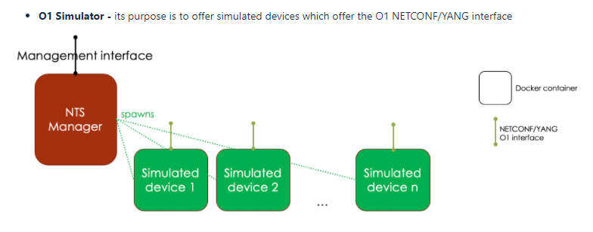
O-RAN Software Community (OSC) sim project
Ref: https://wiki.o-ran-sc.org/display/SIM/Architecture
Contact: Alex Stancu
Simulated devices in Simulated RAN are netconf (netopeer) devices representing CU/DU O1 instances with CU/DU yang models
NTS (Network Topology Simulator) Manager uses netconf to connect to devices using yang model of simulation entities
NTS also has NB netconf interface for external entity (e.g. SDN-R) to control simulation
Datastore in NTS provided by netopeer

Slide 15
Comparing RAN-Sim and OSC sim
RAN-Sim
OSC sim
SDNR GUI
VES Collector
SDNR
Web GUI
VES Collector
SDNR
Netconf
SDNR
REST
REST
REST
Netconf
Netconf
Simulated
Network
Simulated
Network
REST
(docker daemon)
O1 sim n
RANSim
Controller
O1 sim n
NTS
Manager
O1 sim 1
(with VES client)
O1 sim 1
(with VES client)
Extension
Websocket
Extension
Netconf/yang
Honeycomb
Config DB
(MariaDB)
netopeer
Yang Model
Yang Model
Datastore
(xml database with yang)
Extension
Extension
Yang Models
Yang Models
RAN-Sim was developed for ONAP Use case
Has use case specific logic (e.g. analyze cell relations and generate fault message)
Netconf devices are mounted manually
VES message details are generated in Controller as per usecase logic
OSC sim developed as O1 building block
NTS can be used by SDN-R to spawn O1 (CU/DU) instances. SDNR GUI can be used to configure NTS
FM VES messages are pre-configured in O1 sim
NTS uses netconf to each O1 sim netopeer device, and REST to the docker

Slide 16
ONAP-based SON: Target - with O-RAN O1, A1, O2
SON ⬄ Control Loop (CL)
ONAP: Open-source platform, with basic open-source code
Companies can use framework to add proprietary SON solutions, including optimization algorithms, etc.
Optimization (OOF)
Co-ordination, Decisions
(Policy)
Data Collection,
& Analysis
(DCAE)
Action
(SDN-R)
OOF-SON use case has built a foundation for ONAP/O-RAN integration
Radio network uses common netconf/yang model
Data flows
SDN-R to RAN: netconf-based configuration
RAN to DCAE: VES format for FM alarms, PM KPI, CM Notification
RAN to SDN-R: Netconf ack
Control loop
A1
O1
VES Collector
CM, FM, PM
Data
RIC (near RT)
A1
O1
O-RAN Network
(RAN-Sim)
O1
CU, DU, RU
O2
Cloud Infra.

Slide 17
ONAP SON Use Case – Control Loop with O1 & A1 (Rel 10)
DMaaP
SON
Handler
MS
2,5
REST API
1
Policy
O1
3
9,13
3
10,12
6,8
SDN-R
(SDN-C)
11b
A1
O1
Control
Loop
O-RAN O1
OOF
4f
3
A1
Config Change
11c
FM/PM DB
4e
O-RAN A1
A1 Policy
RAN-Sim
7b
4c,4d
1
2
3
7
2
VES
Coll
FM, PM, CM
DES
MS
CM-VES
Parser
O1
3a-CM (for O1 & A1 actions)
3d-FM,PM (for O1 & A1 actions)
TBDMT
O-RAN O1
1
Data
Lake
4b
4a
2
CPS DB
2
Jakarta Release:
New VES Message format to
align with O1
Complete CM-Notify carryover
work
Include A1-based action
(stretch goal, may be planning
only)
Steps 3a,4a,4b,4c: CM data received from RAN, update of state in CPS DB
Steps 3d,4d: FM/PM data received from RAN, processing in SON MS
Steps 2,4e,4f, 5: SON MS analyzes need for optimization
Steps 6,7,7b,8: Optimization using OOF
Steps 9,10,11b,11c: Automated action to make change in RAN (O1 and A1)
Steps 11,12,13: Action status
Notes:
When is CPS updated with new PCI values?

Slide 18
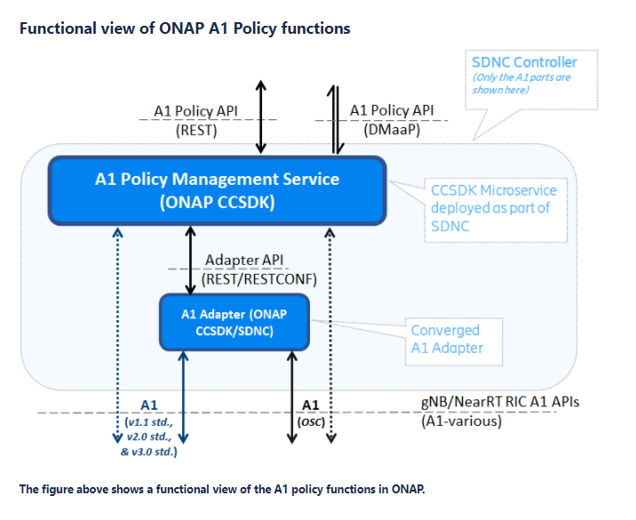
A1 Functions in ONAP / OSC
Ref: https://wiki.onap.org/pages/viewpage.action?pageId=84672221
A1-related message can be sent from Policy to SDN-R/CCSDK
Current Control Loop architecture would use DMaaP CL message
A1 Policy Management Service can connect to A1-termination in the Near-RT RIC with or without an A1 Adapter
In the SON Use Case context, the A1-termination in Near-RT RIC would be part of the simulated RAN (RAN-Sim) with usecase logic in the simulated/abstracted xApp which results in events from CU/DU over O1

Slide 19
Summary of Requirements
Target for I-release
Category | Requirement | Content | Priority
Interoperability | O-RAN alignment (VES, O1 interface) | Updates of VES message format (using stndDefined domain) for PM, FM, CM | HIGH
 |  | Configuration Management (CM) notifications over VES | HIGH
Functional | RAN Config Data(base) (CPS), including new RAN models | Use 3GPP NRM/O-RAN yang models for O1 Config | HIGH
 |  | Use CPS for storing/retrieving RAN config data for this use case | HIGH
Functional | Include A1-based action (stretch goal, may be implemented partially) | Implement A1 Adapter in SDN-R Enhance RAN-Sim to include Near-RT RIC and xApp Addition of new CL msg for A1-based action | MEDIUM (stretch)
Platform | Control Loop Coordination (CLC) extensions | Collaborate on CLC extensions (queueing, priority, …) | LOW
Functional | SON co-ordination | Co-ordination across SON functions | LOW

Slide 20
Requirements

Slide 21
ONAP Component Impacts for Jakarta release
COMPONENT | IMPACT(S)
OOF (test-only) | Interface to CPS (test-only? - work done in Istanbul)
SDN-C (SDN-R) | Use new Yang model for netconf config Receive and parse Configuration Management (CM) notifications from VES Collector Interface to CPS Implementation of A1 interface (stretch goal)
DCAE | Interface to CPS (test-only? - work done in Istanbul) Adapt to modified VES message format for PM, FM, CM Generate CL message for A1 action (stretch goal, needs to be coordinated with other reqs)
CPS (test-only) | TBDMT to support required APIs (test-only? - work done in Istanbul)
RAN-Sim (Simulators) | Reporting PM, FM, CM messages using new VES format (stndDefined) Support of new yang models for SON use case Enhancements for Near-RT RIC and xApp (stretch goal)
Policy | Support for second CL for A1 action (stretch goal, needs to be coordinated with other reqs)

Slide 22
Roadmap
R7 Guilin
R8 Honolulu
R9 Istanbul
R10 Jakarta
R11 and beyond
ML-based SON – first steps (training done offline), additional input from ML-model for PCI optimization (based on PM data)
Preparation work for 3GPP/ORAN yang model
O-RAN alignment preparation (O1 for CM notification & FM)
CPS - RAN config data base: first steps
CSIT and use case automation
O-RAN alignment (FM notifications over O1 for SON)
CPS – Full-fledged RAN data base, full alignment with 3GPP NRM
CM-Notify handling (partial)
Improved O-RAN alignment
Updated VES message format (stndDefined) for PM/FM/CM
CM-Notify handling and CPS DB update
Inclusion of A1 action with simulated Near-RT RIC and E2 (stretch goal)
Improved Harmonization with O-RAN OSC for implementing end-to-end use case
Improved RAN Simulation/Emulation with Near-RT RIC functions
Control Loop Co-ordination, SON function co-ordination
LCM for SON

Slide 23
Thank You!

