Slide 1
Technical Debt Management
Definition and Process
5/10/2022

Slide 2
Software Quality Issues
Quality plays a big role in the success of a software
Errors in coding or logic causing unexpected results
System weaknesses of
- System flaw
- Flaw accessible to attacker
- Attacker capability to exploit the flaw
Defects
Vulnerabilities
Technical Debt
Design or implementation construct that has consequences and makes future changes more costly

Slide 3
Understanding Technical Debt
Trade off of short-term benefits of rapid delivery and the long-term value of developing a software system that is easy to evolve, modify, repair, and sustain
Difference between promised value and actual delivered value
short-term goals at the expense of long-term quality
Makes system less maintainable and falls short of stakeholders' expectation
Business needs may require to take on technical debt for expedient delivery, and similar to financial debt, it must be managed

Slide 4
Type of Technical Debt
Reckless
Prudent
“We don’t have time for design”
“We must ship now and deal with consequences”
Deliberate
Inadvertent
“What is layering?”
“Now we know how we should have done it”
Credit: https://martinfowler.com/bliki/TechnicalDebtQuadrant.html

Slide 5
Type of Technical Debt
People and Resource debt
Design debt
Architectural debt
Compliance debt
Code debt
Defect debt
Testing debt
Automation debt

Slide 6
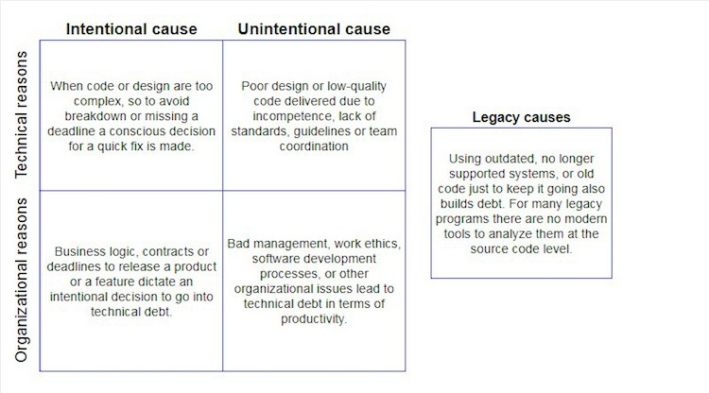
Reasons for Debt
https://brainhub.eu/library/how-to-deal-with-technical-debt/

Slide 7
Tracking and Managing
Leadership and Governance (in lieu of Product owner)
  PTL, Arch-SubComm, TSC (final decision maker on user story priority)
Backlog
  Does project backlog contain Technical Debt (JIRA)? Issue Type classification?
  Vulnerabilities, Code Defect, Global Requirements
Release/PI/Sprint Planning
  Are TD backlog items part of the planning? (Project vs ONAP Product)
  How much time is allocated in each PI/Sprint for TD now relieve? (10-20%)
  Do we need TD Sprints to catch up?
Top down or Bottom-up planning?

Slide 8
Suggested activities
Monetize Technical Debt in Level of effort (PTLs)
  True Story points (FTE) now or in the future
Create Per project Priority list
Awareness and Transparency
  Develop KPIs to track technical Debt
  Definition of done or release candidate qualification (authorized exceptions?)
Backlog grooming/Planning
  Feature vs software quality improvements in every planning and review
Architecture/TSC to review priority list and cost
Resource allocation per guidelines (ONAP TSC to decide?)
  Story points allocated to TD relieve

Slide 9
Questions to ask
What will this shortcut save us now?
What are we gaining by opting for a less-than-ideal fix today?
What kinds of challenges or limitations does this set us up for later?
Do we fully understand why we can’t address this today or do we need to further investigate before committing to future reworking or refactoring?
Do we fully understand the dependencies involved in this solution? Is it going to impact more than just the feature currently on the table?
If we do take on this debt, what are the future implications?
Does that timeline conflict with other release plans, feature updates, etc?
How long can we possibly put this off?
Are we putting this off for a strategic reason, i.e. do we suspect there will be a better way to fix this later if we wait?
Notes:
https://www.productplan.com/learn/manage-technical-debt/

Slide 10
Backup

