Slide 1
Service Design & Onboarding
Amdocs Open Network
Alla Goldner
Director, Technology, Strategy and Standardization, Amdocs

Slide 2
Service Lifecycle Management
DESIGN
ORCHESTRATE
OPERATE
PRODUCT CATALOG
DESIGN—ONBOARDING
OFFLINE
IN LAB
CONTINUOUS
REAL-TIME FULFILMENT
REAL-TIME
IN PRODUCTION
REAL TIME
OPERATION
HYBRID CLOUD

Slide 3
Identifying the critical path
Design time
Real time
Service Development
Service Delivery
3 Months
6 Months
9 Months
Service onboarding
process today
Analysis
Service Design
Test & De-bug
Packaging
Instantiate & configure
Service development is constrained by the speed of the Network Engineering create, test and debug cycle – typically a very manual, document-based and time-consuming process

Slide 4
Identifying the critical path
Design time
Real time
Service Development
Service Delivery
3 Months
6 Months
9 Months
Service onboarding
process today
Analysis
Service Design
Test & De-bug
Packaging
Instantiate & configure
Instantiate & configure
Service onboarding
automation
Analysis
Vendor VNF Onboarding
ONAP Service Design and Create (SDC) will address the service development agility :
Highly Automated design of new and updated services and virtual resources
Auto-readiness for rapid service launch
Service Design
Test & Debug
Packaging
Instantiate & configure
Notes:
Service agility encompasses:
Automated design of new and updated services
Auto-readiness for rapid service launch
Instantiation or implementation of services in minutes
Service on-boarding automation:
Shorten service development lifecycle
Cut resource and service on-boarding time
Reduce engineering and IT costs

Slide 5



ONAP Architecture
E – Services Ordering Channels
Operational Functions
Dashboard
External Data Movement & APIs
ONAP Portal
OA&M
Operation
Administration
& Maintenance
Active & Available Inventory
Service Orchestrator
Design Functions
Integration API
Recipe/Engineering Rules & Policy Distribution
Common Services, Data Movement, Access Control & APIs
OSS
Data Collection & Analytics
Controllers
Engineering Rules
& Inventory
Big Data
Service Design & Creation
Policy Creation
ONAP Controller
Storage
Analytic Application Design
Compute
Networking
VNFs / Applications

Slide 6
Service Development life cycle
VNF
VNF
VNF
VNF
Endpoint
Endpoint
Endpoint
1
Onboarding
Design
VNF
Endpoint
2
VNF
Workflow
Workflow
Policies
Policies
VNF
VNF
VNF
VNF
Debug and re-design
\
Operations
Distribution
Packaging
Testing
6
5
4
3
ISSUE
VNF
VNF
VNF
VNF
Self Service Portal
Debug and re-design
EP
EP
EP
VNF
EP
Service Orchestrator
READY
VNF
ISSUE
Active & Available Inventory
Policies /
Workflow
Policies /
Workflow
Notes:
New tooling to fast design and onboard new services & resources
Accelerate, simplify & reduce cost to onboard new service designs & resources
1 –The onboarding of VNF Descriptors (models) and associated artifacts (SW images, Documentation, Templates).
Our onboarding automates the process and provide a scheme for capturing operational requirements and knowledge from experts via interactive wizards including OS support, VNF component makeup and dependencies, VM CPU size and other general or hypervisor specific platform requirements, network, security, non-functional requirements.
Importing of externally provided information (e.g. VNF images or details contained in standard based files formats). Formats like Yang or TOSCA while the standards bodies still mature are generally vendor specific at this time, the import capability can be customized to support these by the addition of an adaptor that provides any bespoke translation.
This stage automatically generate an initial resource definition for next stage( design of service)
Will reduce integration effort per VNF
2- Visual Design of Service - a graphical environment to define services based on these VNFs including policies, thresholds, deployment process models and factors to be used in their operation.
Within the same graphical environment user can combine VNFs into more complex virtual services together with classical resources associated with the physical network.
Palettes of re-usable elements, graphical canvas for drag ‘n’ drop assembly of a network service definitions.
Customizable support for different scenarios:
Service level design templates: vCPE, vEPC, vIMS etc.
VNF design templates: multi-VM, multi-component, load-balanced etc.
Great simplification and validation of design.
3- Testing – ( maybe debugging is better name) lets you take a definition and use the NFVO component to step through the planning function and see the outcomes of any policies that have been configured.
It allows you to view and interact with fixed or derived parameters at each step to make adjustments to any issues in the definition logic, these changes can then be reconciled in the original definition after you have finished debugging.
Debugging applies equally at a Service or VNF level within the definition so that individual parts of a service can be debugged in isolation of the others if required.
4- Packaging - Publishing of the predefined and tested services to a catalogue such that they can be offered to the fulfilment process. Significant benefit of using our NCSO is that service design was tested via target system (NCSO) right on design stage.
5 - Distribution of essential artifacts and information such as software images, policy definitions, model definitions, performance thresholds, etc. to key consuming systems –NFV Orchestrators, catalogues, VIM, assurance etc.
This process today mainly manual – we targeting to automate distribution – i.e. significantly reduce time and cost of handover from design stage to service build/ fulfillment stage.
VNF Managers, SDN Controllers and the VIM itself have their own metadata requirements. This metadata is partial derived but linked to the service and resource definitions used by the orchestrator. The SDC component can build artefacts or other metadata from the service and resource definition model and any associated extensions, store and version these within its registry.

Slide 7
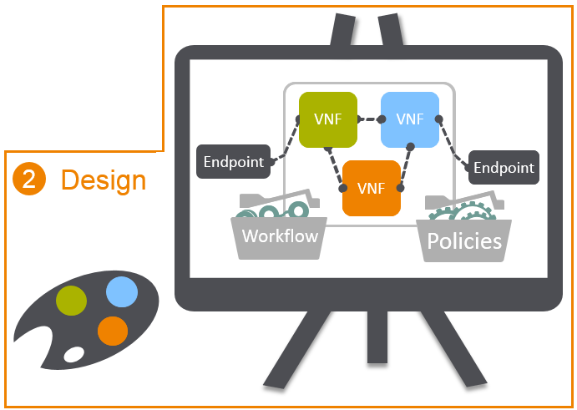
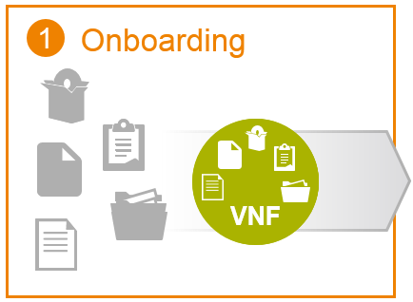
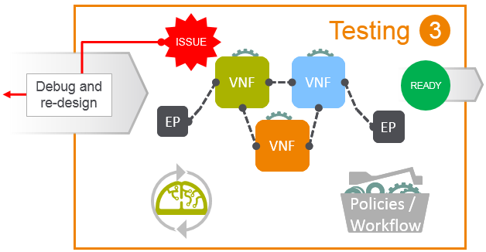
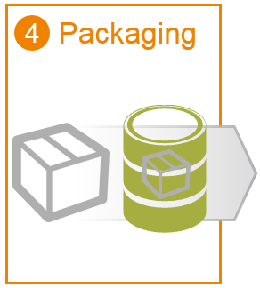
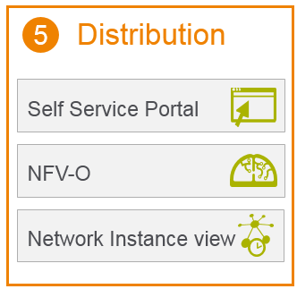
What's the challenge
A development toolset for non-developers
Reusable
Multiple users
Collaborate and build
Model
Release
and distribute
Different Systems
Tested
Service Orchestrator
Active & Available Inventory
Notes:
The challenge of any ‘design’ toolset in this area is to manage what is basically a development process (explain) but not give this complexity to the non-IT users.

Slide 8
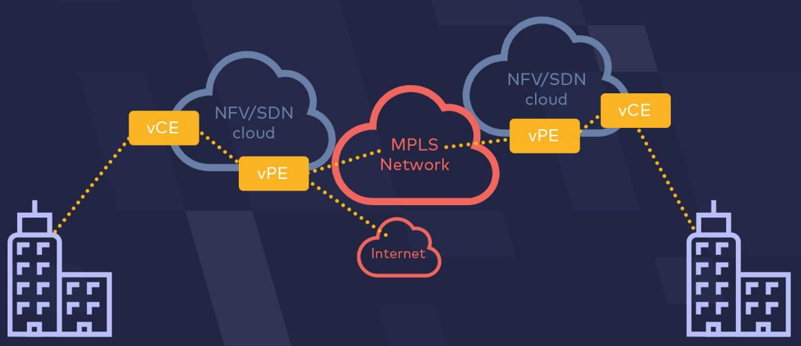
What needs to be modeled
Model ( metadata ) for:
Composition of service including its topology – that an orchestrator will process and enrich by details of placement, IP Address allocation, number of VMs per VNF etc.
Life cycles such as instantiate, configure, delete, test, heal (reboot, recreate, migrate), scale, backup, restore, patch / upgrade, snapshot - a description of workflows, monitoring( KPIs, Events) and policies required by orchestrators or other components to fulfil, repair or manage a service or resource
Policies - Decisions made during the planning or deployment of services or resources
Connecting two branch offices
through corporate VPN
Notes:
vPE – virtual provider edge
vCE – virtual Customer Equipment

Slide 9
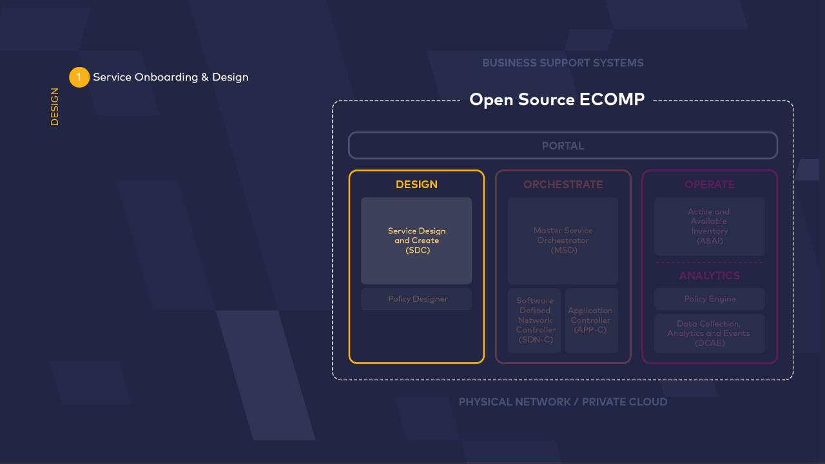




ONAP

Slide 10
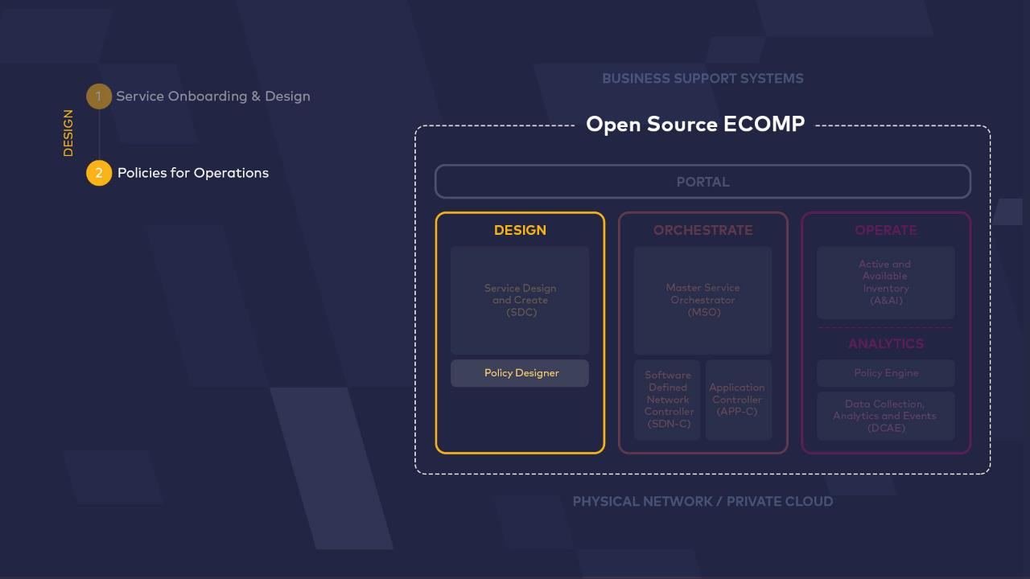
ONAP

Slide 11
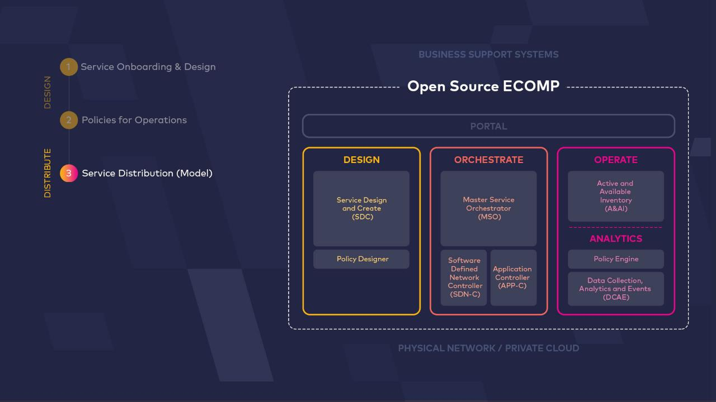


ONAP

Slide 12
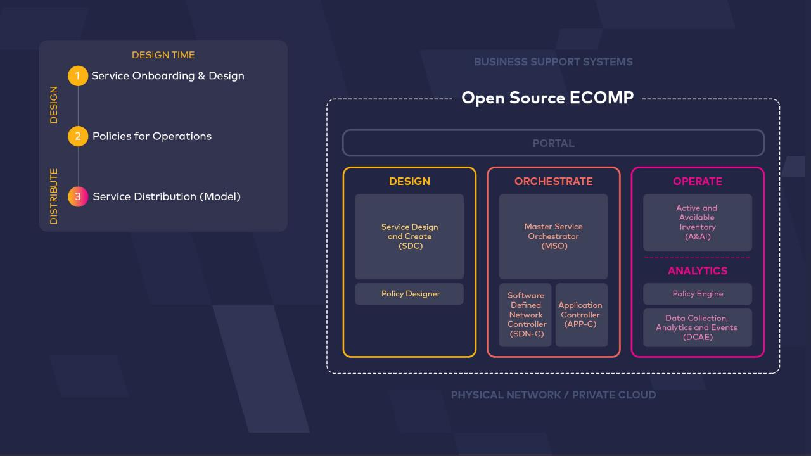
ONAP

Slide 13
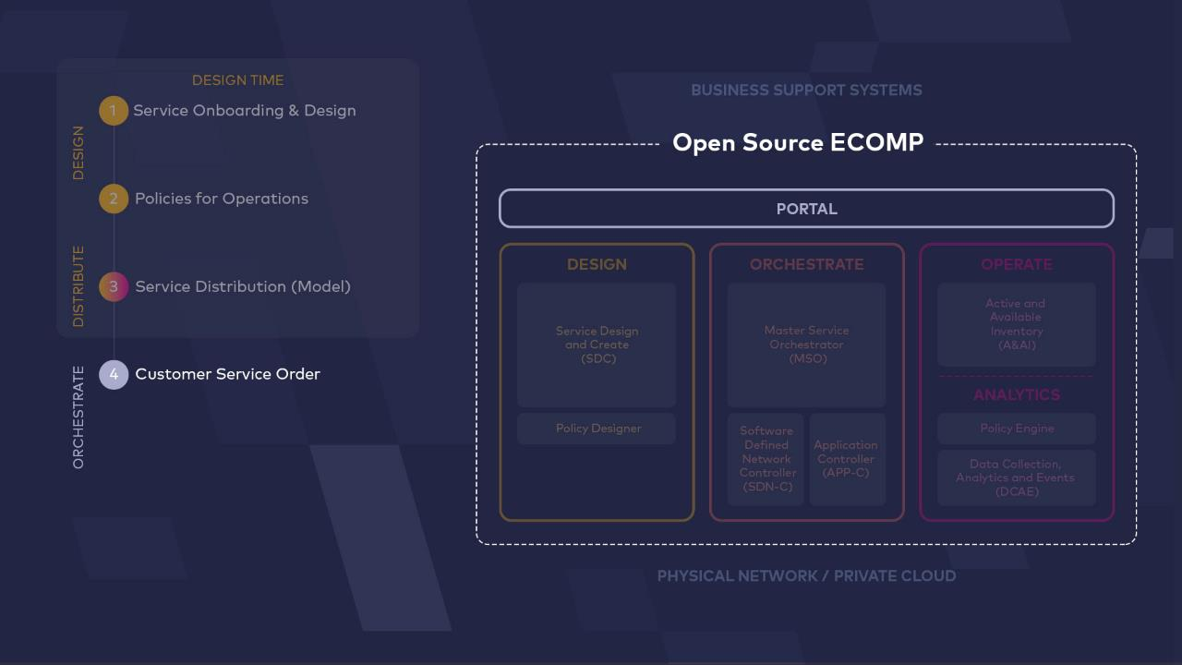

ONAP

Slide 14
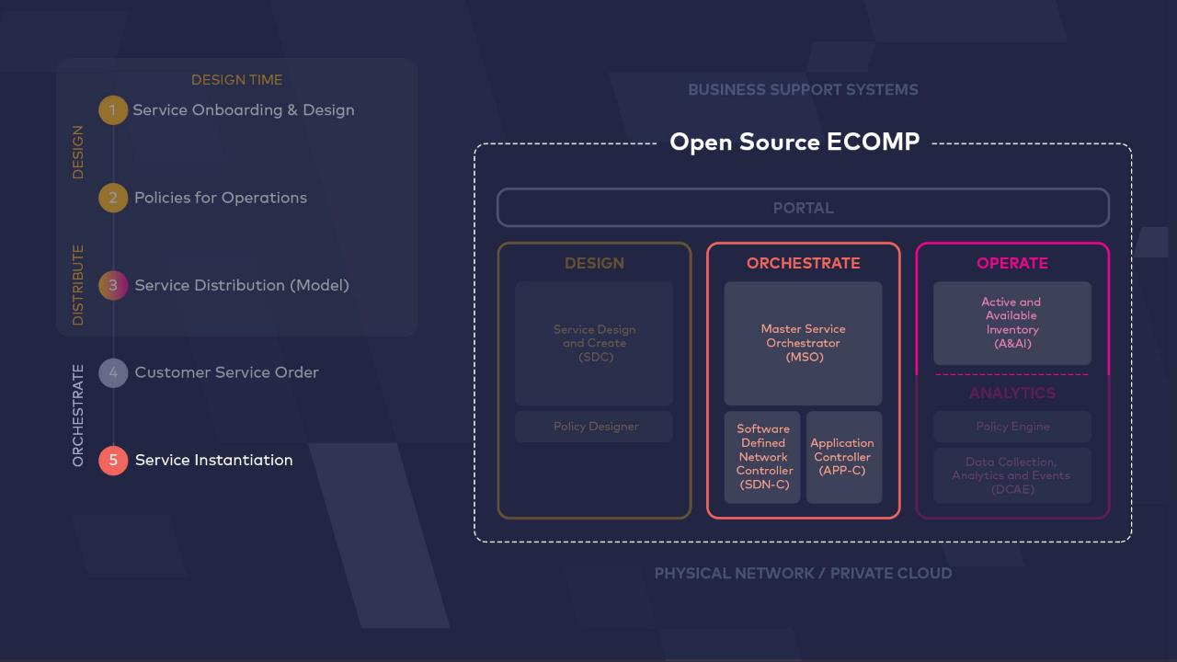
ONAP
ONAP

Slide 15
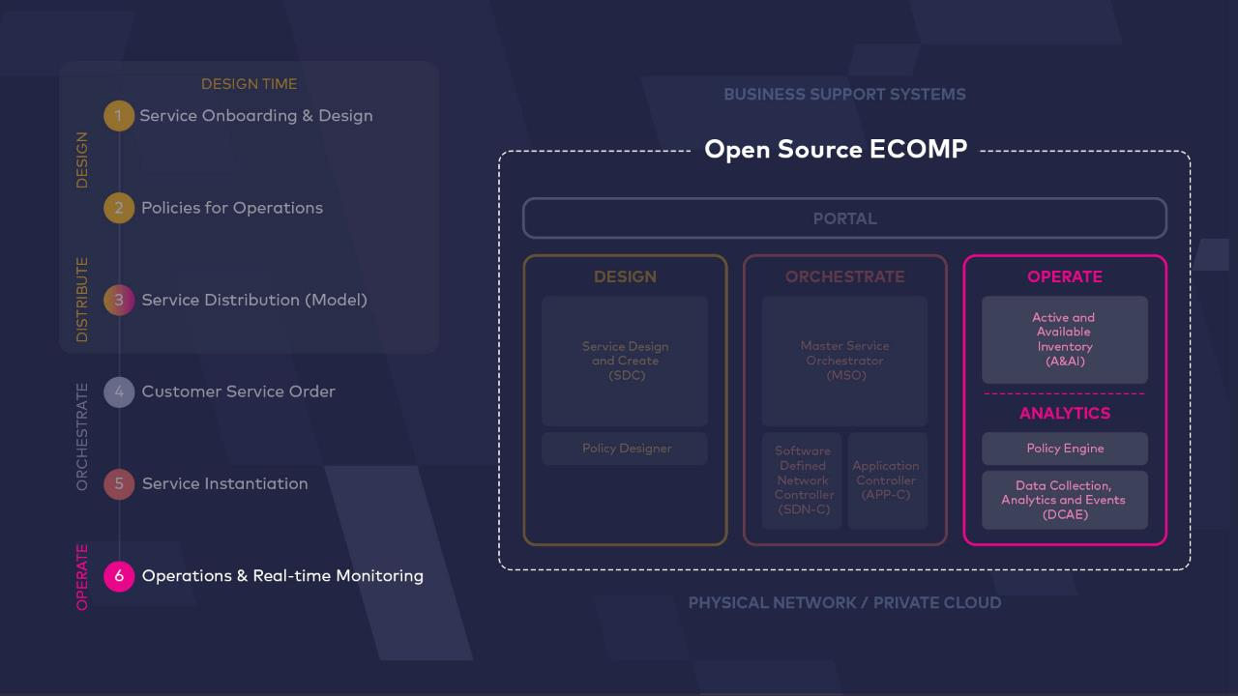
ONAP

Slide 16
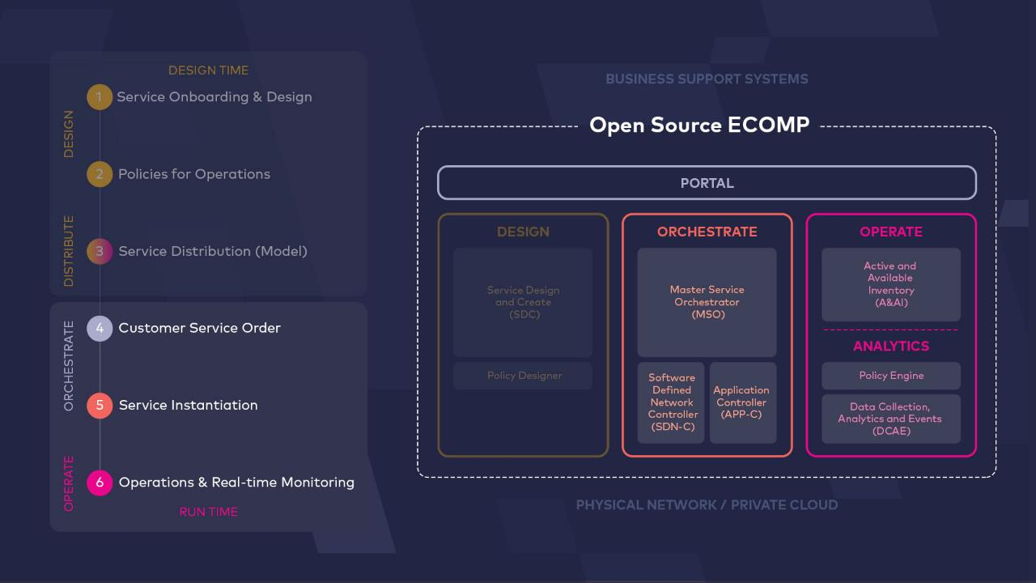
ONAP

Slide 17
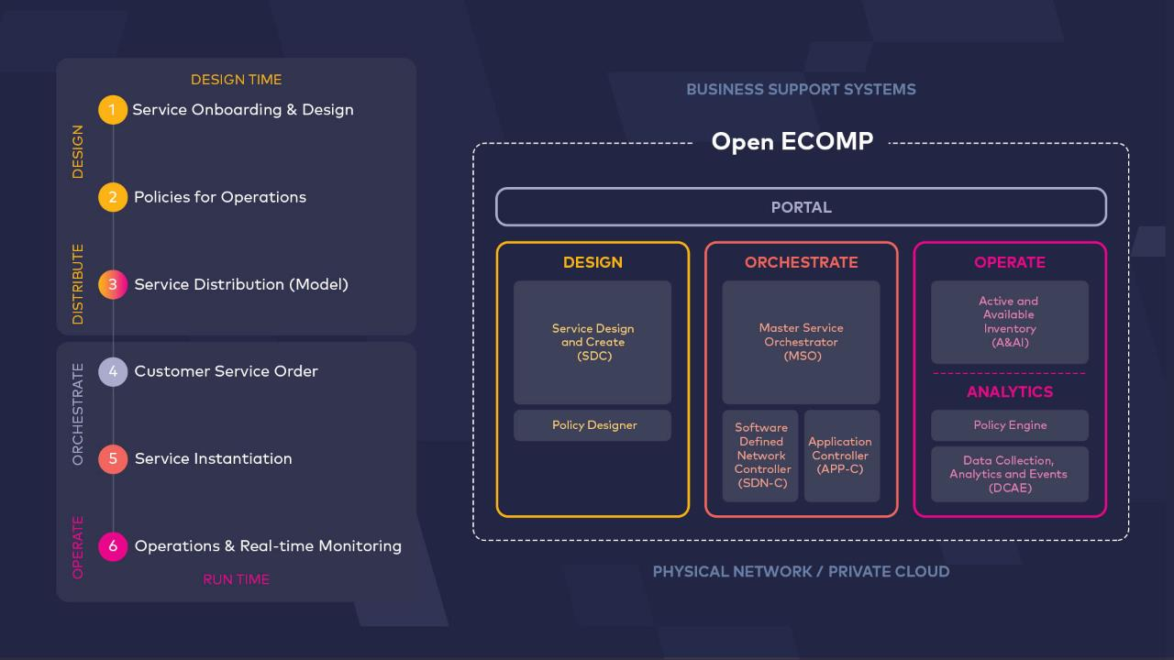

ONAP

Slide 18
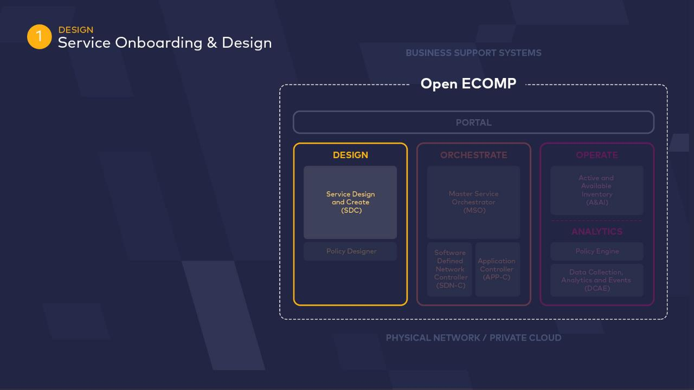
ONAP

Slide 19
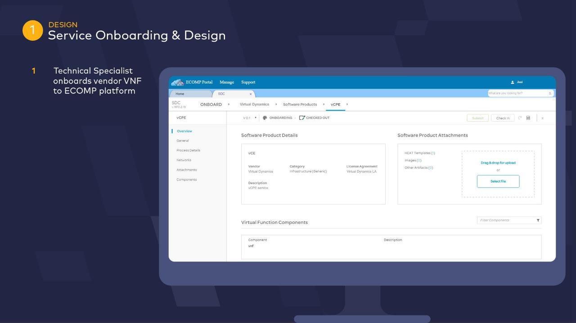




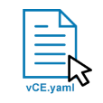
ONAP Portal
ONAP

Slide 20
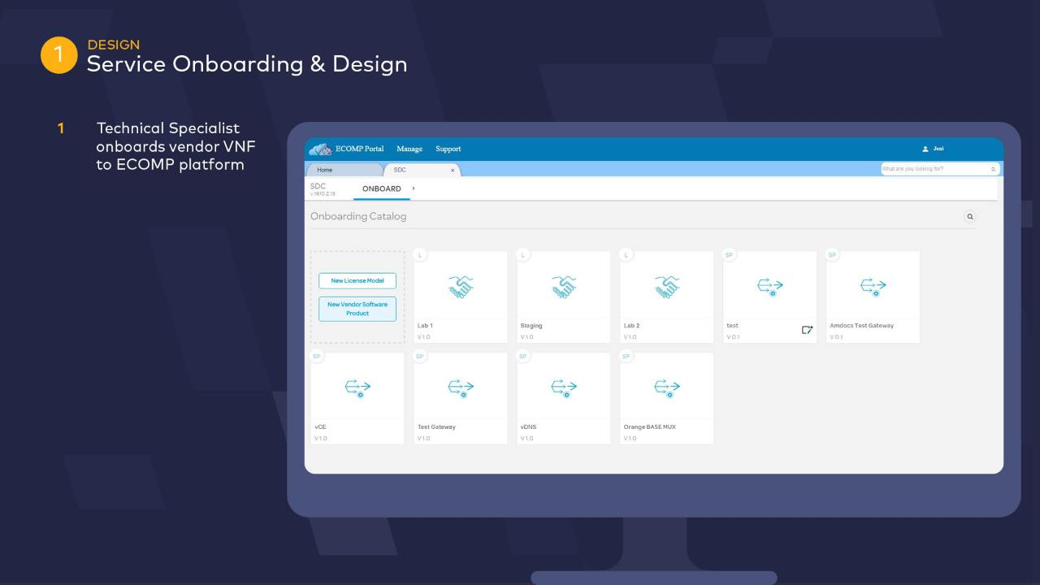

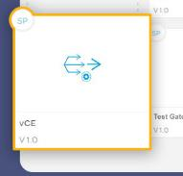
ONAP Portal
ONAP

Slide 21
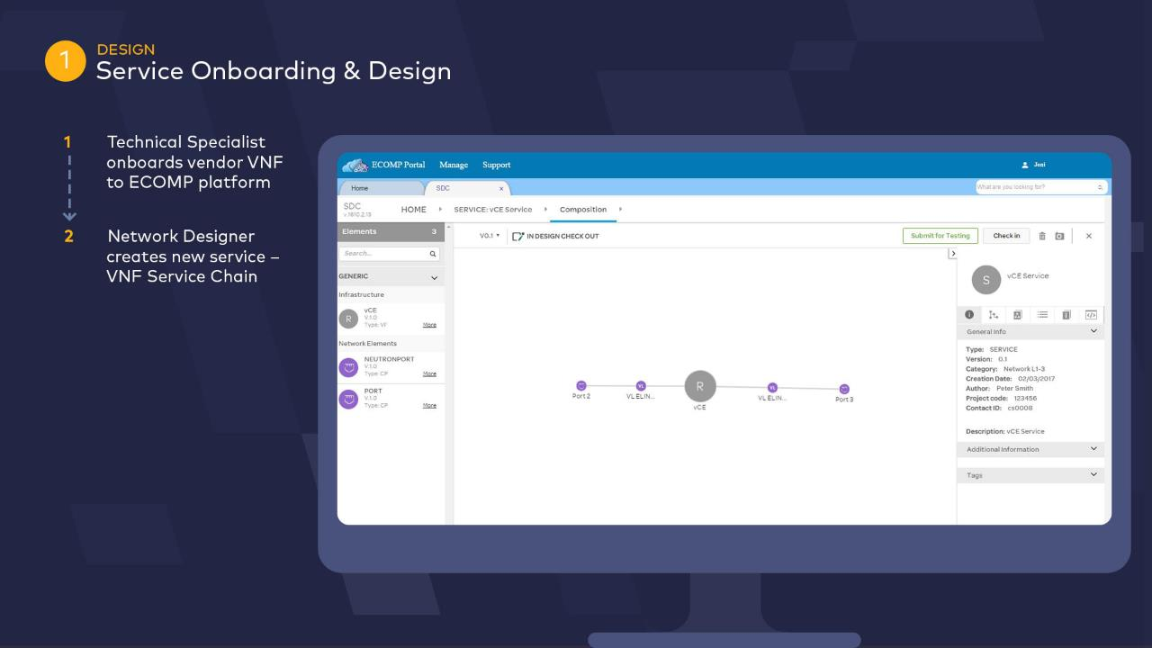

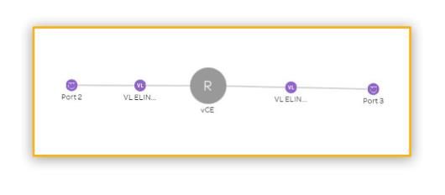
ONAP Portal
ONAP

Slide 22
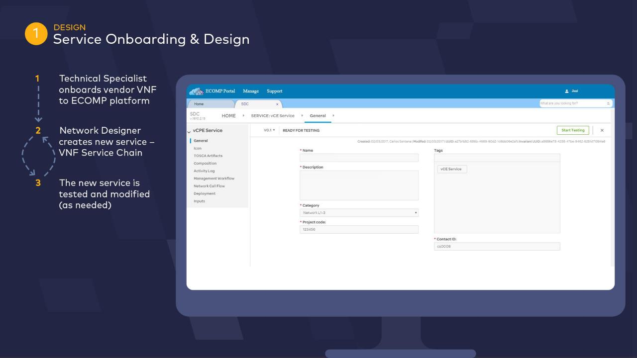
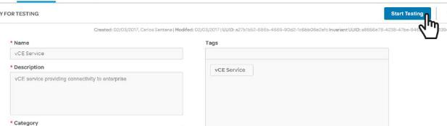

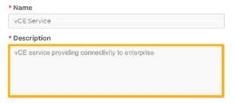
ONAP Portal
ONAP

Slide 23
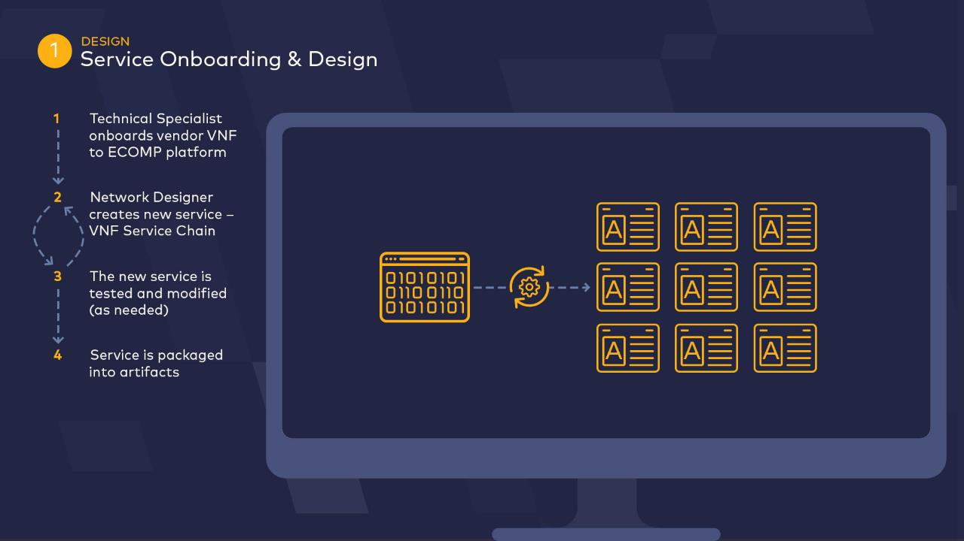

ONAP

Slide 24
ONAP

Slide 25
ONAP

Slide 26
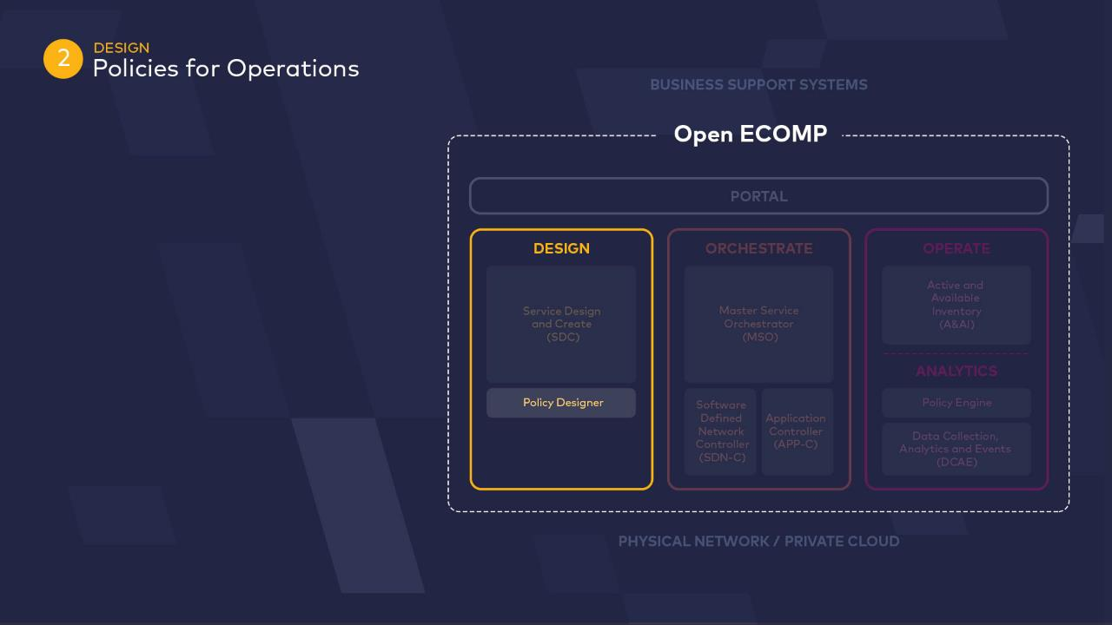
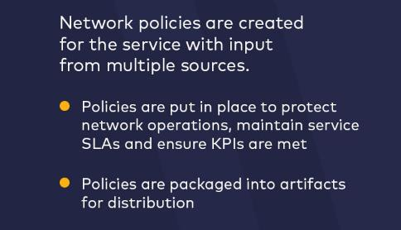
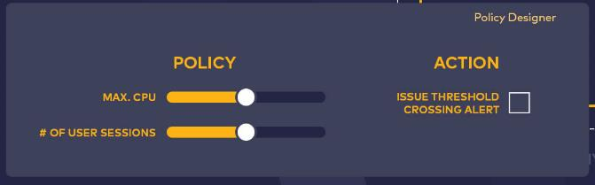




ONAP

Slide 27
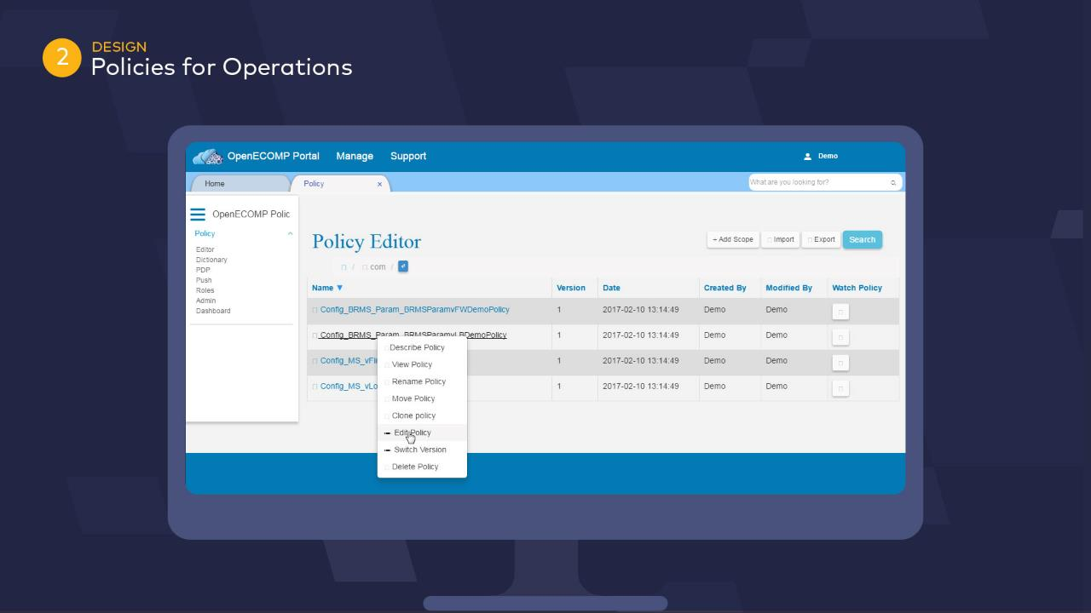

ONAP Portal

Slide 28
ONAP

Slide 29
ONAP

Slide 30
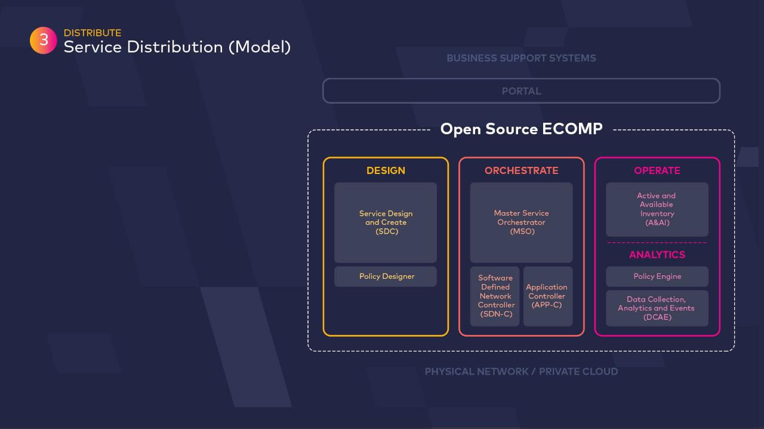

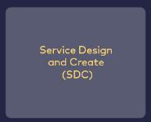
ONAP

Slide 31
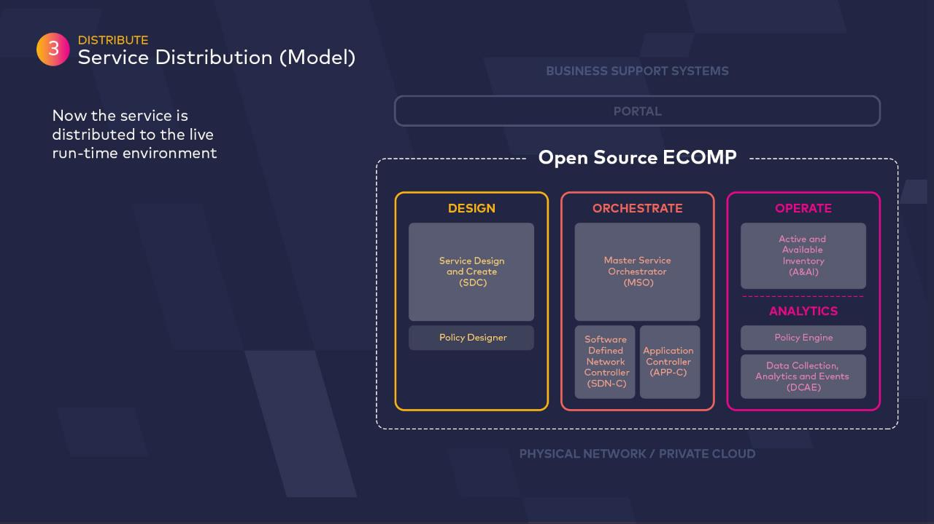

ONAP

Slide 32
ONAP

Slide 33
ONAP

Slide 34
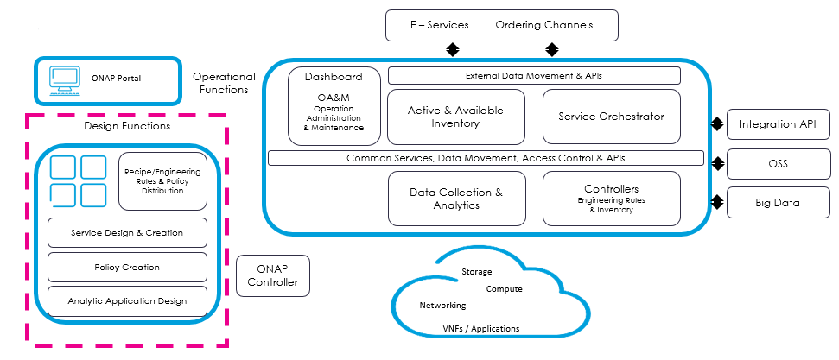
Summary - Service Design and Create (SDC)
ONAP - service development automation
Business challenges
  Today’s systems cannot define new services in hours
  Service design is time consuming (9-12 months typical) and costly with low levels of automation
Solution – service development automation
  Simplify and accelerate service composition with intuitive drag-and-drop interface
  Lower design costs through re-use of modular components
  De-risk service introduction and adaptation through automated test and debug loop

