Slide 1
RAN-Simulator (RAN-Sim)

Slide 2
Problem: RAN-Sim Upgrade is Needed
All SON Use Case planned work has impact on RAN-Sim
RAN-Sim uses Honeycomb netconf server
Honeycomb project ( https://wiki.fd.io/view/Honeycomb ) has been archived, and future support is an issue
  There is a new project Hc2VPP ( https://wiki.fd.io/view/Hc2vpp ) which used Honeycomb
Other parts of RAN-Sim provide great value for ONAP and OSC Use Cases
  Controller, Database, GUI for Usecase logic
  VES message generation for PM, FM, CM
Need to develop plan for:
  Replacement of Honeycomb in RAN-Sim
  Adding simulated Near-RT RIC and xApp in RAN-Sim for Use Cases
  Harmonization of RAN-Sim with OSC projects (sim, oam, smo)

Slide 3
Enhancement to include xApp and A1
SMO/Non-RT RIC (SDNR, DCAE)
O1
A1
RANSIM controller
and DB
Near-RT-RIC(netopeer)
O1
“E2”
xapp
xapp
O-CU (Honeycomb)
O1
O-DU (Honeycomb)
O1
RAN-Sim

Slide 4
Enhancing RAN-Sim
VES Collector
SDNR
New module in RAN-Sim
Near-RT RIC
xApp
A1 termination
Areas of work
A1 termination
xApp functionality
O1 functionality in Near-RT RIC (netopeer)
Connection from Controller*
to xApp/Near-RT RIC
  websocket (simpler?)
  Netconf (need client in Controller)
E2 abstraction options:
  Via controller (simpler?)
  Direct interfaces (working towards E2)
* From Alex:
Choice of interface will depend on team doing the development.
RAN-Sim is Java based, netopeer is C/C++ based
For netconf client in RAN-Sim for netconf options, see for example https://github.com/Juniper/netconf-java
VES(REST)
Netconf
A1
(A1/xApp)
(O1-netconf/VES)
A1
Web GUI
xApp
xApp
xApp
REST
Netopeer -?
?
VES(REST)
RANSim
Controller
Yang Models
Netconf
xApp/nRT-RIC
Config DB
(MariaDB)
(O1-netconf/VES)
NF
(O1-netconf/VES)
NF
(O1-netconf/VES)
NF
Extension
Extension
Extension
Honeycomb
Honeycomb
Honeycomb
Websocket
Yang Model
Yang Model
Yang Model
Extension
Extension
Extension
Yang Models
Yang Models
Yang Models
CU/DU NF
CU/DU NF
CU/DU NF
RAN-Sim

Slide 5
Near-RT RIC in RAN-Sim
Assumptions
  netopeer-based container to represent Near-RT RIC and xApp
  Near-RT RIC has interface to RAN Sim Controller
  (For now) No direct interaction between Near-RT RIC and CU/DU
Interfaces
A1 interface in Near-RT RIC
  - REST API, leverage A1 termination work
Interface from Near-RT RIC/xApp to RANSim Controller
  Websocket (like RAN-Sim)
  Netconf/yang (like osc sim) – needs netconf client in RANSim Controller
Interface from Near-RT RIC/xApp to CU/D
  With assumption 3, this is done via Controller

Slide 6
Information about A1
Message from Jon Keeney: Re A1 implementation in the RAN-Sim simulator.
I suggest you use as a starting point one of the existing A1-P opensource implementations (near-RT-RIC end)
I strongly suggest complying with the latest approved version of the A1 Interface (A1-AP v3.1)
1: The OSC A1 Simulator:
https://gerrit.o-ran-sc.org/r/gitweb?p=sim/a1-interface.git;a=tree;f=near-rt-ric-simulator/
https://docs.o-ran-sc.org/projects/o-ran-sc-sim-a1-interface/en/latest/
https://wiki.o-ran-sc.org/display/RICNR/Release+E+-+Run+in+Docker#ReleaseERuninDocker-RuntheNear-RTRICA1SimulatorDockerContainers
A very lightweight spec-compliant implementation.
Handles all aspects of A1 termination and spec-adherence (All known A1-P versions/flavours supported).
Does not have any concept of xApps, or the E2 interface.
Does not contain any domain-/app-/A1Policy-specifc behaviour.
Can be easily extended to redirect operations about specific A1-Policy types or instances to custom functions.
2: The OSC near-RT-RIC Platform A1 Mediator:
https://gerrit.o-ran-sc.org/r/gitweb?p=ric-plt/a1.git;a=tree
https://docs.o-ran-sc.org/projects/o-ran-sc-ric-plt-a1/en/latest/overview.html
https://wiki.o-ran-sc.org/display/RICP/A1+Mediator
A mediator function in near-RT-RIC platform to terminate A1 interface and re-distribute A1-Policy operations to relevant xApps.
Implements an old pre-spec version of the A1 application protocol, not spec-compliant, but similar to the spec.
Handles all aspects of A1 termination.
Does not contain any domain-/app-/A1Policy-specifc behaviour, all such behaviour is implemented in appropriate xApps.
3: The ONAP Integration project’s A1 Policy Enforcement Simulator
https://gerrit.onap.org/r/gitweb?p=integration/simulators/A1-policy-enforcement-simulator.git;a=tree
https://docs.onap.org/projects/onap-integration/en/latest/integration-simulators.html
https://wiki.onap.org/download/attachments/107252299/ONAP%20CNF%20based%20A1%20Policy%20Enforcement%20Simulator.pptx
A domain-/app-/A1Policy-specifc simulator to simulate UE-load balancing across simulated cells.
Implements the same pre-spec version of the A1 application protocol from the near-RT-RIC platform’s A1 mediator above, not spec-compliant, but similar to the spec.
Does not have any concept of xApps, or the E2 interface.
Also supports the creation & presentation (FTP) of related app-specific O1 bulk PM files for collection using ONAP VES/DFC functions.
Behaviour can be tuned by (simulated) topology configuration and manual runtime triggering.
Only 1 hardcoded implementation-/app-specific A1-Policy type supported

Slide 7
A1

Slide 8
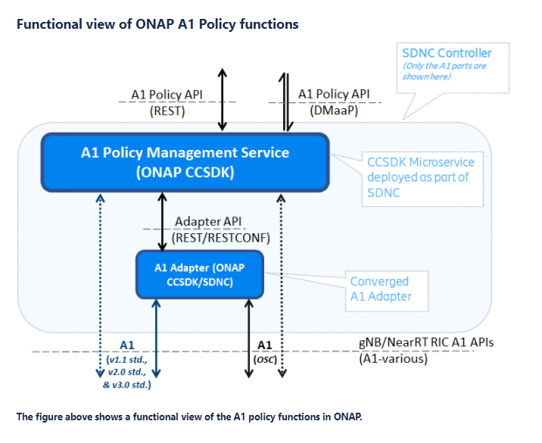
A1 Functions in ONAP / OSC
Ref: https://wiki.onap.org/pages/viewpage.action?pageId=84672221
A1-related message can be sent from Policy to SDN-R/CCSDK
Current Control Loop architecture would use DMaaP CL message
A1 Policy Management Service can connect to A1-termination in the Near-RT RIC with or without an A1 Adapter
In the SON Use Case context, the A1-termination in Near-RT RIC would be part of the simulated RAN (RAN-Sim) with usecase logic in the simulated/abstracted xApp which results in events from CU/DU over O1

Slide 9
OSC A1 (Near-RT RIC) Simulator
Stateful A1 test stub for “South-end” of A1 Interface
Used to create multiple stateful A1 providers (simulated near-rt-rics)
  Supports A1-Policy and A1-Enrichment Information
Does not include and app-specific behavior – just what is defined in A1 Application Protocol specs
Implemented as a lightweight Python application
Swagger-based northbound interface, so easy to change the A1 profile exposed (e.g. A1 version, A1 Policy Types, A1-E1 consumers, etc)
  All A1-AP versions supported as configurable profiles
Source: https://gerrit.o-ran-sc.org/r/admin/repos/sim/a1-interface
Docs: https://docs.o-ran-sc.org/projects/o-ran-sc-sim-a1-interface
Wiki: https://wiki.o-ran-sc.org/display/RICNR

Slide 10
RAN-Sim

Slide 11
Approach for RAN Simulator (RANSim) – Dublin - FM
ONAP
OOF
GUI
  Provide Control to User in UI to select a cell and modify neighbor list to simulate collision/confusion
Controller
  Send message to corresponding Netconf Server about the collision/confusion
Netconf Server
  Send configChangeNotification to SDNR
  Send FM/alarm message to VES Collector for collision/confusion. Thus the control loop starts
GUI
  Show the modified PCI values
Controller
  When the modified RAN configuration received, same is updated into DB and informed to UI
Netconf Server
  When the SDNR provides the modified RAN configuration, same is forwarded to Controller
DCAE
SON Handler
Policy
VES Collector
SDNR
Web GUI
REST
Netconf
REST
Simulated
Network
Netconf server 1
RANSim
Controller
Netconf server n
Honeycomb
Websocket
Honeycomb
Extension
Config DB
(MariaDB)
Extension
Yang Model
Yang Models

Slide 12
Approach for RAN Simulator (RANSim) – Dublin - PM
ONAP
OOF
GUI
  Provide Control to User in UI to select a cell and generate PM data
Controller
  Send PM message to corresponding Netconf Server with KPI values. Initially send good values and after few minutes send bad values for selected cell.
Netconf Server
  Send PM message to VES Collector with given KPI values. Thus the control loop starts.
GUI
  Show the ANR updates as dotted lines.
Controller
  When the modified RAN configuration received, same is updated into DB and informed to UI
Netconf Server
  When the SDNR provides the modified RAN configuration, same is forwarded to Controller
DCAE
SON Handler
Policy
VES Collector
SDNR
Web GUI
REST
Netconf
REST
Simulated
Network
Netconf server 1
RANSim
Controller
Netconf server n
Honeycomb
Honeycomb
Websocket
Extension
Config DB
(MariaDB)
Extension
Yang Model
Yang Models

Slide 13
O1 simulator in OSC sim

Slide 14
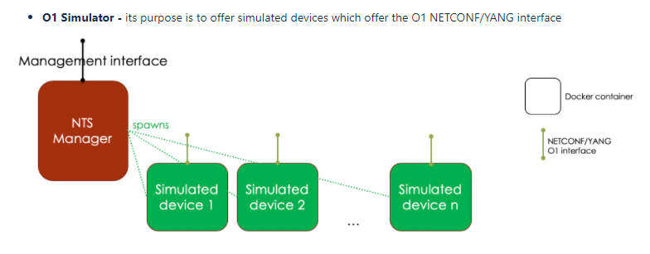
O-RAN Software Community (OSC) sim project
Ref: https://wiki.o-ran-sc.org/display/SIM/Architecture
Contact: Alex Stancu
Simulated devices in Simulated RAN are netconf (netopeer) devices representing CU/DU O1 instances with CU/DU yang models
NTS (Network Topology Simulator) Manager uses netconf to connect to devices using yang model of simulation entities
NTS also has NB netconf interface for external entity (e.g. SDN-R) to control simulation
Datastore in NTS provided by netopeer

Slide 15
O-RAN-SC O1 Simulator architecture
Docker container
VES Client
FTPes / SFTP Server
NETCONF Datastore
NETCONF Server
Exposed port
Use Case logic
YANG Models (O-CU/O-DU/O-RU)
Sysrepo
Process (C/C++ Code)
Connection to VES Endpoint
Simulated NF (O-CU/O-DU/O-RU)
Internal communication
NETCONF Server framework – Netopeer2

Slide 16
Comparing RAN-Sim and OSC sim
RAN-Sim
OSC sim
SDNR GUI
VES Collector
SDNR
Web GUI
VES Collector
SDNR
Netconf
SDNR
REST
REST
REST
Netconf
Netconf
Simulated
Network
Simulated
Network
REST
(docker daemon)
O1 sim n
RANSim
Controller
O1 sim n
NTS
Manager
O1 sim 1
(with VES client)
O1 sim 1
(with VES client)
Extension
Websocket
Extension
Netconf/yang
Honeycomb
Config DB
(MariaDB)
netopeer
Yang Model
Yang Model
Datastore
(sysrepo: xml database with yang)
Extension
Extension
Yang Models
Yang Models
RAN-Sim was developed for ONAP Use case
Has use case specific logic (e.g. analyze cell relations and generate fault message)
Netconf devices are mounted manually
VES message details are generated in Controller as per usecase logic
OSC sim developed as O1 building block
NTS can be used by SDN-R to spawn O1 (CU/DU) instances. SDNR GUI can be used to configure NTS
FM VES messages are pre-configured in O1 sim
NTS uses netconf to each O1 sim netopeer device, and REST to the docker

