Slide 1
ONAP R11- General Intent Model Impact on DCAE
Requirements and Realization Discussion
23th Jul, 2022
Shuting Qing (Huawei)

Slide 2
Contents
01
Background
02
Realization and Impact
03
Consultation on Way of Realization
Ref: ITU-T “Scenarios and Requirements of Intent-Based Network for Network Evolution”

Slide 3
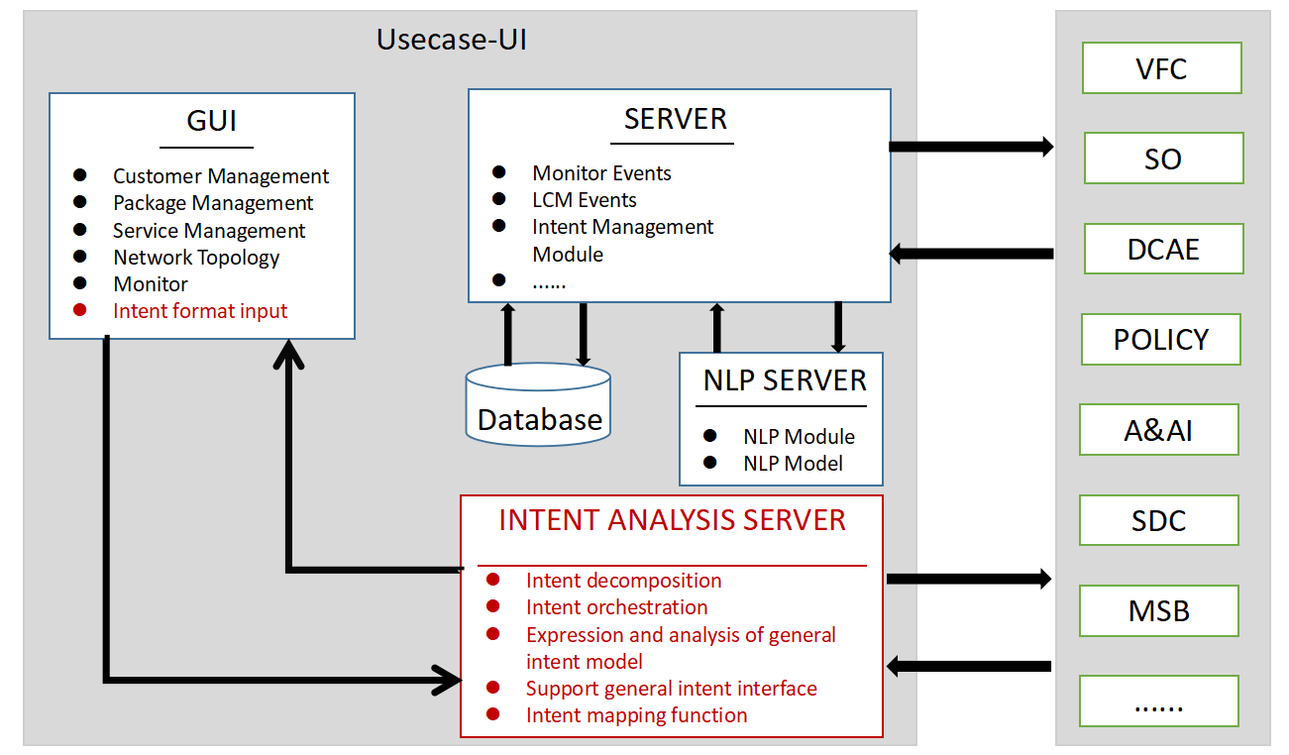
Contents
Release Requirement: General intent model and general intent interface requirements in R11
Jira: REQ-1268
Description: For complex intent, such as the intent of cloud leased line, it is necessary to decompose the complex intent to sub intents.
Ref: ITU-T “Scenarios and Requirements of Intent-Based Network for Network Evolution”

Slide 4
Use case description
Operators provide intent based cloud leased line services, and provide corresponding assurance measures based on user level (provide different levels of capacity expansion assurance for different levels of users). An enterprise user orders a cloud leased line with a bandwidth of 1G from the operator. In order to meet this intent, the intent handler will configure the cloud leased line with a bandwidth of 1G and enable the exclusive assurance measures. When the bandwidth utilization rate exceeds 80%, the bandwidth will be expanded by 60% to ensure the user experience. At the same time, when the traffic returns to normal (the utilization rate is 30%), the service bandwidth will be restored to 1g. Whenever the expansion / reduction operation is executed, the intent handler will notify the intent owner through the intent report.
Decompose to:
1. Provision intent
2. Assurance Intent
Assurance Intent: When the bandwidth utilization rate exceeds 80%, the bandwidth will be expanded by 60% to ensure the user experience. At the same time, when the traffic returns to normal (the utilization rate is 30%), the service bandwidth will be restored to 1g.

Slide 5
Contents
01
Background
02
Realization and Impact
03
Consultation on Way of Realization
Ref: ITU-T “Scenarios and Requirements of Intent-Based Network for Network Evolution”

Slide 6
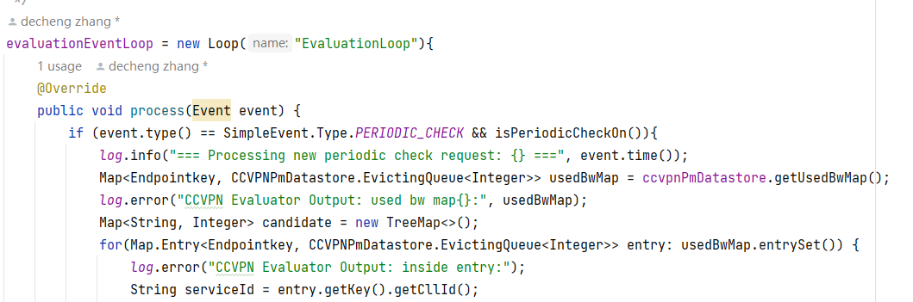
Contents
Background: Slice MS has realized the function to do an closed-loop and user-triggered auto expand bandwidth based on real time bandwidth usage.
To do list:
Add a lower-down-bandwidth logic if bandwidth utilization rate is below 30%.
There is already a flag used to control the closed-loop logic. But now it’s hard coded as env param. We want to add a run-time configuration logic in Slice MS to pass in this param.
Start an Assurance Inteng
Flag: start closed loop
DCAE
Slice MS
Remove an Assurance Inteng
Flag: endclosed loop
DCAE
Slice MS
Ref: ITU-T “Scenarios and Requirements of Intent-Based Network for Network Evolution”

Slide 7
Contents
01
Background
02
Realization and Impact
03
Consultation on Way of Realization
Ref: ITU-T “Scenarios and Requirements of Intent-Based Network for Network Evolution”

Slide 8
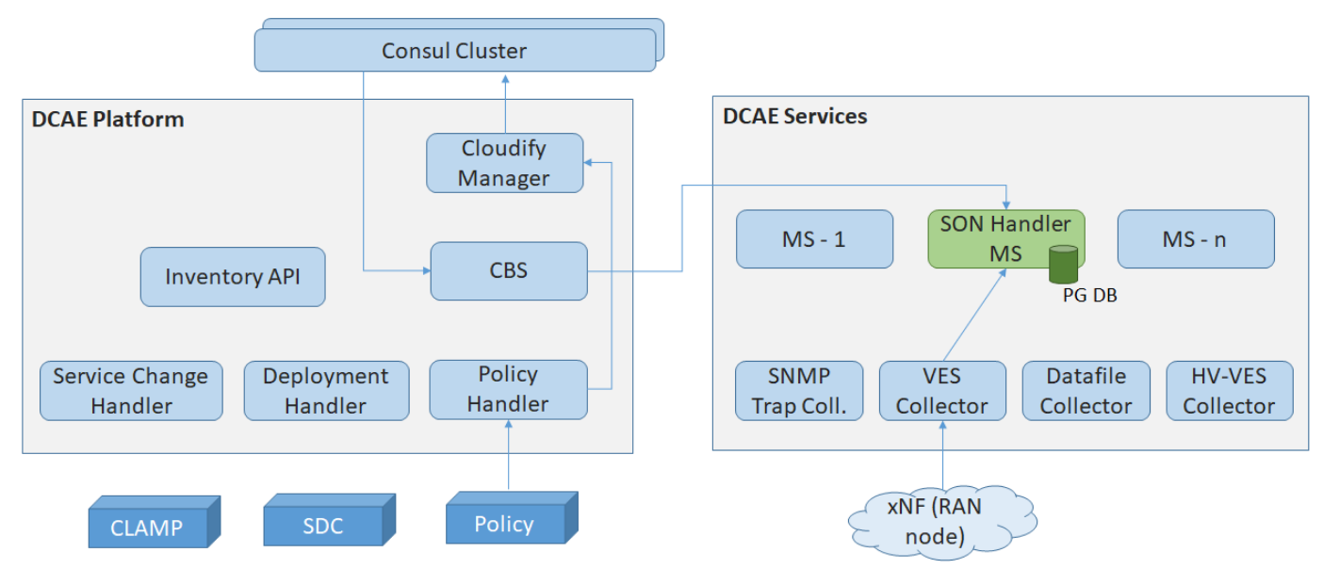
Consultation
Refer to Son-handler
Two ways:
Policy PDP - Policy Sync - SON Handler MS
Policy PDP - Policy Handler - Cloudify Mnagaer - Consul Cluster - CBS - SON Handler MS
Policy PDP
Policy Sync
Son Handler
file system

Slide 9
Consultation
Testing on Son-handler -- Need some help
Two ways:
For way 1, we can see policy sync retrieve latest data from pdp, write it to file system, and data retrieved by SON handler every time we restart SON Handler pod.
  It’s not real time for policy sync to write.
  It’s not real time for son handler to retrieve.
For way 2, we are now at having deployed every components, and we deployed policy to policy pdp.
  Data can not be sync to SON Handler.
Policy PDP
Policy Sync
Son Handler
file system

Slide 10
Thanks!
shutingqing1@huawei.com

