Slide 1
ASD-based CNF Orchestration
PoC Status and London Requirements
Byung-Woo Jun, byung-woo.jun@est.tech, Ericsson
Ericsson SDC & SO Team:
Michael Morris, Krupa Nagabhushan, Jeff van Dam, Vasyl Razinkov,
Waqas Ikram, Raviteja Karumuri, Gerard Nugent, Nadeeshani Jayathilake
2023-01-09

Slide 2
Application Service Description (ASD)
What?
  Deployment descriptor for cloud native applications/ functions​
  Minimum information needed for the Orchestrator
  References to the cloud native artifacts
  CSAR package adhering to ETSI SOL004
Why?
  Minimize duplication​
  Use Kubernetes management capabilities​
  Clean separation between high-level orchestration and cloud native application deployment
Business Driver?
  ORAN
  Reference implementation in ONAP
  Nephio

Slide 3
ASD Proof of Concept (PoC) in ONAP*
The PoC was executed in ONAP framework to demonstrate viability of the ASD concept for NF modelling and packaging.​
Sample applications like {MariaDB, nginx}, {Free5GC and UERANSIM} have been modelled and packaged following the ASD concept.​
The packages have been onboarded in the ONAP management system.​
Using ONAP components, the sample applications modelled and packaged using the ASD concept have been successfully instantiated in the underlaying Kubernetes cluster.​
* ONAP – Open Network Automation Platform, https://www.onap.org/

Slide 4
ASD Orchestration London Goals
ASD Package Onboarding & Design to SDC (Done in Kohn)
  Onboarding & validating vendor ASD App packages
  Transforming onboarding ASD models and packages into ONAP internal models and packages
  Adding additional artifacts, such as vendor licensing models
  Adding custom properties as needed
Service CSAR with ASD resources distribution to ONAP Runtime thru DMaaP
  Preserving the vendor ASD CSAR inside Service CSAR
  Providing Query APIs for ASD, Helm Charts and Image artifacts
Learning &
Feedback
SO Orchestration for ASD-Aligned CNFs/Apps
    Create / Instantiate / Terminate / Delete AS operations
    External K8s Clusters registration
    AS topology inventories (Generic VNF / VF-Modules / K8s Resources)
    Deploy associated Helm Charts to a selected K8s cluster, based on ASD definitions and User input

Slide 5
ASD Functional Requirements for London
Executive Summary - Application Service Descriptor (ASD) is a simplified deployment descriptor for cloud-native applications/functions. This functional requirement is for enabling a vendor provided Application Service Descriptor (ASD) compliant CNF package including an ASD CNF Descriptor to be orchestrated by ONAP SO and its sub-components. The function will provide ASD-based CNF runtime onboarding, distribution and orchestration.
  Support ASD package runtime onboarding
  Support AS LCM RESTful protocol APIs
  Support ASD-based CNF orchestration operations, such as Create AS, Instantiate AS, Terminate AS and Delete AS, providing:
    External K8s Clusters registration
    AS topology inventories
    Helm charts deployment to a selected K8s cluster
Business Impact - Enables operators and service providers to use ASD-compliant CNF packages with ONAP to simplify CNF design and orchestration, by minimizing duplication, using Kubernetes management capabilities and providing clean separation between high-level orchestration and cloud-native application deployment.
Business Markets - All operators that are currently using ETSI packages and descriptors to deploy CNFs can consider ASD-based CNF package deployment and orchestration.
Funding/Financial Impacts - Reduction in operations expense from using simplified CNF packaging and orchestration. Reduction in capital expense from vendors using a simplified packaging and deployment methodology.
Organization Mgmt, Sales Strategies -There is no additional organizational management or sales strategies for this requirement outside of a service providers "normal" ONAP deployment and its attendant organizational resources from a service provider.

Slide 6
Requirement and Epic for London
REQ-1394 : Provide ASD-based CNF runtime Onboarding, Distribution & Orchestration capabilities:
    Support ASD Package runtime onboarding
    Support AS LCM RESTful protocol APIs
    Support ASD-based CNF orchestration operations, such as Create AS, Instantiate AS, Terminate AS, and Delete AS, providing:
      External K8s Clusters registration
      AS topology inventories
      Helm Charts deployment to a selected k8s cluster
SO-4048 (Epic): SO and its sub-component shall support ASD-based CNF lifecycle orchestration:
  Support ASD package runtime onboarding
    Enhance ONAP SO to accept and process ASD packages from SDC
  Support AS LCM RESTful protocol APIs
  Support ASD-based CNF orchestration
    Enhance ONAP SO for ASD package onboarding and ASD-based CNF orchestration launching with AS LCM RESTful APIs
    Build a new ONAP SO subcomponent, SO CNFM, to orchestrate and deploy ASD-based CNFs into K8s Clusters
    Support Create/Instantiate/Terminate/Delete AS LCM operations
    Support Update AS (stretch goal)

Slide 7
Related ONAP Wiki Page Links
London release – functional requirements proposed list, https://wiki.onap.org/display/DW/London+release+-+functional+requirements+proposed+list
London Impact View per Component, https://wiki.onap.org/display/DW/London+Impact+View+per+Component
ASD-Based CNF Orchestration, https://wiki.onap.org/display/DW/ASD-Based+CNF+Orchestration

Slide 8
Project and Component Impacts
Impact on SO project (code changes to be done in):
  SO api-handler
  BPMN Infra
  SO CNFM
Impacted components:
  SO (Code change)
  SO CNFM (Code change) - new optional SO sub-component
  AAI (Test only)
  SDC (Test only)

Slide 9
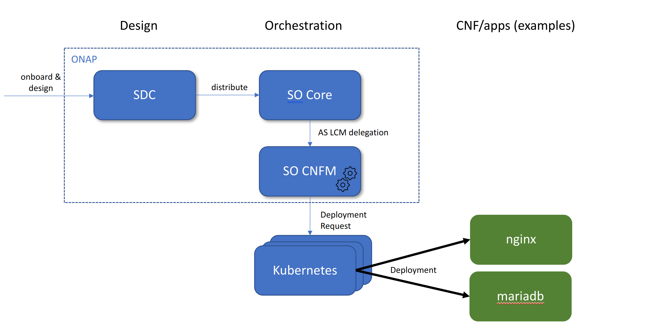

ASD Design & Orchestration Overview
ASD Package
(SOL004)
UERANSIM
query &
store
distribute
free5gc
(AMF, SMF, UPF)
AAI
store AS instance
Registry
(ASD, helm chart, image)
Service Design & Creation (SDC) is a design component in ONAP for onboarding and designing VNF/CNF(ASD)/NS/Service
Onboarded ASD, Helm Charts and Images will be stored into Registries
Service Orchestration (SO) is a generic ONAP orchestration component for Service/NS/VNF/CNF
SO CNFM is designed for ASD orchestration
Available & Active Inventory (AAI) provides real-time views of the resource and service instances and relationships
ASD POC wiki page: https://wiki.onap.org/display/DW/ASD+Onboarding+and+Orchestration+PoC

Slide 10
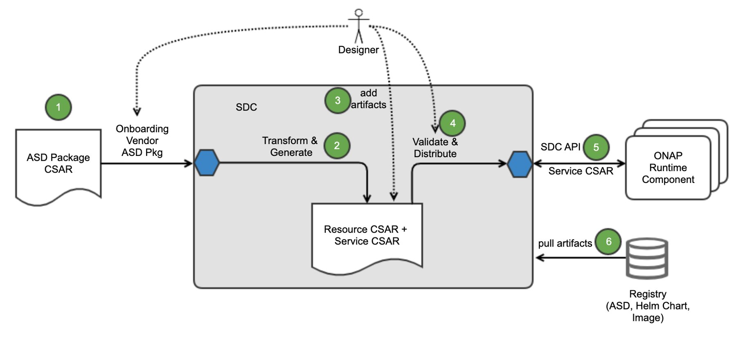
ASD Onboarding to ONAP SDC (Done in SDC)
Onboard vendor ASD packages and package validation​
Transform onboarding ASD models into ONAP models and generate Resource CSAR and Service CSAR for distribution​
Add additional artifacts such as vendor licensing models​
Validate and decide for distributing the Service CSAR to ONAP runtime​
Distribute the Service CSAR to ONAP runtime​
Pull & store ASD, Helm Charts and Images from SDC to Registries (future implementation)​
SDC generates Resource (VF) CSAR, based on ASD.
  ASD-specific metadata is copied into the specific files, which will be used by Runtime components.
    (entity_definition_type = ‘asd’)
  Onboarded ASD models are mapped into the ONAP internal models; ASD <-> ONAP VF, DeploymentItems <-> VF-Modules).
  Add the AS_PACKAGE directory to store the original vendor ASD CSAR

Slide 11

ASD Model Transitions in ONAP
ETSI VNFD does not have its sub-structure that corresponds to ONAP Vf-module
  Current ONAP ETSI-Alignment supports VNF and above, no mapping to ONAP Vf-module
ASD models are mapped into ONAP internal models
ONAP VF and Vf-module will be stored into AAI as generic-vnf and vf-module
K8s Cluster resource Kinds will be represented as K8s resources in AAI
ETSI
onboarding view
runtime view
VNFD
(policy > scaling_aspect>properties>aspect)
SDC
AAI
K8s
Cluster
VF
Generic_vnf
Vf-Module(s)
1
1
m
m
DeploymentItem
Vf-Module
kind
Vf-Module
1
m
K8s
Resource
1
1
ASD
ASD
1
ASD = VF
DeploymentItem = VF-Module
VF = VNF/generic_vnf (CNF)
VF-Module = VF-Module
VF-Module contains V-Server(s)
VF-Module contains K8S-RES
K8S-RES = K8S Kind
m
DeploymentItem
DeploymentItems

Slide 12
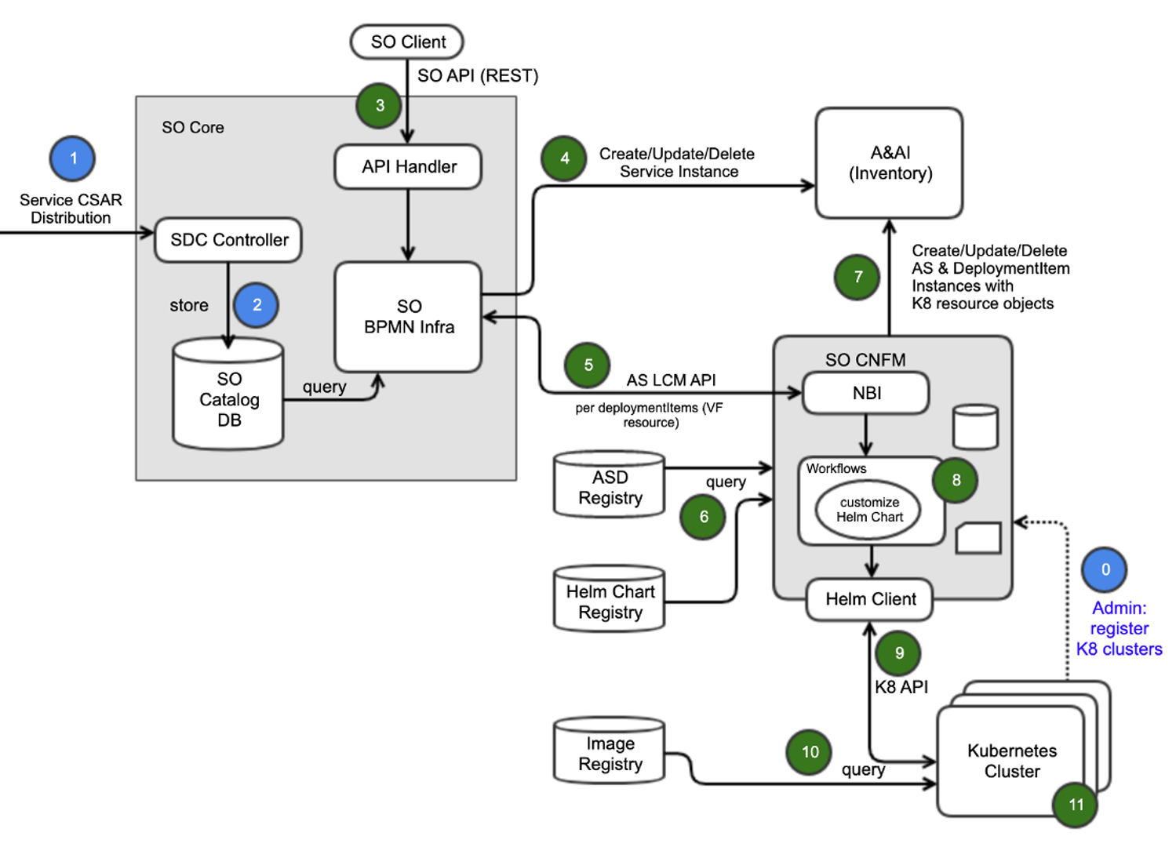
ASD Orchestration By ONAP SO
0. Register multiple Kubernetes Clusters​
SO Core​
Onboard ASD Service CSAR into SO runtime​
Store ASD Metadata into SO Catalog DB​
Support SO API Endpoint for ASD-CNF orchestration​
Create/Update/Delete a Service Instance in AAI​
SO CNFM​
Use AS LCM APIs as NBI​ (AS LCM RESTful Protocols)
Query ASD and Helm Charts from the registries ​
Store ASD & DeploymentItems instances with K8 resources (kind list) in AAI​
Customize instance-level Helm Chart values, based on User Input and ASD​
Deploy ASD-based CNFs to Kubernetes clusters through Helm Commands and Kubernetes APIs ​
Query Images from the registry​
Applications deployed in the K8s and operational​
In PoC, images will be provided to K8s Clusters manually

Slide 13
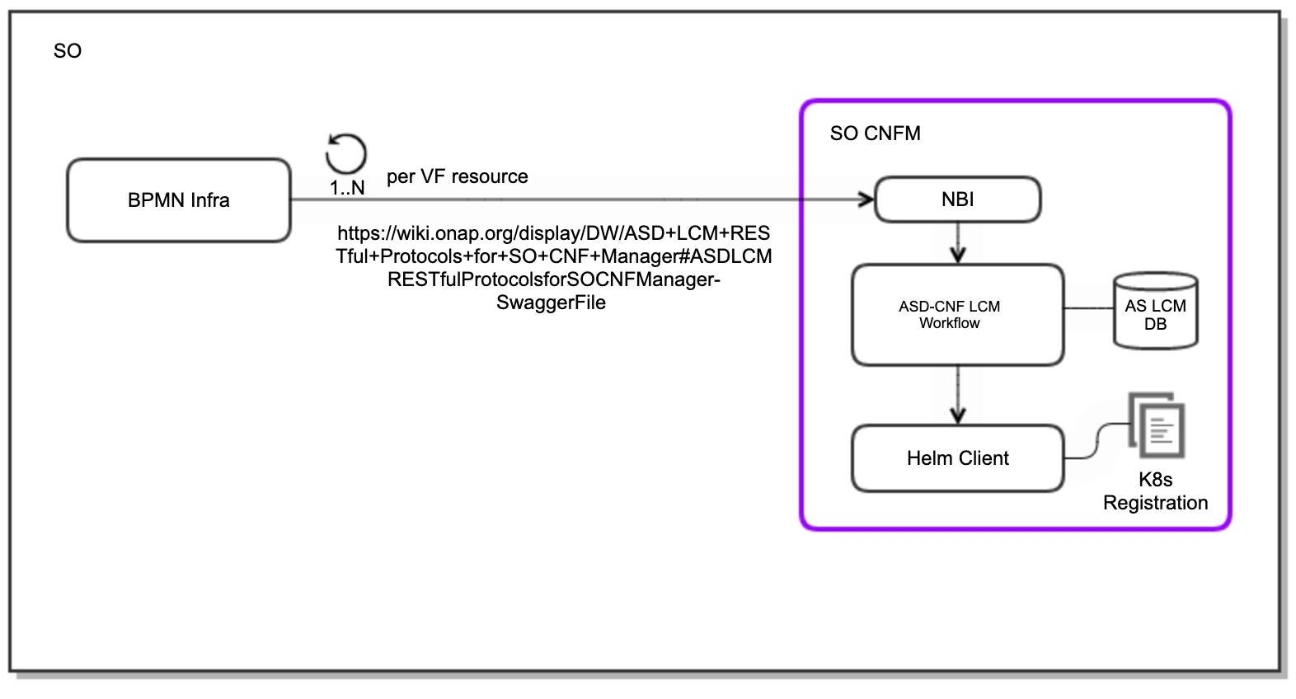
SO CNFM, an SO Plug-In Component
Supports NBI which implements AS LCM RESTful protocols
  Create/Instantiate/Terminate/Delete AS workflows in BPMN Infra invokes SO CNFM thru AS LCM RESTful protocols
  AS LCM RESTFul Protocols
Is a pluggable SO sub-component with NBI, Business Logic (AS-CNF LCM) and SB plugin (Helm client for now, CNF Adapter for EMCO is under consideration)
Has corresponding workflows for Create/Instantiate/Terminate/Delete/Query AS operation
  ASD LCM Operations in PoC
Contains Camunda-based BPMN workflows and associated Java business logics for AS-CNF LCM.
Handles external K8S cluster registration for creating available K8S cluster pools
Manages ASD and associated Helm Charts Queries
  For the initial PoC, SO CNFM retrieves ASD, Helm Charts from SDC, instead of artifact registries.
  Images will be provided to K8S clusters manually for now
Customizes instance-level Helm Charts values, based on ASD lifecycleparameters and user input
Invokes Helm commands to deploy ASD-CNFs
Invokes Kubernetes Java API to monitor K8s resources
Note: Helm Client is used as the SO CNFM SB adapter. When EMCO is used, another adapter can be used (e.g., SO CNF Adapter)

