Slide 1
OF-HAS for Residential broadband vCPE Use Case
Date Aug 28, 2017

Slide 2
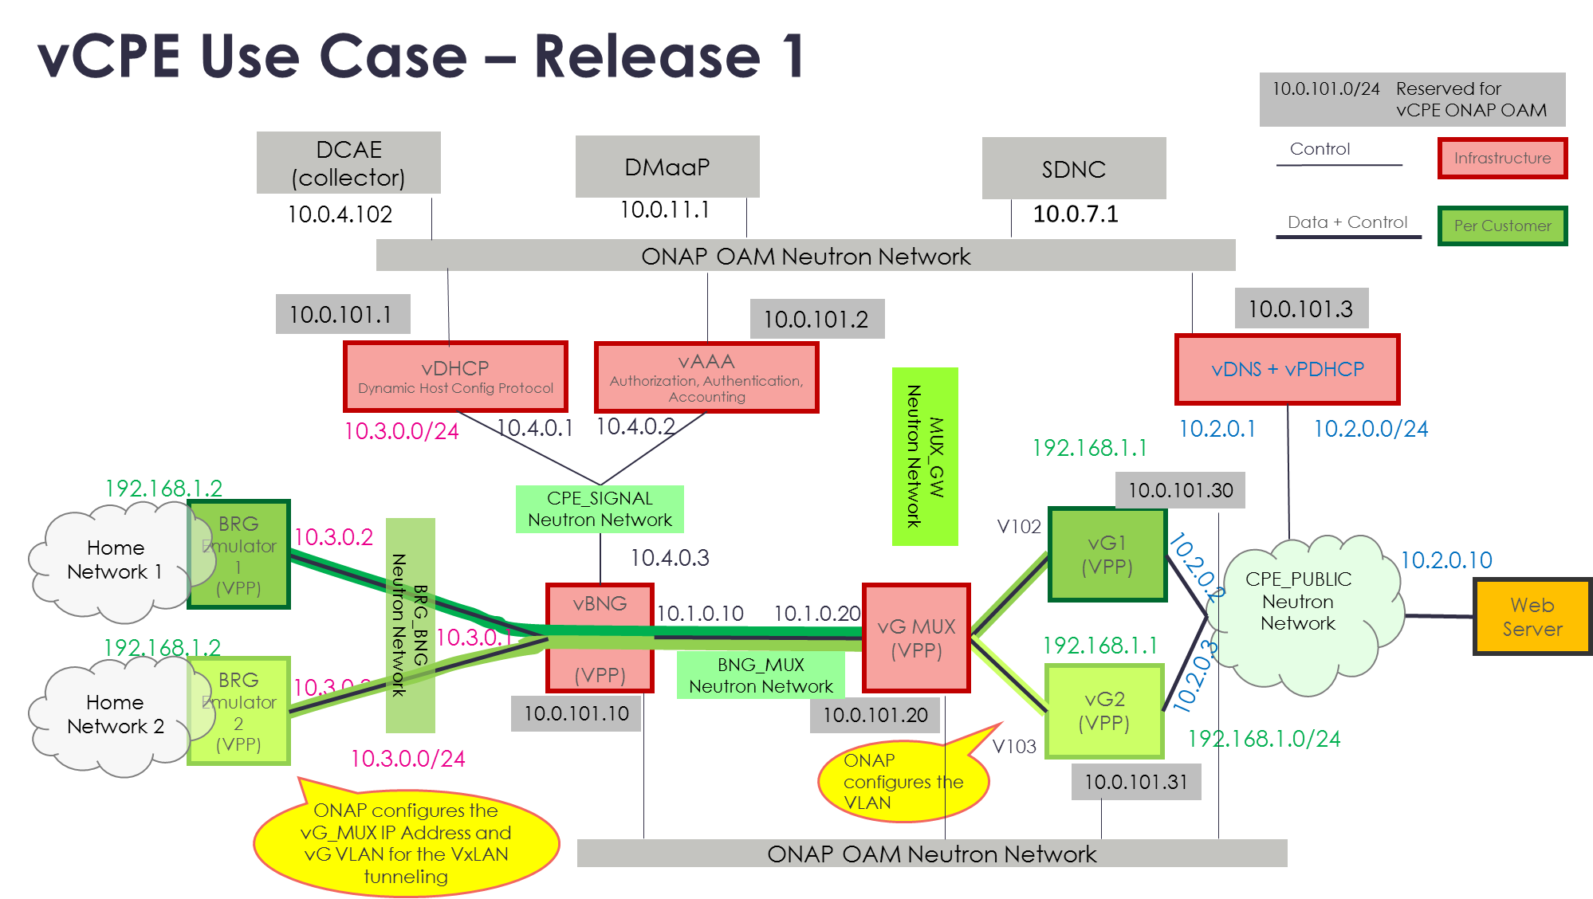
vCPE Use Case Architecture (R1)
https://wiki.onap.org/pages/viewpage.action?pageId=3246168
Physical resources at Customer Premise
vG MUX
vG
Resources in Cloud
https://wiki.onap.org/display/DW/Residential+Broadband+vCPE+Drafts+for+discussion?preview=%2F10783327%2F14483520%2FvCPE+Use+Case+-+Customer+Service+Instantiation+-+170824b.pptx

Slide 3
vCPE use case consists of two types of VNFs/services:
Infrastructure services – e.g., vGMuxInfra
  deployed prior to any customer request for a vCPE service, assumed to be up and running and ready to provide their services when a customer order is received
Customer services – e.g, vG
  deployed on a per customer order basis, using the various infrastructure services.

Slide 4
Residential Broadband vCPE Use Case Model: vCpeResCust & vGMuxInfra Topology
TOSCA
HEAT
TunnelXConn AllottedResource:
Requirement:
TunnelXConnCapability
vCpeResCust Service:
topology_template:
node_templates:
TunnelXConn (AllotRes):
BRG (PNF):
vG (VNF):
BRG PNF Resource:
vG VNF Resource:
vG (VFC)
Per-Customer
vG VF Module:
vGMuxInfra Service:
topology_template:
node_templates:
MUX_GW (Ntw):
vGMux (VNF)
Capabilities:
TunnelXConnCapability
Infrastructure
MUX_GW Network Resource:
vGMUX VNF Resource:
vGMUX (VFC)
vGMUX VF Module:

Slide 5
Homing Requirements for vCPE customer service instantiation (R2)
vCpeResCust Service:
topology_template:
node_templates:
TunnelXConn (AllottedResource):
vG (VNF):
BRG (PNF):
Homing_Policy: Latency
{Customer_Location, TunnelXConn} < X ms
Homing_Policy: Affinity
{TunnelXConn, vG} <Same Cloud Zone>
https://wiki.onap.org/display/DW/Residential+Broadband+vCPE+Drafts+for+discussion?preview=%2F10783327%2F14483520%2FvCPE+Use+Case+-+Customer+Service+Instantiation+-+170824b.pptx

Slide 6
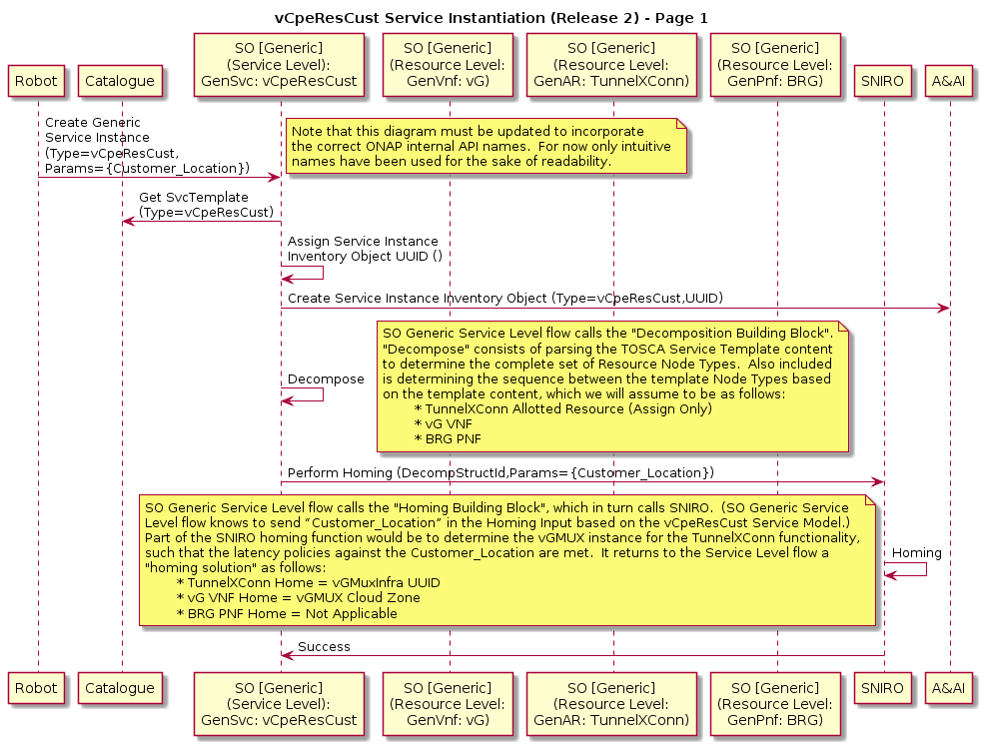
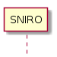
R2 View of Customer Service instantiation workflow
vCpeResCust Service Level Processing
Aspirational goal: In Release 2 we will have support for a Generic Service-Level (“top level”) flow that handles both Allotted Resources and PNFs, as well as integration with SNIRO.
OF-HAS
https://wiki.onap.org/display/DW/Residential+Broadband+vCPE+Drafts+for+discussion?preview=%2F10783327%2F14483520%2FvCPE+Use+Case+-+Customer+Service+Instantiation+-+170824b.pptx

Slide 7
Sample HAS inputs for vCPE Customer Service Instantiation:
Runtime parameters:
# Customer location
# Required capacity for VGMUX
Constraints:
# Customer_Location, TunnelXConn should be within X ms latency
# TunnelXConn and vG should be in the same cloud zone
# Existing instances (VGMuxInfra), Cloud regions should have capacity to accept new order
# Need to match the hardware capability requirements of the service
# For each VNF
- inventories from which potential candidates can be fetched
Inventory_Provider: aai, multicloud
- What types of candidates to fetch (Inventory_type)
Existing instances (service) or
new cloud sites (cloud) where a new instance could be spun up
- attributes by which to select initial candidates:
{
service_type: vG, vGMuxInfra (TunnelXConn)
customer_id: customer_12345
cloud_type: TitaniumCloud
}
optimization:
# Minimize the distance between customer location and TunnelXConn
minimize {distance_between [Customer_Location, TunnelXConn ]}

Slide 8
Sample HAS API for vCPE Customer Service Instantiation (1/3)
Demands (Resources to be homed)
Runtime Order parameters
demands:
vg:
- inventory_provider: aai
inventory_type: service
attributes: [
service_type: vG
]
- inventory_provider: aai, multicloud
inventory_type: cloud
vgmux:
- inventory_provider: aai
inventory_type: service
attributes: [
service_type: vgmux
TunnelXConn: customer_12345
cloud_type: titanium
]
# Service Info
SERVICE_ID: abc123
# Customer location
locations:
customer_loc: {"latitude": "41.76", "longitude": "-88.15"}
# Required Bandwidth
BANDWIDTH: 10
UNIT: Mbps

Slide 9
Sample HAS API for vCPE Customer Service Instantiation (2/3)
Constraints
# vgmux must be within 100ms of the customer
constraint_ vgmux _customer:
type: latency_to_location
demands: [vgmux ]
properties:
distance: < 100 ms
location: customer_loc
# vGMux can get a “slice” of an existing allotted resource, only if it has enough capacity.
check_capacity:
type: instance_capacity
demands: [vgmux]
properties:
controller: SDNC (?)
request:
entity-type: service-instance
entity-id: {SERVICE_ID}
required-bw: {BANDWIDTH}
bw-unit: {UNIT}
vnf-type: VGMUX
# The vG and vgMux must be deployed in the same cloud zone
colocation:
type: zone
demands: [vgmux, vg]
properties:
qualifier: same
category: zone

Slide 10
Sample HAS API for vCPE Customer Service Instantiation (3/3)
Constraints
# vG should be deployed in regions that have some hardware capabilities
vg_attributes:
type: attribute
demands: [vg]
properties:
evaluate:
hardware_capability_1: attrib1
hardware_capability_2: attrib2
version: attrib3
optimization:
# Minimize distance between customer location and vgmux
minimize:
{distance_between : [customer_loc, vgmux]}

Slide 11
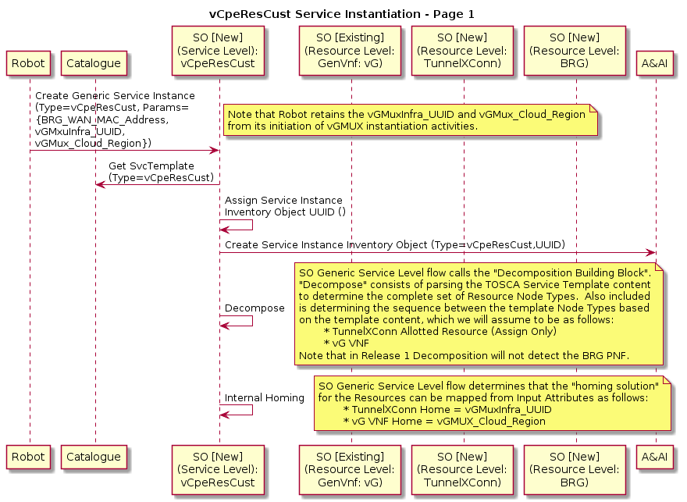
Release 1 View
vCpeResCust Service Level Processing
Because the vCpeResCust service involves an Allotted Resource and a PNF, the generic Service Level (“top level”) SO flow will not support this Service. So in Release 1 we either need to extend the generic Service Level flow to support Allotted Resources/PNFs or build a Custom flow for vCpeResCust.
https://wiki.onap.org/display/DW/Residential+Broadband+vCPE+Drafts+for+discussion?preview=%2F10783327%2F14483520%2FvCPE+Use+Case+-+Customer+Service+Instantiation+-+170824b.pptx

