Slide 1
ONAP Modeling: long-term strategy vs short-term tactics
Michael Brenner, Cloudify, michael@cloudify.co
Sep 25 , 2017

Slide 2
Agenda
What is permitted and what is prohibited
Why a long-term strategy
Strategic goals
Tactics for R2
Conclusions

Slide 3
Permitted vs prohibited
In Project A, what is permitted, is permitted, and what is prohibited, is prohibited.
In Project B everything is permitted except for what is prohibited.
In Project C everything is prohibited except for what is permitted.
In Project D everything is permitted, even what is prohibited.
In Project E everything is prohibited, even what is permitted.
What about ONAP?
  It should be permitted to have long-term goals and strategy for architecture, information model, data model
  It should be prohibited to short-term tactics to ignore the above once agreed

Slide 4
Why long-term strategy in ONAP?
ONAP is an open source project, so “code is king” …
… but king of what?
  if you don’t know why/what you are ruling, how will you that you succeed?
ONAP has a stated vision:
  ONAP brings together Open ECOMP and Open-O projects as a comprehensive platform for real-time, policy-driven orchestration and automation of physical and virtual network functions that will enable software, network, IT and cloud providers and developers to rapidly create new services. By consolidating member resources, ONAP will deliver a unified architecture and implementation, with an open standards focus, faster than any one product could on its own.
Automation, service agility, unified architecture/ implementation … require long-term strategy, implemented by increasingly converging short-term tactics

Slide 5
ONAP Long-term modeling strategy vs short-term tactics
ONAP Target
Architecture
Strategy
ONAP
Vision/
Requirements
(service agility/automation)
E2E Target Information Model
ONAP Target
Data Model(s)
ONAP Target
DSL(s)
ONAP Target
Realization
ONAP Short-term Release Implementation
How close?
ONAP short-term available
DSL(s)
ONAP short-term Data Model(s) dictated by available DSL(s)
ONAP Info Models picked as dictated by realizable Data Models
ONAP Short-term de-facto
architecture
Tactics

Slide 6
Let’s assume these are ONAP goals
Goals
Service
Agility
Automation
Models/
abstractions
OPEX
reduction

Slide 7
Strategic goals for models/abstractions
An E2E ONAP info model
  Could be constructed with a hierarchy of info models
A primary Data Modeling framework for design/run-time
  It must make it easy to implement any/all of the E2E ONAP IM and allow flexible implementations
A unified, extensible primary DSL:
  coverTelco/NFV, policy, EPA, telemetry, improved LCM for “Day2”, licensing, run-time service composition, declarative-imperative handshake
Identify an appropriate balance between declarative and imperative workflows
ECOMP ++
TOSCA ++
SimpleYAML ++
80% D vs 20% I

Slide 8

ECOMP++ IM is TBD – but it cannot be just NFV
Portal
Run-time
OPEN-O UI
(GUI/CLI)
Dashboard OA&M
(VID)
External Data Movement & APIs
Design-time
A&AI
Service
Orchestration
SDC
UI Server
VNF Design
Service Design
ESR
Interface
Workflow Design
Common Service
Resource Orchestration
(using ETSI terminology – will refine label)
DMaaP
Auth.
Microservice Bus
Policy Creation
Analytic Application Creation
Interface
DCAE
SDN-C
Recipie/
Engineering Rules & Policy Distribution
Alarm Correlation (Holmes)
Policy
APP-C
gvnfm
Other?
Catalog
NFV-O NFV Collector
(Monitor)
Multi-VIM/MultiCloud
VNF SDK
Cloud & WAN
OpenStack
VMware
RackSpace
Azure
......

Slide 9
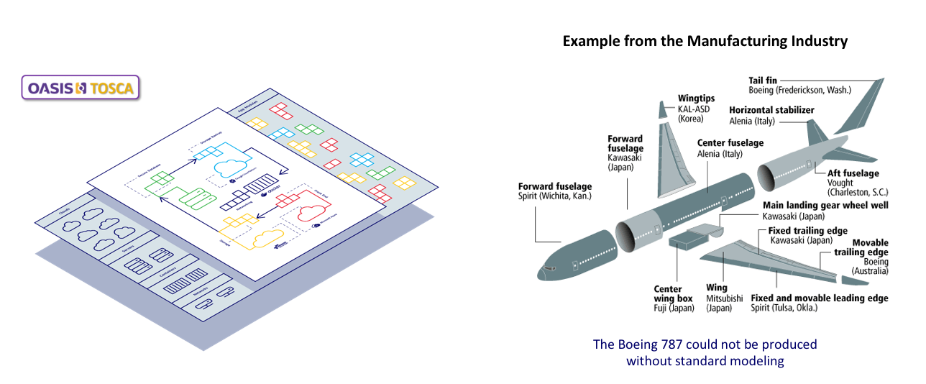
TOSCA++ is TBD – but the foundation is good
Standard modeling leads to automation at scale
ONAP has the opportunity to define/drive modeling Open Standards: TOSCA) ++

Slide 10
SimpleYAML++ is TBD – but a unifying path exists
Area | NFV profile (CSD03/CSD04) | Pure Model Driven
TOSCA | Kind of Mix of SimpleYAML and ETSI VNF info model matching NFV profile | Simple YAML TOSCA v1.x
EPA Support | Some | ALL
Extendable Model | No (Retrofit) | Yes
NFV Profile Changes | Redesign | No Change
NFV Profile | Flawed approach | TOSCA Logic (Requirements/Capabilities)
Profile and Telemetry | No support | Optional
Standard Based | Proprietary approach – csd03 was obsoleted by csd04, and csd04 will be obsoleted by csd05. Almost invariably a re-write without backward compatibility. | This approach SHOULD become part of other orchestration solutions like ONAP. Implement, adopt, and then drive into OASIS/TOSCA TC

Slide 11
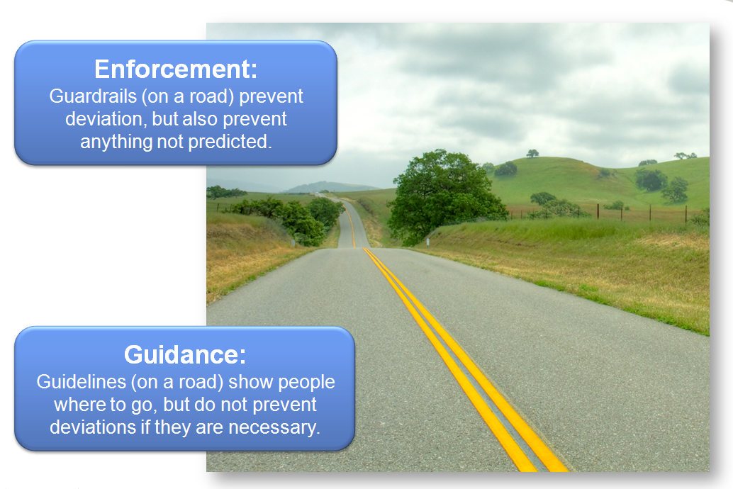
Imperative vs Declarative

Slide 12
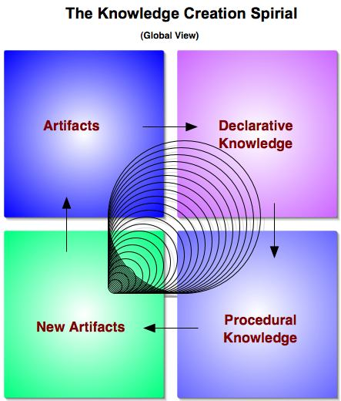
The right balance: Declarative with Imperative

Slide 13
Tactics for R2: information model
Start with ECOMP
Identify what ECOMP does not cover, but should
  Re-use complementary portions from existing standard Ims (ETSI NFV VNF/NS IM, MEF/LSO, TM Forum SID, …)
For each complementary IM to ECOMP, identify needed subset/gaps/overlaps
Define/agree ECOMP ++ IM
Decide on IM-to-DM priorities for R2

Slide 14
Tactics for R2: data models/DSL
Must be able to at least implement the ECOMP++ IM priorities for R2
Confirm TOSCA & SimpleYAML as targets
Start with ECOMP Data Model, complement or replace with TOSCA TC/NFV ad-hoc NFV profile as needed
  Identify “short-term flawed approach” for enhancements in future release
  Extend/replace consistent with strategy towards unified SimpleYAML
Push implemented extensions into TOSCA TC towards a SimpleYAML++

Slide 15
Tactics for R2: declarative with imperative
Define/implement a native TOSCA orchestration that enables assessing/validating the right balance
SDC
Template/CSAR
SO
DCAE
TOSCA Orch.
BPMN
ONAP TOSCA Types
VID
ONAP TOSCA Types
Get assgns
Get assgns
APPC
ONAP TOSCA Types
AAI
MultiVIM
User Inputs
SDNC
OF

Slide 16
Conclusions
Code is king, but even kings need guidance
Document an agreed long-term strategy
Periodically check short-term tactics against strategy
Strive for industry convergence of IM, DM, DSL based on tested implementations
Leverage existing standards where they meet ONAP requirements
Drive standardization based on ONAP results

Slide 17
Thanks!

Slide 18
Backup slides

Slide 19
TOSCA DSL landscape – October 2017
2013
2014
2015
2016
2017
2018
TOSCA
1.0
(TOSCA_XML)
TOSCA_
YAML_V1.0
TOSCA
YAML_V1.1
TOSCA
YAML
V1.2
TOSCA
YAML
2.0?
TOSCA
(main)
TOSCA
NFV Profile
ETSI NFV
SOL001 ?
NFV
Profile
csd03
NFV
Profile
csd04
?
NFV Profile
csd05?
Cloudify
DSL
Clodify 3.0
(yaml)
ARIA/
TOSCA
YAML_V1.0
ARIA/
TOSCA
YAML_V1.x
DSL
Cloudify 3.4
(yaml)
DSL
Cloudify 3.x
(yaml)
ARIA
ARIA 1.0
(YAML 1.0)
ARIA
incubation
ARIA 1.y
(YAML 1.x)

