Slide 1
Intel HF2 ONAP Community POD 01
(AKA: POD-25)
Gooch Stephen, Windriver, stephen.gooch@windriver.com

Slide 2
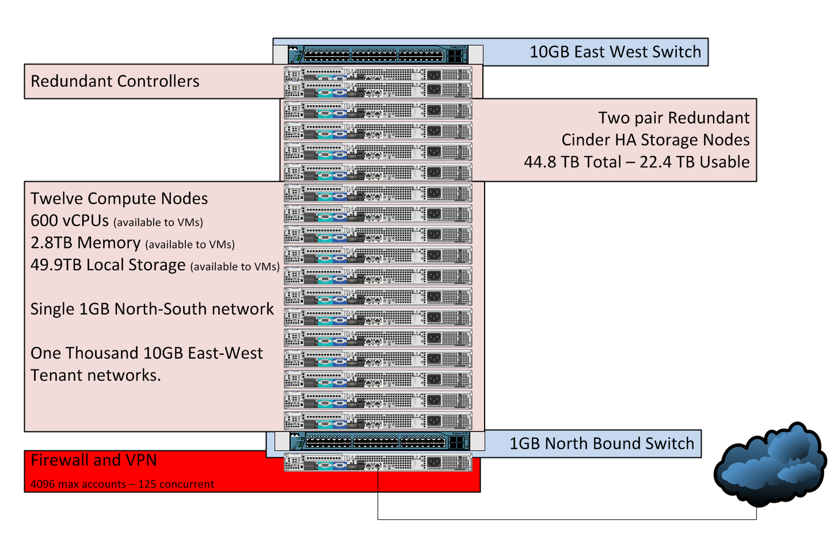
ONAP Developer POD Overview
Located in Hillsboro Oregon USA
Intel Hawthorn Farm 2 (HF2)

Slide 3
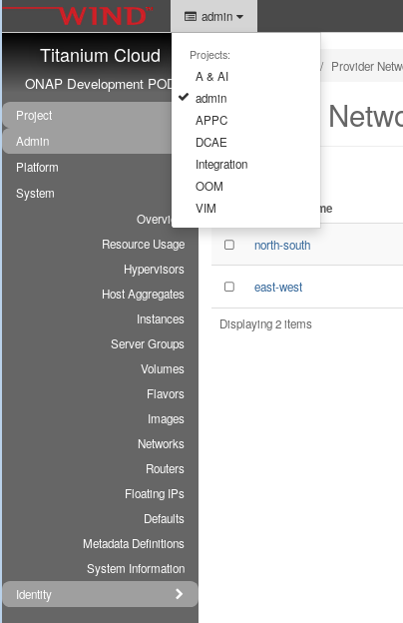
ONAP Developer POD - Projects
Integration – every has visibility.
Individual Projects
A & AI | AAF | APPC | CLAMP | CC-SDK
DCAE | DMaaP | External-API-Framework | Holmes | Logging
Microservices | Modeling | VIM | CLI | PFPP
PPPP | SDN-C | SO | VID | VFC
VNF-SDK | OOM | SDC | PAF-PAL | vCPE
Integration-SB-00 | Integration-SB-01 | Integration-SB-02 | Integration-SB-03

Slide 4
ONAP Developers Lab – Request Access
Add name and email to https://wiki.onap.org/pages/viewpage.action?pageId=15992234
  Associate with existing project or create a new project
Open JIRA: https://jira.onap.org/projects/OPENLABS
  Component MULTI_GEOLAB
  Assign to Stephen Gooch

Slide 5
ONAP Developers Lab – Using the VPN
From the JIRA, a form letter is sent with an encrypted zip file.
  There are two files in this zip
    login.txt (your username and password)
    pod-onap-01.ovnp (Open VPN CA same for all)
Edit pod-onap-01.ovpn to include login information
  Linux/Mac
    auth-user-pass login.txt
  Windows
    auth-user-pass “C:\\Program Files\\OpenVPN\\config\\login.txt”
  You many need to add “http-proxy url:port” or “socks-proxy url:port”
    Discuss with your IT reprehensive.
Execute
  Linux
    $ sudo openvpn –config pod-onap-01.ovpn
  Windows
    Install the Open VPN client, import pod-onap-01.ovpn and select connect

Slide 6
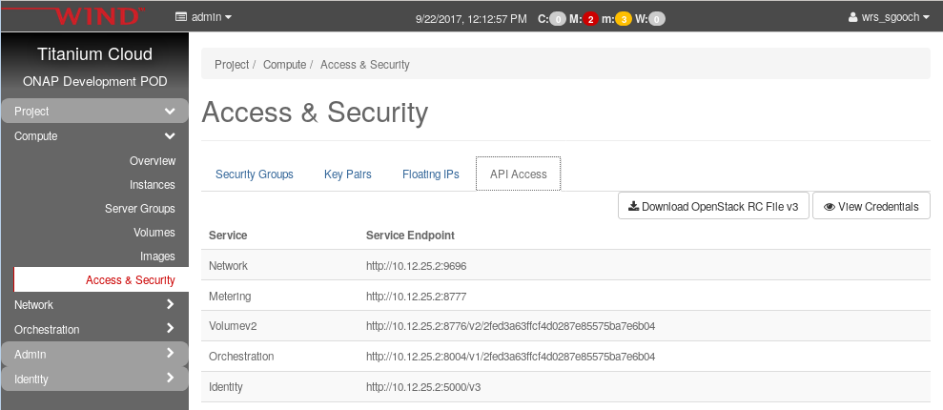
ONAP Developers Lab – Using remote CLI
After connecting the VM. You can use a local Linux machine or the supplied jumpstation for OpenStack CLI access.
Download OpenStack RC File from UI:
  Project -> Compute -> Access & Security -> API Access
Upload file to jumpsation (or local machine)
  If running on local machine, ask stephen.gooch@windriver.com
  for remote CLI SDK.
Source and run OpenStack commands
  user@pod-onap-01-vjhost:~$ source ./Integration-openrc.sh
  Please enter a path for your CA certificate pem file, #or press enter if you are not using HTTPS
  Please enter your OpenStack Password for project Integration as user username:
  user@pod-onap-01-vjhost:~$ openstack usage list
Jumpstation IP 10.12.25.44

Slide 7
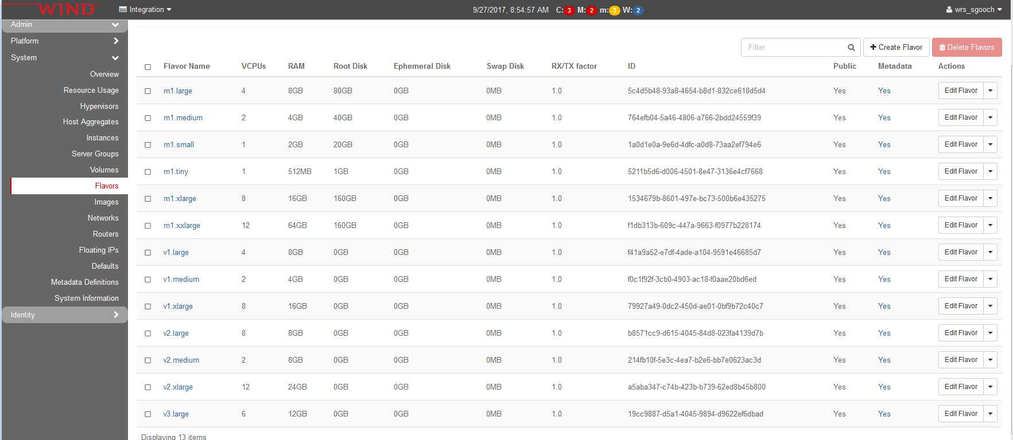
Flavors, Live Migration and HA
Under Normal Cloud Maintenance:
  v1 flavors w/volumes are recommended over m1 flavors using local storage for faster live migrations
  m1 flavors over 80G do not support live migration. They will rebuild on a host lock/upgrade
Under node failure
  VMs using m1 flavors and local storage will restart after host evacuation
  VMs using v1 flavors w/volumes will live migration – even with a node power failure.
We are considering deleting the m1.xlarge and m1.xxlarge flavors.

Slide 8
Intel HF2 ONAP Community POD 01
(AKA: POD-25)
Gooch Stephen, Windriver, stephen.gooch@windriver.com

